Slide 1

BASICS OF PYTHON
Grenston George

Slide 2
Contents
Introduction to Python
Setting Python in VS Code
First python script
Variables in Python
Basic Operators
Numbers , Strings & Derived Data Types
Decision Making
The Loops
Functions and Modules
Python I/O
Exception handling

Slide 3

WHAT Is python?
High-Level language
Interpreted
Interactive
Object Oriented
Beginners Tool

Slide 4
CHARACTERISTICS OF PYTHON
Multi-Style Coding
Scalable
Integrated with C, C++, ActiveX, CORBA, Java
Easy to read
A broad library
Portable
Supports GUI and web App

Slide 5
Start with python
Download:
https://www.python.org/downloads/
Python Doc:
https://docs.python.org

Slide 6
FIRST PYTHON SCRIPT
Script:
print("Hello Python")
Interactive Mode
Script Mode
Indentation
Multi Line statements
Comments
Multiple statements on single line
Command Line Arguments

Slide 7
VARIABLES IN PYTHON
Assignment
Multiple Assignment
Standard Data Types
Numbers
Strings
Lists
Tuples
Dictionaries
Data Type Conversions

Slide 8
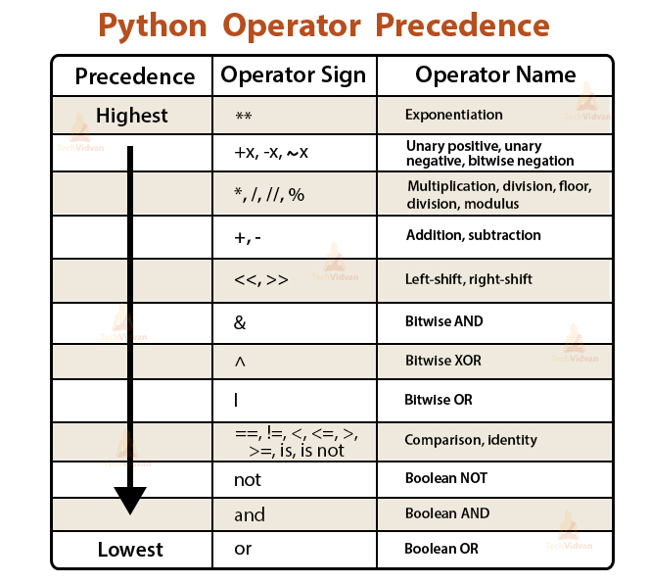
BASIC OPERATORS
Arithmetic Operators ( + , - , * , / , ** , // )
Comparison Operators ( == , != , <> , > , < , >= , <= )
Assignment Operators ( = , += , -= , *= , /= , **= , //= )
Logical Operators ( and , or , not )
Bitwise Operators ( & , | , ^ , ~ , << , >> )
Membership Operators ( in , not in )
Identity Operators ( is , is not )

Slide 9
NUMBERS
TYPES – int , float , complex
MATH FUCTIONS – abs, log , min, max, etc.
RANDOMS – choice, randrange, random, etc.
TRIGNOMETICS – asin, acos, atan, etc
MATH CONTANTS – pi, e

Slide 10
STRINGS
SINGLE LINE
MULTI LINE
SLICE OPERATOR
ESCAPE CHARACTERS (\n, \r, \t, \v…..)
OPERATORS (+, *, [], [:], r, %)
FORMATTING
FUNCTIONS ( upper, lower, swapcase, replace, len, etc.)

Slide 11
DERIVED DATA TYPES
LISTS
TUPLES
DICTIONARIES

Slide 12
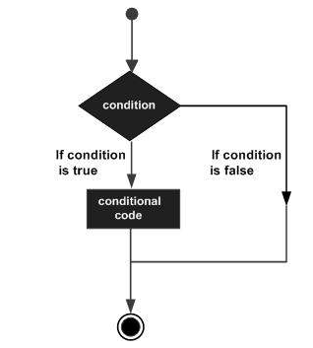
DECISION MAKING
IF
IF-ELSE
NESTED IF

Slide 13

THE LOOPS
WHILE
FOR
NESTED

Slide 14
FUNCTIONS & MODULES
DEFINE FUNCTIONS
RETURN
MODULES
OS & SHUTIL MODULE FOR DEVOPS
https://docs.python.org/3/library/os.html
https://docs.python.org/3/library/shutil.html

Slide 15

PYTHON I/O
INPUT
OPEN
CLOSE
READ
WRITE

Slide 16
EXCEPTIONS
TRY BLOCK
EXCEPT BLOCK
FINALLY BLOCK
BUILT-IN ERRORS :
https://docs.python.org/3/library/exceptions.html
NameError
TypeError
ArithmeticError etc.

Slide 17
Q&A

