Slide 1
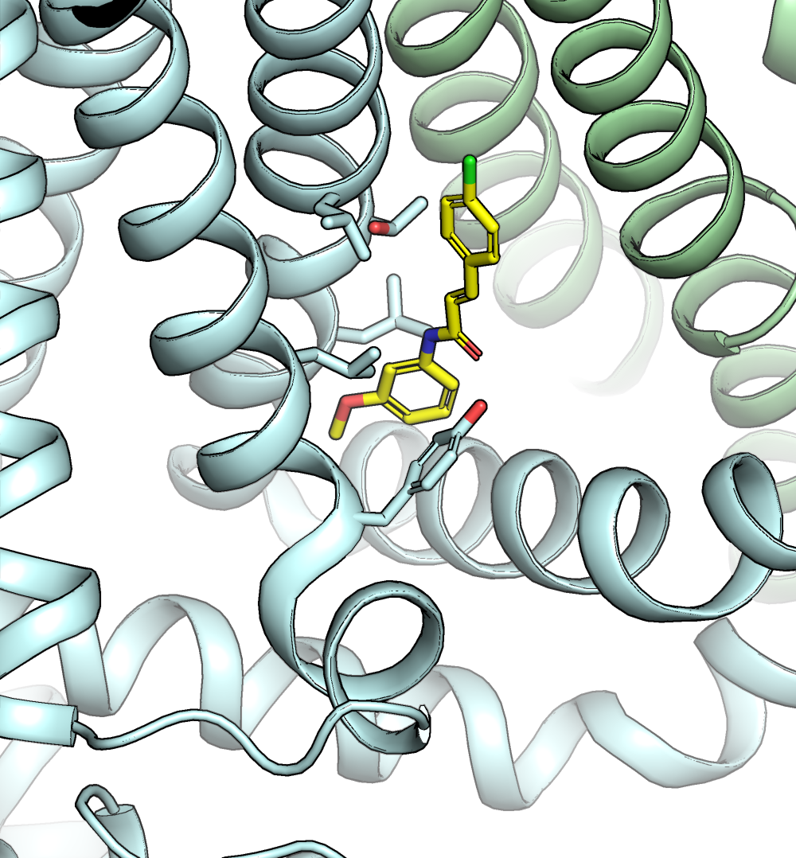
S4
S6
S3
S5
L547
T550
SB
L553
L515
Y511
S4-S5

