Slide 1
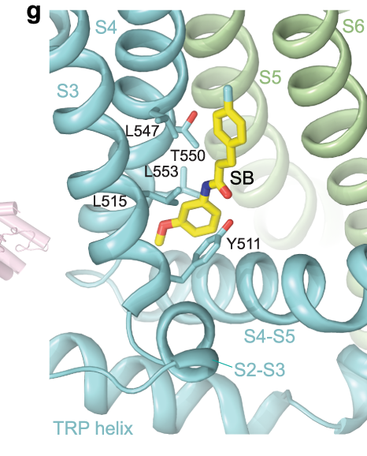
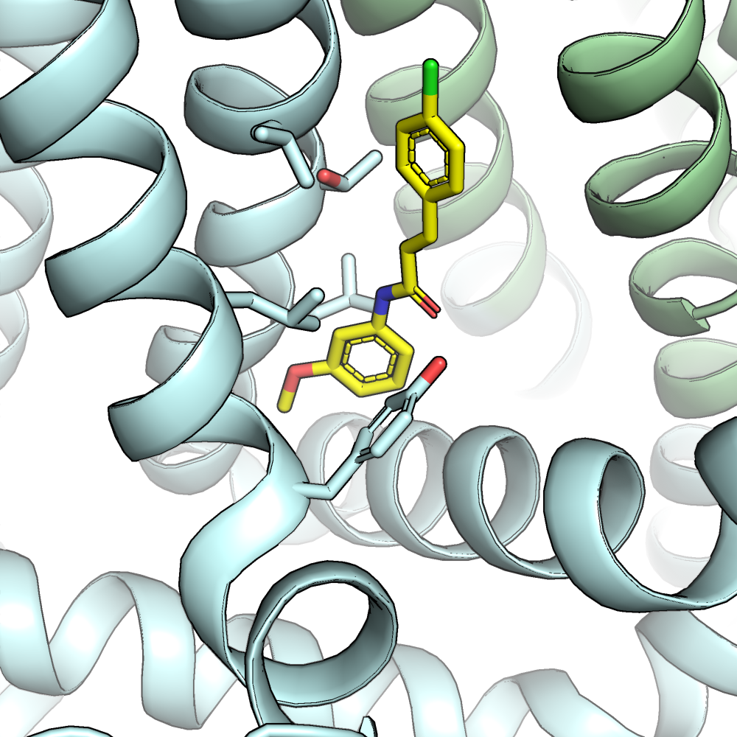
S4
S5
S6
L547
S3
T550
L553
SB
L515
Y511
S4-S5
S2-S3
TRP helix

