Slide 1
A Web portal for Student Grievance support system. (Theme based project)
-1602-18-737-069 Greta.K
-1702-18-737-119 Vyuha.K
-1602-18-737-111 Ayaz.S

Slide 2
Aim and Abstract
To design web portal which resolves the grievances of students by consulting the respective department. It helps us to solve the problems in a time efficient manner.
We develop a web Application which is dynamic, interactive, responsive and user-friendly.
This project covers complaints in all sorts not only complaints regarding
ragging
irregularities in admission process,
finance (fee payment),
Schedule
Migration process,
Revaluations,
conflicts in names and mark sheets if any and also other issues faced by the students.
The main objective of the project is to provide redressal to the complaints without time consumption.
The web Application is accessed by the registered students and login is provided for the Department faculty with appropriate credentials

Slide 3
Existing Problem
The existing way to get our queries solved is, going to college and enquiring the respective faculty.
But It becomes very difficult for us to manually go and resolve our problems.
When we approach them, sometimes they might be engaged in some other tasks and may not be available.
Though we succeed in approaching them, there will be some situations where they need some time to solve it.
But later there are odds that they might forget. This will not help us in getting our problems solved.
This scenario is old-fashioned in this advanced technological world.

Slide 4
Proposed Solution
This problem can be solved through our website.
Students and Faculty members should login with their respective credentials.
Student: Once they login, they can choose a particular domain, faculty they want to address according to their problem and raise a complaint.
This complaint will be further forwarded to that respective faculty of that domain.
Faculty: After logging in, they can view all the issues posted by students.
As soon as the complaint is rectified, the status of the complaint is updated by the Faculty which can be directly viewed by the student.

Slide 5
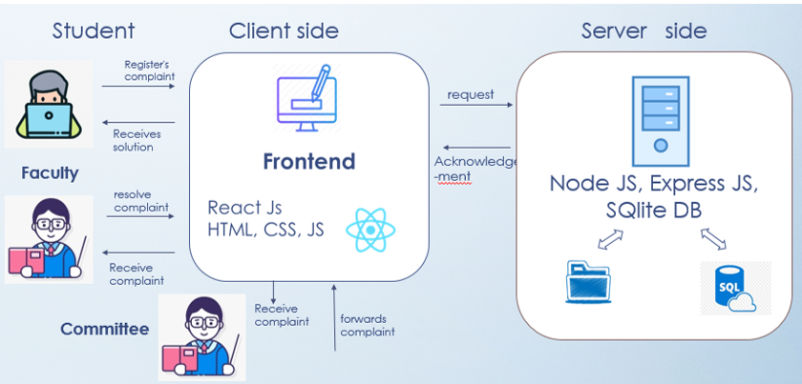
Architecture:

Slide 6
Technologies Used
Frontend technologies:
Html
Css
JS
React Js library
Backend technologies:
Express js
SQLite (Database)
Node js

Slide 7
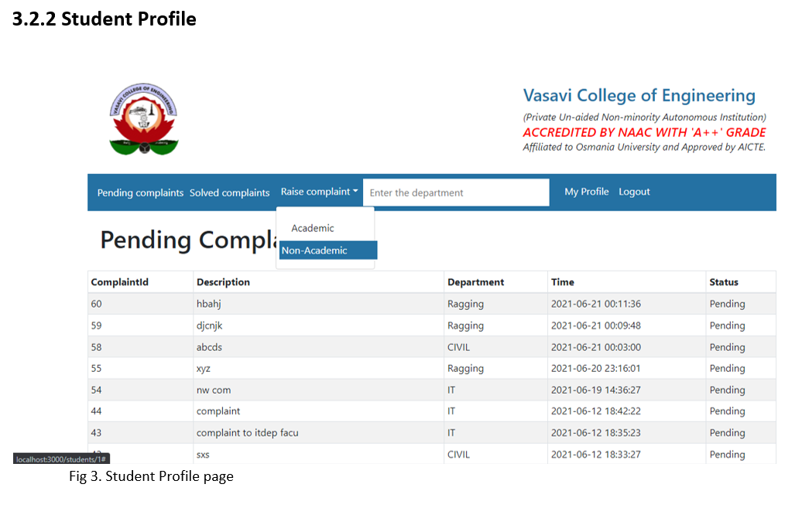
Sample Implementation Screenshots

Slide 8
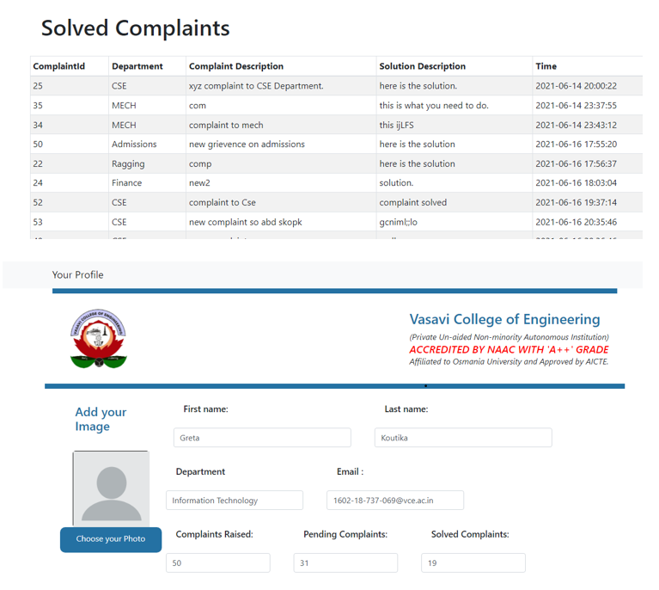
Student profile

Slide 9
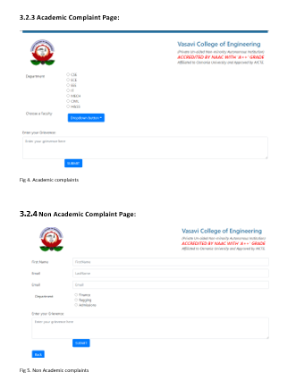
Academic and Non-Academic complaint pages

Slide 10
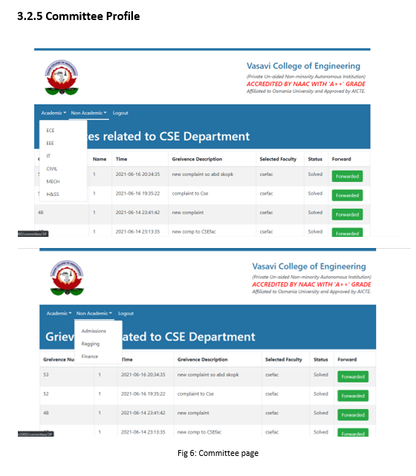
Committee Page

Slide 11
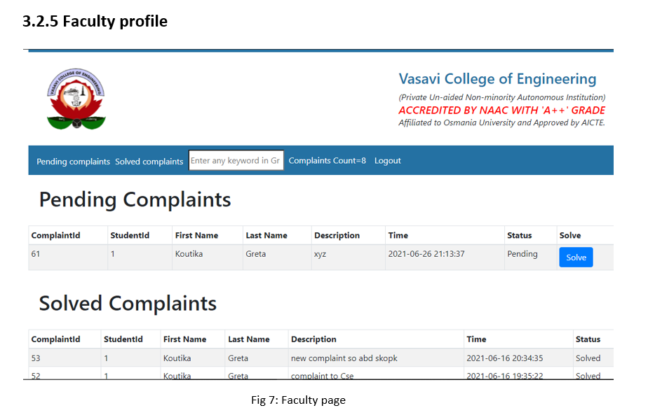
Faculty Profile

Slide 12
Pro’s & Con’s
Pro’s:
Userfriendly
Reusable components
Easy to Learn and USe.
ReactJS is much easier to learn and use.
Con’s:
using Sqlite Database

Slide 13
Conclusion:
We created this project for the issues faced by the students in various domains which can be logged easily and obtain the solution.
The status of the grievance can also be viewed by the students which are pending and solved .
Thus this system provides way to qualitative improvement of the educational organization.

Slide 14
Future Scope:
Mobile application
Adding multi media (i.e where students can add videos,pictures)
Adding a dashboard where head of department can see the statistics of complaints raised.

Slide 15
References:
https://reactjs.org/
https://youtu.be/w7ejDZ8SWv8 - React tutorial
https://youtu.be/Oe421EPjeBE - Node and Express js tutorial
4. https://accounts.ccbp.in/login -ccbp portal

