Slide 1
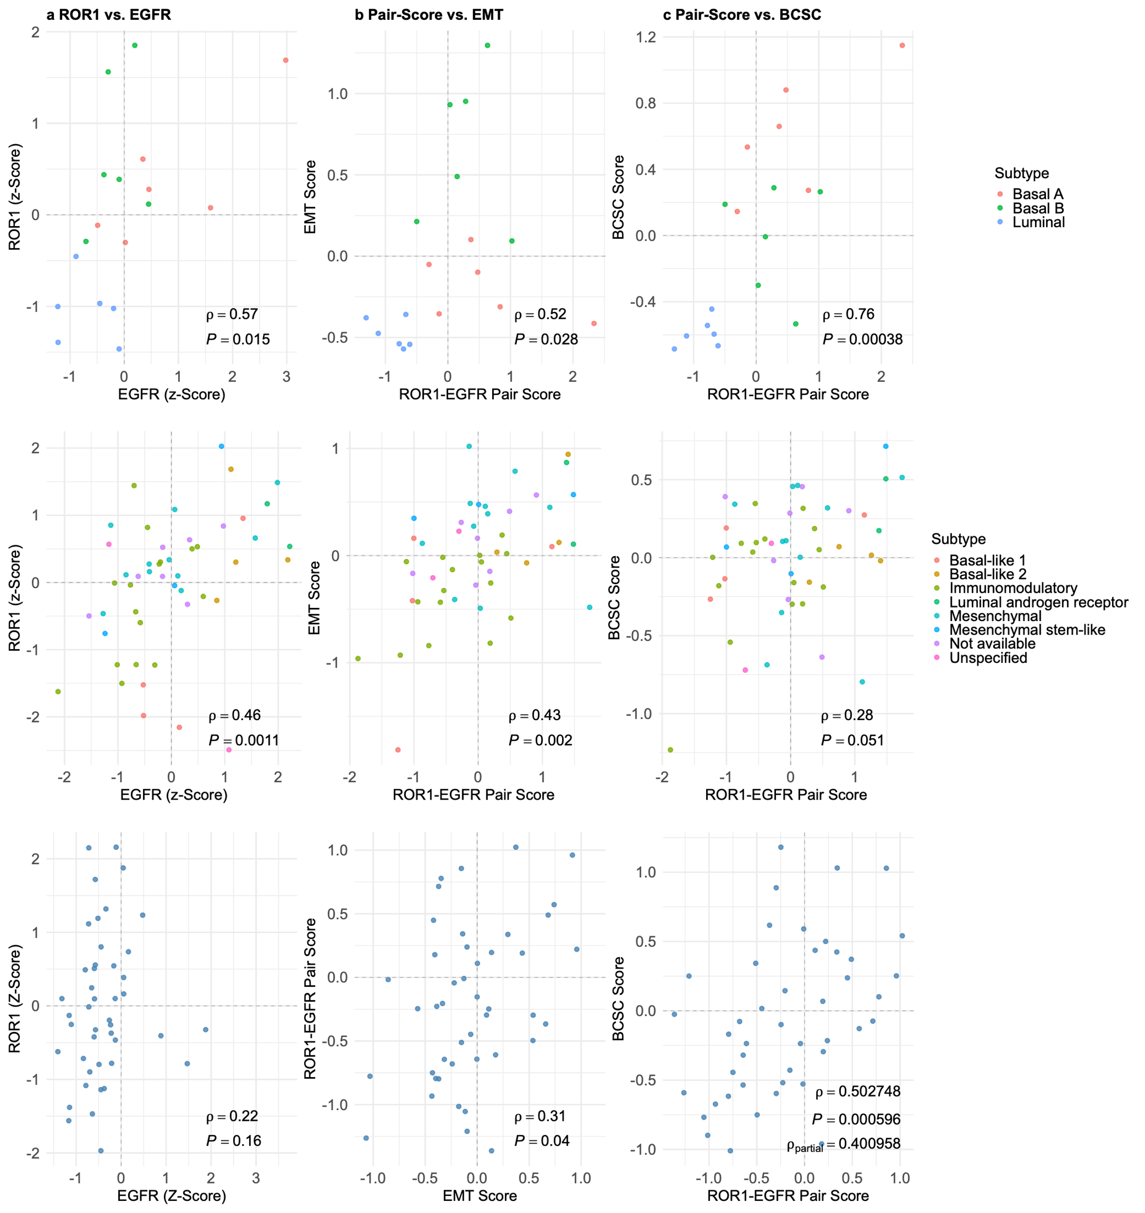
 | ROR1 vd EGFR (Protein Abundance) | ROR1-EGFR pair score vs EMT | ROR1-EGFR pair score vs BCSC
Kosok et al
BC Cellines (n=18)
Lee et al
Pretreatment TNBC
Biopsies (n=50)
Anurag et al
TNBC Biopsies (n=44)

Slide 2
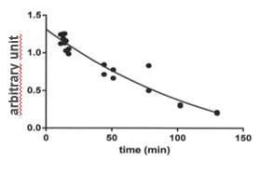
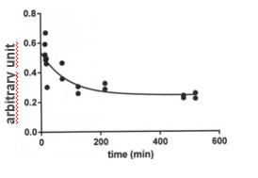
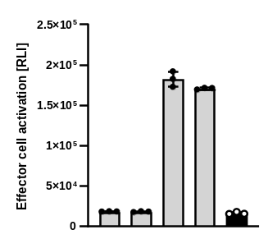
a second generation hemibody architecture (2G)
b Mode of action
Split T cell enganger (V_{H} or V_{L})
Split Fv (single domain)
Anti-target module
(full scFv, nanobody or DARPin)
Single-antigen binding
Dual-antigen binding
Conditionally binds
CD3 or TCR
binds target
antigen 1 or 2
Normal cell
Tumor cell
Antigen 1
(e.g. Her2 or ROR1)
Antigen 1
(e.g. Her2 or ROR1)
Antigen 2
(e.g. EpCAM or EGFR)
Knob-into-hole Fc
CD3 or TCR
T cell
conditional activation
c pharmacokinetics (PK)
T cell
No activation
1st generation
(rapid clearance)
2nd generation
(prolonged persistence)
arbitrary units
d orthogonal activatability
Mismatched
(cross-pair)
Matched
(pair)
αCD3 matched
αTCR matched
αCD3/αTCR mismatched
VL αCD3
VH αTCR
Linker
VH αCD3
Target cells only
VH αCD3
VL αTCR
VL αTCR
T cell
VH
VL
VH
VL
VH
VL
VH
VL
CTRL

