Slide 1
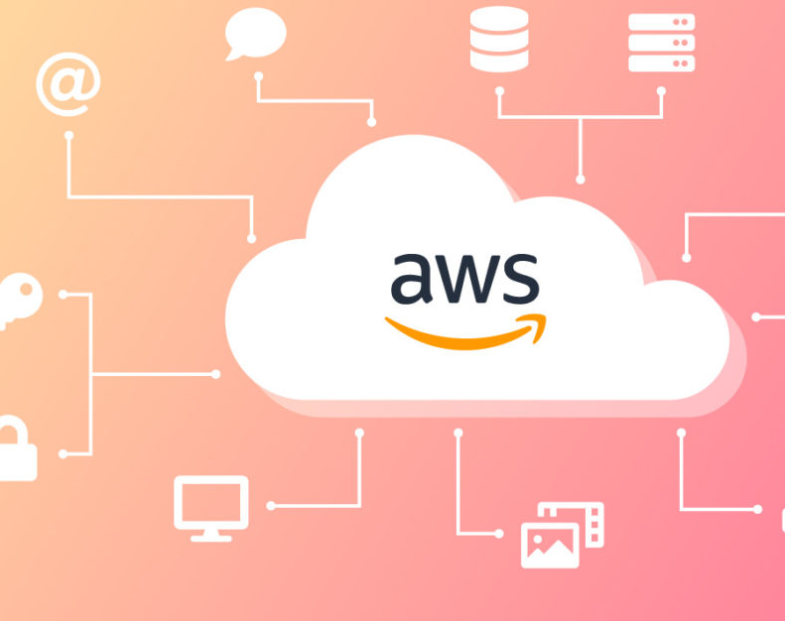
SENTIA ASSIGNEMENT PROOF OF CONCEPT
- Grevil Colaco

Slide 2

Assumptions Made after Customer required and MOM
Cloud of choice is AWS.
Iac method implemented for various AWS resources is cloud formation.
Code Editor used is Visual Studio Code.
Version control tool used was a git.
Assuming that the structured and unstructured data in on-premise and comes from the Database management systems or data sources like My SQL, Microsoft SQL Server, Mongo DB.
Assuming AWS Lambda function as a data ingestion resource.
Assuming AWS glue is used for ETL and S3 bucket for storage.
Assuming AWS redshift to be used for data warehousing.
Assuming BI application like Power BI is used for the Analytics process.
Assuming we have a batch or historical data.

Slide 3
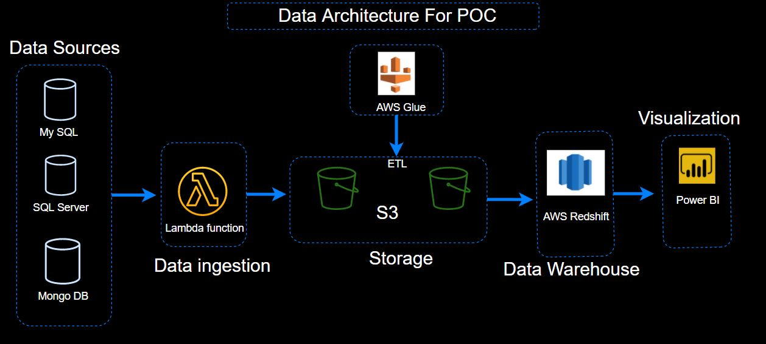
Data Architecture/Infrastructure Diagram To Support Customer POC
The Above resources were considered as per customer requirement during the meeting

Slide 4


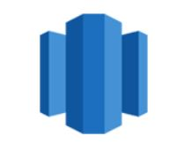


Why this resources
Data Sources
Lambda Function
AWS Glue
Redshift
BI Application
Data Sources like:
My SQL
SQL Server
Mongo DB
Are chosen as per customer requirement
To extract data from different data sources `lambda` function was chosen, because it has can seamlessly and asynchronously extract data and can ingest the data into the data lake(Storage)
Serverless solution/application and there is no need to maintain a server.
It also has the benefit of pay when you use it.
For data storage `Amazon S3` is used because it is highly available and cost-efficient.
Assuming huge loads of data and assuming large time and memory requirements for data processing `AWS Glue` is used for the ETL and Data Normalization
Serverless solution/application and there is no need to maintain a server.
Redshift provides Massively
Parallel Processing (MPP)
of databases by parallel execution of one query on multiple CPUs.
A Redshift cluster consists of n --slices(CPU) and these slices can process n-partition of tables simultaneously.
Power BI is shown because someone suggested it during meeting Other applications like Tableau or Quick-sight can also be used.

Slide 5
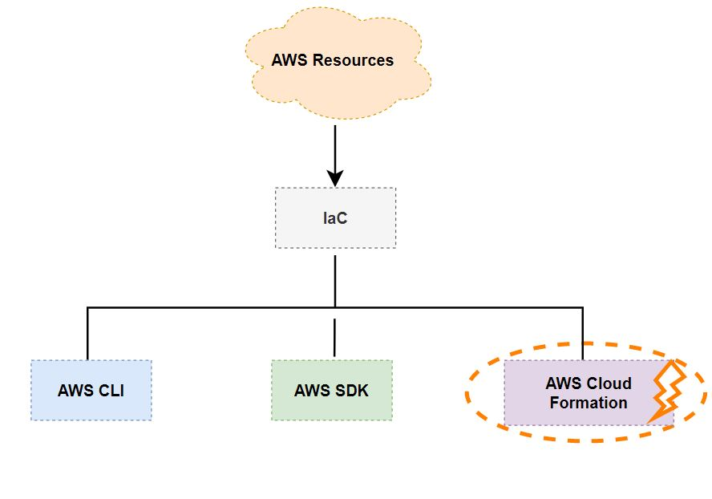
Infrastructure As Code (IaC) To form CI/CD pipeline

Slide 6
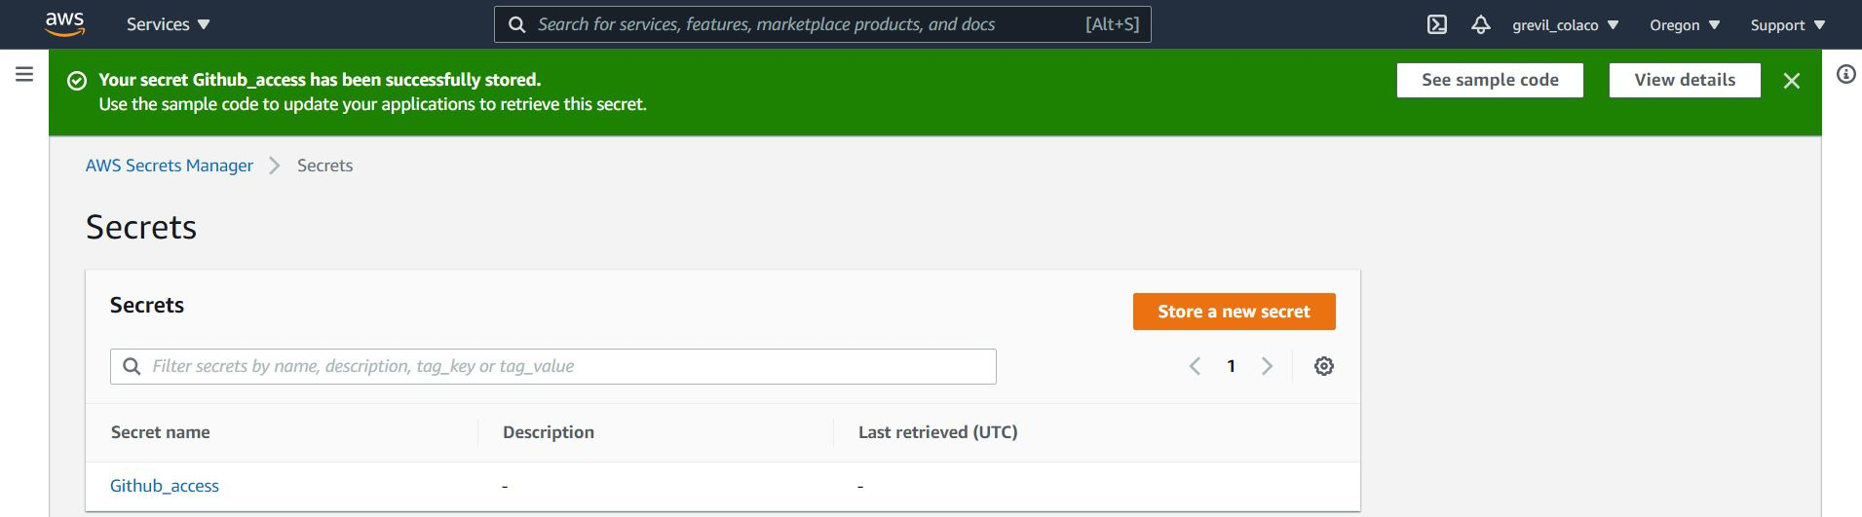
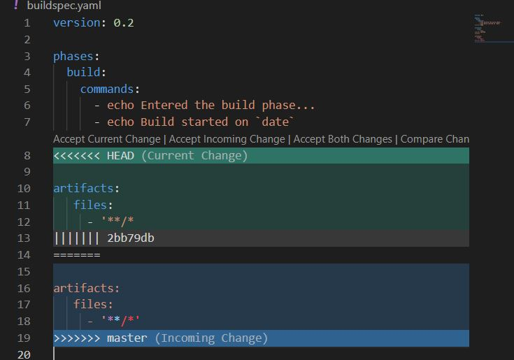
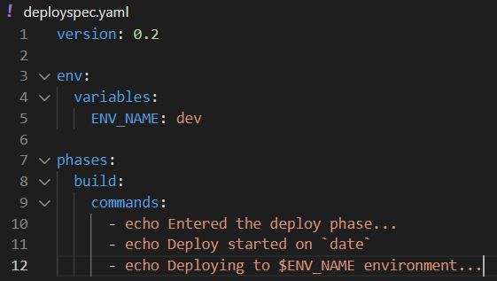
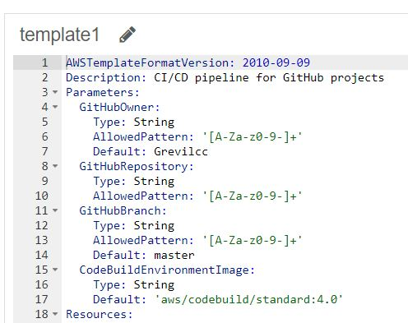
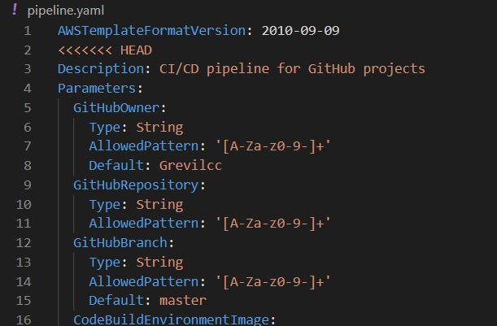
Building CI/CD pipeline using AWS Cloud Formation Platform Example
Step 1
Step 2
Step 3
Creating a New GitHub Repo
Generating Personal Access Token on GitHub
Step 4
Add token to AWS Secret Manager
Step 7
Step 5 &6
Creating a `.YAML` file (Buildspec Template)
Creating deployspec. yaml file
Update file In AWS Cloud formation stack
Creating CodePipline.yaml template

Slide 7
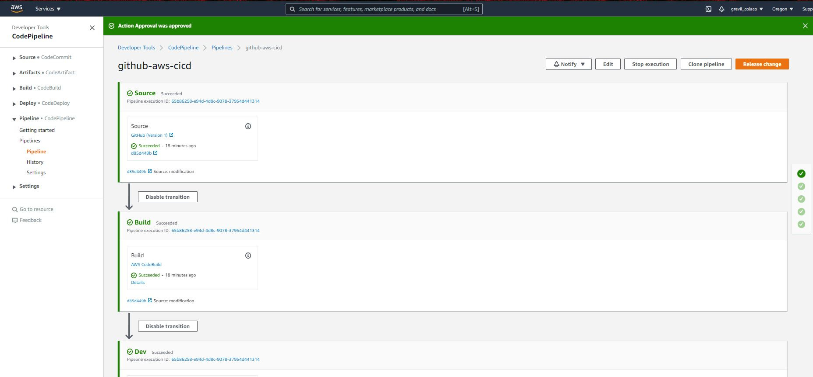
Building CI/CD pipeline using AWS Cloud Formation Platform Example contd
Finally !!

Slide 8
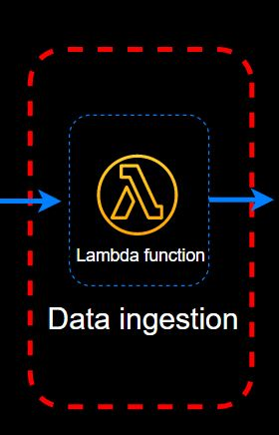
Creating Serverless Application Continuous Deployment Workflow With Cloud Formation for building Lambda Function Architecture
1 Create A Service Role
CloudFormation service role:
- S3
- Cloud pipeline
- lambda function
- API getaway
- CloudFormation
2 Application Setup
SAM Template:
- Sam Template.yaml
Code Buildspec:
- Buildspec.yaml
3 Create Pipeline
Code Pipeline stages:
- Source
- Build
- Create change set
- Approve change set
- Execute Change set

Slide 9
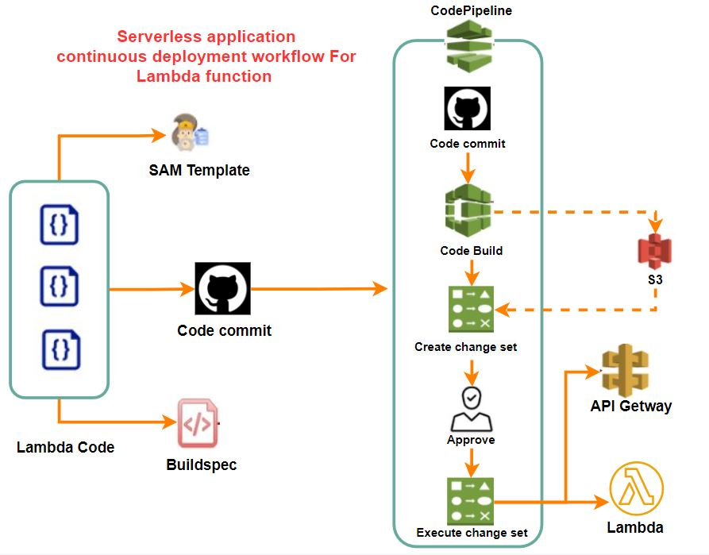
Creating Serverless Application Continuous Deployment Workflow With Cloud Formation for building Lambda Function Architecture Contd..

Slide 10
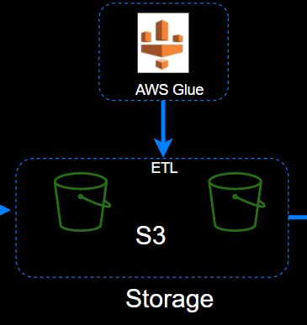
Creating AWS Glue ETL Process Architecture
AWS Glue is a fully managed serverless ETL service for developers.
Some advantages if AWS Glue
Job authoring: Auto-generates ETL code in Python Apache spark
Job execution: serverless execution and flexible scheduling.
The transformed and normalized data from AWS Glue can then be sent to the Redshift data warehouse and then for analytical processes.

Slide 11
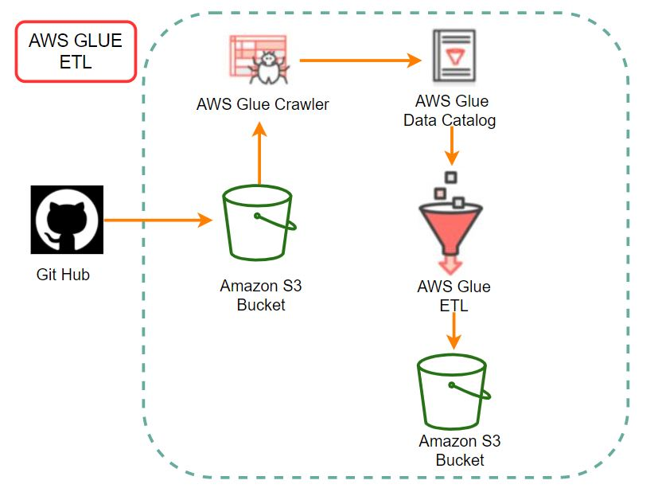
AWS Glue Architecture

Slide 12

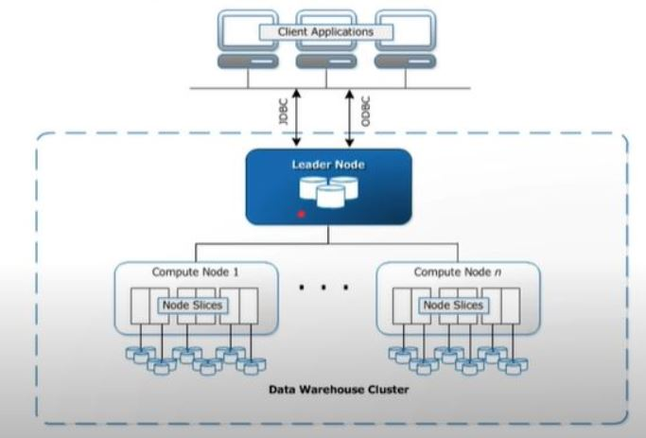
AWS Redshift Datawarehouse Architecture
Redshift provides Massively Parallel Processing (MPP)
of databases by parallel execution of one query on multiple CPUs.
A Redshift cluster consists of n-slices(CPU) and these slices can process n-partition of tables simultaneously.

Slide 13
Some Important Commands Implemented in Version/Source Control management tool(Git)
Create a directory on your local machine use the command: $ mkdir
Create your working directory into GitHub repo with : $ git inti
To add changes made to git repo use the command : $ git add
Then commit changes using: $ git commit -am "message during commit"
Repo on GitHub give it a name in my case it's called aws-cicd-project-Grevil
Link the repo to local machine using command: $ git remote add origin https:// followed by the URL
This will link our local directory to the GitHub repo.
Finally, we need to push the files from the local machine to our GitHub repo using the command : $ git push --set--upstream origin master
You will see new files uploaded to the GitHub repo.
Finally, some important `$ git` commands:
`$ git add .`
`$ git commit -am "type a message"`
`$ git push origin master`
`$ git pull origin master`
`$ git checkout master`
`$ git log`
`$ git status`
$ git push --set-upstream origin develop`
`$ git init `
`$ git push origin develop --force `
“There is no right tool or wrong tool in this process, it always depends on your/customer needs”.

Slide 14

Thank You

