Slide 1
Gram Matrix
Style img
LOADER
input
a = batch
b = number of feature maps
c = feature map dimension
d = feature map dimension
res = ??
Content
img
Neural Style
MODEL-vgg19
Content Loss
input: cnn(content img)
Style Loss
input: cnn(style img)
* cnn부분은 매번 달라진다. conv1 ~ conv5
target = content img
result = mse (input, target)
target = gram_matrix(input)
result = mse (G(input), target)
conv_1 -> feature map
conv_2 ->
conv_3 ->
conv_4 ->
conv_5 ->
feature maps
1 x filter 개수 * height * width
*NOTE
Style image: 이미지 내의 스타일을 따라할 이미지
Content image: 이미지 내의 contents를 따라할 이미지
Input image:
- 1. random noise: random noise 이미지를 content는 content image, style은 style image로 바꾸기 위함
- 2. Content image: Content image의 style을 style image로 바꾸기 위함.
파이토치 튜토리얼은 input image 2에 해당하는 경우이다.
해당 부분이 언급이 없으니 나중에 구현할 일이 있으면 꼭 알려주자!

Slide 2
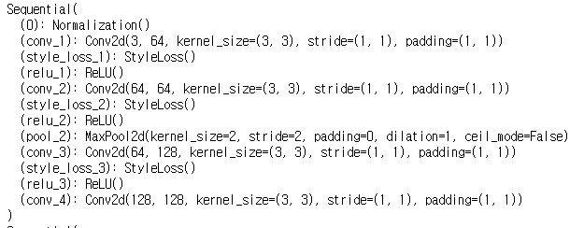
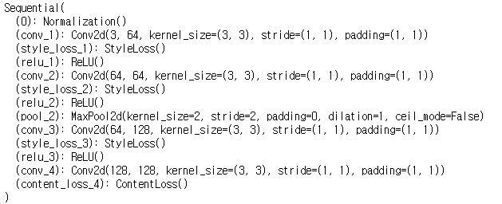
Content Loss
생성 전
Content Loss
생성 후

Slide 3
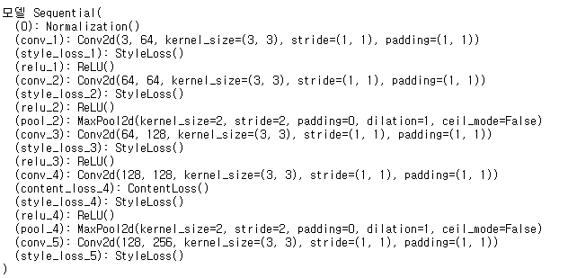
customized VGG19
neural style model
즉, content loss와 style loss를 만들어 삽입하여
forward 할 때 마다 계산을 하고 backward시 편하게 input image의 Gradient를 구할 수 있게 된다.
* input image에 requires grad를 True로 설정하면 쉽다.

Slide 4
Filter64
.......
Filter2
Filter 1
Filter 1
Filter1
Filter 2
Filter 2
*
......
......
Filter 64
Filter 64
1 x 64 x 128 x 128
input
64 x 16384
16384 x 64
features
features.T
Result
64 * 64
Gram matrix
How does Gram matrix encode the Style of an image?
Assume that Filter 1 captures horizontal, Filter 2 do vertical line in a given image.
Calculating dot product with filter 1s in features and transpose of it
makes activated neural more activated.
The reason is that trained filters activate particular area where they see the specific pattern or texture,
the area gets more enforced with matrix multiplication calculating the gram matrix.

Slide 5
MSE
Result
Result
64 * 64
64 * 64
Gram matrix_target
Gram matrix_input
How does Gram matrix encode the Style of an image?
Assume that Filter 1 captures horizontal, Filter 2 do vertical line in a given image.
Calculating dot product with filter 1s in features and transpose of it
makes activated neural more activated.
The reason is that trained filters activate particular area where they see the specific pattern or texture,
the area gets more enforced with matrix multiplication calculating the gram matrix.

