Slide 1
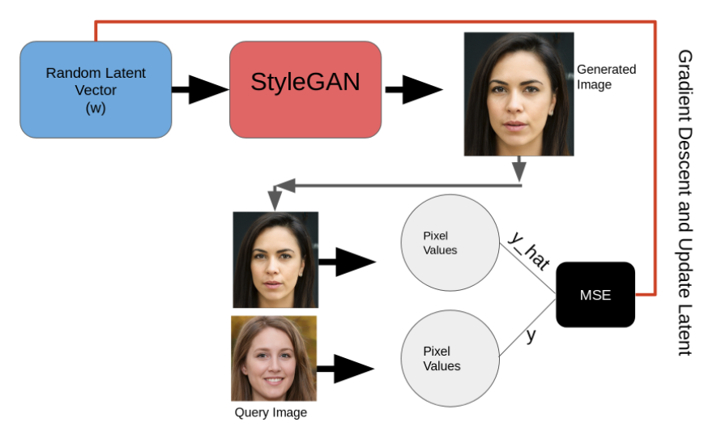
Simple way
Then directly update latent!
with the difference
But soo hard to update!
We want to know
the latent vector of this image
Let’s compare random generated random vector

Slide 2
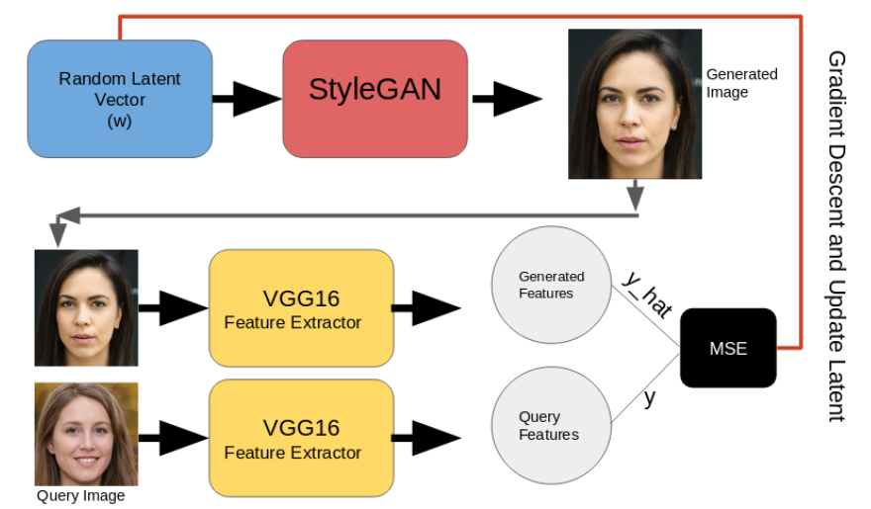
Novel way
Then update the latent!
We want to know
the latent vector of this image
Let’s compare each feature vector through VGG16!

