Slide 1

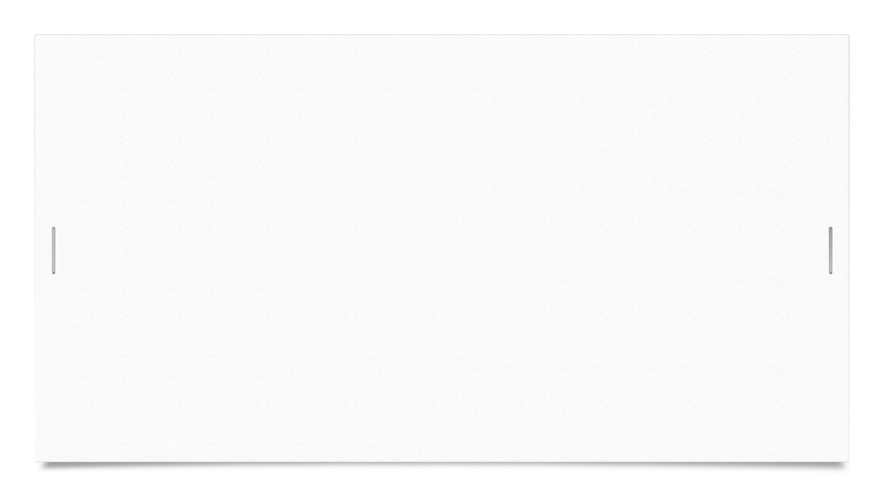


NNFL Group project

Slide 2
Assigned TA -
Honnesh Rohmetra
Group Members –
Sanjeev Singla I.D. - 2017A8PS0152P
Swastik Mohanty I.D. - 2017A8PS0282P
Paper I.D. -
CATEGORIES
CNN
Semantic Segmentation
Encoder-Decoder
71
Course Instructors
Prof. Surekha Bhanot
Prof. Bijoy Krishna Mukherjee

Slide 3
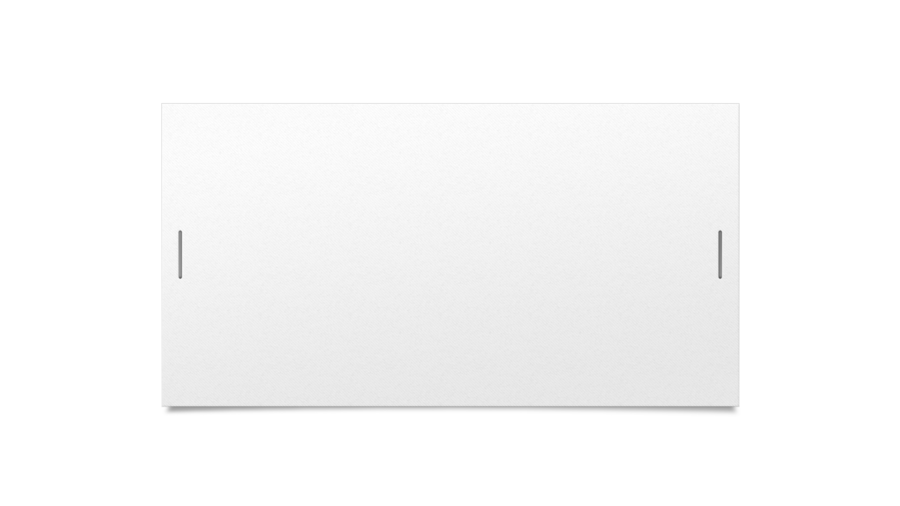

U-Net: Convolutional Networks for Biomedical Image Segmentation

Slide 4
U-Net Model
U-Net is a convolutional neural network that was developed for biomedical image segmentation. It consists of a contracting path and an expansive path, which gives it the u-shaped architecture.
Contraction path consists of a repeated application of a 3x3 convolutions(unpadded) each followed by a ReLU and a 2x2 max pooling operation with stride 2 for downsampling. At each downsampling step, we double the number of feature channels. This captures context via a compact feature map.
The expansion path consists of upsampling of the feature map followed by a 2x2 convolution(“up-convolution”) that halves the number of feature channels a concatenation with the cropped feature map from the contracting path, and a 3x3 convolutions, followed by a ReLU. The upsampling of the feature dimension is done to meet the same size as the block to be concatenated on the left.

Slide 5
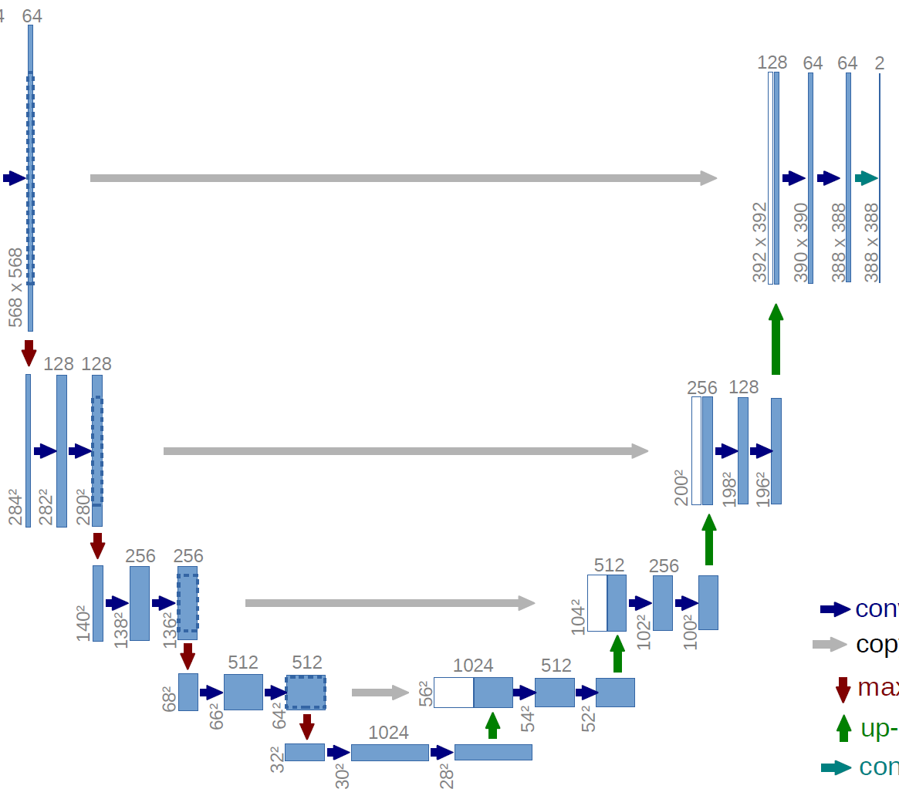
Network Architecture

Slide 6
Data
The photographs for the DRIVE database were obtained from a diabetic retinopathy screening program in The Netherlands. The screening population consisted of 400 diabetic subjects between 25-90 years of age. Forty photographs have been randomly selected, 33 do not show any sign of diabetic retinopathy and 7 show signs of mild early diabetic retinopathy.
Each image has been JPEG compressed. The images were acquired using a Canon CR5 non-mydriatic 3CCD camera with a 45-degree field of view (FOV). Each image was captured using 8 bits per color plane at 768 by 584 pixels. The FOV of each image is circular with a diameter of approximately 540 pixels. For this database, the images have been cropped around the FOV. For each image, a mask image is provided that delineates the FOV.

Slide 7
Pre – Processing
Gray-scale conversion
Standardization
Contrast-limited adaptive histogram equalization (CLAHE)
Gamma adjustment

Slide 8
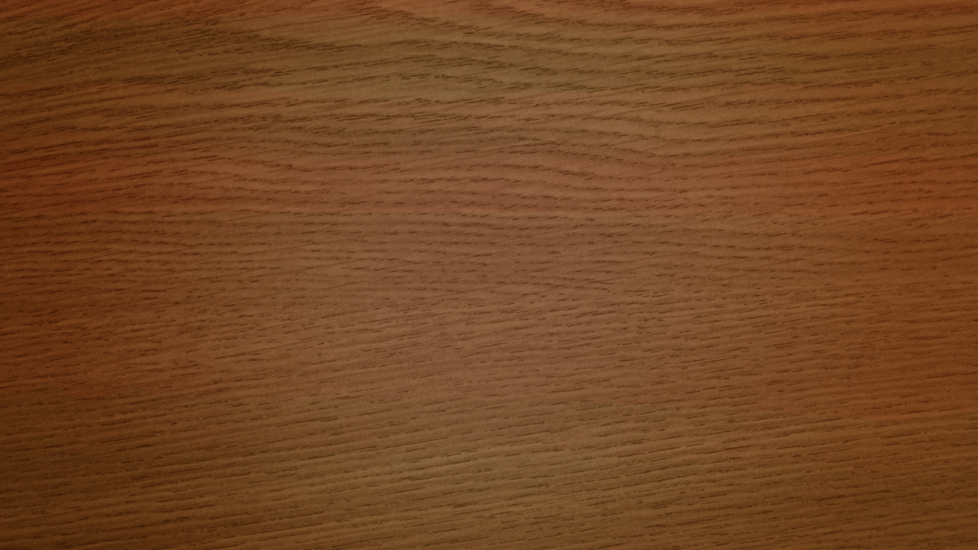
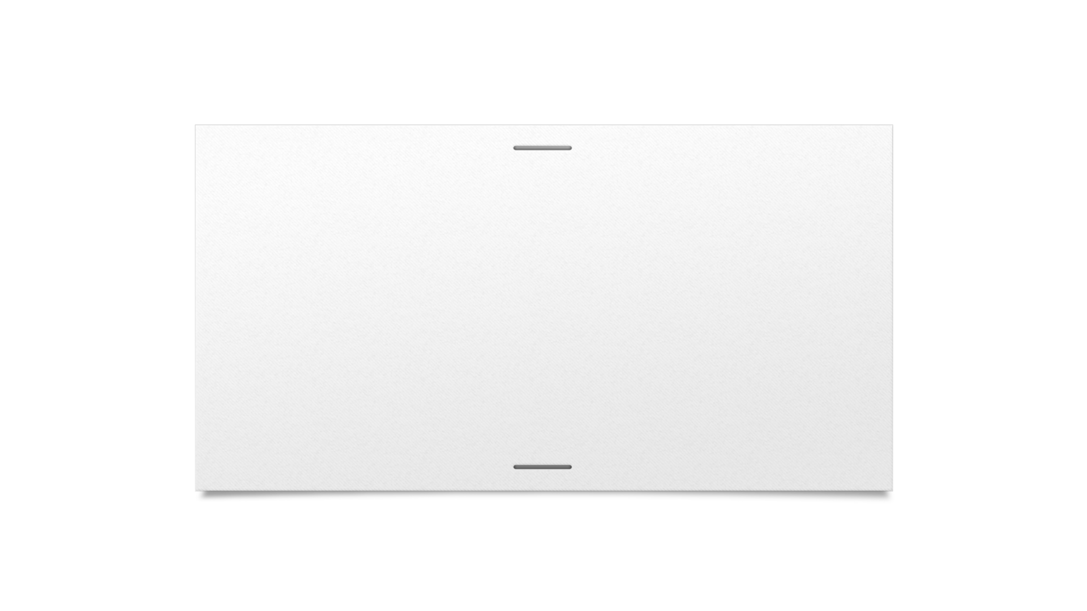

Results

Slide 9
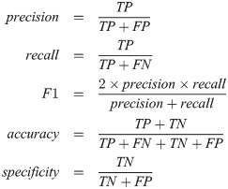
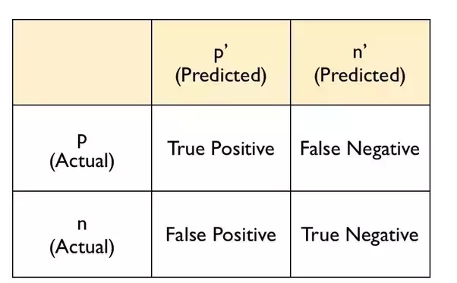
ACCURACY: 0.955983978469
RECALL: 0.767137136912
SPECIFICITY: 0.98352781244
PRECISION: 0.871673216962
F1 SCORE: 0.816071114516

Slide 10

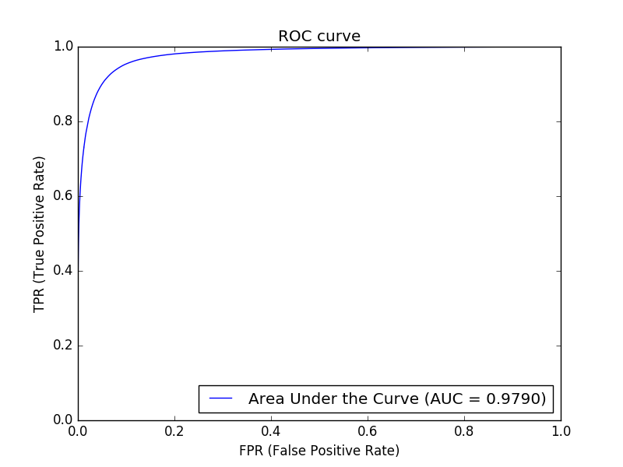
ROC Curve

Slide 11

Thank You

