Slide 1

Optimizing Qwen for FinQA
Benchmarking and Enhancing Qwen 2.5 0.5B on the FinQA Hybrid Benchmark
May 2026

Slide 2
Research Objectives
•
Explore the FinQA benchmark for multi-step hybrid reasoning.
•
Evaluate the performance of the Qwen-2.5 0.5B model.
•
Perform a forensic audit of failure modes to identify architectural limitations.
•
Implement data-level innovations to break the performance ceiling for small models.

Slide 3
The Dataset: FinQA
FinQA challenges models with heterogeneous financial reports containing tables and prose.
•
8,281 Expert-annotated QA pairs.
•
Sample Data:
Question: what is the net change in net revenue during 2015 for entergy corporation?
Program: subtract(5829, 5735)
Execution Answer: 94.0
Gold Evidence (Indices): {'table_1': 'the 2014 net revenue of amount ( in millions ) is $ 5735 ;', 'table_8': 'the 2015 net revenue of amount ( in millions ) is $ 5829 ;'}
Table Row 0: ['', 'amount ( in millions )']
Pre-text sample: ['entergy corporation and subsidiaries management……

Slide 4
Layer 2: The Baseline Wall
9.0%
The Initial State
•
Model often guesses based on narrative hints.
•
Struggles with 2D grid linearization.
•
Reliability gap between numerical match and reasoning logic.
Execution Accuracy

Slide 5
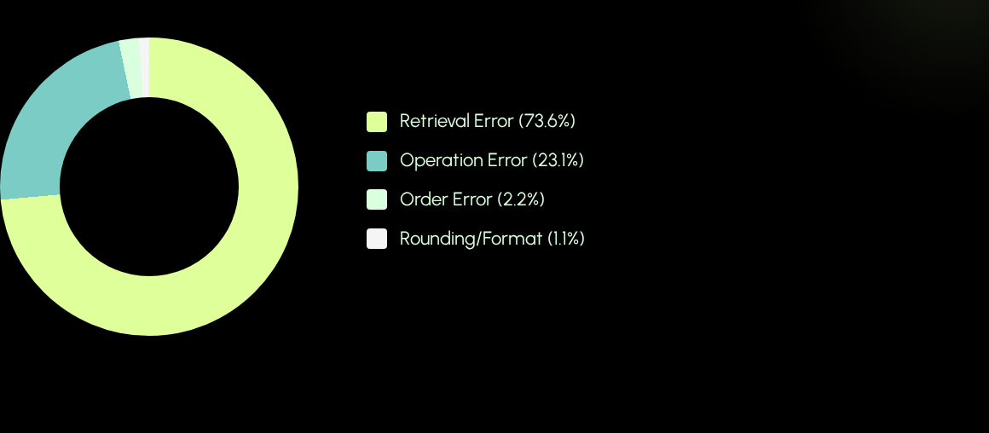
Forensic Audit: Error Taxonomy
The "Smoking Gun": Retrieval Drift is the primary bottleneck for 0.5B models.

Slide 6
Context Sensitivity Analysis
Observation: Text-only achieved higher raw scores, but a 58.3% False Positive rate proved these were "lucky guesses" from semantic matching.
Format | Total Correct Answer | True Positive | False Positive | False Positive Rate (%)
Full | 8 | 7 | 1 | 12.5
Text Only | 5 | 1 | 4 | 80
Table Only | 12 | 5 | 7 | 58.3

Slide 7

The Reliability Gap
The Table Trap
Full Context Advantage
80% False Positive rate in isolation. Without text, the model "blind-guesses" formulas against any visible digits.
Lowest False Positive rate (12.5%). Integration of structured and unstructured data is critical for logical grounding.

Slide 8
Innovation: The Pivot
Attempted Semantic Transliteration and Two-Pass Extraction.
Went back to basics with a "less is more" strategy. implemented Row-Header Injection combined with Strict Extraction
Modified the table grid so that the metric name was repeated at the start of every single row (e.g., | Metric: Net Revenue | 5829 | 5735 |). This provided a "constant anchor." No matter where the model was looking in the row, the label was right there. It didn't have to "remember" the header from the top of the page.
Forced the model to end every response with a Final Answer: tag and added a code-level fix to automatically convert percentages to decimals during evaluation.

Slide 9

Optimization Results
Metric | Baseline | Layer 3 Optimized | Trend
Execution Accuracy | 9.0% | 26.0% | +189% Increase
Retrieval Errors | 35 Count | 23 Count | -34% Reduction
Operational Errors | 55 Count | 49 Count | -11% Reduction
Accuracy Trend: Baseline → Attempt 1 → Optimized

Slide 10
Strategic Conclusions
•
Grounding > Scaling: Structural engineering can triple capability in tiny models.
•
Retrieval Blindness: 0.5B models are math-capable but retrieval-blind; fixing the input fixates the mind.
•
Efficiency: Grounded SLMs provide a cost-effective path for secure, on-premise financial reasoning.

Slide 11
Thank You
Benchmarking & Enhancing Qwen 2.5 0.5B on FinQA
github.com/czyssrs/FinQA

