Slide 1
Mid-state Shuttle service
Team Revan

Slide 2
MEET OUR TEAM
Nic
Phoo
Alexis
Nathan
Product Owner/Scrum Master
Developer
Developer
Developer

Slide 3
Project Overview
Our project aims to optimize and simplify the existing process by centralizing all data into one accessible platform. Eliminating the need for manual data entry, enhancing efficiency and accuracy for our clients.

Slide 4
Project Overview
Introduced a unified interface for riders, offering a seamless experience for ride requests, check-ins, and communication with dispatch.
By consolidating these functions into a single location, we aimed to enhance user convenience and efficiency.

Slide 5
- maintaining papers to track each route - Recorded manually and inputted into spreadsheets -Changes to routes require updates to reservation and schedule forms
Current Process

Slide 6
Rider Experience - Riders access a separate Cognito form to request rides - existing system lacks an efficient method for riders to contact dispatch
Current Process

Slide 7
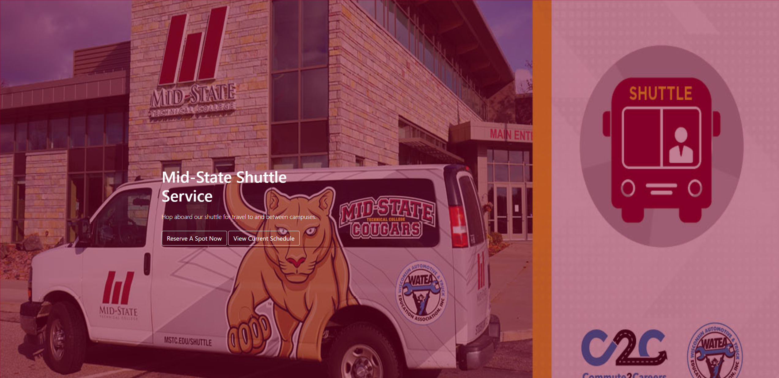
DEMO

Slide 8
Questions?

