Slide 1
Voronoi Diagrams

Slide 2
Post Office: What is the area of service?
p_{i} : site points
e : Voronoi edge
v : Voronoi vertex
v
e
p_{i}

Slide 3
Definition of Voronoi Diagram
Let P be a set of n distinct points (sites) in the plane.
The Voronoi diagram of P is the subdivision of the plane into n cells, one for each site.
A point q lies in the cell corresponding to a site p_{i} ∈ P
iff
Euclidean_Distance( q, p_{i} ) < Euclidean_distance( q, p_{j} ), for each p_{i} ∈ P, j ≠ i.

Slide 4
Voronoi Diagram Example:
1 site

Slide 5
Two sites form a perpendicular bisector
Voronoi Diagram is a line
that extends infinitely in
both directions, and the
two half planes on either
side.

Slide 6
Collinear sites form a series of parallel lines

Slide 7
Non-collinear sites form Voronoi half lines that meet at a vertex
v
A vertex has
degree ≥ 3
A Voronoi vertex is
the center of an empty
circle touching 3 or
more sites.
Half lines

Slide 8
Voronoi Cells and Segments
v

Slide 9
Voronoi Cells and Segments
Segment
v
Bounded Cell
Unbounded Cell

Slide 10
Degenerate Case: no bounded cells!
v

Slide 11
Summary of Voronoi Properties
A point q lies on a Voronoi edge between sites p_{i} and p_{j}
iff
the largest empty circle centered at q touches only p_{i} and p_{j}
  A Voronoi edge is a subset of locus of points equidistant from p_{i} and p_{j}
p_{i} : site points
e : Voronoi edge
v : Voronoi vertex
v
p_{i}
e

Slide 12
Summary of Voronoi Properties
A point q is a vertex iff
the largest empty circle centered at q touches at least 3 sites
  A Voronoi vertex is an intersection of 3 more segments, each equidistant from a pair of sites
p_{i} : site points
e : Voronoi edge
v : Voronoi vertex
v
p_{i}
e

Slide 13
Voronoi diagrams have linear complexity {|v|, |e| = O(n)}
Intuition: Not all bisectors are Voronoi edges!
p_{i} : site points
e : Voronoi edge
p_{i}
e

Slide 14
Voronoi diagrams have linear complexity {|v|, |e| = O(n)}
Claim: For n ≥ 3, |v| ≤ 2n − 5 and |e| ≤ 3n − 6
Proof: (Easy Case)
…
Collinear sites → |v| = 0, |e| = n – 1

Slide 15
Voronoi diagrams have linear complexity {|v|, |e| = O(n)}
Claim: For n ≥ 3, |v| ≤ 2n − 5 and |e| ≤ 3n − 6
Proof: (General Case)
Euler’s Formula: for connected, planar graphs,
|v| – |e| + f = 2
Where:
|v| is the number of vertices
|e| is the number of edges
f is the number of faces

Slide 16
Voronoi diagrams have linear complexity {|v|, |e| = O(n)}
Claim: For n ≥ 3, |v| ≤ 2n − 5 and |e| ≤ 3n − 6
Proof: (General Case)
For Voronoi graphs, f = n → (|v| +1) – |e| + n = 2
To apply Euler’s Formula, we
“planarize” the Voronoi diagram
by connecting half lines to
an extra vertex.
p∞
p_{i}
e

Slide 17
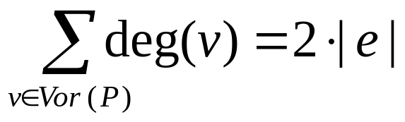
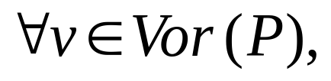
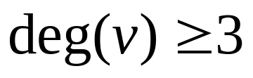
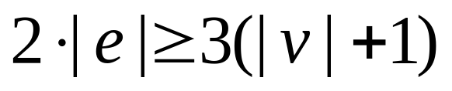
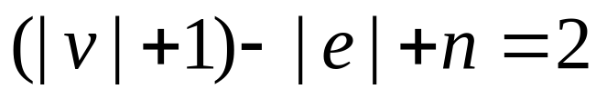
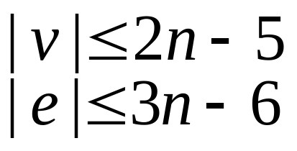
Voronoi diagrams have linear complexity {|v|, |e| = O(n)}
Moreover,
and
so
together with
we get, for n ≥ 3

Slide 18
Constructing Voronoi Diagrams
Given a half plane intersection algorithm…

Slide 19
Constructing Voronoi Diagrams
Given a half plane intersection algorithm…

Slide 20
Constructing Voronoi Diagrams
Given a half plane intersection algorithm…

Slide 21
Constructing Voronoi Diagrams
Half plane intersection algorithm: O(n log n)
Repeat for each site
Running Time:
O( n² log n )

Slide 22
Constructing Voronoi Diagrams
Fortune’s Algorithm
  Sweep line algorithm
    Voronoi diagram constructed as horizontal line sweeps the set of sites from top to bottom
    Incremental construction → maintains portion of diagram which cannot change due to sites below sweep line, keeping track of incremental changes for each site (and Voronoi vertex) it “sweeps”

Slide 23
Constructing Voronoi Diagrams
What is the invariant we are looking for?
q
p_{i}
Sweep Line
v
e
Maintain a representation of the locus of points q that are closer to some site p_{i} above the sweep line than to the line itself (and thus to any site below the line).

Slide 24
Constructing Voronoi Diagrams
Which points are closer to a site above the sweep line than to the sweep line itself?
q
p_{i}
Equidistance
Sweep Line
The set of parabolic arcs form a beach-line that bounds
the locus of all such points

Slide 25
Constructing Voronoi Diagrams
Break points trace out Voronoi edges.
q
p_{i}
Sweep Line
Equidistance
Notes:
Break points do not trace out edges continuously in the actual algorithm. The sweep line stops at discrete event points as will be shown later.

Slide 26
Constructing Voronoi Diagrams
Arcs flatten out as sweep line moves down.
q
p_{i}
Sweep Line

Slide 27
Constructing Voronoi Diagrams
Eventually, the middle arc disappears.
q
p_{i}
Sweep Line

Slide 28
Constructing Voronoi Diagrams
We have detected a circle that is empty (contains no sites) and touches 3 or more sites.
q
p_{i}
Sweep Line
Voronoi vertex!

Slide 29
Beach Line properties
Voronoi edges are traced by the break points as the sweep line moves down.
  Emergence of a new break point(s) (from formation of a new arc or a fusion of two existing break points) identifies a new edge
Voronoi vertices are identified when two break points meet (fuse).
  Decimation of an old arc identifies new vertex

Slide 30
Data Structures
Current state of the Voronoi diagram
  Doubly linked list of half-edge, vertex, cell records
Current state of the beach line
  Keep track of break points
  Keep track of arcs currently on beach line
Current state of the sweep line
  Priority event queue sorted on decreasing y-coordinate
Notes:
Discrete sweep steps, rather than a continuous sweep

Slide 31
Doubly Linked List (D)
Goal: a simple data structure that allows an algorithm to traverse a Voronoi diagram’s segments, cells and vertices
Cell(p_{i})
v
e

Slide 32
Doubly Linked List (D)
Divide segments into uni-directional half-edges
A chain of counter-clockwise half-edges forms a cell
Define a half-edge’s “twin” to be its opposite half-edge of the same segment
Cell(p_{i})
v
e

Slide 33
Doubly Linked List (D)
Cell Table
  Cell(p_{i}) : pointer to any incident half-edge
Vertex Table
  v_{i} : list of pointers to all incident half-edges
Doubly Linked-List of half-edges; each has:
  Pointer to Cell Table entry
  Pointers to start/end vertices of half-edge
  Pointers to previous/next half-edges in the CCW chain
  Pointer to twin half-edge

Slide 34
Balanced Binary Tree (T)
Internal nodes represent break points between two arcs
  Also contains a pointer to the D record of the edge being traced
Leaf nodes represent arcs, each arc is in turn represented by the site that generated it
  Also contains a pointer to a potential circle event
< p_{j}, p_{k}>
p_{j}
p_{i}
p_{k}
p_{l}
< p_{i}, p_{j}>
< p_{k}, p_{l}>
l
p_{i}
p_{j}
p_{k}
p_{l}

Slide 35
Event Queue (Q)
An event is an interesting point encountered by the sweep line as it sweeps from top to bottom
  Sweep line makes discrete stops, rather than a continuous sweep
Consists of Site Events (when the sweep line encounters a new site point) and Circle Events (when the sweep line encounters the bottom of an empty circle touching 3 or more sites).
Events are prioritized based on y-coordinate

Slide 36
Site Event
A new arc appears when a new site appears.
l

Slide 37
Site Event
A new arc appears when a new site appears.
l

Slide 38
Site Event
Original arc above the new site is broken into two
→ Number of arcs on beach line is O(n)
l

Slide 39
Circle Event
An arc disappears whenever an empty circle touches three or more sites and is tangent to the sweep line.
q
p_{i}
Circle Event!
Sweep Line
Voronoi vertex!
Sweep line helps determine that the circle is indeed empty.

Slide 40
Event Queue Summary
Site Events are
  given as input
  represented by the xy-coordinate of the site point
Circle Events are
  computed on the fly (intersection of the two bisectors in between the three sites)
  represented by the xy-coordinate of the lowest point of an empty circle touching three or more sites
  “anticipated”, these newly generated events may be false and need to be removed later
Event Queue prioritizes events based on their y-coordinates

Slide 41
Summarizing Data Structures
Current state of the Voronoi diagram
  Doubly linked list of half-edge, vertex, cell records
Current state of the beach line
  Keep track of break points
    Inner nodes of binary search tree; represented by a tuple
  Keep track of arcs currently on beach line
    Leaf nodes of binary search tree; represented by a site that generated the arc
Current state of the sweep line
  Priority event queue sorted on decreasing y-coordinate

Slide 42
Algorithm
Initialize
  Event queue Q ← all site events
  Binary search tree T ← ∅
  Doubly linked list D ← ∅
While Q not ∅,
  Remove event (e) from Q with largest y-coordinate
    HandleEvent(e, T, D)

Slide 43
Handling Site Events
Locate the existing arc (if any) that is above the new site
Break the arc by replacing the leaf node with a sub tree representing the new arc and its break points
Add two half-edge records in the doubly linked list
Check for potential circle event(s), add them to event queue if they exist

Slide 44
Locate the existing arc that is above the new site
The x coordinate of the new site is used for the binary search
The x coordinate of each breakpoint along the root to leaf path
is computed on the fly
< p_{j}, p_{k}>
p_{j}
p_{i}
p_{k}
p_{l}
< p_{i}, p_{j}>
< p_{k}, p_{l}>
p_{m}
l
p_{i}
p_{j}
p_{k}
p_{l}

Slide 45
Break the Arc
Corresponding leaf replaced by a new sub-tree
< p_{j}, p_{k}>
< p_{i}, p_{j}>
< p_{k}, p_{l}>
< p_{l}, p_{m}>
p_{j}
p_{i}
p_{j}
p_{k}
p_{i}
p_{k}
p_{l}
< p_{m}, p_{l}>
p_{m}
l
p_{l}
Different arcs can be identified
by the same site!
p_{l}
p_{m}

Slide 46
Add a new edge record in the doubly linked list
New Half Edge Record
Endpoints ← ∅
< p_{j}, p_{k}>
Pointers to two half-edge
records
< p_{i}, p_{j}>
< p_{k}, p_{l}>
< p_{l}, p_{m}>
p_{j}
p_{i}
p_{j}
p_{k}
p_{i}
p_{k}
p_{l}
< p_{m}, p_{l}>
p_{m}
p_{m}
l
l
p_{l}
p_{m}
p_{l}

Slide 47
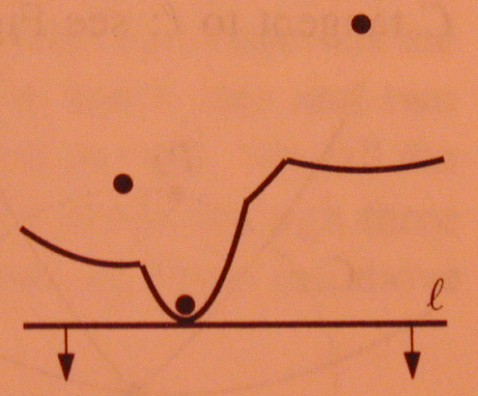
Checking for Potential Circle Events
Scan for triple of consecutive arcs and determine if breakpoints converge
  Triples with new arc in the middle do not have break points that converge

Slide 48
Checking for Potential Circle Events
Scan for triple of consecutive arcs and determine if breakpoints converge
  Triples with new arc in the middle do not have break points that converge

Slide 49
Checking for Potential Circle Events
Scan for triple of consecutive arcs and determine if breakpoints converge
  Triples with new arc in the middle do not have break points that converge

Slide 50
Converging break points may not always yield a circle event
Appearance of a new site before the circle event makes the potential circle non-empty
l
(The original circle event becomes a false alarm)

Slide 51
Handling Site Events
Locate the leaf representing the existing arc that is above the new site
  Delete the potential circle event in the event queue
Break the arc by replacing the leaf node with a sub tree representing the new arc and break points
Add a new edge record in the doubly linked list
Check for potential circle event(s), add them to queue if they exist
  Store in the corresponding leaf of T a pointer to the new circle event in the queue

Slide 52
Handling Circle Events
Add vertex to corresponding edge record in doubly linked list
Delete from T the leaf node of the disappearing arc and its associated circle events in the event queue
Create new edge record in doubly linked list
Check the new triplets formed by the former neighboring arcs for potential circle events

Slide 53
A Circle Event
< p_{j}, p_{k}>
< p_{i}, p_{j}>
< p_{k}, p_{l}>
< p_{l}, p_{m}>
p_{i}
p_{i}
p_{j}
p_{k}
p_{k}
p_{l}
p_{j}
< p_{m}, p_{l}>
p_{m}
l
p_{l}
p_{m}
p_{l}

Slide 54
Add vertex to corresponding edge record
Link!
< p_{j}, p_{k}>
Half Edge Record
Endpoints.add(x, y)
Half Edge Record
Endpoints.add(x, y)
< p_{i}, p_{j}>
< p_{k}, p_{l}>
< p_{l}, p_{m}>
p_{i}
p_{i}
p_{j}
p_{k}
p_{k}
p_{l}
p_{j}
< p_{m}, p_{l}>
p_{m}
l
p_{l}
p_{m}
p_{l}

Slide 55
Deleting disappearing arc
< p_{j}, p_{k}>
< p_{i}, p_{j}>
p_{i}
p_{i}
p_{j}
p_{k}
p_{k}
p_{l}
p_{j}
< p_{m}, p_{l}>
p_{m}
l
p_{m}
p_{l}

Slide 56
Deleting disappearing arc
< p_{j}, p_{k}>
< p_{i}, p_{j}>
< p_{k}, p_{m}>
< p_{m}, p_{l}>
p_{i}
p_{i}
p_{j}
p_{k}
p_{k}
p_{l}
p_{j}
p_{m}
p_{m}
p_{l}
l

Slide 57
Create new edge record
< p_{j}, p_{k}>
New Half Edge Record
Endpoints.add(x, y)
< p_{i}, p_{j}>
< p_{k}, p_{m}>
< p_{m}, p_{l}>
p_{i}
p_{i}
p_{j}
p_{k}
p_{k}
p_{l}
p_{j}
p_{m}
p_{m}
p_{l}
l
A new edge is traced out by the new
break point < p_{k}, p_{m}>

Slide 58
Check the new triplets for potential circle events
< p_{j}, p_{k}>
< p_{i}, p_{j}>
< p_{k}, p_{m}>
< p_{m}, p_{l}>
p_{i}
p_{i}
p_{j}
p_{k}
p_{k}
p_{l}
p_{j}
p_{m}
p_{m}
p_{l}
l
Q
…
y
new circle event

Slide 59
Minor Detail
Algorithm terminates when Q = ∅, but the beach line and its break points continue to trace the Voronoi edges
  Terminate these “half-infinite” edges via a bounding box

Slide 60
Algorithm Termination
< p_{j}, p_{k}>
< p_{i}, p_{j}>
< p_{k}, p_{m}>
< p_{m}, p_{l}>
p_{i}
p_{i}
p_{j}
p_{k}
p_{k}
p_{l}
p_{j}
p_{m}
p_{m}
p_{l}
Q
∅
l

Slide 61
Algorithm Termination
< p_{j}, p_{m}>
< p_{m}, p_{l}>
< p_{i}, p_{j}>
p_{i}
p_{i}
p_{j}
p_{k}
p_{l}
p_{m}
p_{l}
p_{j}
p_{m}
Q
∅
l

Slide 62
Algorithm Termination
< p_{j}, p_{m}>
< p_{m}, p_{l}>
< p_{i}, p_{j}>
p_{i}
p_{i}
p_{j}
p_{k}
p_{l}
p_{m}
p_{l}
p_{j}
p_{m}
Terminate half-lines
with a bounding box!
Q
∅
l

Slide 63
Handling Site Events
Running Time
Locate the leaf representing the existing arc that is above the new site
  Delete the potential circle event in the event queue
Break the arc by replacing the leaf node with a sub tree representing the new arc and break points
Add a new edge record in the link list
Check for potential circle event(s), add them to queue if they exist
  Store in the corresponding leaf of T a pointer to the new circle event in the queue
O(log n)
O(1)
O(1)
O(1)

Slide 64
Handling Circle Events
Running Time
Delete from T the leaf node of the disappearing arc and its associated circle events in the event queue
Add vertex record in doubly link list
Create new edge record in doubly link list
Check the new triplets formed by the former neighboring arcs for potential circle events
O(log n)
O(1)
O(1)
O(1)

Slide 65
Total Running Time
Each new site can generate at most two new arcs
  beach line can have at most 2n – 1 arcs
  at most O(n) site and circle events in the queue
Site/Circle Event Handler O(log n)
→ O(n log n) total running time

Slide 66
Is Fortune’s Algorithm Optimal?
We can sort numbers using any algorithm that constructs a Voronoi diagram!
Map input numbers to a position on the number line. The resulting Voronoi diagram is doubly linked list that forms a chain of unbounded cells in the left-to-right (sorted) order.
Number
Line
-5
1
3
6
7

Slide 67
Summary
Voronoi diagram is a useful planar subdivision of a discrete point set
Voronoi diagrams have linear complexity and can be constructed in O(n log n) time
Fortune’s algorithm (optimal)

