Slide 1
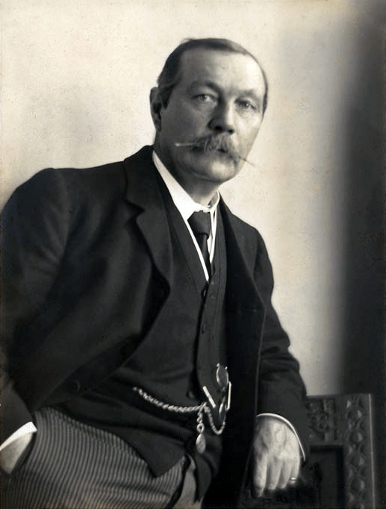
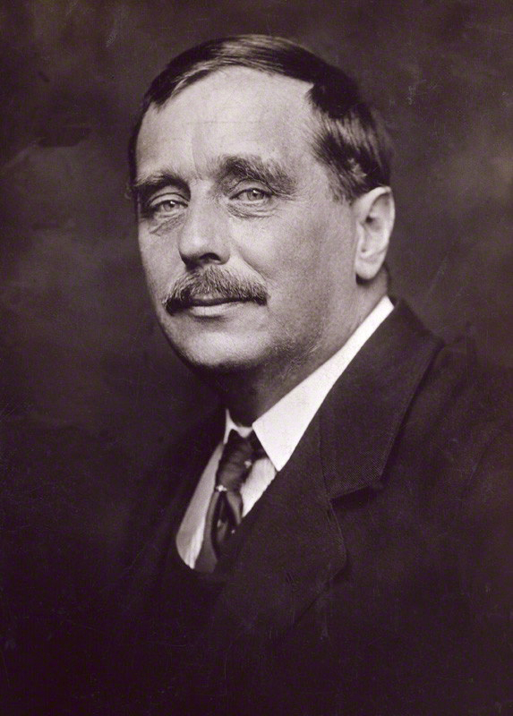
Mini Project 1
Word Frequency Analysis: Arthur Conan Doyle vs. H. G. Wells
Greyson Wright
COSC 445 • Fall 2026
1

Slide 2
Question
What is the goal
Goal
Texts used
How do word frequencies differ between Arthur Conan Doyle and H. G. Wells?
Are there words that one author uses noticeably more often than the other?
How consistent are those word-frequency patterns across two works by the same author?
Arthur Conan Doyle
• The Adventures of Sherlock Holmes
• The Hound of the Baskervilles
H. G. Wells
• The Time Machine
• The War of the Worlds
books = {
"Doyle": ["Sherlock Holmes", "Hound"],
"Wells": ["Time Machine", "War of the Worlds"]
}
COSC 445 Mini Project 1
2

Slide 3
Method
How I made the texts comparable
Steps
Core code
I downloaded plain-text files from Project Gutenberg.
I lowercased the text, removed punctuation, and counted words with Counter.
I removed common stop words so that words like “the” and “and” did not dominate.
I normalized every count to occurrences per 10,000 words.
words = re.findall(r"[a-z']+", text.lower())
words = [w for w in words if w not in stop_words]
counts = Counter(words)
freq = count / total_words * 10000
# Normalization matters because longer books
# naturally contain more total words.
COSC 445 Mini Project 1
3

Slide 4
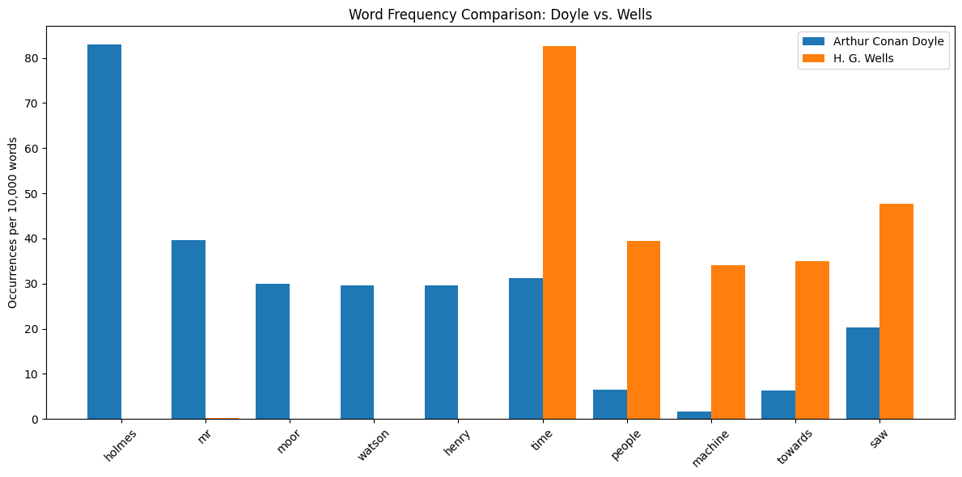
First Pass
Initial Doyle vs. Wells comparison
Interpretation
The first author comparison showed very large differences between Doyle and Wells.
Doyle was dominated by Sherlock-related words such as “holmes.”
Wells was dominated by subject words such as “time,” “machine,” and “martians.”
This made the result useful, but it also exposed a topic problem.
Original author comparison
COSC 445 Mini Project 1
4

Slide 5
Confound
The first graph mixed style with story content
Problem
Filtered terms
The highest-impact terms were often character names or words tied to a specific plot.
That means the graph did not cleanly separate author style from book subject matter.
I treated this as a limitation and ran a second comparison with obvious story-specific words removed.
story_specific_words = {
"holmes", "watson", "moor", "henry",
"time", "machine", "martians", "traveller"
}
# These terms were removed only for the
# second author-level comparison.
COSC 445 Mini Project 1
5

Slide 6
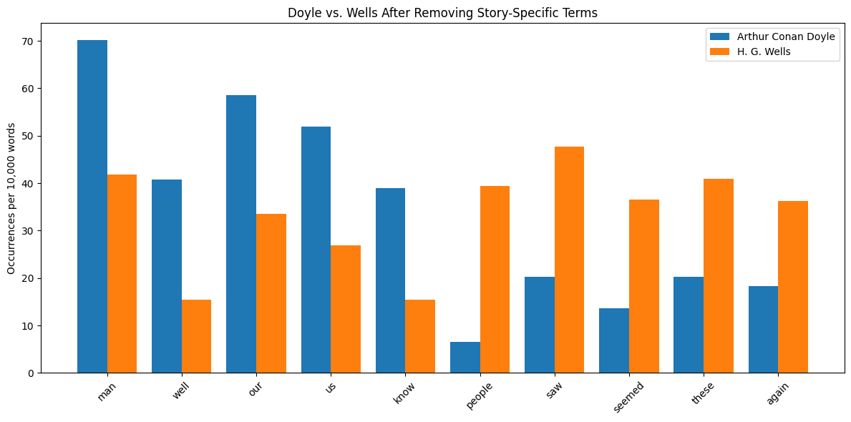
Second Pass
Doyle vs. Wells after story-word filtering
Main result
After filtering obvious story-specific terms, differences between the authors still remained.
Doyle used words such as “man,” “well,” “our,” “us,” and “know” more often.
Wells used words such as “people,” “saw,” “seemed,” “these,” and “again” more often.
This comparison was more useful, although it still required judgment.
Filtered author comparison
COSC 445 Mini Project 1
6

Slide 7
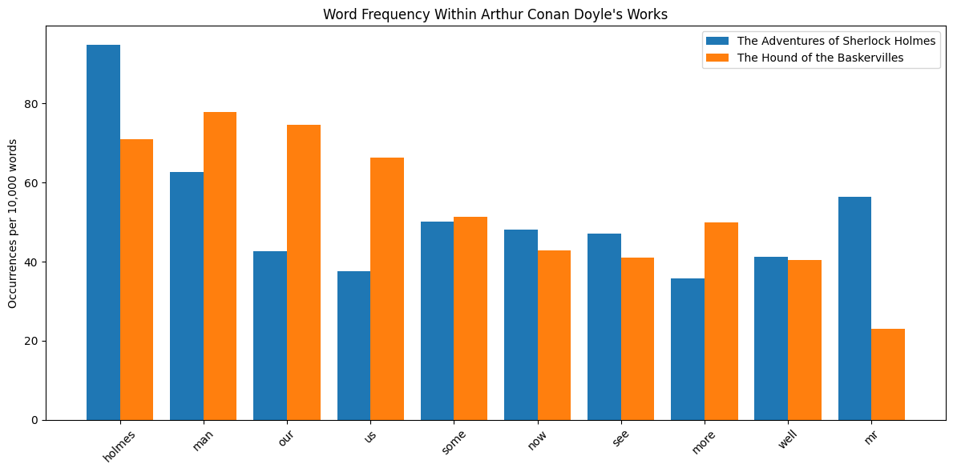
Doyle
Comparing Doyle’s two books
Interpretation
Some words were fairly consistent across Doyle’s books, such as “some” and “well.”
Other words changed sharply, including “our,” “us,” and “mr.”
This shows that even one author can have noticeable word-frequency differences across books.
Within-author comparison for Arthur Conan Doyle
COSC 445 Mini Project 1
7

Slide 8
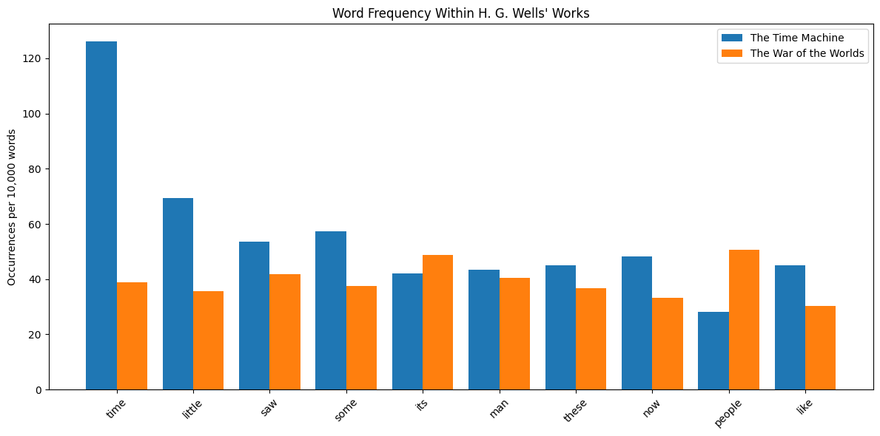
Wells
Comparing Wells’s two books
Interpretation
The Wells books also differed strongly from each other.
The word “time” was far more common in The Time Machine than in The War of the Worlds.
Words such as “people” and “its” were more common in The War of the Worlds.
This supports the same limitation: topic affects word frequency.
Within-author comparison for H. G. Wells
COSC 445 Mini Project 1
8

Slide 9
Limits
What this analysis cannot fully prove
Limitations
Examples
Word frequency does not automatically equal author style.
Stop-word selection affects the final rankings.
Choosing which terms are story-specific is somewhat subjective.
Using only two books per author limits how general the conclusions can be.
holmes -> character/topic term
time -> title and subject term
martians -> story-world term
The second pass improved the comparison,
but it could not remove every source of
context or subject-matter bias.
COSC 445 Mini Project 1
9

Slide 10
Takeaways
What was learned from the project
Conclusion
Normalized word frequency can reveal meaningful differences between books and authors.
The strongest raw differences were often caused by topic and character names.
The second pass made the author comparison more defensible by directly addressing that limitation.
A larger future study could use more books or a systematic method for identifying story-specific terms.
COSC 445 Mini Project 1
10

