Slide 1
Cyber Security by Henrik Lange

Slide 2
Agenda
OWASP
Access Control
  Login Systems
  Basic Auth
  Oauth
Authentication
Injection
  Backend Script Injection
  SQL Injection
  Cross-Site Scripting (XSS)
Request Forgery (XSRF)
Vulnerabilities
Security Logging and Monitoring
  Log files (txt)
  DB Audit Log
DDoS

Slide 3
Cyber Security

Slide 4
OWASP:
Open Web Application Security Project

Slide 5
How login systems work
The Open Web Application Security Project (OWASP) is an online community that produces freely available articles, methodologies, documentation, tools, and technologies in the fields of IoT, system software and web application security. The OWASP provides free and open resources. It is led by a non-profit called The OWASP Foundation. The OWASP Top 10 (2021) is the published result of recent research based on comprehensive data compiled from over 40 partner organizations.

Slide 6
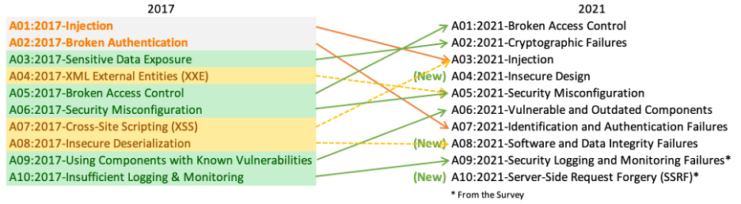
OWASP has a 4 year update cycle
OWASP has transitioned from a yearly cycle to a 4-year cycle, after concluding that the security landscape does not change fast enough to prompt faster update cycles.

Slide 7
OWASP top 10 (2021)
A01:2021-Broken Access Control moves up from the fifth position; 94% of applications were tested for some form of broken access control. The 34 Common Weakness Enumerations (CWEs) mapped to Broken Access Control had more occurrences in applications than any other category.
A02:2021-Cryptographic Failures shifts up one position to #2, previously known as Sensitive Data Exposure, which was broad symptom rather than a root cause. The renewed focus here is on failures related to cryptography which often leads to sensitive data exposure or system compromise.
A03:2021-Injection slides down to the third position. 94% of the applications were tested for some form of injection, and the 33 CWEs mapped into this category have the second most occurrences in applications. Cross-site Scripting is now part of this category in this edition.
A04:2021-Insecure Design is a new category for 2021, with a focus on risks related to design flaws. If we genuinely want to “move left” as an industry, it calls for more use of threat modeling, secure design patterns and principles, and reference architectures.

Slide 8
OWASP top 10 (2021)
A05:2021-Security Misconfiguration moves up from #6 in the previous edition; 90% of applications were tested for some form of misconfiguration. With more shifts into highly configurable software, it’s not surprising to see this category move up. The former category for XML External Entities (XXE) is now part of this category.
A06:2021-Vulnerable and Outdated Components was previously titled Using Components with Known Vulnerabilities and is #2 in the Top 10 community survey, but also had enough data to make the Top 10 via data analysis. This category moves up from #9 in 2017 and is a known issue that we struggle to test and assess risk. It is the only category not to have any Common Vulnerability and Exposures (CVEs) mapped to the included CWEs, so a default exploit and impact weights of 5.0 are factored into their scores.
A07:2021-Identification and Authentication Failures was previously Broken Authentication and is sliding down from the second position, and now includes CWEs that are more related to identification failures. This category is still an integral part of the Top 10, but the increased availability of standardized frameworks seems to be helping.

Slide 9
OWASP top 10 (2021)
A08:2021-Software and Data Integrity Failures is a new category for 2021, focusing on making assumptions related to software updates, critical data, and CI/CD pipelines without verifying integrity. One of the highest weighted impacts from Common Vulnerability and Exposures/Common Vulnerability Scoring System (CVE/CVSS) data mapped to the 10 CWEs in this category. Insecure Deserialization from 2017 is now a part of this larger category.
A09:2021-Security Logging and Monitoring Failures was previously Insufficient Logging & Monitoring and is added from the industry survey (#3), moving up from #10 previously. This category is expanded to include more types of failures, is challenging to test for, and isn’t well represented in the CVE/CVSS data. However, failures in this category can directly impact visibility, incident alerting, and forensics.
A10:2021-Server-Side Request Forgery is added from the Top 10 community survey (#1). The data shows a relatively low incidence rate with above average testing coverage, along with above-average ratings for Exploit and Impact potential. This category represents the scenario where the security community members are telling us this is important, even though it’s not illustrated in the data at this time.

Slide 10
Access Control

Slide 11
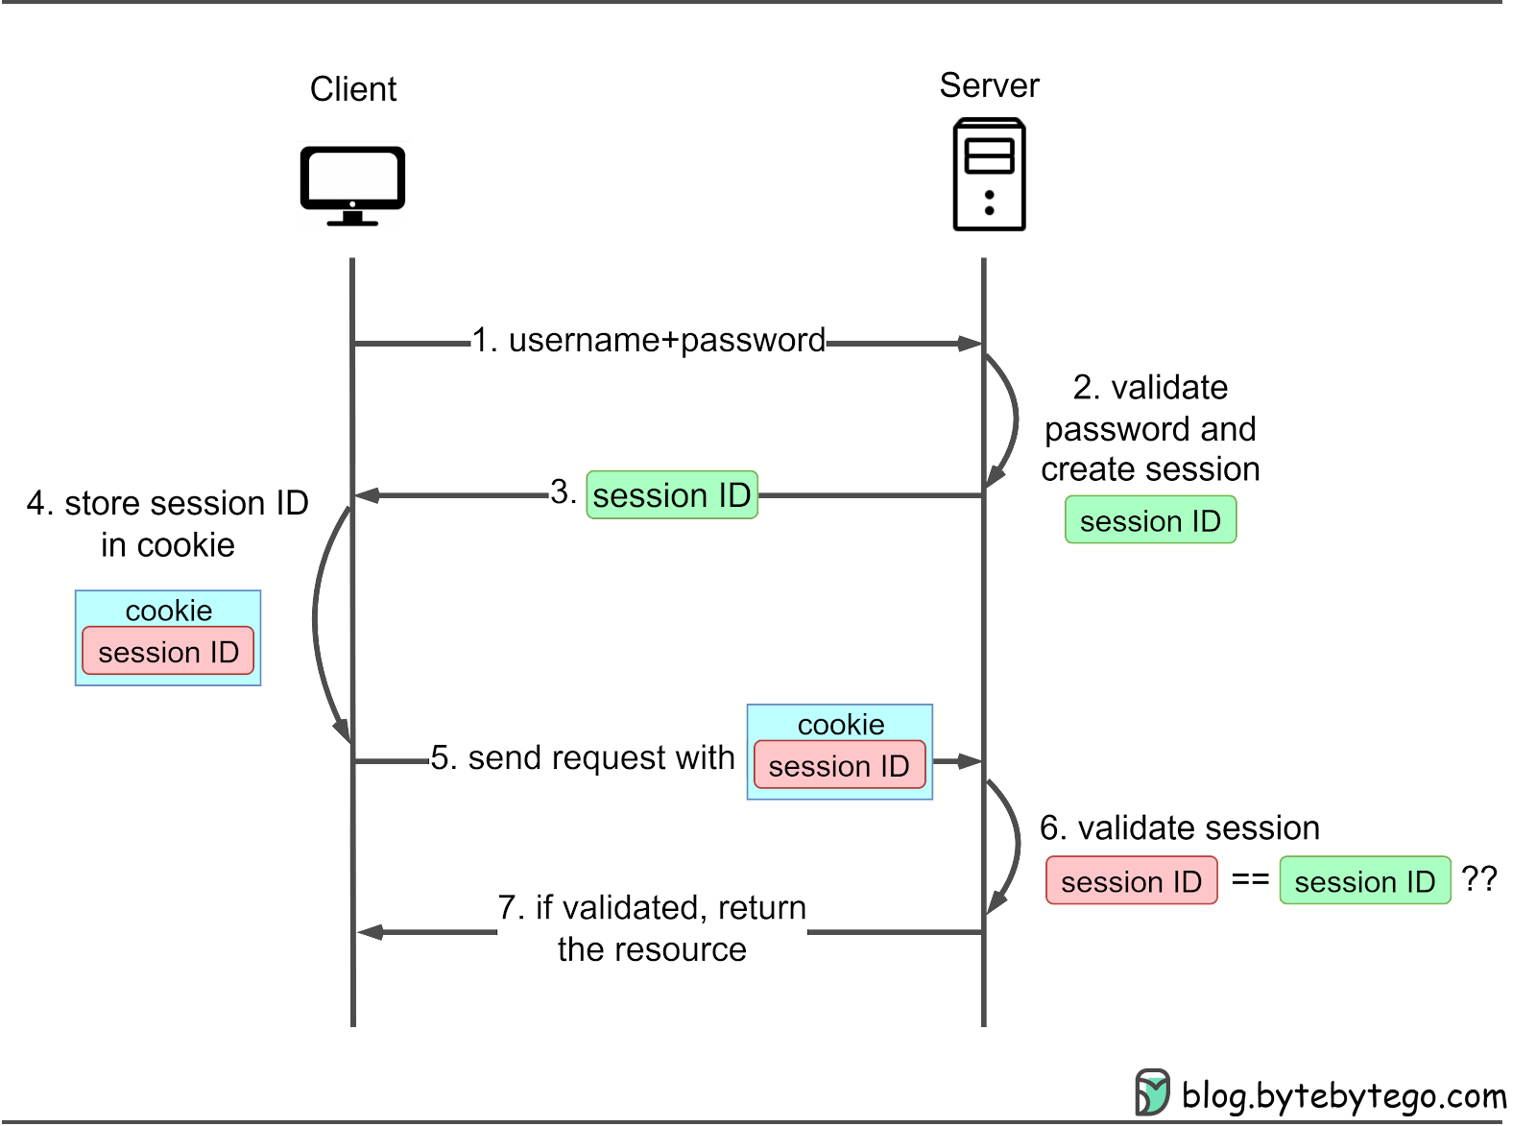
How login systems work
Send username/email and password
Validation of passwords NEVER happen in clear text
  Passwords on the server is most often hashed
  Check incoming password by hashing it and compare the hashes
A session is created for the user, where "isLoggedIn" is true
SessionId is saved in a cookie
  This can then be used when accessing the same resource again to validate without username/password

Slide 12
API Key
Some APIs use API keys for authorization. An API key is a token that a client provides when making API calls. The key can be sent in the query string:
or as a request header:
or as a cookie:
API keys are supposed to be a secret that only the client and server know.
Authentication is only considered secure if used together with other security mechanisms such as HTTPS/SSL.
Multiple API keys can be combined
GET /something?api_key=abcdef12345
GET /something HTTP/1.1
X-API-Key: abcdef12345
GET /something HTTP/1.1
Cookie: X-API-KEY=abcdef12345
GET /something?api_key=abcdef1234&app_key=fedcba4321

Slide 13
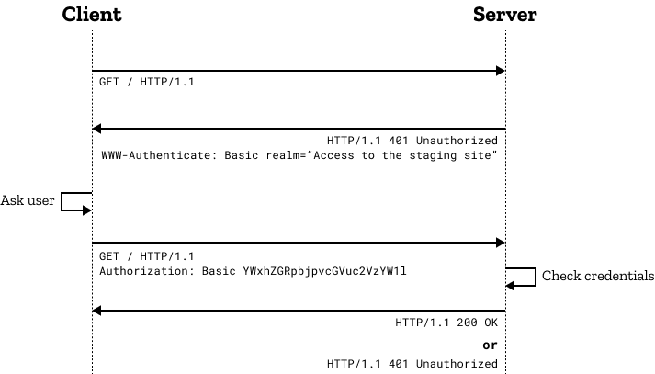
BasicAuth
Basic auth is a standardized way to authenticate users.
It uses the "Authorization" http header as key
The value is this:
  The word "Basic" followed by a whitespace
  The username and password as a single string with a colon inbetween
    This part is base64 encoded
    There is absolutely zero security in base64 encoding things

Slide 14
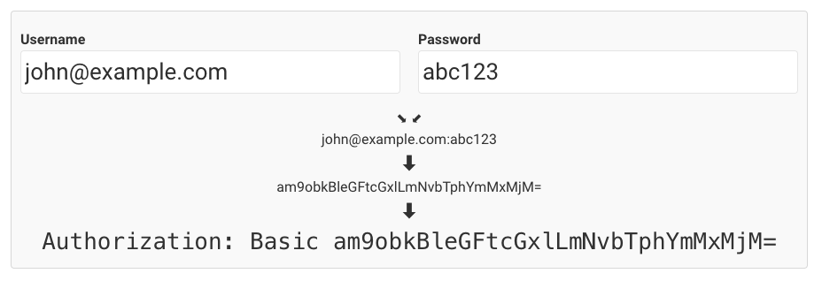
BasicAuth

Slide 15
OAuth with API Keys
Oauth is used when one site authenticates a user through the service of another system
OAuth is based on flows
There are several but the most common looks like this
An application can only act on behalf of users if the app itself is validated by the same third-party
App/API
Open
Client
Authorization Server
Redirect
Redirect
Require Consent / Login
Consent / Login
Authorization Code
Authorization Code
Authorization Code + API Key
Access token
Access granted

Slide 16
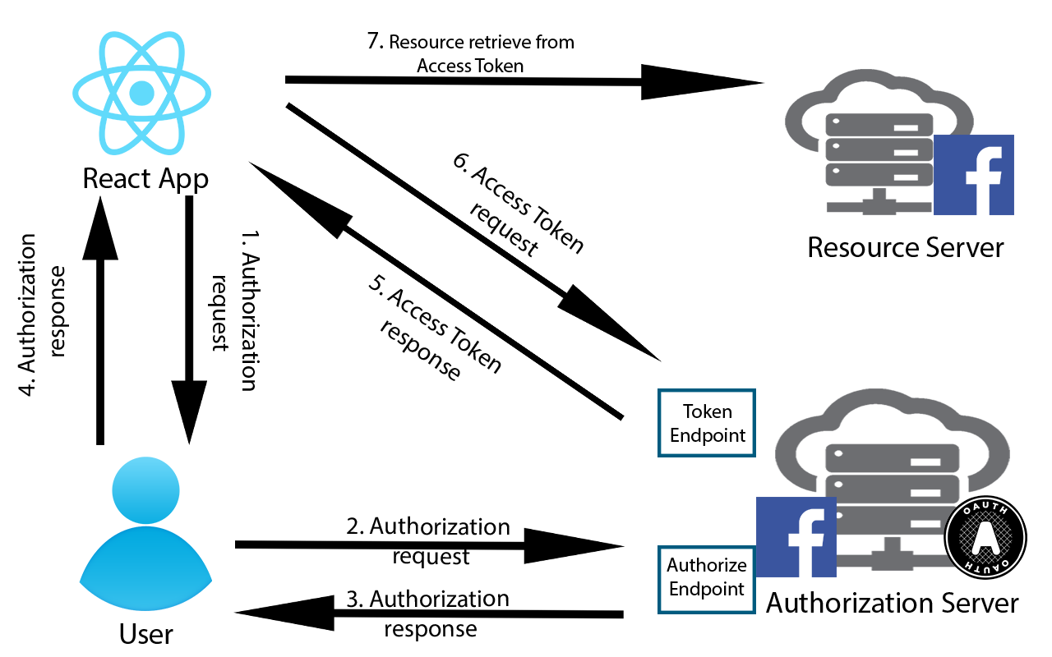
Oauth – Facebook login example
The app requests the User for authorization and the user chooses to authorize with Facebook
The request is then passed on to Facebook then passes back an authorization grant
The authorization grant can be used to request an access token
The access token can then be used to request the protected resource and if validated the protected resource is returned
5. Access Token request
6. Access Token response

Slide 17
The difference between authentication and authorization
Authentication is a process that verifies that someone or something is who they say they are
  This is where things such as username/password is used
  This is vital to verify the identity of a user
  Do they have access?
Authorization is a security process that determines a users level of access.
  This is often depicted as roles, where different roles may have access to different parts of the system
  What do they have access to?
It is important to separate these two things. Knowing who people are should not be enough to let them do what they want.

Slide 18
Injection

Slide 19
Cross-Site Scripting (XSS)
A type of injection, in which malicious scripts are injected into otherwise benign and trusted websites
XSS attacks occur when an attacker uses a web app to send malicious code, generally in the form of a browser side script, to a different end user
These can occur anywhere a web app takes input from a user that is used within the output with validation or encoding
Generally there are two types of XSS attacks, Reflected and Stored
Reflected: These are those where the injected script is reflected off the web server, such as in an error message, search result or any other response that includes some of the input sent to the server as part of the request.
  These are usually delivered to victims via e-mail or another website
  When a malicious link is clicked the malicious code travels to the vulnerable site and is executed since it came from is "trusted" server
Stored: This is when a injected script is permanently stored on the target servers, such as in a database, message forum or comment field, etc.
  The victim retrieves the malicious script from the server when it requests the stored information.

Slide 20
Cross-Site Scripting XSS
Solution:
Protect all variables
  Ensure that all variables go through validation and are then escaped or sanitized
    This is known as perfect injection resistance
    Use whitelisting instead of blacklisting – as in all security filtering
  An attacker must be able to insert and execute malicious content in a webpage to be successful
  Use Regex filters as a way to validate that only acceptable content is allowed to enter your system
Use HTML Entities
  HTML entities are a way to represent characters that could typically be used in code
  If you write <script> inside an HTML document, it will not show on screen, since it is interpreted as part of the HTML code
  Write &lt;script&gt; instead, and the browser will display the text <script> since &lt; and &gt; are the HTML Entities for < and > respectively.
  There are standardized functions in all programming languages to encode and decode any string into a version that has or doesn't have HTML-entities
  Make sure you do this in a consistent way. Encoding the same string twice would encode the & and ; characters into their own HTML entities, and you will end up displaying unreadable nonsense.

Slide 21
SQL Injection
An attacker can use SQL injection on an application if it has dynamic database queries that use string concatenation and user supplied input.
This gives the hacker full access to the database and thus all data within
Most common attacks:
  Always true (or 1=1)
    SELECT * FROM Users WHERE UserId = 105 OR 1=1;
  Query stacking attacks
    SELECT * FROM products WHERE id = 10; DROP members--
  Data exfiltration
    SELECT * FROM health_records WHERE date = '22/04/1999'; -- ' AND id = 33
Solution: Prepared statements/Parameter binding
  Prepared statements are simple to write and easier to understand than dynamic queries and parameterized queries force the developer to define all SQL code first and pass in each parameter to the query later
  This enables the database to easily distinguish between code and data
  This means attackers are unable to change the intent of the query

Slide 22
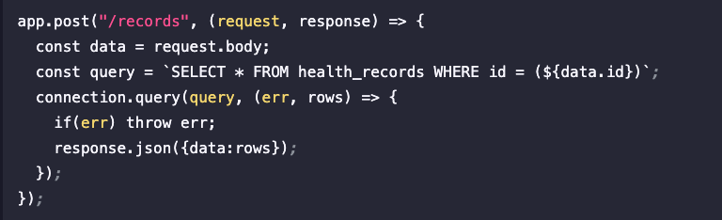
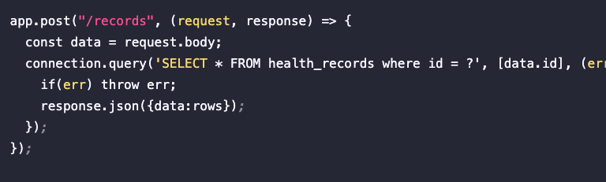
SQL Injection
Example
Solution

Slide 23
Solution: SQL Injection
When your application interacts with the database, it uses the databases API
The database API supports separation of query and content so you can give it a full SQL statement with placeholders for data, and then the data afterwards
  This is typically done with prepared statements with parameter—inding
  Alternatively, it can be done using stored procedures, where the SQL statement is stored in the database and can be run as a command where you just give it the necessary data

Slide 24
Backend Script Injection
If an attacker uploads a script to a server and runs it by accessing its URL
The script can either replace an existing file or just be a new file
This is primarily an issue on servers that run PHP and JavaScript
  Since they are interpreted languages, any file that is successfully injected into an interpreted space can act as real servercode
It is possible with compiled languages as well, but then it requires more knowledge about the server application composition and will most likely require replacing a compiled library with another compiled library that has the same functions available

Slide 25
Solution: Backend Script Injection
Always use a whitelist of filetypes that you allow upload of
  Blacklists will likely allow you to forget something or allow formats that doesn't exist yet
Make sure the upload path is not prone to injection
  Filename = ../../app/important/stuff.php
Make sure the upload folder does not allow code interpretation
  This is set up in your application configuration

Slide 26
Direct Database Access
A lot of applications have a username and password for the DB connection stored in a configuration file
If anyone gets this string, they can open a connection to it and run SQL directly against it
They can easiliy ask for a list of databases and tables and select any data they want, including billing info, passwords and other sensitive data

Slide 27
Solution: Direct Database Access
Hash verification tokens such as passwords
  A hashing algorithm does not allow de-hashing, so for data we only need to validate, but never to display – use hasing
Encrypt sensitive data
  Encryption can be decrypted if the private key and algorithm are known, but it adds a layer of protection and difficulty
Make sure the database only accepts requests directly from the same server
  This is a setting in all proper databases
Audit logging
  Set up triggers for specific queries and log to an audit log
  Have an application look into the audit log for specific occurences on a regular schedule, and send out a warning if something unwanted is happening
  More on this later…

Slide 28
Solution: Direct Database Access
In severe cases where data protection is important, you can take even steeper measures:
Don't give the application a database user. Make a DB user for each end-user, and relay their user-information to the database. That way, the database knows who is looking and manipulating.
Applications can work like this, if they relay the user credentials instead of having its own.
In this setup, you would typically use a third-party login-system, such as LDAP or Microsoft Azure

Slide 29
XSRF:
Cross-Site Request Forgery

Slide 30
Cross-Site Request Forgery
Request Forgery is when a request is sent by a malicious third party.
  They run a script on your computer or from your browser
  They injected a different form or different content into a form that you are submitting
  They intend to act on your behalf
Example:
  A hacker wants to log in as you by guessing your username and password (brute force attack)
  They find a way to run their script from your computer in the background, so that the server will recognize your IP address and your browser will automatically send all relevant cookies along with the request
  They find the names of the login fields and the URL to send it to, and then start sending your username and a new guess for a password.
  They try a new password every couple of hours - they are not in a rush.

Slide 31
Cross-Site Request Forgery
Solution
  An XSRF token is placed on each page that a user loads
  The token is random-generated and inserted as a hidden field in the users form
  The token is stored in a list of valid tokens in the servers session along with a timestamp
    The list might have a limited length as well
  Whenever an XSRF token is accepted, it is either
    Accepted as being on the list – and then removed
    Rejected because it is not on the list
How it works
  A previous post is repeated
    The XSRF token was already used and removed, so the repeated post is invalid
  A hacker finds your XSRF token and use it from their own computer
    Doesn't matter – they are not on your session
  A form is saved so that it can be filled out and posted later
    The XSRF token has a timestamp and is only valid for a short period of time

Slide 32
Let's find some!
Let's look at some basic forms around the interwebs and check if they use XSRF tokens

Slide 33
Logging and monitoring

Slide 34
Logging
"Logging" typically refers to saving data to text-files from your application
You may have done something like this for debugging, where a web app or GUI app also writes something in the command line using a "print" statement.
The act of logging is simply this, but saved into .txt files.
Log files are typically stored in a dedicated folder with a specific subfolder structure that allows you to browse to specific dates a la year > month > day . Within a day, a log-file is typically named after a timestamp a la HH.MM so that they can be ordered alphabetically and end up in a timely sequence.
A log file typically contains the content of 15 minutes of runtime, but can contain more or less, if the system has very little/much traffic.

Slide 35
Logging
Logs are great for debugging. A system will sometimes run a bit different in production or run into usecases that were never tested, and the log contains your own error messages along with any relevant stack traces.
When someone runs into an issue, they can give you the point in time to help you locate the error.

Slide 36
Monitoring – rolling application log
We want to know if something critical is being logged
  This example uses the popular ELK Stack (Elasticsearch, Logstash, Kibana)
Configure Logstash for Log Processing:
  Logstash is used to process logs and send them to Elasticsearch. Configure Logstash to read your log files. In the Logstash configuration, specify the path to your log files and set it to check the files periodically (every hour, as per your requirement).
  Logstash can handle rolling log files by keeping track of which lines it has already read.
  Within your Logstash configuration, define filters to parse your log data. You can set conditions or match patterns that, when met, trigger an alarm.
Use Kibana as a web UI for Logstash (and elastic search):
  Use Kibana to set up dashboards that monitor your log data.
  Kibana also offers alerting features (through Kibana Alerting or Watcher in X-Pack) to notify you when certain conditions in your log data are met. These alerts can be set up based on the conditions defined in Logstash.
Elasticsearch for indexing and searching logs:
  Elasticsearch is a search and analytics engine. It can easily find data in vast data amounts, such as rolling logs.
  It can store and index your log data.

Slide 37
Monitoring – database audit log
In the database, an audit log is usually made using triggers, that will insert specific data into the audit-log table whenever something happens in the database.
By utilizing database triggers, we can ensure logging, even when changes are made directly in the database via SQL.
These logs can be automatically read every x minutes to retrieve any log entries made since last check.
If these entries contain any specific logs, we can set up alarms for it.
Splunk or elasticsearch can be used for automating the reading and alarm processes here.

Slide 38
Vulnerabilities

Slide 39
What is a vulnerability
When it is found that a commonly used or public framework or library has a security issue that could potentially be exploited, this is referred to as a vulnerability.
Most security issues are found by white-hat hackers and made available to the public before any exploits happen.
Most hackers either work to find vulnerabilities or to exploit existing ones – typically the latest ones
Vulnerabilities worth exploiting are typically exploited within 30 days or so
Most popular frameworks or libraries are patched within a few days after a vulnerability is found.
Vulnerability: A known security risk
Exploit: Taking advantage of a vulnerability
Patch: Fix the vulnerability

Slide 40
Vulnerabilities
Some libraries are abandoned and will never be patched – we should avoid using these
  You should look at when your libraries were last updated and how long it has existed for before you start using it
  Avoid an overreliance on external libraries
Some vulnerabilities exist in a format where a simple patch is not possible – there could be a systematic problem with the whole setup of the library. When this is fixed, the library might work slightly differently from how it did before – and this will force users to update their own application code in order to use the patched library.
This is one of the most expensive software maintenance processes.
There are tools that will scan your imported libraries and frameworks for vulnerabilities, simply by scanning their names and version numbers and comparing it to a list of known vulnerabilities.
  Jfrog, OWASP ZAP

Slide 41
Vulnerabilities
Since vulnerabilities are part of a specific version, a simple version-spoof can introduce a vulnerability that is difficult to detect. Many large software companies have their own library repositories for safe storage of verified external libraries to make sure nothing is injected into third-party libraries.

Slide 42
DDoS
Distributed Denial of Service

Slide 43
DDoS – Distributed Denial of Service
A simple way to break a service is to simply saturate its ressources
Call a server frequently enough, and it will surely break
The simplest way to defend agains this is to deny access for any IP address making more than x requests per second
But if you gain access to enough different IP-addresses via VPN's, malware, XSS, etc., then you can make the max number of requests per second from a plethora of different IP addresses simultaneously.

Slide 44
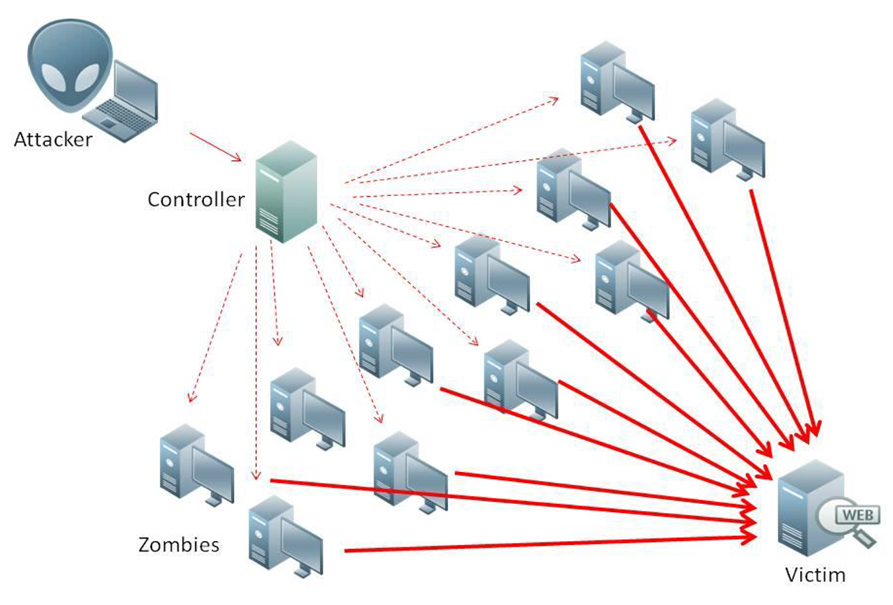

Slide 45
DDoS – Distributed Denial of Service
Solution:
  Make sure you know your users
  NemID and UniLogin will generally not allow access from outside of Europe
    IP geography can be tested on a dedicated server to avoid impacting application performance
  Block known offenders
    BlockList.de is an example of a site that logs and publishes IP addresses that have recently been used for malicious attacks
    This can block your system from integrating with other systems if you share hosting with someone who is blacklisted
  Make application validity checks early in the application response
    Avoid wasting ressources on someone who will end up being blocked
  Prepare for disasters
    Make sure you have a plan that will allow you to immediately take down the application and get it back up and running
  IP whitelisting
    IP whitelisting can be used a way to slowly validate users for a period of time
    Once you know your typical cadence of whitelisting, you can shut down whitelisting when that cadence grows significantly
DDoS is one of the most difficult attacks to protect against, but you can severely decrease the probability by decreasing the number of acceptable IP addresses

Slide 46
Recap

Slide 47
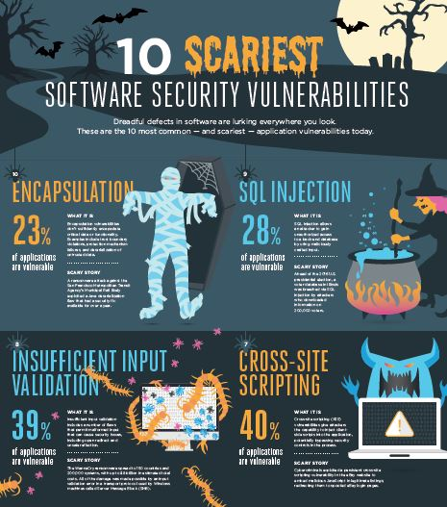
What do we do?

