Slide 1


Slide 2
MongoDB by Henrik Lange Bendixen

Slide 3
Agenda
I. Introduction to NoSQL databases
A. What are NoSQL databases?
B. Comparison with relational databases
C. When to use NoSQL databases
II. MongoDB Basics
A. Introduction to MongoDB
B. Collections and documents
C. BSON data format
D. Installing and configuring MongoDB
III. Querying MongoDB
A. Introduction to MongoDB Query Language (MQL)
B. Filtering data with MQL
C. Sorting data with MQL
D. Grouping and aggregating data with MQL
IV. Indexing
A. Introduction to indexing
B. Index types in MongoDB
C. Creating and managing indexes
V. Data Modeling in MongoDB
A. Best practices for data modeling
B. Schema design
C. Data normalization and denormalization
VII. Security
A. MongoDB security features
B. Authentication and authorization
C. Encryption
VIII. MongoDB and Node.js
A. Connecting to a MongoDB database using Node.js
B. CRUD operations using Node.js and MongoDB
C. Handling errors and exceptions
D. Injection attacks in Node.js and MongoDB
E. Cross-site scripting (XSS) in Node.js and MongoDB
IX. Conclusion
A. Recap of key concepts

Slide 4
Goal of todays lecture
After this lecture you should be able to understand what a NoSQL database is, how it is different from a relational database, and when each of them are appropriate.

Slide 5
NoSQL Databases

Slide 6
Introduction to NoSQL Databases
NoSQL databases are non-relational databases that do not use the traditional tabular schema of relational databases
They are different from relational databases in terms of data models, scaling, and query languages
Advantages of using NoSQL databases include flexibility, scalability, and performance, while disadvantages include complexity and lack of standards
MongoDB is a popular open-source NoSQL database that uses a document-oriented data model

Slide 7
Overview of NoSQL Database Types
NoSQL databases are non-relational databases that use different data models than traditional relational databases
There are several types of NoSQL databases, including key-value, document-based, column-family, and graph-based databases
Key-value databases store data as a collection of key-value pairs and are highly scalable
Document-based databases store data in documents that can be nested and are highly flexible
Column-family databases store data in columns rather than rows and are designed for large-scale data storage and retrieval
Graph-based databases store data in nodes and edges and are designed for highly connected data
Examples of NoSQL databases include Apache Cassandra (column-family), MongoDB (document-based), Redis (key-value), and Neo4j (graph-based)
NoSQL databases differ from relational databases in their data model, scalability, and query language, among other factors

Slide 8
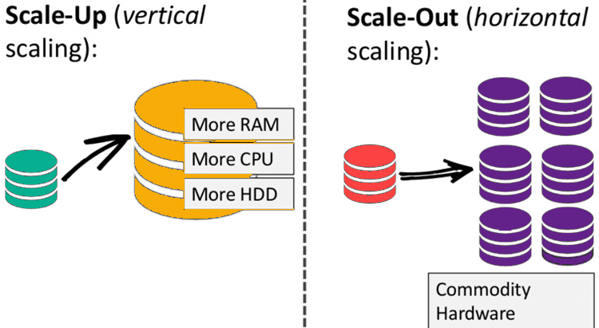
Key Differences Between NoSQL and Relational Databases
NoSQL databases:
use a non-tabular data model, while relational databases use a tabular data model
are designed for scalability and performance, while relational
databases are designed for consistency and data integrity
are schema-less or have flexible schemas, while relational databases have fixed schemas
typically use horizontal scaling, while relational databases use vertical scaling
have a different query language than relational databases, often using a variant of SQL or a custom query language
A tabular data model is a way of organizing data in rows and columns, similar to a spreadsheet.

Slide 9
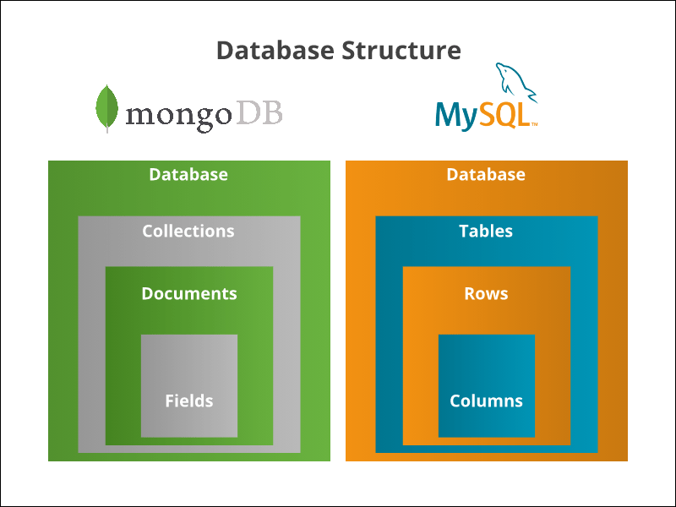
Key Differences Between NoSQL and Relational Databases

Slide 10
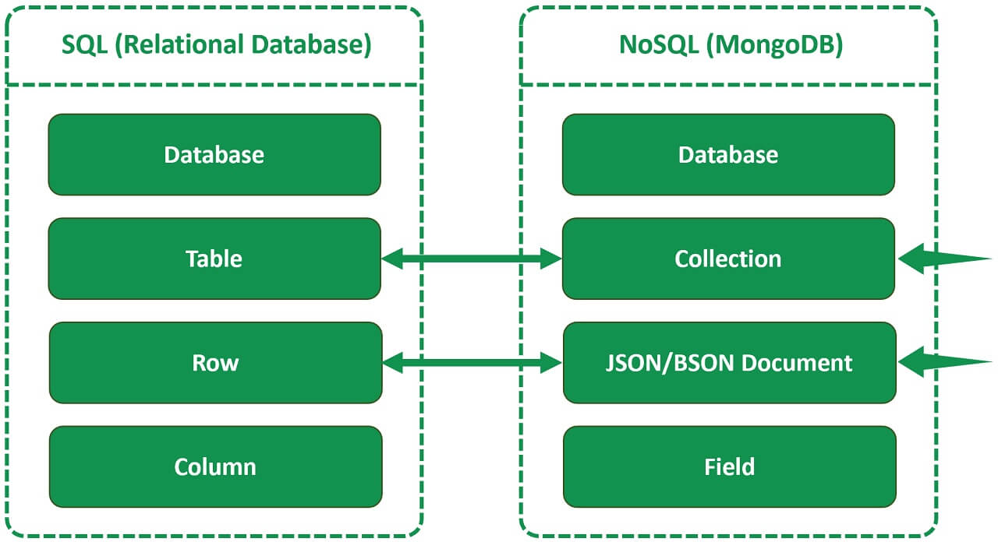
Key Differences Between NoSQL and Relational Databases

Slide 11
Considerations for Choosing NoSQL Databases
NoSQL databases are best suited for applications that require high scalability, flexibility, and performance, such as web applications, real-time analytics, and big data processing
They are particularly useful for applications that handle semi-structured or unstructured data, such as social media data or sensor data
Furthermore, NoSQL databases can be a good choice for startups or small companies that need to rapidly develop and iterate their applications, as NoSQL databases offer more flexibility and require less upfront design than relational databases
However, NoSQL databases may not be the best choice for applications that require strict consistency, data integrity, and transaction support, such as financial systems or e-commerce applications
Choosing a NoSQL database should also take into account factors such as data size, query complexity, and development team expertise

Slide 12
Examples of NoSQL Database Applications
General web applications: Document-based NoSQL databases such as MongoDB are often used for web applications due to their flexibility and scalability. MongoDB allows for easy modeling of complex data structures, such as user profiles or product catalogues, and can easily scale horizontally as traffic increases.
Real-time analytics: Column-family NoSQL databases such as Apache Cassandra are often used for real-time analytics due to their ability to handle large amounts of data and support for high write throughput. Cassandra allows for fast writes and queries of data, making it suitable for real-time data processing.
Big data processing: Key-value NoSQL databases such as Redis or Memcached are often used for big data processing due to their ability to handle large amounts of data in memory. They can be used for caching frequently accessed data, which can improve application performance and reduce load times.
Social media: Graph-based NoSQL databases such as Neo4j are often used for social media applications due to their ability to store and query highly connected data. Neo4j allows for efficient querying of data based on relationships between nodes, making it suitable for recommendation engines or social network analysis.
Choosing the right NoSQL database for an application depends on several factors, such as the size and complexity of the data, the query requirements, and the development team expertise.

Slide 13
Examples Relational Database Applications
Financial systems: Relational databases are often used for financial systems due to their strict consistency and data integrity. These databases allow for transaction support, which ensures that data changes are atomic and durable, making them suitable for financial applications that require precise and accurate data.
E-commerce applications: Relational databases are often used for e-commerce applications due to their support for complex transactions and data integrity. They allow for the creation of complex relationships between entities, such as products, orders, and customers, and can enforce constraints to ensure data consistency.
Content management systems: Relational databases are often used for content management systems due to their ability to handle complex data relationships and queries. They allow for the creation of complex relationships between entities, such as articles, comments, and authors, and can easily handle complex queries, such as filtering and sorting by multiple attributes.
Enterprise resource planning (ERP) systems: Relational databases are often used for ERP systems due to their ability to handle complex data structures and relationships. All relational databases allow for the creation of complex relationships between entities, such as customers, vendors, and products, and can easily handle complex queries, such as data aggregation and reporting.
Choosing the right relational database for an application depends on several factors, such as the size and complexity of the data, the query requirements, and the development team expertise.

Slide 14
MongoDB Basics

Slide 15
Introduction to MongoDB Data Model and Architecture
MongoDB is a document-oriented NoSQL database that stores data as BSON documents in collections
A BSON document is a binary-encoded representation of a JSON document, which can contain nested documents and arrays
Collections are analogous to tables in relational databases and can contain documents with different structures and fields
MongoDB has a flexible schema that allows for dynamic changes to the structure of documents and collections
This database supports horizontal scaling through the use of sharding, which distributes data across multiple servers
MongoDB can be accessed through a command-line interface or through drivers and APIs in different programming languages

Slide 16
Overview of MongoDB and its Features
MongoDB:
is a popular open-source document-oriented NoSQL database
is designed for scalability, flexibility, and performance, and is used by many organizations for large-scale data storage and retrieval
supports dynamic schema, which allows for the easy addition and removal of fields in documents without having to modify the entire collection schema
supports horizontal scaling through sharding, which allows for the distribution of data across multiple servers
secures ACID transactions at the document level, which ensures that changes to documents are atomic, consistent, isolated, and durable
has a flexible query language, called MongoDB Query Language (MQL), which allows for complex queries, aggregations, and data manipulations
has a large community and a wide range of drivers and tools available for different programming languages and platforms

Slide 17
MongoDB Data Model Basics
MongoDB stores data in collections, which are analogous to tables in a relational database
  Each collection can contain multiple documents, which are similar to rows in a table
  Every document in MongoDB are stored in BSON format, which allows for efficient storage and retrieval of data
  Each document in a collection can have a different structure and can contain different fields
Documents in the database can contain nested documents and arrays, which allows for flexible data modeling
MongoDB documents have a unique identifier, called an ObjectID, which is automatically generated by MongoDB when a new document is inserted into a collection

Slide 18
Overview of BSON and its Advantages
BSON:
is a binary-encoded serialization format used by MongoDB to store and retrieve data
has a structure similar JSON, but BSON is more efficient and supports additional data types, such as Date, Binary, and Regular Expression
allows for the storage of binary data, such as images or multimedia files, which can be difficult to represent in JSON format
supports indexing and query operations, which allows for efficient searching and retrieval of data in MongoDB
is more compact than JSON, which reduces the amount of disk space and network bandwidth required for data storage and transfer
is compatible with JSON, which allows for easy conversion between the two formats

Slide 19
Installing MongoDB on Windows
Go to mongodb.com/try/download/community
Select the latest (current) version
Choose your platform
Choose and msi (Microsoft installer) package
Click download
Run the installation wizard

Slide 20
Installing MongoDB on Mac
Install homebrew vi the terminal if you haven’t already:
/bin/bash -c "$(curl -fsSL https://raw.githubusercontent.com/Homebrew/install/HEAD/install.sh)"
Now run the following commands in the terminal and wait for each of them to finish:
sudo rm -rf /Library/Developer/CommandLineTools
Removes xcode commandline tools (recursive, forced)
sudo xcode-select --install
Installs xcode commandline tools (latest version)
brew tap mongodb/brew
Makes mongoDB available in homebrew
brew update
Updates all homebrew references
brew install mongodb-community
Installs mongodb community server
brew services start mongodb/brew/mongodb-community
Start the mongodb server
mongosh

Slide 21
Configuring MongoDB
Download the MongoDB Community Server from the official MongoDB-website
Follow the installation instructions for your operating system
If necessary, configure the MongoDB server to run as a service or daemon on your operating system
Start the MongoDB server by running the mongod command in a terminal window
Connect to the MongoDB server using the mongo command in another terminal window
Here are some examples of command line options that can be used when starting the MongoDB server:
mongod --dbpath /data/db # specify the data directory for the MongoDB server
mongod --port 27017 # specify the port number for the MongoDB server
mongod --auth # enable authentication for the MongoDB server

Slide 22
Using MongoDB from the Command Line
Start the MongoDB server by running the mongo command in a terminal window
Connect to the MongoDB server using the mongo command in another terminal window
Create a new database using the use command:
use mydb
Show the available databases using the show dbs command:
show dbs
Create a new collection using the db.createCollection() method:
db.createCollection('mycollection')
Insert a new document into a collection using the insertOne() method:
db.mycollection.insertOne({ name: 'John', age: 30 })

Slide 23
Using MongoDB from the Command Line
Find documents in a collection using the find() method:
db.mycollection.find()
Update a document in a collection using the updateOne() method:
db.mycollection.updateOne({ name: 'John' }, { $set: { age: 31 } })
Delete a document from a collection using the deleteOne() method:
db.mycollection.deleteOne({ name: 'John' })

Slide 24
Using MongoDB Compass
Download MongoDB Compass from the official MongoDB website
Follow the installation instructions for your operating system
Start MongoDB Compass and connect to a MongoDB server
Use the "Create Database" button to create a new database
Click the "Create Collection" button to create a new collection in a database
Press the "Insert Document" button to add a new document to a collection
Use the "Find Documents" button to query documents in a collection
Click the "Update Document" button to update a document in a collection
Press the "Delete Document" button to remove a document from a collection

Slide 25
Using MongoDB Compass with Commands
Open the MongoDB Compass application and connect to a MongoDB server
Click on the "Collection" tab to display a list of collections in the current database
Select a collection by clicking on its name
Click on the "Aggregation Pipeline" button to open the pipeline editor
Enter the desired command(s) in the pipeline editor, using MongoDB query syntax
Click the "Run" button to execute the command(s) and view the results in the pipeline view
Use the "Explain Plan" button to see the execution plan for a command
Use the "Charts" tab to visualize data using various chart types

Slide 26
Aggregation Pipeline commands
Commands written in the MongoDB Aggregation Pipeline syntax, which is used within MongoDB Compass, are slightly different from the command-line syntax, but the commands themselves are the same.
Insert a new document into a collection using the insertOne() method:
[{
$insertOne: {
document: { name: 'John', age: 30 }
}
}]
Insert a new document into a collection using the insertOne() method:
[{
$match: {}
}]

Slide 27
Aggregation Pipeline commands
Update a document in a collection using the updateOne() method:
[{
$match: { name: 'John' },
}, {
$set: { age: 31 }
}]
Delete a document from a collection using the deleteOne() method:
[{
$match: { name: 'John’ }
}, {
$deleteOne: {}
}]

Slide 28
Aggregation Pipeline commands
Aggregation Pipeline syntax is more flexible and powerful than the MongoDB shell syntax, and is often used for more complex data processing tasks. The Aggregation Pipeline is a framework for manipulating and transforming data using a set of pipeline stages, each of which performs a specific operation on the data. The syntax can be more difficult to read and write for beginners, but is more powerful and expressive than the MongoDB shell syntax.

Slide 29
Querying MongoDB

Slide 30
Querying MongoDB using Aggregation Pipeline
MongoDB's Aggregation Pipeline is a powerful tool for querying data in MongoDB
The Aggregation Pipeline provides a flexible and powerful way to manipulate and transform data in MongoDB
The basic structure of an Aggregation Pipeline query is a set of pipeline stages applied to a collection
db.users.aggregate([
{ $match: { age: { $gte: 18 } } },
{ $sort: { name: 1 } },
{ $limit: 10 }
])
This query finds all documents in the users collection where the age field is greater than or equal to 18
The $match stage filters the results based on the specified criteria
The $sort stage sorts the results by the name field in ascending order (1 means ascending, -1 means descending)
The $limit stage limits the results to the first 10 documents

Slide 31
Querying MongoDB using Aggregation Pipeline
Filtering data with the Aggregation Pipeline involves specifying a set of criteria that a document must match in order to be included in the query results. Examples of filtering operators include $match, $project, $group, and $lookup. Sorting data with the Aggregation Pipeline involves specifying a field to sort by, as well as the order (ascending or descending). Examples of sorting operators include $sort. Grouping and aggregating data with the Aggregation Pipeline involves grouping documents by a certain field and then applying an aggregation function to the grouped data. Examples of aggregation functions include $sum, $avg, $min, $max, $first, and $last.

Slide 32
Filtering Data with Aggregation Pipeline
Filtering data with the Aggregation Pipeline involves specifying a set of criteria that a document must match in order to be included in the query results
The $match stage is used to filter documents based on the specified criteria
Examples of filtering operators include $match, $project, $group, and $lookup
db.users.aggregate([
{ $match: { age: { $gte: 18 } } },
{ $project: { name: 1, email: 1 } }
])
This query finds all documents in the users collection where the age field is greater than or equal to 18
The $match stage filters the results based on the specified criteria
The $project stage selects the name and email fields to include in the query results

Slide 33
Sorting Data with Aggregation Pipeline
Sorting data with the Aggregation Pipeline involves specifying a field to sort by, as well as the order (ascending or descending)
The $sort stage is used to sort the documents based on the specified criteria
db.users.aggregate([
{ $sort: { name: 1 } }
])
This query sorts all documents in the users collection by the name field in ascending order (1 means ascending, -1 means descending)
The $sort stage sorts the results based on the specified criteria

Slide 34
Grouping and Aggregating Data with Aggregation Pipeline
Grouping and aggregating data with the Aggregation Pipeline involves grouping documents by a certain field and then applying an aggregation function to the grouped data
The $group stage is used to group documents based on the specified criteria
Examples of aggregation functions include $sum, $avg, $min, $max, $first, and $last
db.sales.aggregate([
{ $group: { _id: "$product", totalSales: { $sum: "$sales" } } }
])
This query groups all documents in the sales collection by the product field
The $group stage groups the results based on the specified criteria
The $sum function is applied to the sales field to calculate the total sales for each product
The results include the _id field (which contains the product name) and the totalSales field (which contains the total sales for the product)

Slide 35
Indexing in MongoDB

Slide 36
Improving Query Performance with Indexes
Indexing is an important technique for improving query performance in MongoDB
Indexes are data structures that provide quick access to data based on the values of specific fields
Without indexes, MongoDB must perform a full collection scan to find matching documents, which can be slow and inefficient for large collections

Slide 37
Creating Indexes
Indexes can be created in more than one way:
using the createIndex() method in the MongoDB shell or with the appropriate method in the MongoDB Node.js driver
on individual fields or on multiple fields
with unique constraints to prevent duplicate values
db.users.createIndex({ email: 1 })
This query creates an index on the email field in the users collection in ascending order (1 means ascending, -1 means descending)
The createIndex() method is used to create the index

Slide 38
Managing Indexes
Indexes can be managed using the dropIndex() and reIndex() methods in the MongoDB shell or with the appropriate method in the MongoDB Node.js driver
Indexes can be removed, rebuilt, or modified as needed to optimize query performance
db.users.dropIndex({ email: 1 })
This query drops the index on the email field in the users collection
The dropIndex() method is used to remove the index

Slide 39
Overview of Index Types in MongoDB
MongoDB supports several types of indexes to optimize query performance
The most common index types are:
  Single field index
  Compound index
  Multikey index
  Text index
  Geospatial index

Slide 40
Single Field Index
Single field indexes:
are created on a single field to optimize query performance
can be created using the createIndex() method
db.users.createIndex({ age: 1 })
This query creates a single field index on the age field in the users collection
The age field is indexed in ascending order (1 means ascending)

Slide 41
Compound Index
Compound indexes:
are created on multiple fields to optimize query performance
can be created using the createIndex() method
db.users.createIndex({ name: 1, age: -1 })
This query creates a compound index on the name and age fields in the users collection
The name field is indexed in ascending order (1 means ascending) and the age field is indexed in descending order (-1 means descending)

Slide 42
Multikey Index
Multikey indexes:
are created on arrays to optimize query performance
can be created using the createIndex() method
db.users.createIndex({ hobbies: 1 })
This query creates a multikey index on the hobbies field in the users collection
Each value in the hobbies array is indexed

Slide 43
Text Index
Text indexes:
are created on string fields to optimize text search queries
can be created using the createIndex() method
db.articles.createIndex({ content: "text" })
This query creates a text index on the content field in the articles collection
The index is optimized for text search queries

Slide 44
Geospatial Index
Geospatial indexes:
are created on geospatial coordinates to optimize spatial queries
can be created using the createIndex() method
db.places.createIndex({ location: "2dsphere" })
This query creates a geospatial index on the location field in the places collection
The index is optimized for spatial queries using the 2dsphere coordinate system

Slide 45
Security

Slide 46
MongoDB Security Features
MongoDB provides several security features to protect your data
Notably, these features include:
  Authentication and authorization
  Encryption at rest and in transit
  Role-based access control
  Network encryption
  Auditing and logging

Slide 47
Authentication and Authorization in MongoDB
MongoDB provides several mechanisms for authentication and authorization, including:
  Password authentication
  Kerberos authentication
  LDAP authentication
  X.509 certificate authentication
Authorization in MongoDB is based on roles and privileges
Roles define what actions a user can perform on a particular database or collection
Privileges define what actions a user can perform on a specific resource, such as a database or collection
use admin
db.createUser({
user: "admin",
pwd: "password",
roles: [{ role: "userAdminAnyDatabase", db: "admin" }]
})
This query creates a new user with the userAdminAnyDatabase role in the admin database
The user has the ability to create and manage users and roles for any database

Slide 48
Encryption in MongoDB
MongoDB supports encryption at rest and in transit
Encryption at rest can be achieved through the use of:
  WiredTiger Encryption
  File System Encryption
Encryption in transit can be achieved through the use of:
  SSL/TLS encryption for network traffic
  Client-side field level encryption for specific fields in a document
mongod --tlsMode requireTLS --tlsCertificateKeyFile /path/to/certificate.pem --tlsCAFile /path/to/ca.pem
This query starts a MongoDB instance with SSL/TLS encryption enabled
  The --tlsMode parameter specifies that all network traffic must be encrypted
  The --tlsCertificateKeyFile parameter specifies the path to the certificate and private key file
  The --tlsCAFile parameter specifies the path to the certificate authority file for certificate validation

Slide 49
MongoDB with NodeJS

Slide 50
Connecting to a MongoDB Using Node.js
const express = require('express');
const mongoose = require('mongoose');
//initialize express
const app = express();
const PORT = process.env.PORT || 3000;
//connect to mongodb
mongoose.connect('mongodb://localhost:27017/abracadabra’,
{ useNewUrlParser: true, useUnifiedTopology: true });
//create a mongoose schema and model
const abracadabraSchema = new mongoose.Schema({
name: String,
age: Number,
cool: Boolean
});
const Abracadabra = mongoose
.model('Abracadabra', abracadabraSchema, 'abracadabra');
// Create GET Endpoint
app.get('/', async(req, res) => {
try {
const entries = await Abracadabra.find( {age : { $gt : 31 }} );
res.json(entries);
} catch (error) {
res.status(500).json({ error: error.message });
}
});
//start the server
app.listen(PORT, () => console.log(`Server started on port ${PORT}`));
To connect to a MongoDB database using Node.js, use Mongoose
  This example uses Express to create endpoints
The driver provides a MongoClient object that can be used to connect to a MongoDB database and collection using a schema

Slide 51
Differences in Handling Injection and XSS between Node.js/MongoDB and PHP/MySQL
While both Node.js and PHP/MySQL can be used to build web applications, they differ in how they handle injection and cross-site scripting (XSS) vulnerabilities
In PHP/MySQL, developers commonly use prepared statements with parameter binding and htmlspecialchars to prevent injection and XSS attacks
However, Developers often use different approaches to address these security vulnerabilities In Node.js and MongoDB
Prepared statements and parameter binding can still be used in Node.js and MongoDB, but they are not the primary method for preventing injection attacks
Instead, MongoDB provides mechanisms for escaping and validating user input to prevent injection attacks, and Node.js provides built-in modules and libraries for sanitizing user input to prevent both injection attacks and XSS vulnerabilities
These approaches are based on the differences in how SQL and NoSQL databases handle data, and how Node.js processes requests and responses in the context of the web application
While the specific techniques used to prevent injection and XSS attacks may differ between programming languages and databases, it's important for developers to understand the underlying principles and stay up to date with best practices to ensure the security of their applications.

Slide 52
Key Points

Slide 53
Key Points
NoSQL databases are designed for flexible and scalable data storage, and offer benefits for certain types of applications
MongoDB is a popular NoSQL database that uses a document-based data model and supports aggregation pipelines for querying and processing data
MongoDB works with MQL or Aggregation Pipeline syntaxes
Indexing in MongoDB can improve query performance and support advanced data processing techniques like text search and geospatial queries
Data modeling in MongoDB requires careful consideration of the application's data access patterns and data relationships, and can benefit from denormalization and other techniques
Replication and sharding in MongoDB can improve availability and scalability of data storage, but require careful planning and configuration

Slide 54
Key Points
Security in MongoDB involves configuring authentication, authorization, and encryption features to protect data and prevent unauthorized access
In Node.js, developers can use the MongoDB driver to connect to a MongoDB database and perform CRUD operations, and can leverage built-in modules and libraries to sanitize user input and prevent security vulnerabilities like injection and XSS attacks
Best practices for building secure and scalable web applications with MongoDB and Node.js include careful planning and design, regular testing and monitoring, and keeping up to date with emerging technologies and security threats.

