Slide 1
Computer Networks

Slide 2
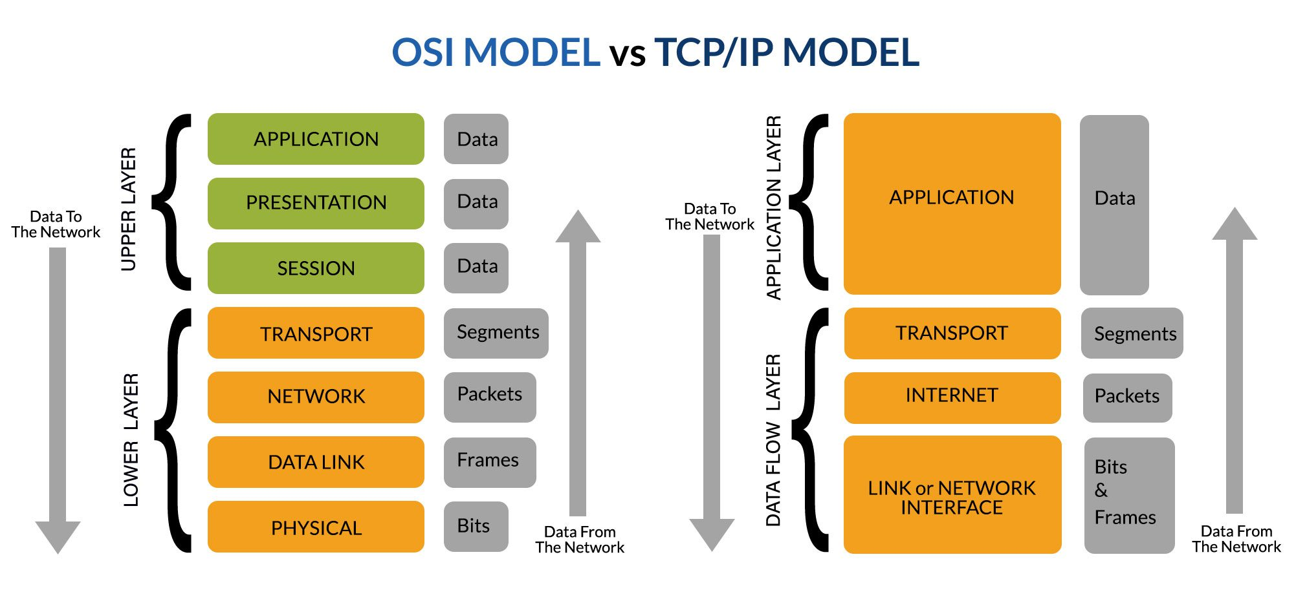
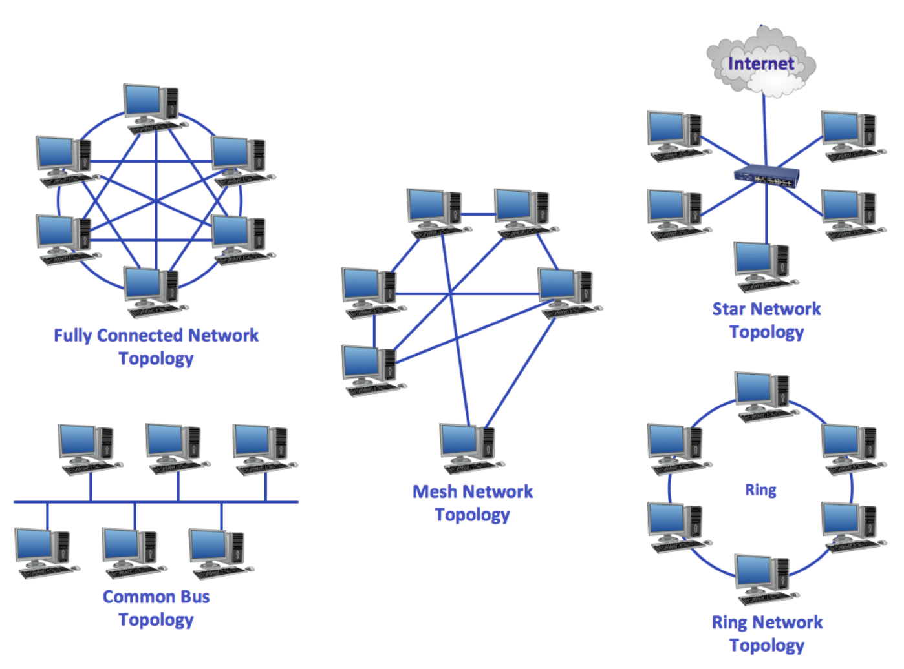
Data Communication
Bits, numbers, ASCII
Communication mediums
Bitrate, delay, packet loss
Protocols, TCP/IP vs OSI
Internet components & topologies
Notes:
Explain how data is represented, transmitted, and structured. Focus on why protocols and layering are essential for scalability and reliability.

Slide 3
Application Layer
Client-server architecture
IP addresses & ports
HTTP (persistent vs non-persistent)
Cookies & web caching
DNS hierarchy & caching
Notes:
Describe how applications use the network. Emphasize HTTP behavior and DNS scalability problems and solutions.

Slide 4
Transport Layer
UDP vs TCP
Multiplexing/demultiplexing
Reliable data transfer
Flow vs congestion control
TCP congestion phases
Notes:
Compare UDP and TCP. Be ready to explain TCP handshaking, ACKs, RTT, and congestion control phases.

Slide 5
Network Layer
Data plane vs control plane
IP addressing, subnetting, CIDR
DHCP & NAT
Routing algorithms
BGP & Autonomous Systems
Notes:
Explain how packets are routed across networks. Know differences between link-state and distance-vector routing.

Slide 6
Link Layer
Framing & error detection
MAC vs IP addresses
Ethernet switching
ARP
Notes:
Focus on how nodes on the same link communicate. Explain ARP resolution and Ethernet multiple access evolution.

Slide 7
Wireless, Security & Industrial
Wi-Fi challenges & hidden terminal
Collision avoidance
Cryptography & key exchange
Industrial networking & real-time
Notes:
Explain wireless challenges and security basics. Industrial networking emphasizes determinism and low latency.

