Slide 1
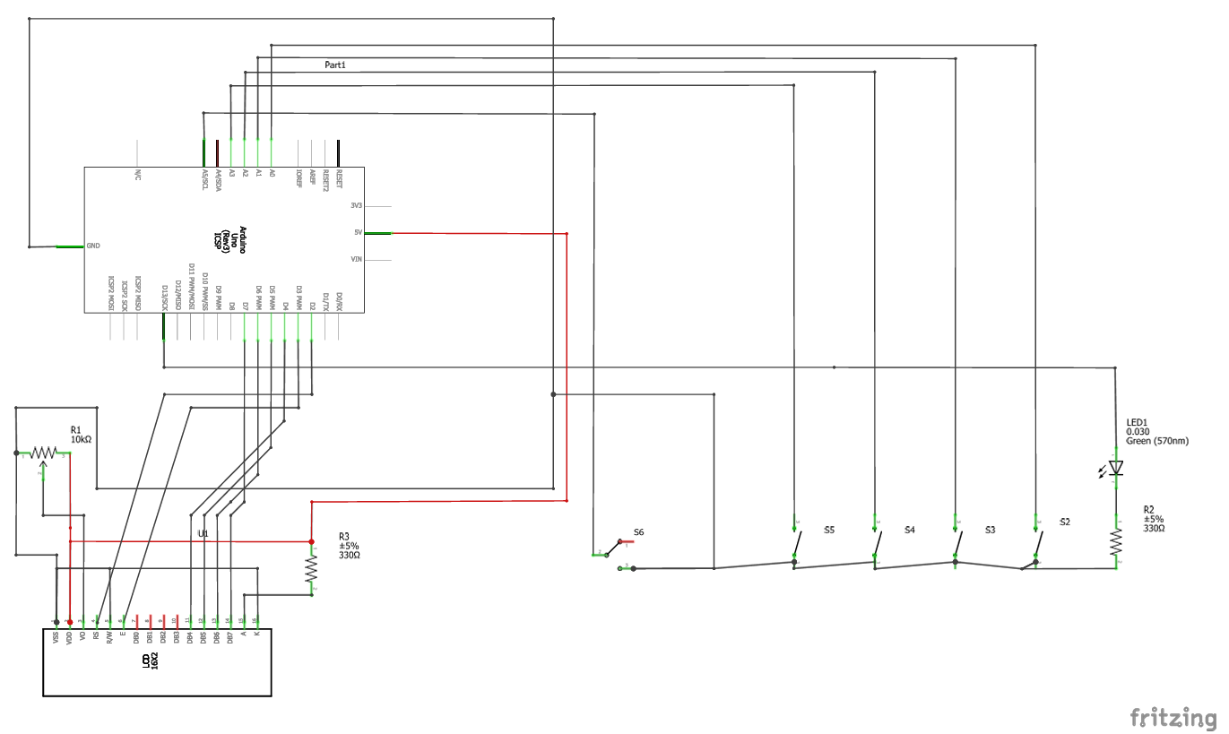
Hardware layout for modular Arduino lab instrument, Greytak lab
This example for stepper motor-based monochromator controller project: arduino-mono-svn
Digital pins 2-7: LCD output
Analog inputs A0-A5 (pins 15-19): Inputs
  A0-A3: pushbuttons
  A5: toggle switch (mode switch)
  A4: available (used for limit switch)
Pin 13: LED/TTL output
Pins 8-12: available (used for stepper motor control)
Pins 0-1: unused
Schematic view: Fritzing
Idea is:
power, input “bus”, and LED out goes to button panel
LCD panel is powered from button panel
Additional inputs can be connected to the input “bus” via peripheral connections to the button panel
The “mode” toggle switch is one such peripheral input
All digital inputs are active low, configured as INPUT_PULLUP (supposed to be 20k-50k internal pull-ups to 5V)

Slide 2
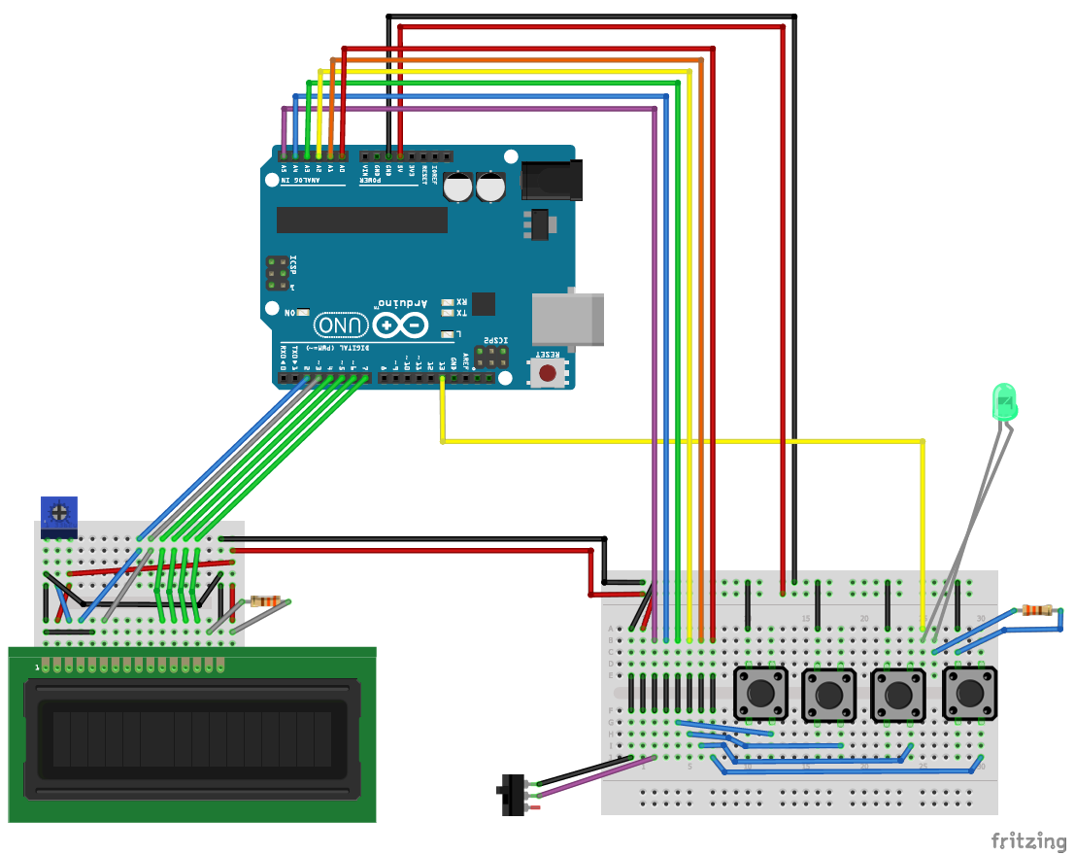
Hardware layout for modular Arduino lab instrument, Greytak lab
This example for stepper motor-based monochromator controller project: arduino-mono-svn
Digital pins 2-7: LCD output
Analog inputs A0-A5 (pins 15-19): Inputs
  A0-A3: pushbuttons
  A5: toggle switch (mode switch)
  A4: available (used for limit switch)
Pin 13: LED/TTL output
Pins 8-12: available (used for stepper motor control)
Pins 0-1: unused
Breadboard implementation: Fritzing
Idea is:
power, input “bus”, and LED out goes to button panel
LCD panel is powered from button panel
Additional inputs can be connected to the input “bus” via peripheral connections to the button panel
The “mode” toggle switch is one such peripheral input
All digital inputs are active low, configured as INPUT_PULLUP (supposed to be 20k-50k internal pull-ups to 5V)

Slide 3
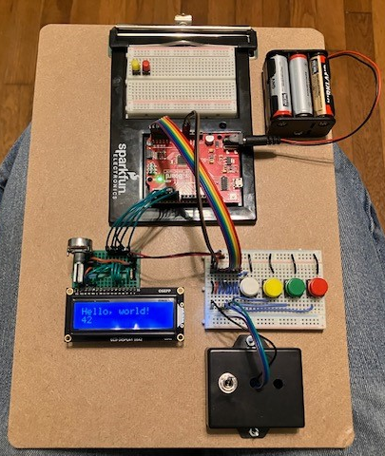
Hardware layout for modular Arduino lab instrument, Greytak lab
This example for stepper motor-based monochromator controller project: arduino-mono-svn
Digital pins 2-7: LCD output
Analog inputs A0-A5 (pins 15-19): Inputs
  A0-A3: pushbuttons
  A5: toggle switch (mode switch)
  A4: available (used for limit switch)
Pin 13: LED/TTL output
Pins 8-12: available (used for stepper motor control)
Pins 0-1: unused
Breadboard implementation: photo
Idea is:
power, input “bus”, and LED out goes to button panel
LCD panel is powered from button panel
Additional inputs can be connected to the input “bus” via peripheral connections to the button panel
The “mode” toggle switch is one such peripheral input
All digital inputs are active low, configured as INPUT_PULLUP (supposed to be 20k-50k internal pull-ups to 5V)

Slide 4
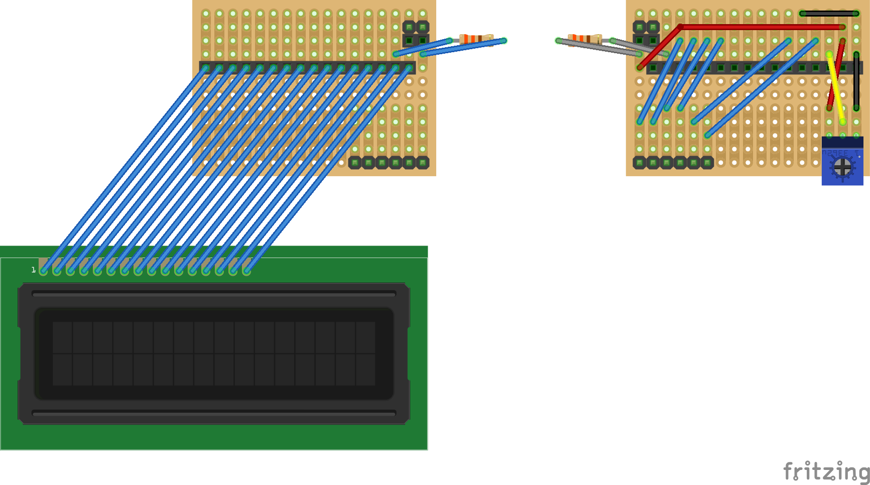
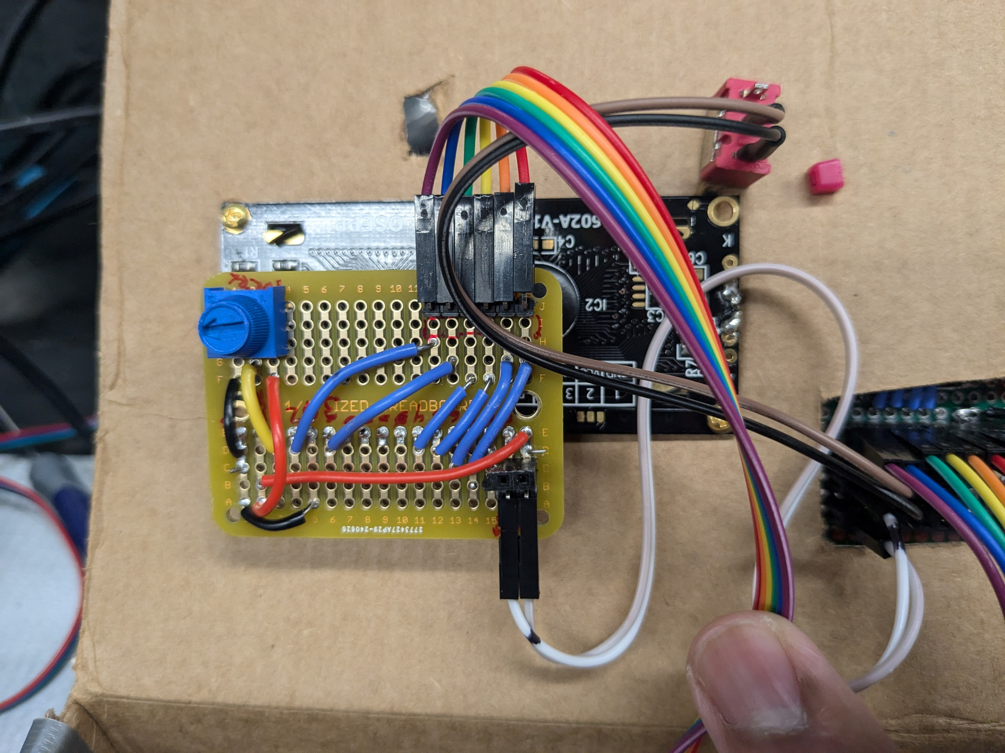
Hardware layout for modular Arduino lab instrument, Greytak lab
This example for stepper motor-based monochromator controller project: arduino-mono-svn
Soldered implementation of LCD panel:
(rendered in Fritzing, but it doesn’t understand two-sided perf boards, so we manually include views from front and back: some components are shown on both sides to illustrate where they are located. Fritzing also does not render right-angle headers. The LCD panel has right-angle male headers for signal connection, so it can be plugged directely into the Arduino if desired, and both RA male and standing female headers for power)
Digital pins 2-7: LCD output
Analog inputs A0-A5 (pins 15-19): Inputs
  A0-A3: pushbuttons
  A5: toggle switch (mode switch)
  A4: available (used for limit switch)
Pin 13: LED/TTL output
Pins 8-12: available (used for stepper motor control)
Pins 0-1: unused
Front
Back
Idea is:
power, input “bus”, and LED out goes to button panel
LCD panel is powered from button panel
Additional inputs can be connected to the input “bus” via peripheral connections to the button panel
The “mode” toggle switch is one such peripheral input
All digital inputs are active low, configured as INPUT_PULLUP (supposed to be 20k-50k internal pull-ups to 5V)

Slide 5
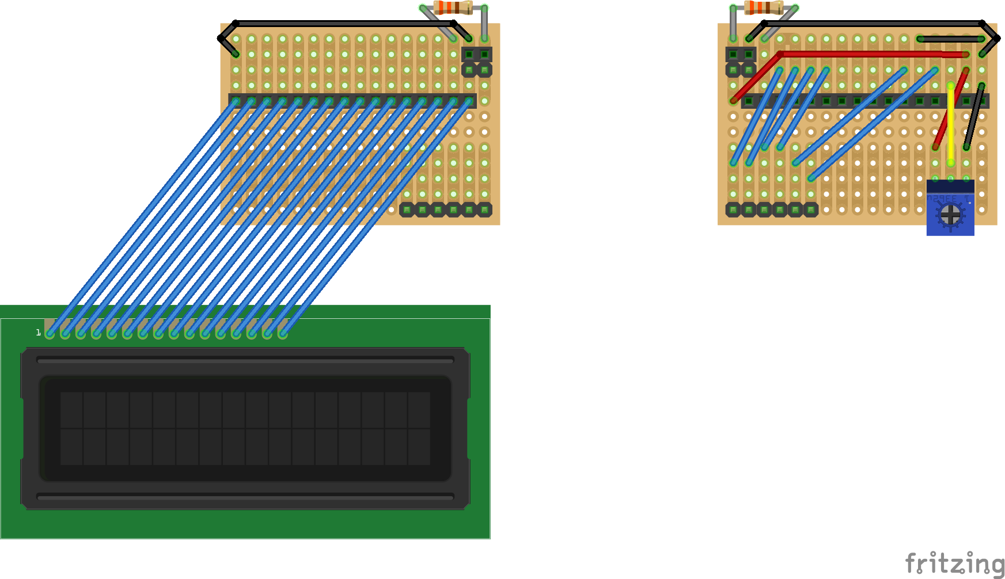
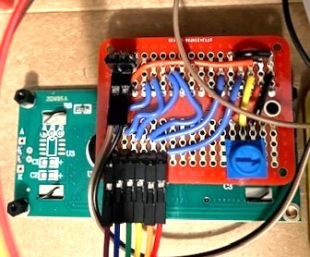
Hardware layout for modular Arduino lab instrument, Greytak lab
This example for stepper motor-based monochromator controller project: arduino-mono-svn
Soldered implementation of LCD panel:
(rendered in Fritzing, but it doesn’t understand two-sided perf boards, so we manually include views from front and back: some components are shown on both sides to illustrate where they are located. Fritzing also does not render right-angle headers. The LCD panel has right-angle male headers for signal connection, so it can be plugged directely into the Arduino if desired, and both RA male and standing female headers for power) … slight improvement to move trim pot away from corner and have right-angle headers point in same direction to save space in project box
Digital pins 2-7: LCD output
Analog inputs A0-A5 (pins 15-19): Inputs
  A0-A3: pushbuttons
  A5: toggle switch (mode switch)
  A4: available (used for limit switch)
Pin 13: LED/TTL output
Pins 8-12: available (used for stepper motor control)
Pins 0-1: unused
Idea is:
power, input “bus”, and LED out goes to button panel
LCD panel is powered from button panel
Additional inputs can be connected to the input “bus” via peripheral connections to the button panel
The “mode” toggle switch is one such peripheral input
All digital inputs are active low, configured as INPUT_PULLUP (supposed to be 20k-50k internal pull-ups to 5V)
Front
Back

Slide 6
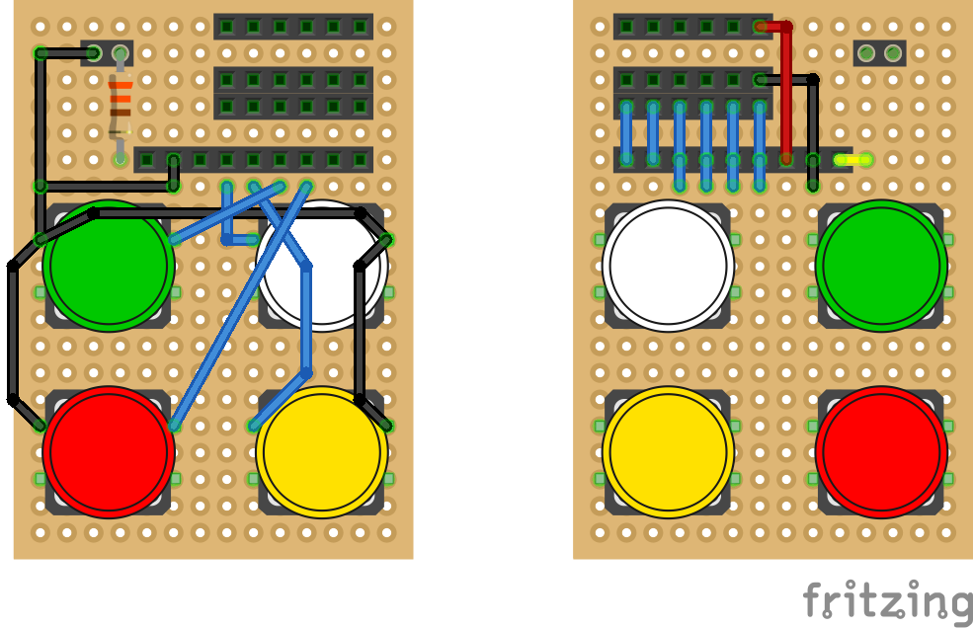
Hardware layout for modular Arduino lab instrument, Greytak lab
This example for stepper motor-based monochromator controller project: arduino-mono-svn
Soldered implementation of button panel (compact):
This arrangement was fairly difficult to solder and does not include an output header for the LED, which would be desirable if we want to be able to use that for external monitoring without splitting the wire from the Arduino to the button panel
Digital pins 2-7: LCD output
Analog inputs A0-A5 (pins 15-19): Inputs
  A0-A3: pushbuttons
  A5: toggle switch (mode switch)
  A4: available (used for limit switch)
Pin 13: LED/TTL output
Pins 8-12: available (used for stepper motor control)
Pins 0-1: unused
Back (with headers)
Front (with buttons and LED)
-
Idea is:
power, input “bus”, and LED out goes to button panel
LCD panel is powered from button panel
Additional inputs can be connected to the input “bus” via peripheral connections to the button panel
The “mode” toggle switch is one such peripheral input
All digital inputs are active low, configured as INPUT_PULLUP (supposed to be 20k-50k internal pull-ups to 5V)
+
5V
GND
Perif.
LED G 5V A0 A1 A2 A3 A4 A5
Ard.
A5 A4 A3 A2 A1 A0 5V G LED

Slide 7
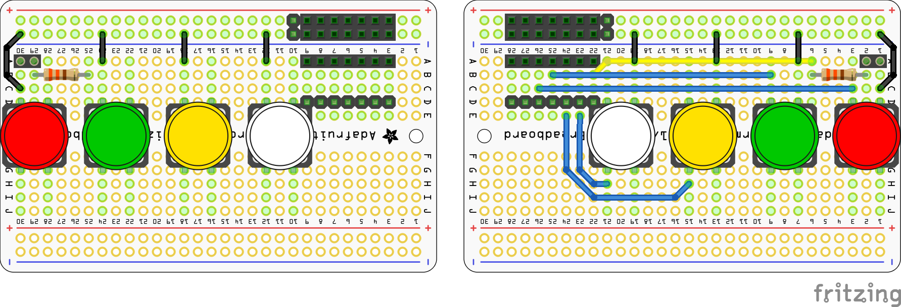
Hardware layout for modular Arduino lab instrument, Greytak lab
This example for stepper motor-based monochromator controller project: arduino-mono-svn
Soldered implementation of button panel (half-breadboard size):
Digital pins 2-7: LCD output
Analog inputs A0-A5 (pins 15-19): Inputs
  A0-A3: pushbuttons
  A5: toggle switch (mode switch)
  A4: available (used for limit switch)
Pin 13: LED/TTL output
Pins 8-12: available (used for stepper motor control)
Pins 0-1: unused
Back (with headers: male headers are right-angle)
Front (with buttons and LED)
Idea is:
power, input “bus”, and LED out goes to button panel
LCD panel is powered from button panel
Additional inputs can be connected to the input “bus” via peripheral connections to the button panel
The “mode” toggle switch is one such peripheral input
All digital inputs are active low, configured as INPUT_PULLUP (supposed to be 20k-50k internal pull-ups to 5V)
LED
-
+
5V
GND
Perif.
LED A0 A1 A2 A3 A4 A5
Ard.
A5 A4 A3 A2 A1 A0 LED

