Slide 1
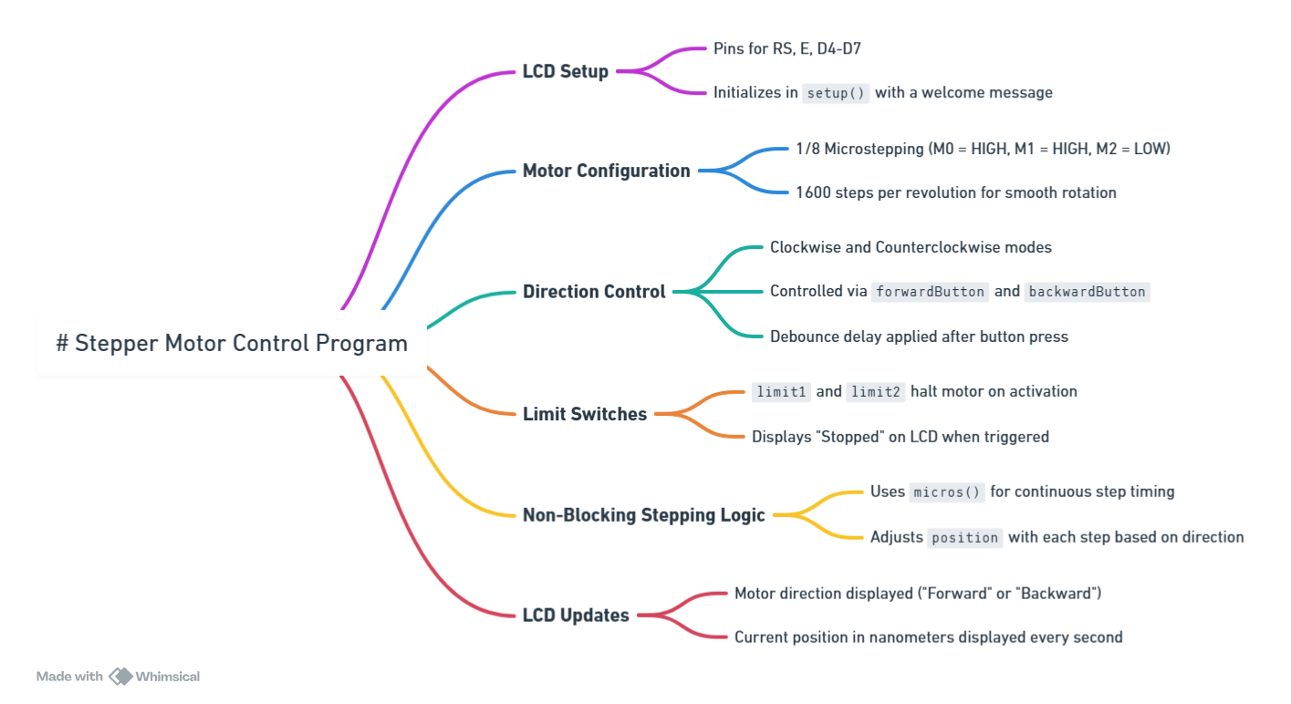
We should define directions in wavelength = LONGER or SHORTER and then use #define to specify which of these is clockwise or counterclockwise for motor rotation.
We can debounce by polling switches with a 100-200 ms “HOLDOFF” delay
All motor motions will be a loop in which only as many steps as can be done in HOLDOFF are carried out before checking switch input values.
We will mainly keep track of progress with position variable as integer number of nm. A subroutine will calculate the change in Steps necessary for every move of nm, and LCD will be updated each move loop iteration.

Slide 2
Power on; possible separate power switch for motor/driver output to enable it to be shut off / cooled without resetting Arduino
setup()
Setup pins, LCD
Set motor speed
Subroutines:
loop()
if initialize (home) flag is set (first run, or commanded):
Ask user if we should initialize; possibly other config options
If commanded, initialize: run backward until limit switch, then forward slow to disengage limit switch, then define position and run forward to starting position target; un-set initialize flag
positionSteps()
Returns the number of steps from home to reach a desired wavelength position in nm, based on lookup table or calibration function
if autoManual true, manual mode
position_target loop: user selects position target; startnext or autoManual to break out
check flags
if new position was selected, move until correct position
check flags
if automanual false, auto mode
Possible Subroutines:
1. auto run setup: Display and update settings
moveSteps()
Get start, end, speed, number of scans; break on automanual
Check flags
Move a number of steps forward or backward at the desired speed while polling limit1, limit2/stopreset
2. auto run: Main Loop
If not at starting position, Move backwards to start, including backlash corr. Check flags. Display ready.
Wait on start key, break on stopreset or autoManual
3. auto run: Scan loop
resetPress()
do while # scans is not completed:
Blink LED / TTL out
Move forwards to end
Check flags
Return to starting position, with backlash corr.
Display scan complete
A possible subroutine to start a counter when reset is pressed and check if it is held down a long time, prompting initialize flag to be set
Check flags

