Slide 1
Porting RIOT OS to the RioT-Board
by Lennart Dührsen and Leon George

Slide 2
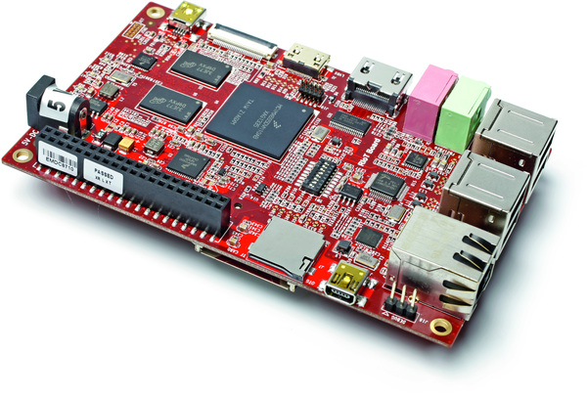
RioT-Board

Slide 3
RioT-Board
Introduced by Freescale Semiconductor in early 2014
Based on the i.MX6Solo Application Processor
Ships with Android installed, Linux (Ubuntu) also available
Costs ca. 70€
Low Energy Consumption (if you don't charge your phone using the USB-Ports :-) ), although quite powerful

Slide 4
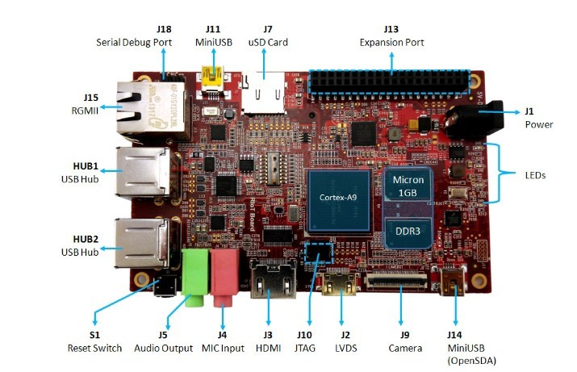
RioT-Board

Slide 5
RioT-Board
CPU:
i.MX6Solo
ARM Cortex-A9 (32Bit)
1GHz, Single Core
32 KByte L1 Instruction Cache
32 KByte L1 Data Cache
512 KB unified I/D L2 cache
Private Timer and Watchdog

Slide 6
RioT-Board
Memory:
Boot ROM 96KB
Internal RAM 144KB
DDR3 RAM 1GB

Slide 7
RioT-Board
Interfaces:
3 Pin Debug Port (UART)
JTAG
USB (4x Host, 1x OTG)
10MBit/100MBit/1GBit Ethernet
GPIO Expansion Port
I²C

Slide 8
RioT-Board
What to do with it?
Suitable for many tasks, including
  Personal Computer
  Multimedia-Station (XBMC)
  Small Server
  …
But what about IoT?

Slide 9
RIoT-Board
Adding some sort of wireless Transceiver/Receiver
(and sensors maybe), it could be
Part of a typical sensor network (you'd need an
AC-Adaptor or a really strong battery)
A Router (Home-Wifi, AODV, OLSR, RPL...)
Central instance of a sensor network that collects
all the data and processes it
...

Slide 10
RIOT-OS
...well you know about RIOT, obviously ;-)
But the question is: How to port it?

Slide 11
RIOT-OS
Operating Systems are (mostly) written in C
Most parts are hardware generic
But some have to be written exactly for the underlying metal!
e.g. the booting process, context switch, timer etc.

Slide 12
RIOT-OS
#include "irq.h"
#include <stdio.h>
#include "kernel_internal.h"
extern void board_init(void);
__attribute__((constructor)) static void startup(void)
{
/* use putchar so the linker links it in: */
putchar('\n');
board_init();
puts("RIOT MSP430 hardware initialization complete.\n");
kernel_init();
}

Slide 13
RIOT-OS
To get RIOT to run, the following has to work:
UART I/O for debugging and shell communication
Timer(s) so the kernel can run
Interrupts
Set up a stack
Build it successfully (probably the hardest part :-) )

Slide 14
Strategy
Read documentation
Read more documentation
Adjust folder structure and create Makefiles
Split work in an ad hoc way, as soon as
we know what we're doing

Slide 15
Strategy
Good luck to ourselfes, thank you for listening!

