Slide 1
I’m Julien.
A scientist and a new web developer

Slide 2
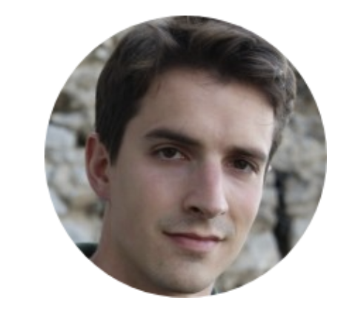
Hello.
I'm an signal processing engineer who decided to dig in web development

Slide 3


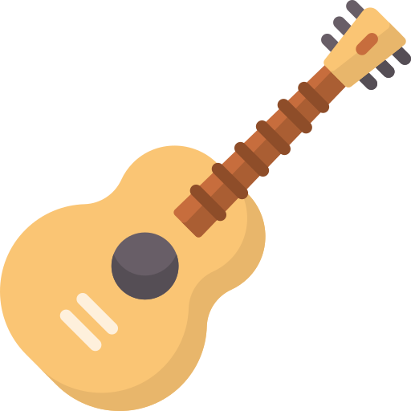
My skills
Digital signal Processing
I have a several years experience designing and implementing world class sonar signal processing chains.
Front End Developement
I got an increasing knowledge in the field of Front-End Web developement including popular libraries/frameworks such as Bootstrap and React.js
Guitar harmony Enthusiast
I'm passionated by learning the harmony rules of occidental music, especially blues, and applying them to push further my guitar practising skills

Slide 4
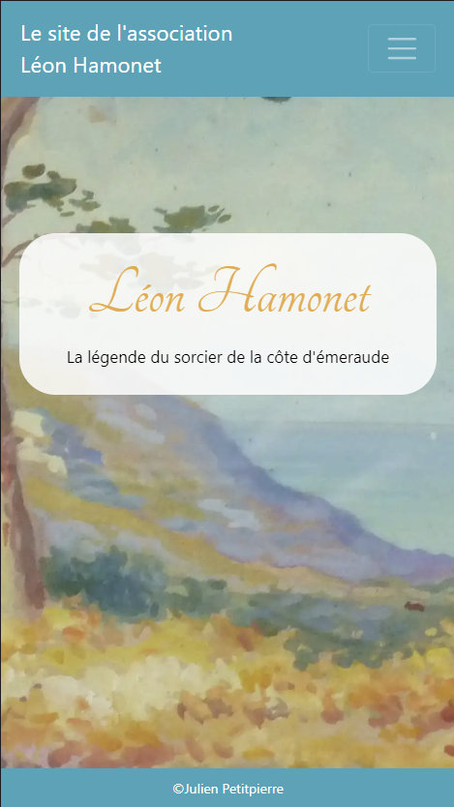
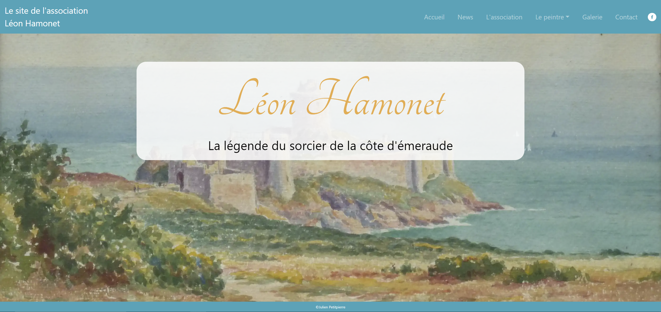
Portfolio
Real Websites

Slide 5
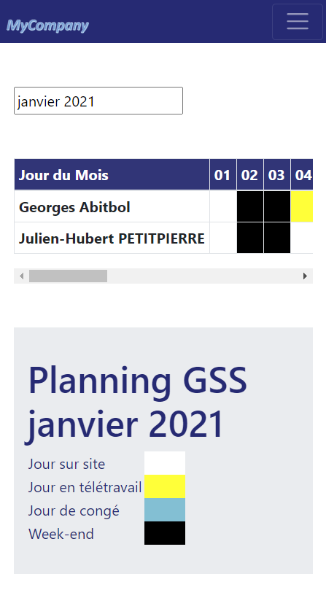
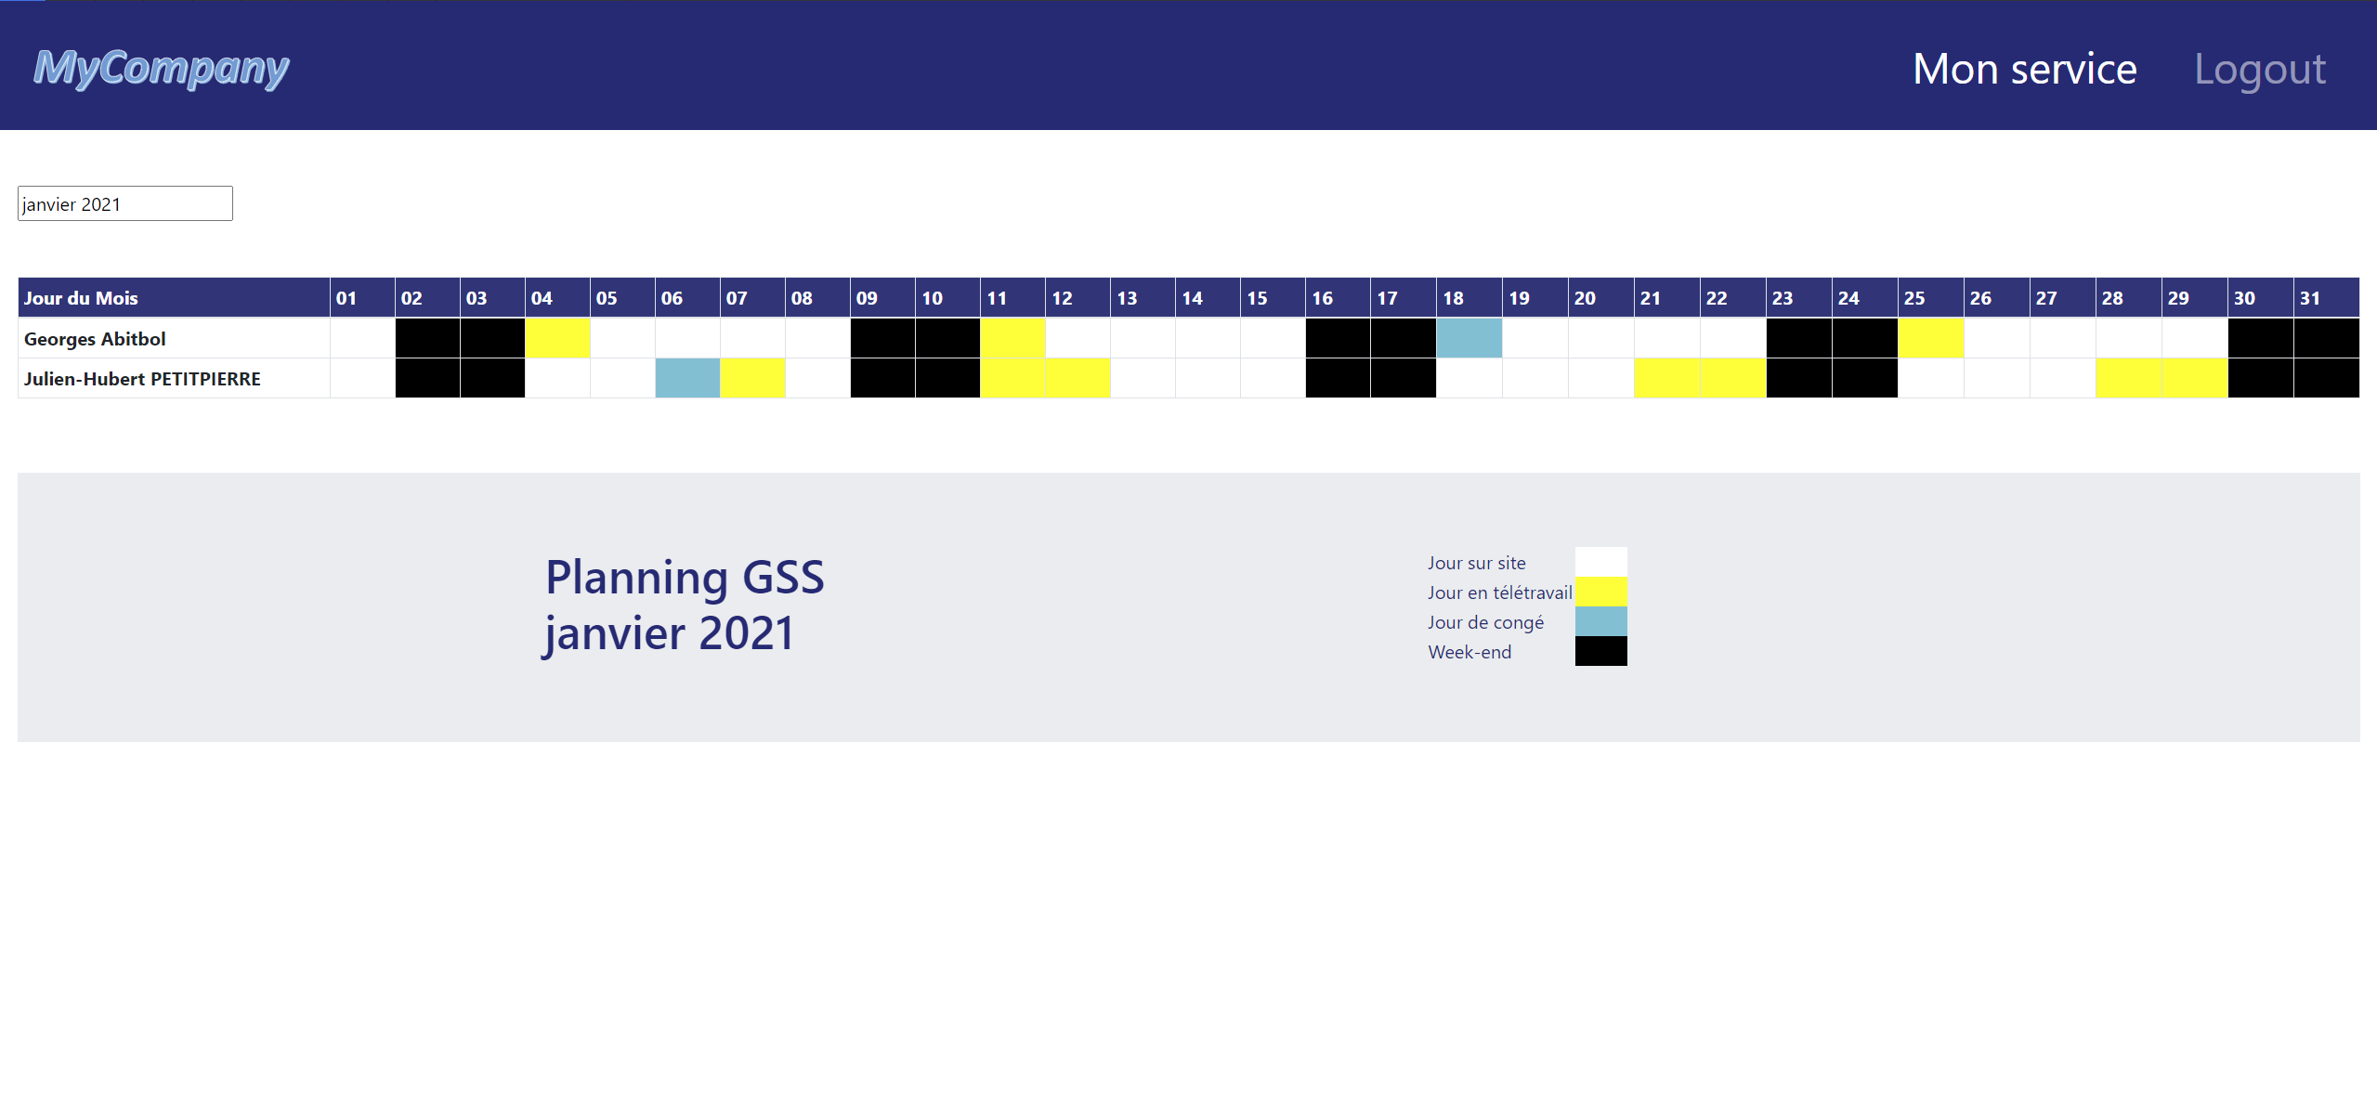
Portfolio
Real Websites

Slide 6
Get In Touch
You're a passionate like me ?
You like to code websites while playing a guitar serenade to your love ? Let's play together !
CONTACT ME

Slide 7
Portfolio
Graphic pages
Little Games

