Slide 1

1st NoB Hackathon
April 26-27
@Stanford University
@Maastrict University

Slide 2




Michel Dumontier
Natasha Haulman (superadmin)
Mark Musen
Andrew Su
Ben Good
Data FAIRport
Mark Wilkinson
Chris Evelo

Slide 3
European site @ Maastricht University
Chris Evelo (NoB)
Mark Wilkinson (FAIRport)

Slide 4
What is it?

Slide 5
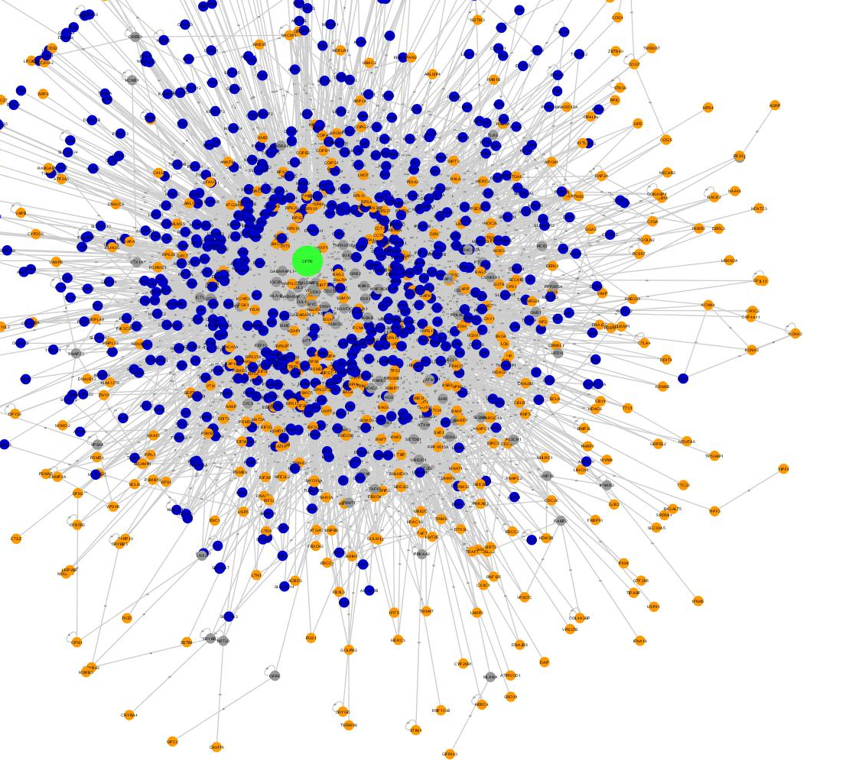
Pathways
Diseases
Proteins
Variants
Genes
Drugs
Goal: Assemble a network of biomedical entities that is comprehensive, current, and computable.

Slide 6
The biomedical literature is growing fast
In 2013, there were 1,108,920 new articles indexed in PubMed, bringing the current total to over 23 million.

Slide 7
The biomedical literature is growing fast
knowledge
In 2013, there were 1,108,920 new articles indexed in PubMed, bringing the current total to over 23 million.

Slide 8
The Kitchen Sink approach
Biocuration
Text-mining
Crowdsourcing
Citizen science
Semantic web
Bio-ontologies
Network biology
Biomedical domain experts
Scientific publishers
Bio-IT
…

Slide 9
1. Knowledgebase infrastructure
Scaling to billions or trillions of relationships
Efficient query and access
Generic and extensible data model
Interoperability with other resources

Slide 10
2. Populating the knowledgebase
Scalability with biomedical research
Synergies between methods
Assessing confidence
Preserving provenance

Slide 11
3. Driving Biological Projects
Defining the domain area
N-of-1 cancer
Drug repurposing
Neuroscience
Defining the specific data needed
Defining the mining/analysis strategy
Defining the testable hypotheses

Slide 12
Overarching goals
Demonstrate feasibility
Demonstrate collaboration
Demonstrate synergy
Secure funding for multi-center multi-PI consortium

Slide 13
Schedule
Saturday April 26
8:30AM: Registration and Breakfast
9:00AM: Introductions, Problem Statement, Ideas session
10:15AM: Project Pitches and Team Formation
11:00AM: Tutorials
12:15PM: Lunch is served
6:00PM: Progress Reports
7:00PM: Transportation leaves for restaurant
7:15-8:00PM: Cocktails @ Left Bank
8:00PM: Dinner @ Left bank
Sunday April 27
8:00AM : Breakfast is served
12:15PM: Lunch is served
4:30PM : Pitches and Demos
6:00PM : Winners announced, prizes awarded, final remarks.

Slide 14
Prizes
$500 for best motivating use case
$500 for most sustainable infrastructure design
2x$500 for best applications

Slide 15
Format
Form groups of at most 5
Must contain at least 2 local participants
Up to 3 additional remote participants (total of 8)
All code must be open and available
GitHub repo https://github.com/Network-of-BioThings/

Slide 16
Judges
Mark Musen (NCBO)
Bob Stanley (IO Informatics)
Paul Alexander (NCBO)
Manuel Salvadores (NCBO)
Michel Dumontier (NCBO)
Andrew Su (Scripps – Use Cases)
Criteria
Innovation
Integration
Sustainability / Scalability
Impact Potential

Slide 17
Other Stuff
Wifi
Bathrooms
Room configuration
projectors

Slide 18
Let’s Get Started!
GitHub
https://github.com/Network-of-BioThings/
Hackathon repo
Use Cases
Resources
Participant Profiles

