Slide 1
THE SITELINE OS WORKITEM DESIGNER
A brief introduction - beta
James K Smith
CTO, Grid-Sky Inc

Slide 2
About siteline os
SitelineOS is an application service that provides two general functions:
A workflow engine that provides visual design, operation, and analysis for workflows.
A visual workitem designer that allows the user to create custom workitems that can be flowed through the workflow engine.
SitelineOS provides additional functions that support the operation of the workflow engine:
Team, team process, and role management to support flow of workitems through designed workflows.
Document management.
Kanban board designer for boards that can be used in the workflow engine.
2023
A SYSTEM OF DEPENDENCY MANAGEMENT
2

Slide 3
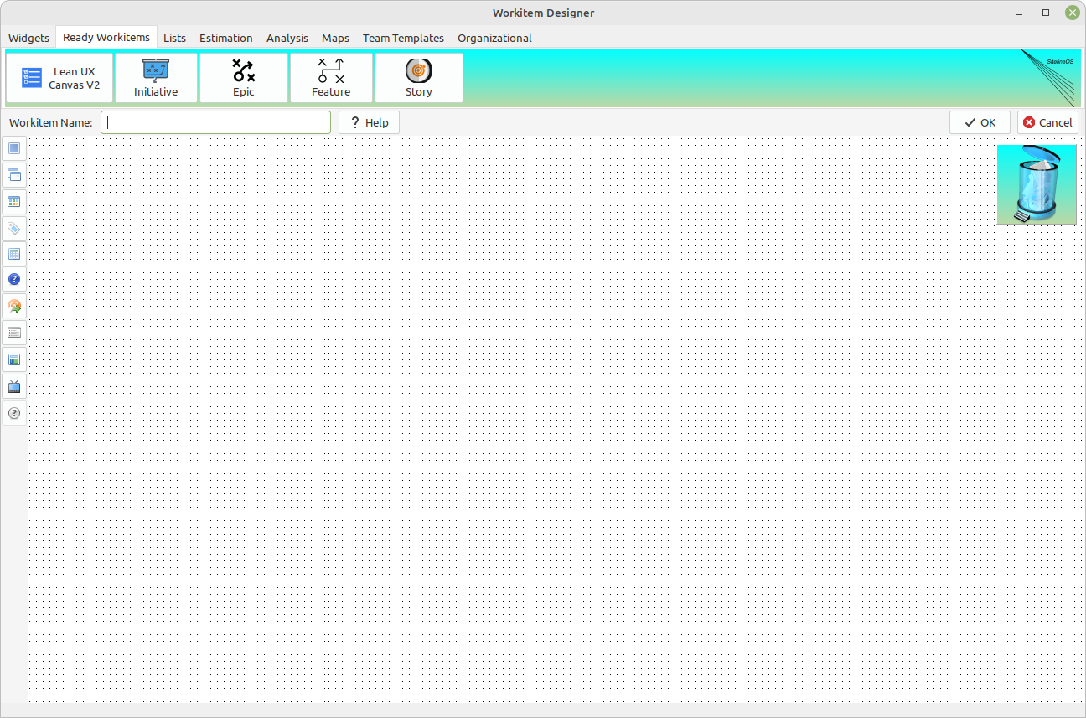
The SitelineOS Workitem Designer Canvas
The Workitem Designer canvas provides functionality for building custom workitems using “widgets” that provide anything from very specific functionality to complete, commonly used workitems ready for use.
The Workitem Designer is flexible enough to build useful workitems across multiple domains, ranging from typical backlog applications, to financial templates.
In effect, anything that can be run through your corporate workflows can be designed in the Workitem Designer.
2023
A SYSTEM OF DEPENDENCY MANAGEMENT
3

Slide 4
Canvas Functionality Layout
The canvas helps you design a single workitem.
The workitem can be saved to the Workitem Manager, which provides functionality for adding, editing, or deleting workitems, along with selecting workitems to be used in a workflow.
Widget bar
1) Clear canvas of all widgets
2) Cascade widgets
3) Tile widgets
4) AI template builder
5) Kanban board designer
6) Help manager
7) Payload message (diagnostic)
8) Tab order manager
9) Toggle design/display mode
10)Toggle dark background theme
11)Help for currently highlighted widget
Unique workitem name, describe your own help for workitem, save or cancel
Drag widgets to trash to remove them from the design canvas.
2023
A SYSTEM OF DEPENDENCY MANAGEMENT
4

Slide 5
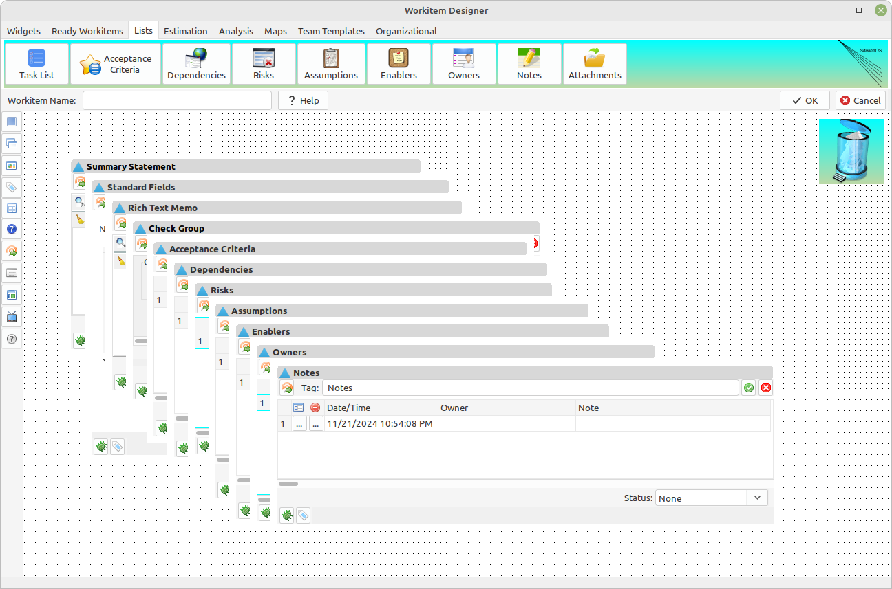
Cascaded widgets
A typical workitem will be comprised of multiple widgets. Treat the widgets and their position management like windows in a multiple document interface. So advanced window management is a required feature.
Click this button to cascade widgets on the canvas.
2023
A SYSTEM OF DEPENDENCY MANAGEMENT
5

Slide 6
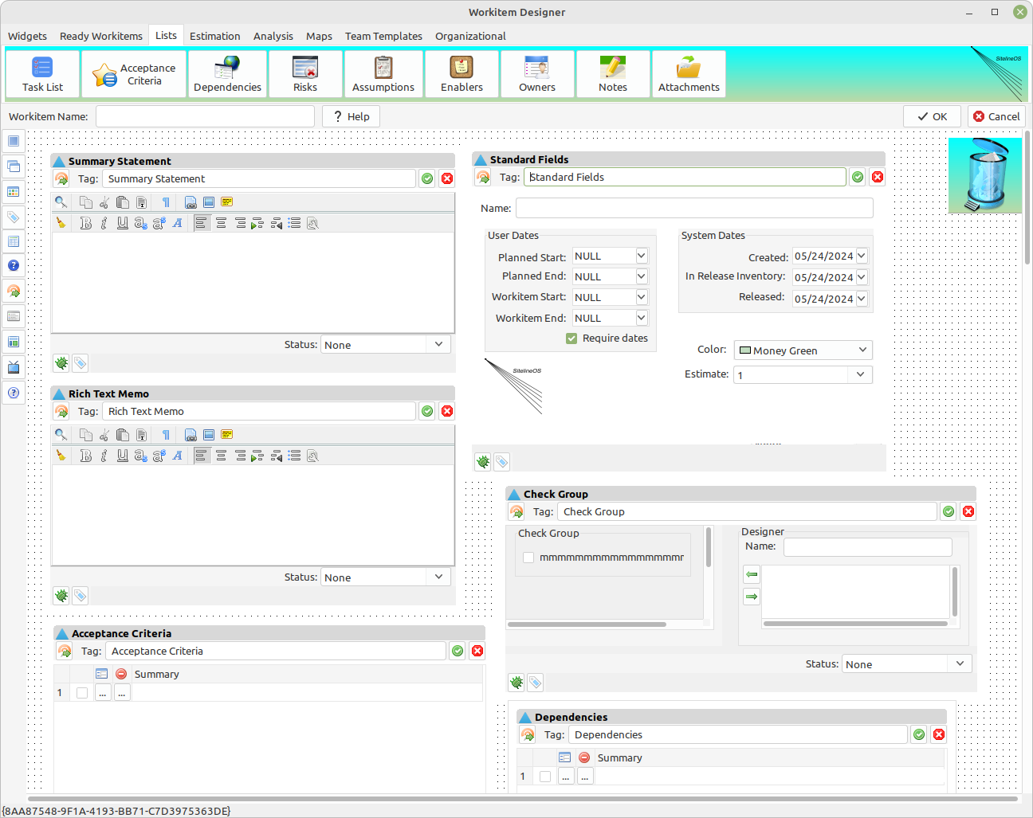
tiled widgets
Click this button to tile widgets on the canvas.
2023
A SYSTEM OF DEPENDENCY MANAGEMENT
6

Slide 7
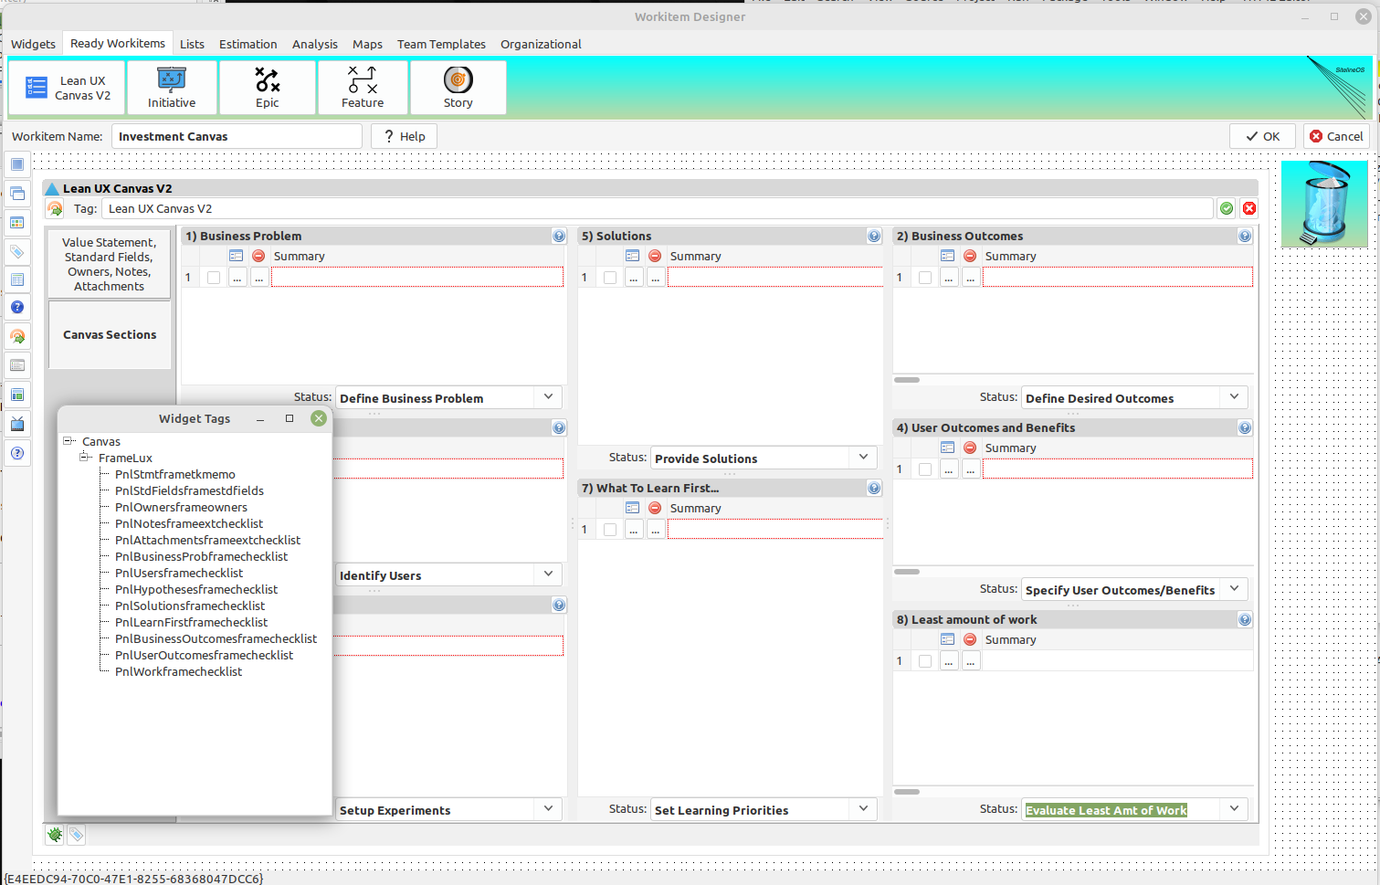
Create your own ai template For each workitem
Note tag title edit control for each widget. This not only allows you to provide each widget a custom name, but also provide a tag to be used in an AI template. This ability provides fine grained, formatted responses from large prompts submitted to your favorite AI language model.
Click this button to open the tag manager for the AI template editor for this workitem. The AI template editor will be displayed in a later presentation.
These prompts can be submitted to the LLM of your choice using the api client built into SitelineOS (currently testing with ChatGPT). SitelineOS is ultimately intended to help you build your own proprietary organizational LLM.
2023
A SYSTEM OF DEPENDENCY MANAGEMENT
7

Slide 8
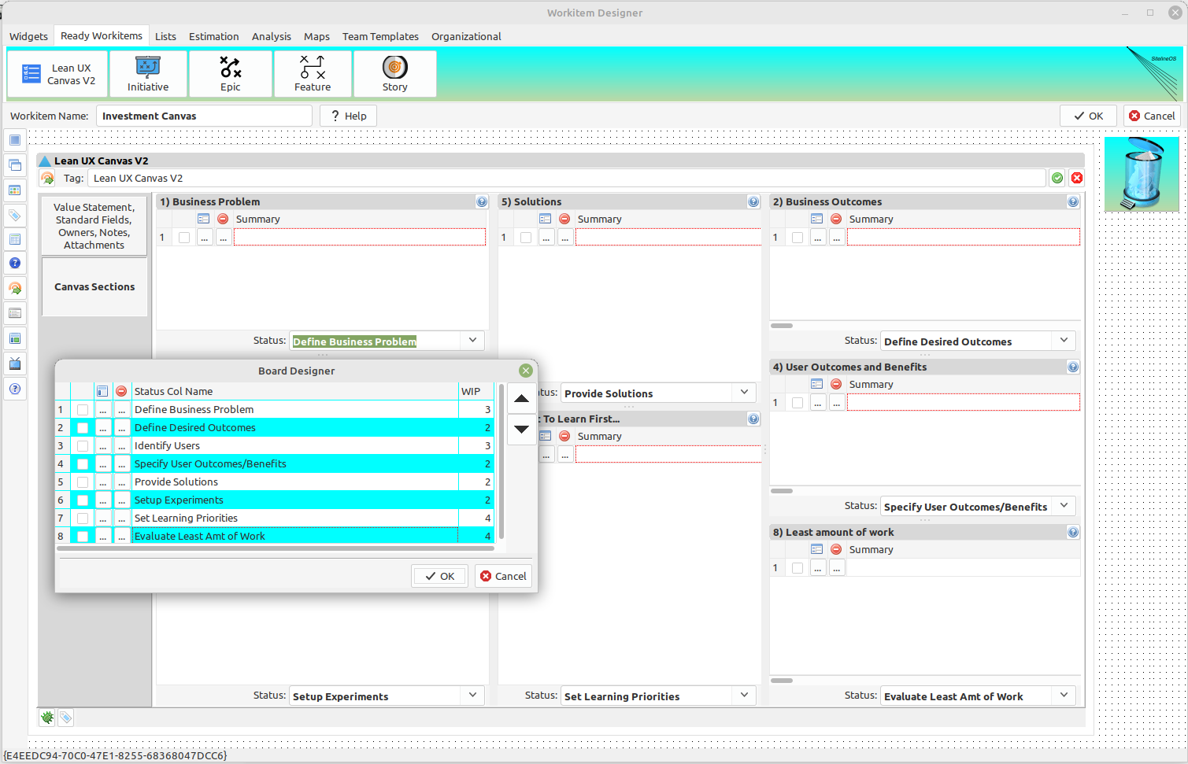
Break EACH Workitem into Kanban statuses (1)
Individual widgets create a single workitem as the user desires. There are also widgets intended to be ready made for immediate use with no designing required. In this case, we will use Jeff Gothelf’s (LI/gothelf) Lean UX Canvas v2, reproduced here in SitelineOS.
Each workitem also has a built-in kanban board status designer, accessible from this button on the designer toolbar. Once this workitem is included in a SitelineOS designed workflow, a kanban board will be automatically created given these statuses.
Each sub-widget conversation in this widget can be assigned a status that denotes when that conversation should be had in the board flow.
2023
A SYSTEM OF DEPENDENCY MANAGEMENT
8

Slide 9
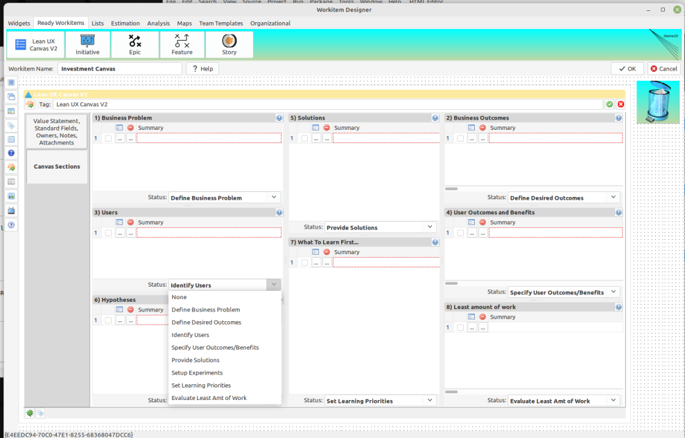
Break EACH Workitem into Kanban statuses (2)
Notice how the statuses from the kanban board designer in the previous slide are now available to each sub-widget. All statuses can be edited and re-assigned as needed.
2023
A SYSTEM OF DEPENDENCY MANAGEMENT
9

Slide 10
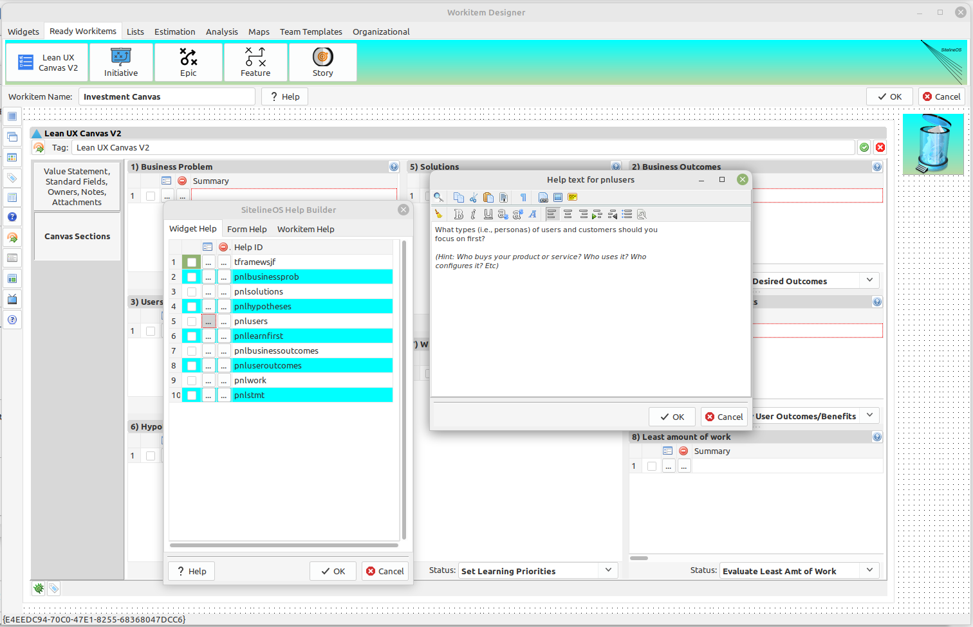
How the custom help system works (1)
If you can create your own work-items, then you need the ability to provide context specific help for these work-items. The SitelineOS Help System provides just that capability. Access the Help System by clicking this button.
Continuing with the Lean UX widget example, enter a help id in the list box, then click the detail button to open a rich text editor for that id.
Here, you can generally enter whatever content you like.
2023
A SYSTEM OF DEPENDENCY MANAGEMENT
10

Slide 11
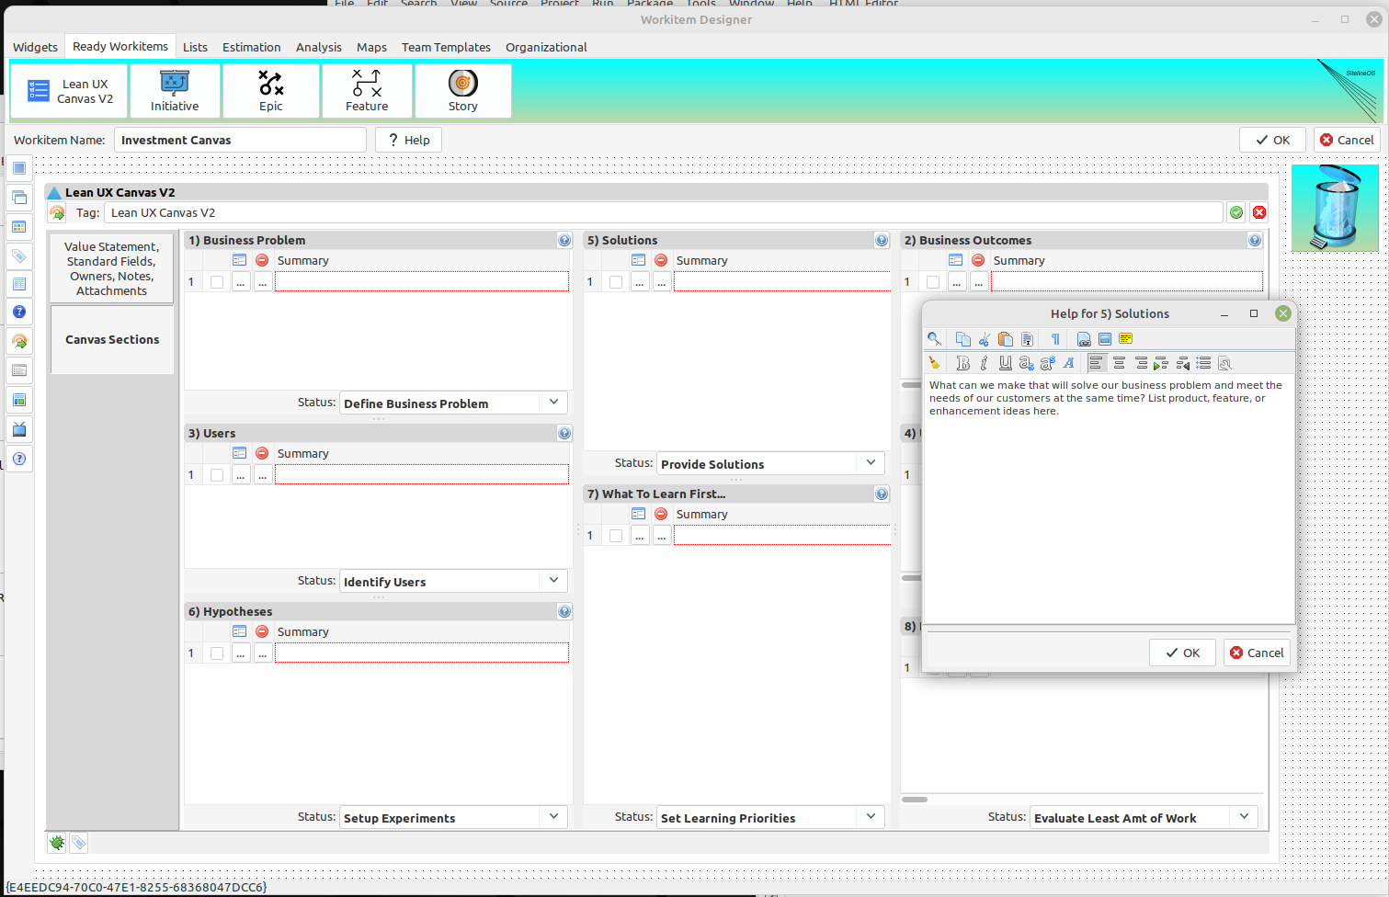
How the custom help system works (2)
For each sub-widget container in this widget, note help button.
In designer mode, you also have the option of editing your help context here without the need to open the Help Manager.
2023
A SYSTEM OF DEPENDENCY MANAGEMENT
11

Slide 12
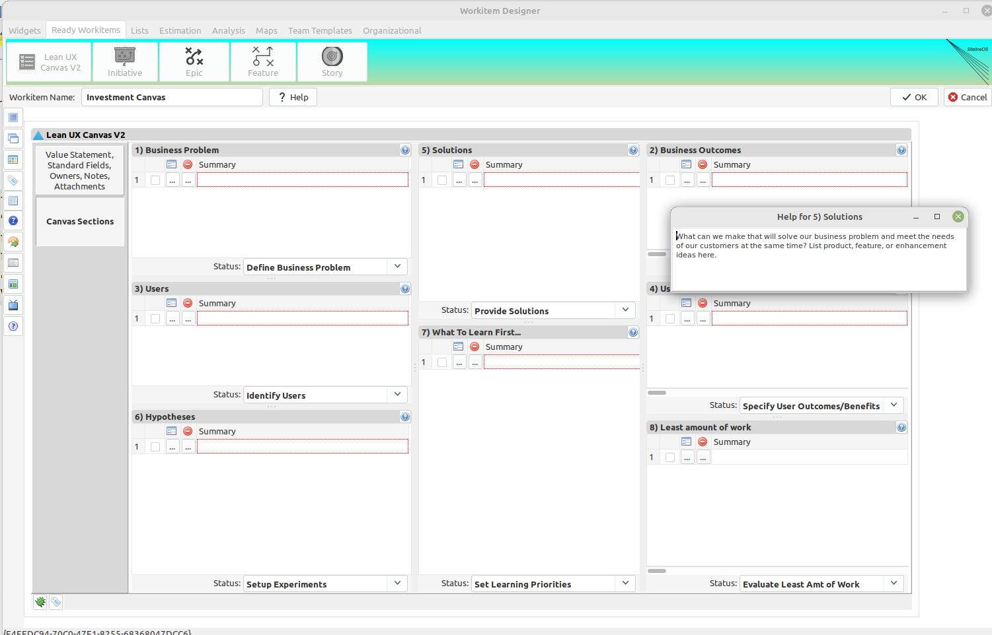
How the custom help system works (3)
This is a view of same work-item in “Active mode.” Active mode can be tested from the designer to show how the work-item will display while actively being used in a SitelineOS workflow.
Active mode is toggled with this button on the toolbar.
Once in Active mode, if any help button is clicked, the help dialog is opened, but in read-only mode without editor toolbar, and the help window will typically be smaller, but still resizeable.
2023
A SYSTEM OF DEPENDENCY MANAGEMENT
12

Slide 13
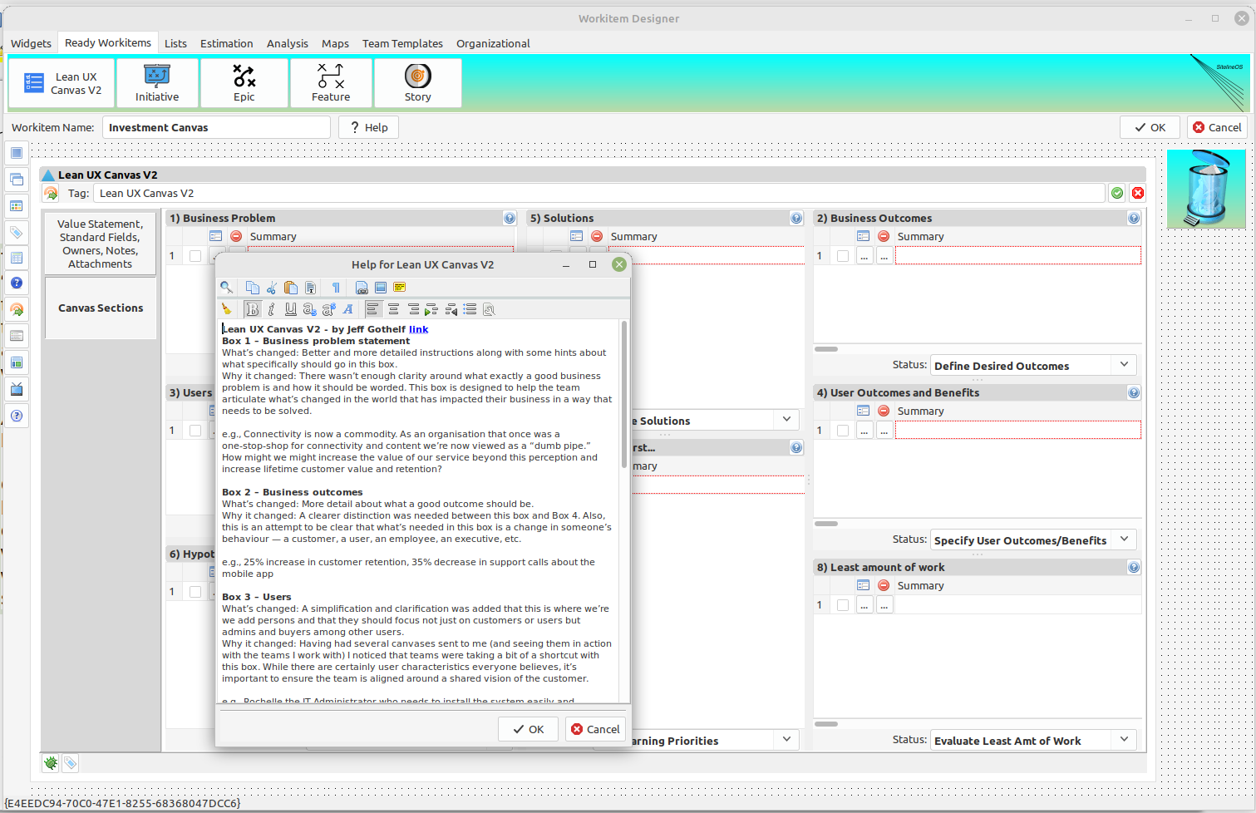
How the custom help system works (4)
You also have the ability to create help for the whole work-item. Click this button to access.
As with specific sub-widget help, overall work-item help is editable in Designer mode, but read-only in Active mode.
2023
A SYSTEM OF DEPENDENCY MANAGEMENT
13

Slide 14
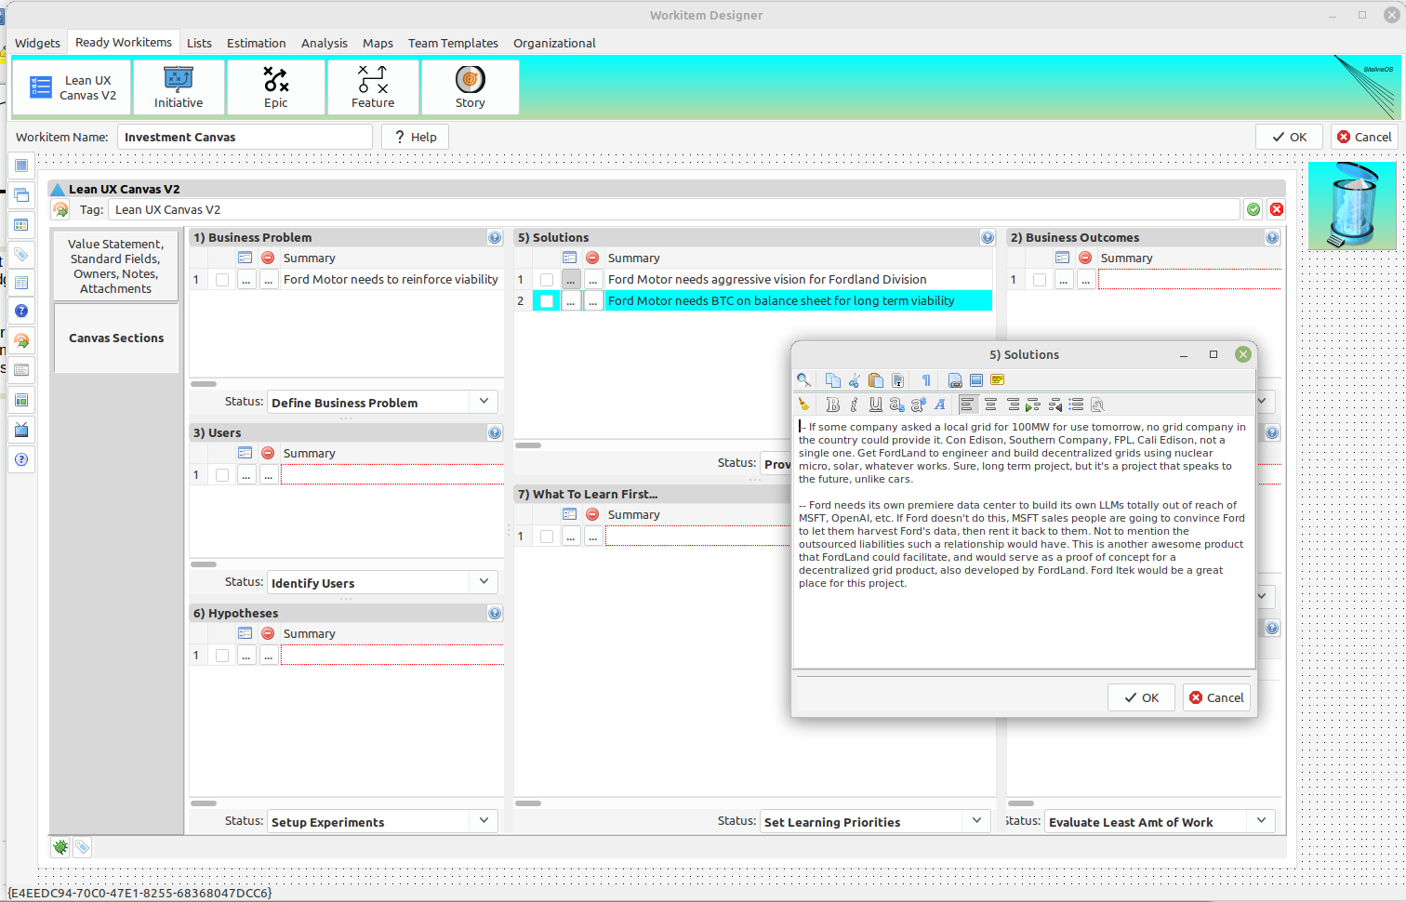
The widgets used in this template
The primary widget used to build Lean UX Canvas V2 is the Checklist widget, available on the “Widgets” toolbar.
It consists of one or more numbered rows that can be tagged, and have a summary entry. Think of these rows as conversation bullets with the ability to be drilled into for greater detail.
All information entered in the widgets for any workitem is collected into a payload that is sent to a multi-user compliant database engine, meaning, multiple users can edit the same workitem at the same time.
A future presentation will include an introduction to all the widgets in the SitelineOS Workitem Designer.
2023
A SYSTEM OF DEPENDENCY MANAGEMENT
14

Slide 15
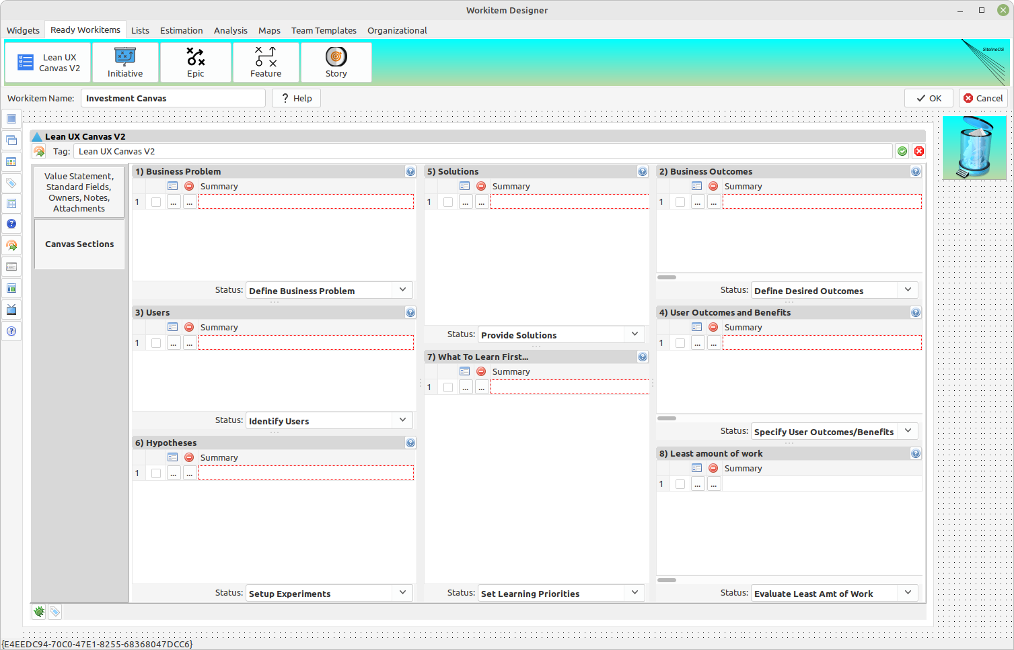
Closing comments and and current state of development
If you would like to be involved in this commercial effort, contact James Smith jksmith@grid-sky.com
Notice that we aren’t working with any actual data at this point. All sub-widgets are blank. That’s because the Workitem Designer in SitelineOS is a first-class citizen, unlike in many backlog tools, where template design comes second. Combined with the Visual Workflow Designer, this allows the user to design business systems from the ground up.
This ability provides for business system design that enables most any organization to fully realize any workflow or value stream with whatever content that can be flowed to deliver value to a market.
Beside the ability to design workitems from scratch with available widgets in the designer, future examples will include workitem packages that include financial worksheets, audit templates, legacy project management templates as examples of the flexibility of SitelineOS.
MVP for the Workitem Designer is 95%.
Visual kanban board designer is at 80%
Visual workflow designer is at 70%
SitelineOS is a rich, native first, workstation quality application. Current platform development state:
Linux – tested 100%
Windows – tested 100%
Mac – under development
Legacy browsers (Chrome, IE, etc – tested 80% (test sandbox spring 2025)
2023
A SYSTEM OF DEPENDENCY MANAGEMENT
15

