Slide 1
15 CPTS In-Processing Briefing
Travel Section
To attend this briefing, you must have a copy of your orders
Please use Blue or Black Ink Pen ONLY!

Slide 2
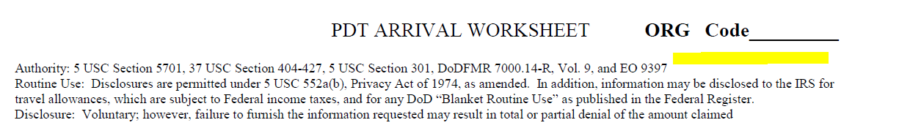
PDT Arrival Worksheet
Please place your travel order number
(located block 27 on your orders)
under the ORG Code

Slide 3
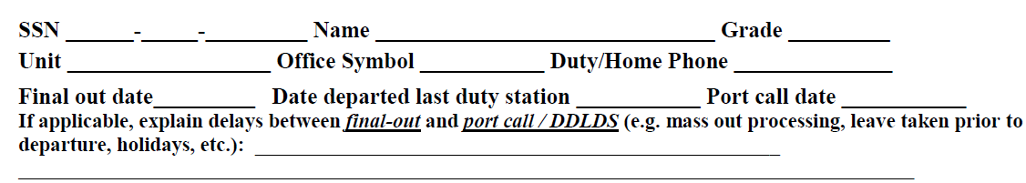
PDT Arrival Worksheet cont.
Final Out Date
The day you out-processed from MPF at your previous location
Date Departed Last Duty Station
The day you actually left your last duty station
Port Call date
Last day you were stateside
If your Final Out date and your date departed last duty station is more than 48 hours, write a brief explanation

Slide 4
PDT Arrival Worksheet cont.
Date arrived new station
The date you actually arrived to your new duty station
Date “Signed Into” station
If no leave was taken after arrival to duty location = Same date as Date arrived
If Permissive leave was taken (i.e. House Hunting) = Same date as Date arrived
If leave was taken after arriving to Tinker = Date you were available for duty
If the dates between the Date arrived new station and the Date “Signed into” station are different, check Yes at the
“Was leave taken upon arrival?” box.
If the dates are the same, check No

Slide 5
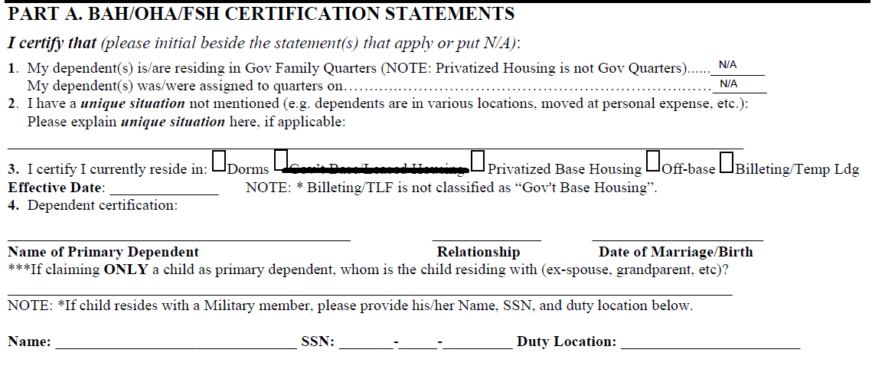
PDT Arrival Worksheet cont.

Slide 6
PDT Arrival Worksheet cont.

Slide 7
PDT Arrival Worksheet cont.

Slide 8
PDT Arrival Worksheet cont.

Slide 9
PDT Arrival Worksheet cont.

Slide 10
PDT Arrival Worksheet cont.

Slide 11
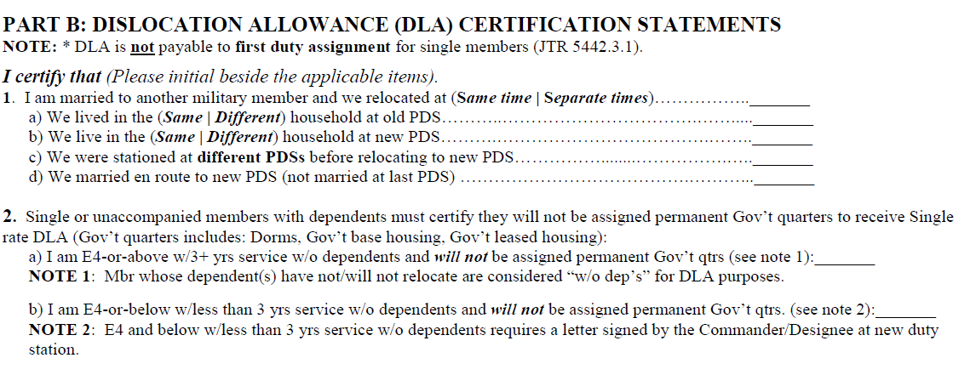
PDT Arrival Worksheet cont.

Slide 12
PDT Arrival Worksheet cont.
Single Airmen (E-4 w/3+yrs and above & Officers) not in the dorms

Slide 13
PDT Arrival Worksheet cont.
Single Airmen (E-4 w/less than 3yrs and below) not in the dorms

Slide 14
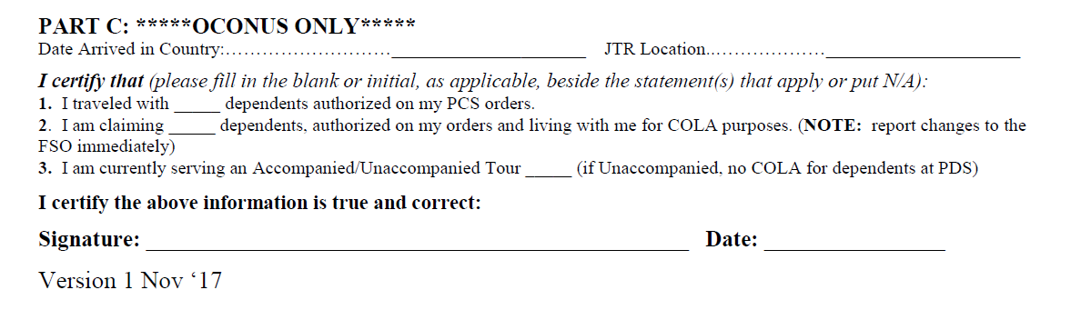
PDT Arrival Worksheet cont.

Slide 15
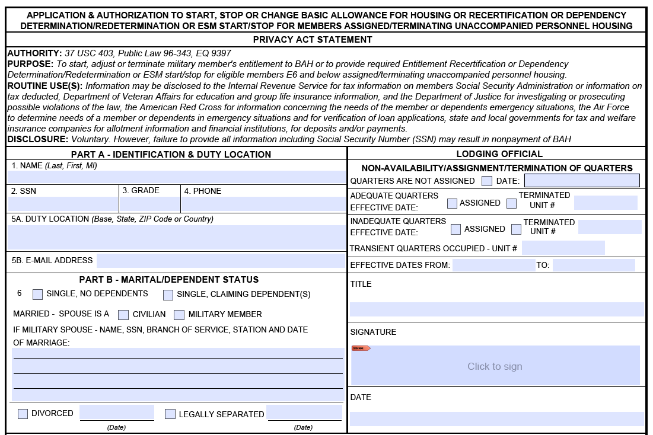

Slide 17
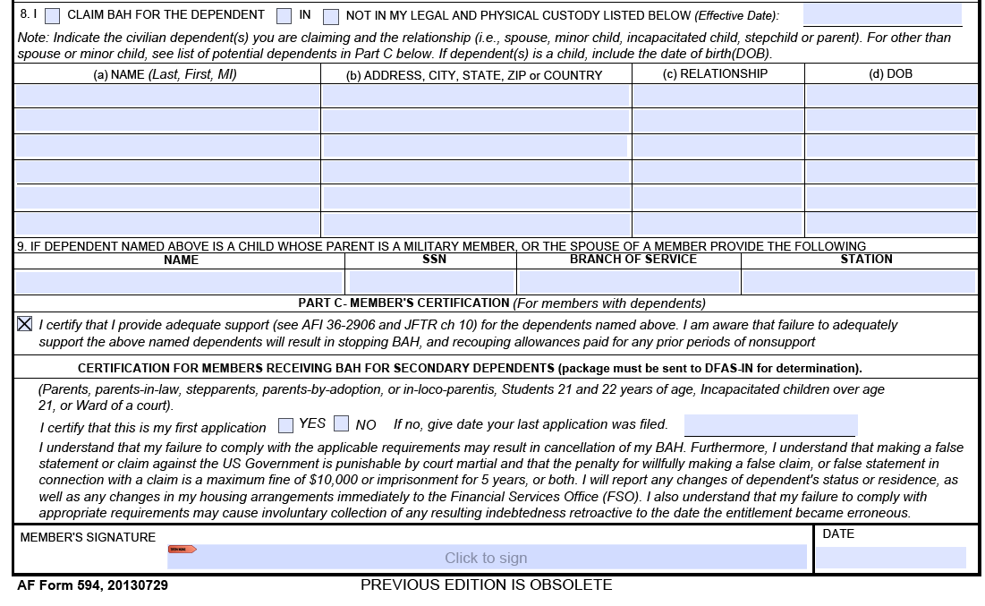

Slide 20
DD Form 1351-2: Travel Voucher
Split Disbursment
If you DO NOT have a Government Travel Card (GTC) or you have one and didn’t use it, put $0
If member used their GTC:
100%- Whole voucher pays towards your GTC
0%- Whole voucher pays to your direct deposit
Amount to be distributed to the GTC and remainder goes to your direct deposit

Slide 21
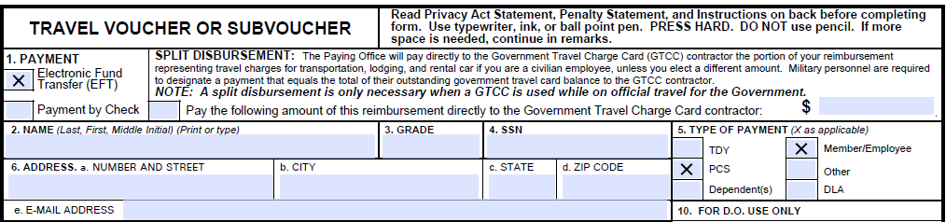
DD Form 1351-2: Travel Voucher

Slide 22
DD Form 1351-2: Travel Voucher

Slide 23
DD Form 1351-2: Travel Voucher
If member is single in the dorms, leave as is
If member is single and is off base, check DLA
If member has dependents that traveled with the member, check Dependent(s) and DLA
If member has a dependent(s) but the dependent(s) didn’t travel together with the member at the same time, leave as is and file separate travel voucher for the dependent(s) travel

Slide 24
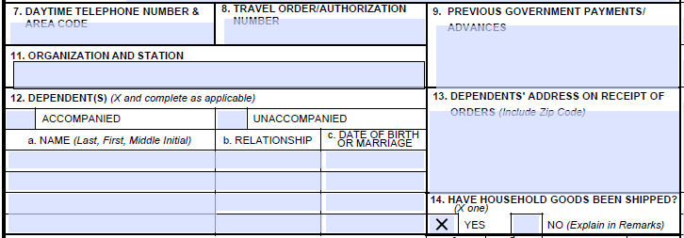
DD Form 1351-2: Travel Voucher
Block 8- Located on Block 27 on Travel Orders
Block 9- PPM/TMO Advance or DLA Advance that PAID in members Direct Deposit
Block 11- Member’s CURRENT organization and Station (Tinker AFB)

Slide 25
DD Form 1351-2: Travel Voucher
Block 12
If no dependent(s)= Mark Unaccompanied
Dependent(s) traveled together with member= Mark Accompanied and fill out info

Slide 26
DD Form 1351-2: Travel Voucher
Block 13- Located on block 17 on the member’s travel orders; member’s dependent(s)
address must be filled in block 13

Slide 27
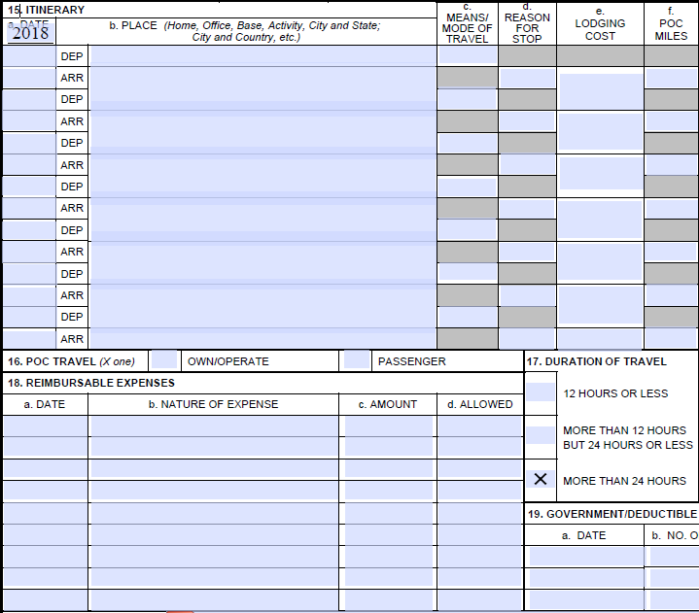
DD Form 1351-2: Travel Voucher
Block 15- Itinerary (BLANK)

Slide 28
DD Form 1351-2: Travel Voucher
Block 16- POC TRAVEL
If you have driven at any point during your PCS (incl. rental), check OWN/OPERATE
If you didn’t drive at all,
check PASSENGER

Slide 29
DD Form 1351-2: Travel Voucher
Block 18- Reimbursable Expenses
TLE –Needs receipt in order to claim
Airfare - Needs receipt to claim
Taxi’s –Needs receipt to claim if over $75
Toll’s- If you ran into tolls, annotate.
Night at Port –Needs receipt to claim
2 Pov’s- Must have dependent(s) in order to claim
SIGN AND DATE BLOCK 20a. AND 20b.

Slide 30
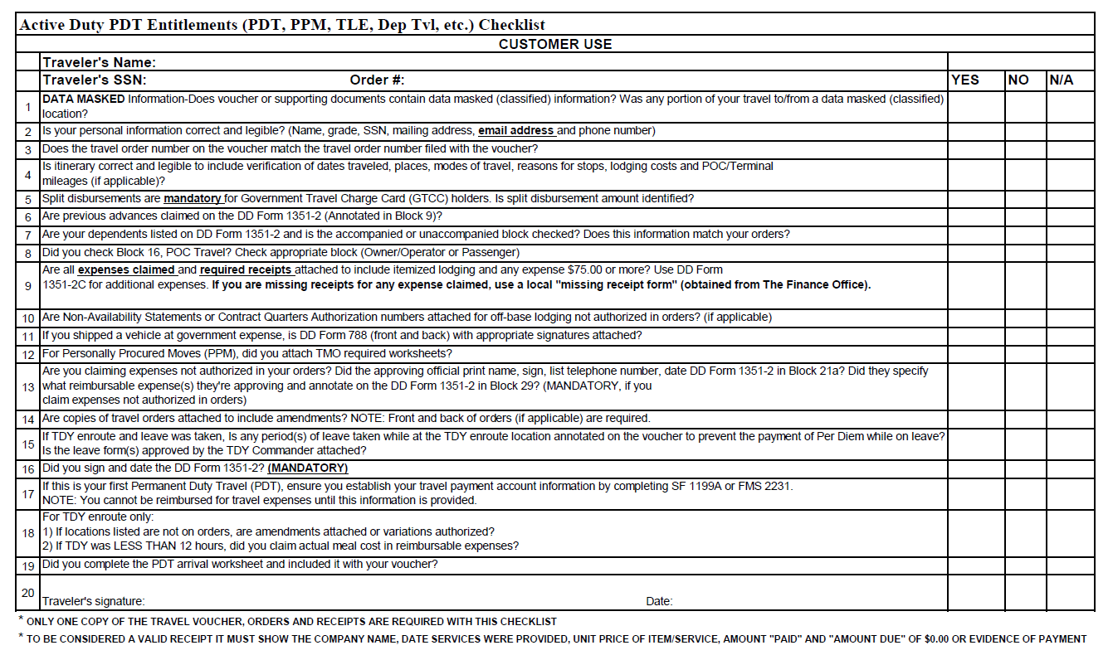

Slide 32
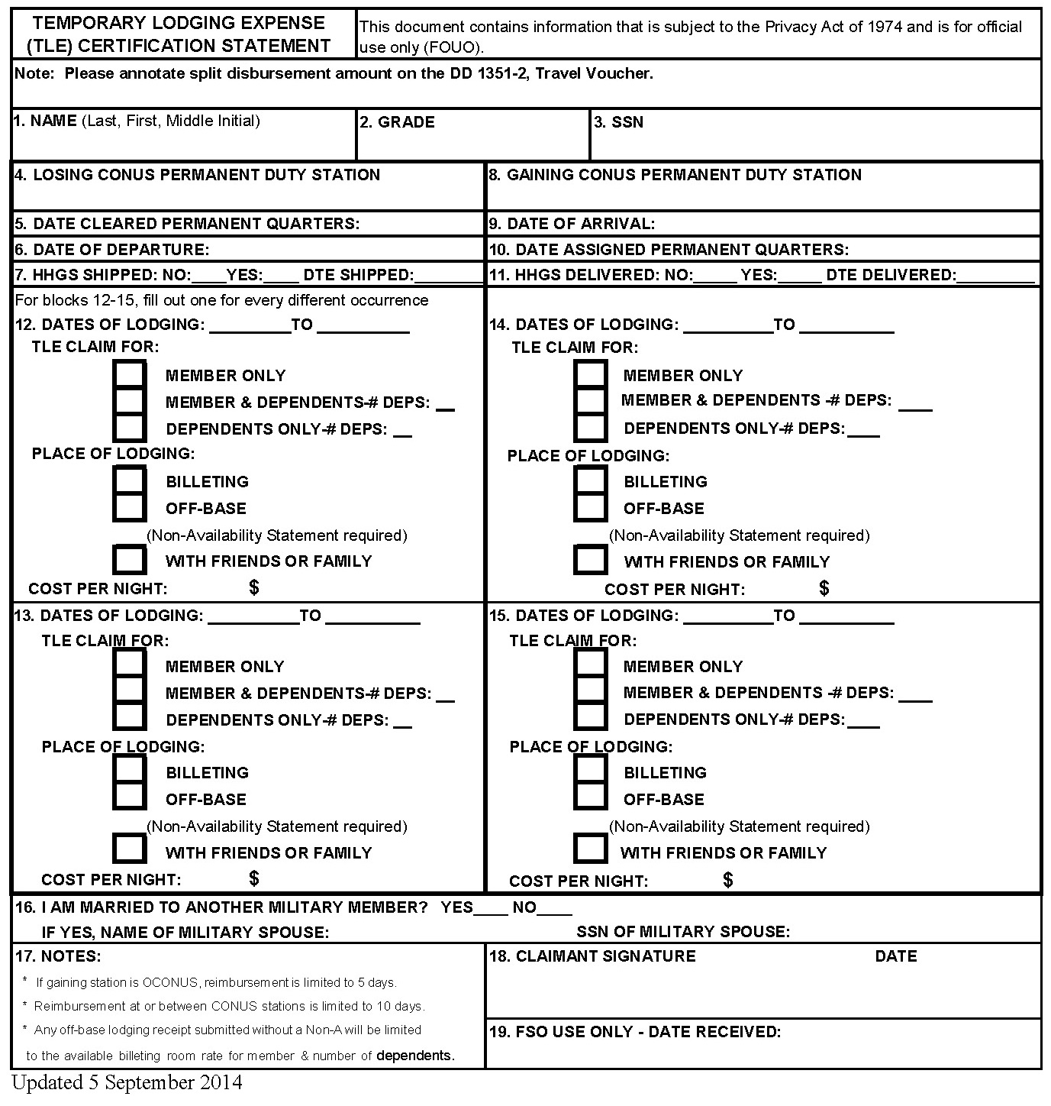

Slide 36
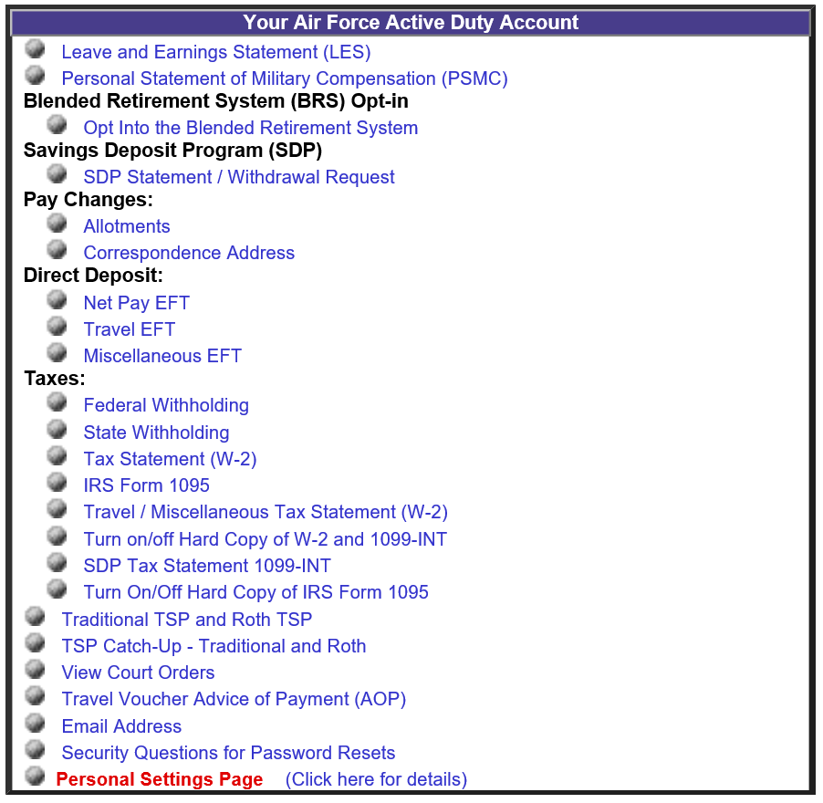

Slide 37
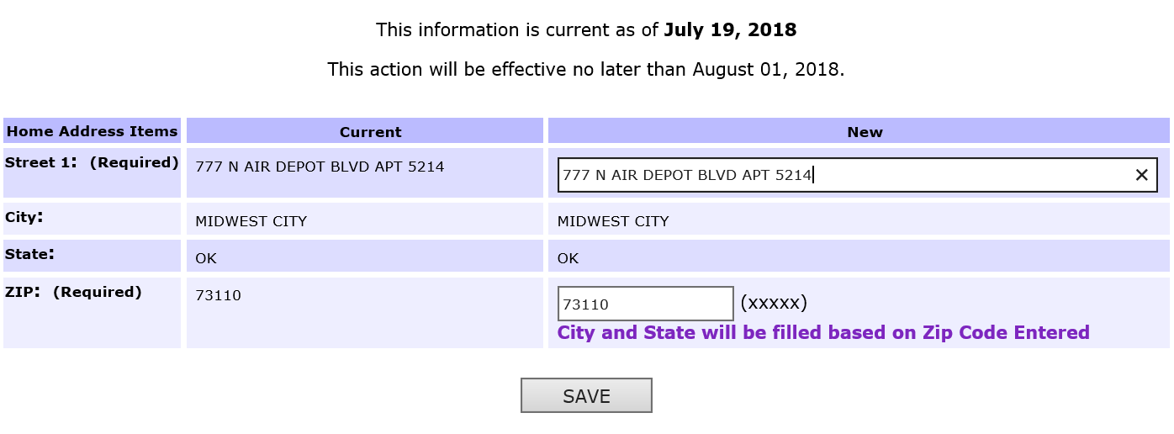

Slide 38
Required Documents
PDT Checklist
PDT Arrival Worksheet
AF Form 594 – BAH Form
DD Form 1351-2, Travel Voucher
1 Copy of PCS Orders (Front and back)
TLE Form (if applicable)
Any Receipts (Airfare, Lodging, Taxi)

