Slide 1







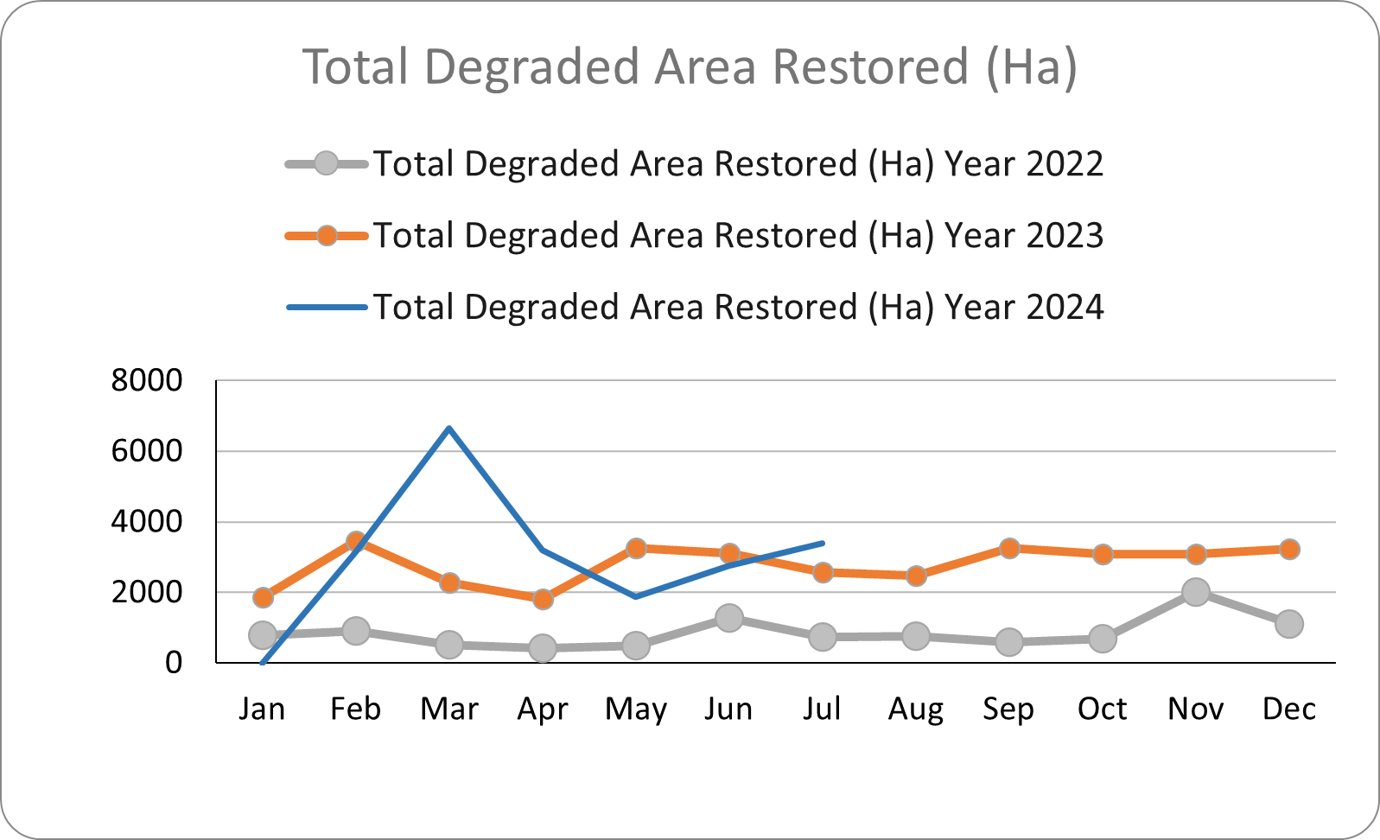


{{SECTOR}}
MUDeNR; Sector Leads: YAB Datuk Patinggi Tan Sri (Dr) Abang Haji Abdul Rahman Zohari Tun Datuk Abang Haji Openg (M), YB Datuk Amar Haji Awang Tengah Ali Hasan (2nd Min), Datu Haji Abdullah bin Julaihi [PS]
Q4 2024
RM 8 bil in exports by 2030
Project/Programme
Q4 2024 Target
Rating
Q4 2024 Status
Generate government
revenue by developing new
revenue streams from forest
resources
Implementation of Forest Landscape Restoration Throughout Sarawak
Cumulative 7 million trees planted (20,000ha area) in 2024
5 planting program/collaborations
Cumulative of 120 jobs created through community engagement in 2024
100% planting data updated in Penghijauan Malaysia
2 Seed Production Area Established Pueh Forest Reserve @ 51 mother trees and Sabal Forest Reserve @ 90 mother trees (geronggang)
Asia-Pacific Regional Conference on Forest Landscape Restoration 2024 in collaboration with ITTO was held in Kuching, Sarawak on 27 - 28 August 2024.
Achieved 35 million tree planting target on 8 June 2024. Premier of Sarawak has planted tree number 35 million at Sabal FR in conjunction with the Satet-Level IDF 2024.
21 planting program/collaborations organized in Q3
TOTAL 2023 = RM3,140,839,231.30
Conservation & Protection
of Wetlands & Watershed Within Heart of Borneo Sarawak (HoB)
1. Workshop to prepare Proposal of Ramsar site
2. Annual Workshop of Wetland and Watershed involving stakeholders and communities
Appointment of consultant to conduct Multi-disciplinary assessment and feasibility study of Kuala Rajang in process of preparing document
Community Development Program (study tours to Ramsar site - Kuching Wetland National Park) was conducted in 10 - 12 September 2024
Karnival Pembangunan Komuniti Perhutanan Tahun 2024 bersama komuniti Tadahan Air, Baleh pada 14 - 22 September 2024
Program Communication, Education & Public Awarenesss in Watershed Area (Program Penghasilan Kraftangan Tempatan bersama Komuniti Kawasan Tadahan Air, Baleh, Kapit pada 24 - 26 September 2024).
Strategy 1
TOTAL 2024 (Jan – Sept) = RM2,128,434,898.20
Quantifying Forest Carbon Stock In Sarawak
1. Organize seminar for knowledge sharing.
2. Prelimary report on biomass findings.
3. Forest biomass assessment at various forest in Sarawak.
Training and MOU signing ceremony successully held at Fukuoka, Japan on 23-27 July 2024
Received CN analyser instrument on 4/9/2024. Currently installing the gas piping and setting up facilities.
Conducted one workshop on "Karbon Hutan bagi Pemilik Tanah Hak Adat Bumiputera at Sibu on 20-22 August 2024.
Currently pending a letter to EPU on consulation work and also company profile from UPM serdang.
Assessment of biomass was conducted in Aug at mangrove plot at Samunsam.
Sebut harga for transport was completed and awarded in Sept 2024
TPA Protection & Biodiversity Conservation Programs (incl. community-based initiatives
32
On-going programs and initiatives by SFC (as of Sept 2024)
Bamboo Industry Development
To produce 650,000 seedlings
To plant 1,500 ha of bamboo
45,856 seedlings produced cumulative
262.11 ha area planted cumulative
1 engagement with ANFA Renewables on Oct 8, 2024 and Dec 19, 2024
Strategy 2
78%
69%
Gain higher export earnings
through the advancement in
downstream processing
Certification of FMU & FPMU
Furniture Park
Completion of design, survey and soil investigation.
1. Pending updates from land and survey on survey status of the lot
2,327,221 ha FMU Certified (as of Sept 2024)
122,800 ha FPMU Certified
(as of Sept 2024)
Sarawak Delta Geopark (SDGp)
UNESCO Global Geopark
i. Submission of Application Dossier to Suruhanjaya Kebangsaan UNESCO Malaysia (SKUM) - FDS
ii. Inter-Agency Workshop - FDS
iii. Readiness assessment by JK Pelaksana Geopark Kebangsaan (MUDeNR/JHS)
Seminar on Sarawak Delta Geopark Expedition held on 17-18 July 2024
Final Draft Report (Application Dossier) submitted on 30 September 2024
Strengthening protection for selected Totally Protected Areas (TPA)
A. CADASTRAL SURVEY
1. Completion of Loagan Bunut NP cadastral survey
LBNP: SFS in principle approved the additional ceiling on 15.08.2024 during budget examination. Pending receipt of official approval in order to proceed with consultant appointment.
Sabal NP: 95.5% completed. Consultant applied for EOT for field work for 8 weeks from 1st July until 30th August 2024. Consultant finalizing the data before submission to Land & Survey.
Gain national and
international recognition
through conservation and
sustainable management
Development and upgrading of integrated facilities of 20 TPA
Call for Tender:
1. Kubah NP
B. MANAGEMENT PLANS
1. Loagan Bunut NP, Gunung Gading NP & Piasau NR:
-MP Final Draft
-Approved by Controller
-Published
Matang Wildlife Centre (Staff accommodation & facilities): Management Tender Committee decided to award the tender to the successful tenderer during the meeting on 24 September 2024. Plan Tender stage and award in Q4 2024.
Gunung Apeng NP (Ranger station): Pending reply on land acquisition enquiry to Land & Survey. Proposal to be refined to suit and consideration of optional site upon finalization of boundary demarcation exercise for scope of work submission under 13MP
Management Plan
Loagan Bunut NP – 59% completion. Data collection and compilation stage.
Gunung Gading NP (46% completion) Data collection and compilation stage.
8. Piasau NR: (46% completion) Data collection and compilation stage.
TOTAL 2024 = 21,028.90 ha
Strategy 3
4 series of Operasi Rengas Bersepadu (combating Illegal logging) conducted in Kuching/Sri Aman, Kapit, Bintulu and Miri Region
2 Awareness Program on Forest Enforcement conducted at Long Busang Kapit, Long lama Miri
Latihan Pengukuhan Penguatkuasaan Hutan (Technical training for forest enforcement officers) conducted at Central Region (Sibu/Kapit/Sarikei) and Northern Region (Bintulu/Miri/Limbang)
Strengthening Forest Enforcement
1. Implementation of forest enforcement activities – 2 Operasi Rengas Bersepadu (combating Illegal logging)
2. Awareness Program (Forest Enforcement) – 2 programmes
3. Technical training for forest enforcement officers – 1 programmes
Half Yearly Report
Obtain world recognition for sustainable management practices and conservation effort
50%
100%
Niah NP
UNESCO World Heritage Site (WHS)
Draft of Niah for UNESCO book
Archaeological Heritage of Niah National Park’s Caves Complex has been inscribed as a UNESCO WHS on 28.07.2024.
Technical committee for the utilization of the federal fund was formed on 27 July 2024.
Request for the Steering Committee meeting had been sent out on 27 Sept 2024 and now pending for confirmation.
SDGP UNESCO
Global Geopark
(as of Sept 2024)
Niah NP UNESCO World Heritage Site(as of Sept 2024)
Monthly target achieved, Project on track
Miss in target but
still on track for 2024
Severe delays
Not started
DRAFT 6 Jan 2025
Legend:
2023
2024

