Slide 1
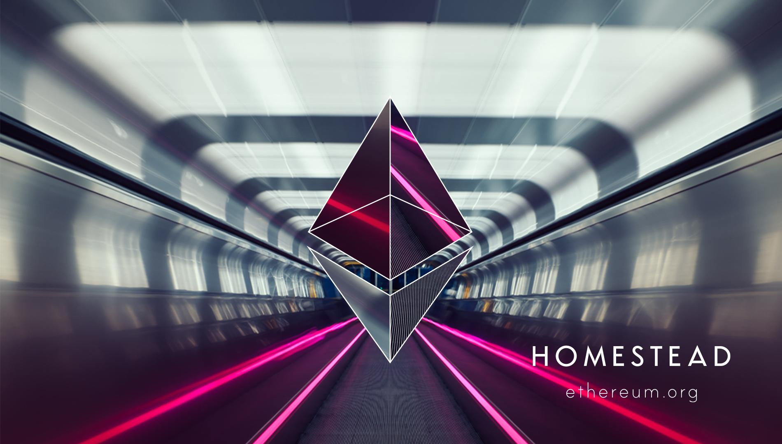
Christian Reitwießner
chris@ethereum.org
Solidity and C++ Team Lead
Ethereum Munich Meetup 2016-05-09

Slide 2
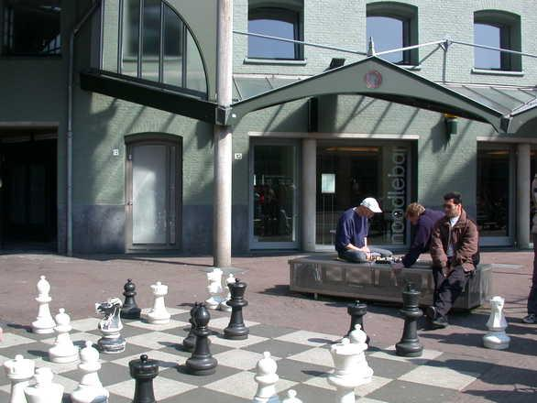


Problems with centralised services
“Data Silos” = walled gardens
Vulnerabilities
Privacy unclear
Lack of transparency
Manipulation
Difficult to use content with other services

Slide 3

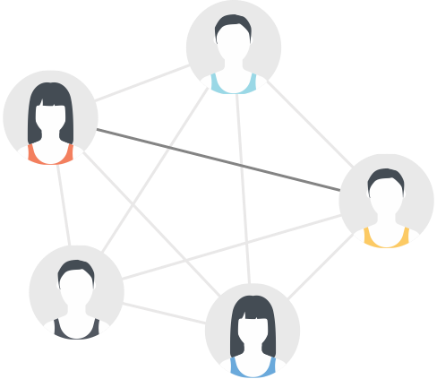
Distributed networks
Peer to peer
Secure
Data is communicated only between shared partners
Transparency and traceability through blockchain technology
Notes:
Überweisungssytem bei Banken ähnlich, nur nicht bis zum Endkunden
Problem der nachvollziehbarkeit: Geld per e-mail versenden?

Slide 4
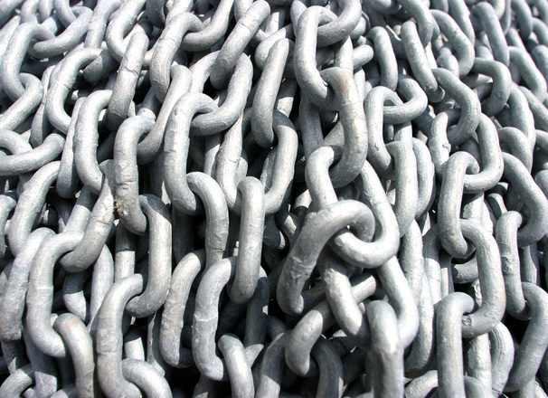
Blockchain
Distributed network , implemented as a global immutable shared ledger
Access control through digital signatures, open to all
Well known example: Bitcoin - digital, uncontrollable currency
Invented 2008/2009 by Satoshi Nakamoto
Bitcoin's problem: Difficult or impossible to implement applications beyond currency

Slide 5

Ethereum
Vitalik Buterin proposes Ethereum at the end of 2013:
Software as part of the blockchain-database
Non-profit-Organisation, open source / free software
$18 million USD raised during a presale in Summer 2014
Community driven R&D project
250 Meetups around the world with 40434 members
Launched July 31st, 2015
Stable Release March 2016 (“Homestead”)

Slide 6

Ethereum Functionality
Anyone can create programs on the blockchain
Execution is visible to and auditable by everyone
Programs control their own data area (e.g. balances)
Programs can interact arbitrarily with each other
“Trustless” - no trust or trusted third party needed
Anyone can make deals with each other

Slide 7
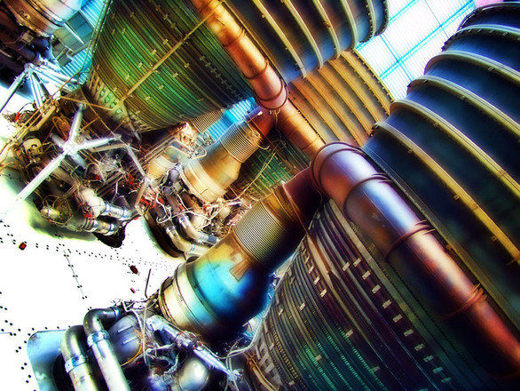
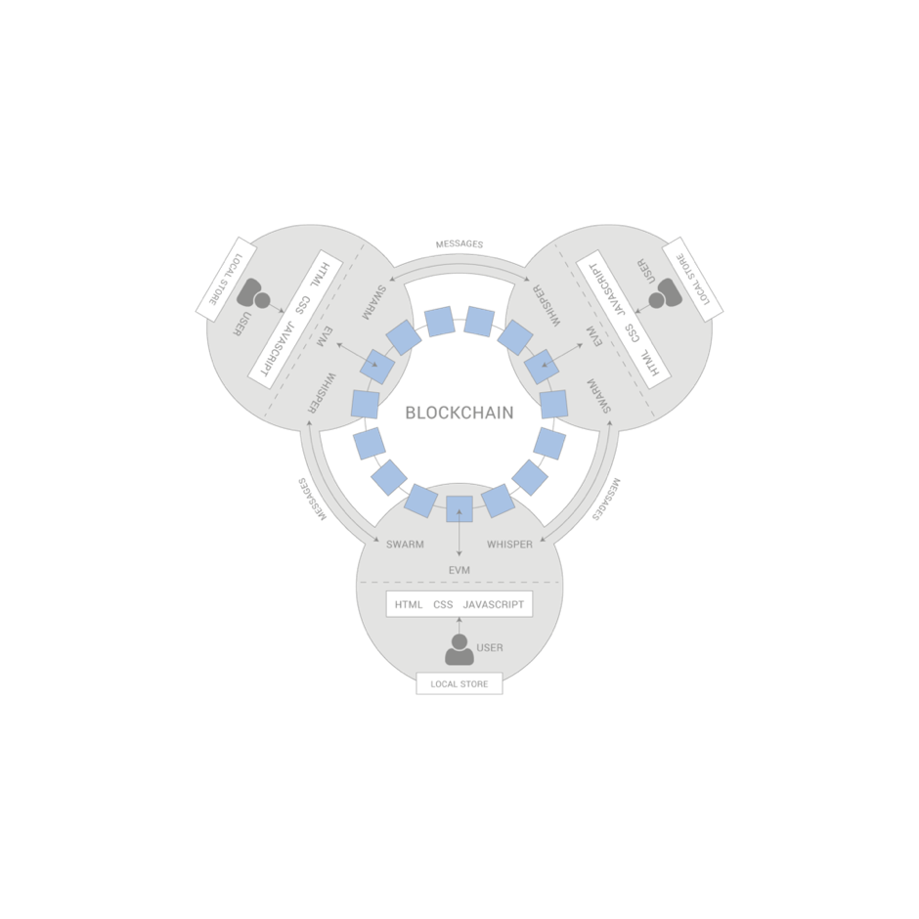
Possible Applications
Name registry
Prediction market
Voting system
Escrow services
File sharing
Crowdfunding
P2P-Insurance
Smart property (IoT)
...

Slide 8
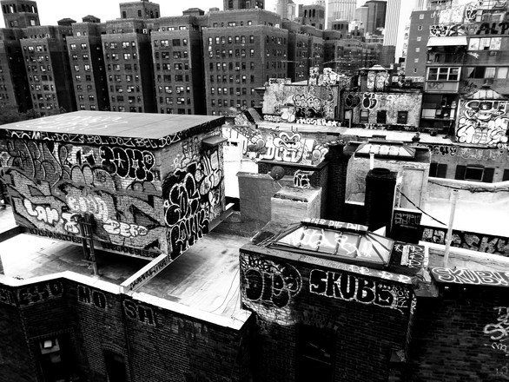
Ethereum Startups (incomplete list)
Slock.it (Smart Locks)
Augur (Prediction Market),
Ujo Music (decentralised music platform),
Maker (stable coin),
...
Crowdfunding / DAOs Business-Model
Network effects exist between all of these - they are interoperable with a simple, standardized interface and benefit through synergy of services

Slide 9
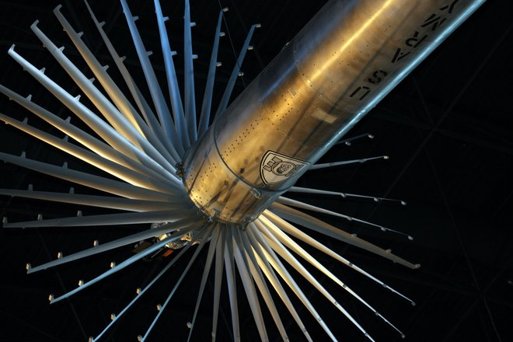
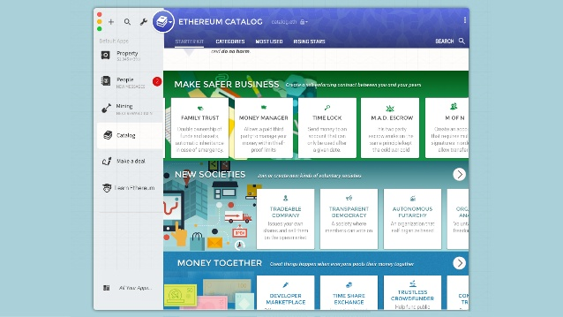
Mist

