Slide 1
Weather Alert Bot
Griffen Marler and Stephen Haugland

Slide 2
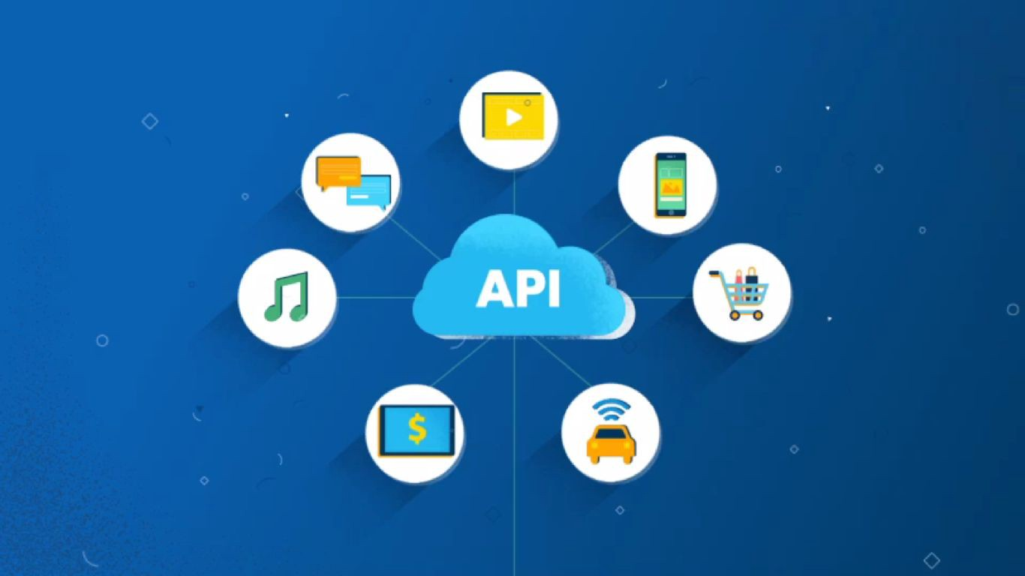
Project Overview
Wanted to work with APIs
Social media integration
Explore virtual machines
Post weather updates to slack channel

Slide 3
Project Interfaces
Slack API
HTTP POST
Post weather updates to slack channel
Utilized JSON library
WeatherBit API
HTTP GET
Retrieve relevant weather data
Current weather and forecast
Azure Cloud Computing
Virtual machine hosts Weather Alert Bot
Runs 24/7
Bare bones

Slide 4

Main challenges
JSON parsing/manipulating
Slack attachment builder
Library set up
Header only libraries
Timing of API calls
When to update forecast?

Slide 5
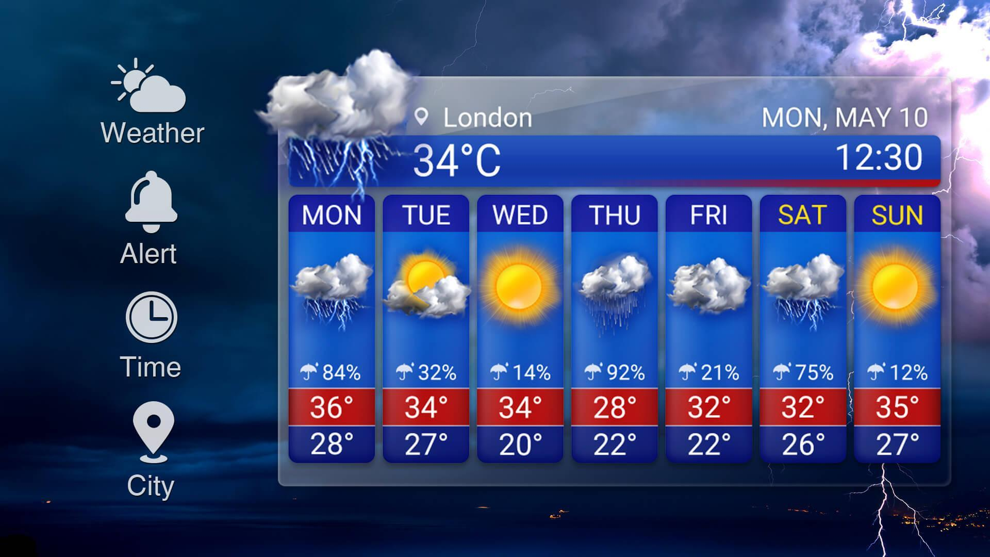
What we learned/would change
C++ has relatively limited support
More detailed weather information
Multiple location functionality
Respond to slack messages(eventsAPI)

Slide 6
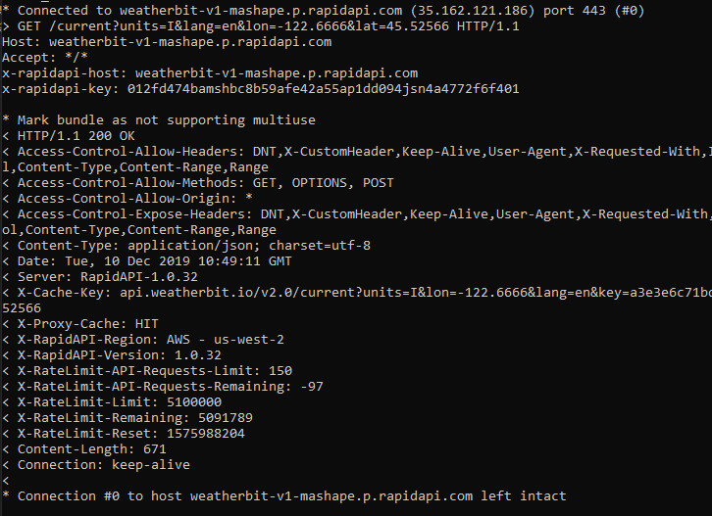
Example HTTP Request and Response
Port 443 - SSL
Content-type JSON
API request limit

Slide 7
Demo Time

Slide 8
Thanks!
Any questions?

