Slide 1
Weekly Market Insights
Covering Sectors:
🔌 Semiconductors
📰 Generated on June 30, 2025

Slide 2
EXECUTIVE SUMMARY
📊 Market Overview
• Comprehensive analysis of 1 key sectors
• 10 articles analyzed
🔍 Sector Highlights
🔌 Semiconductors:
Latest developments in semiconductor technology, chip manufacturing, and industry trends

Slide 3
Semiconductors Sector Update

Slide 4
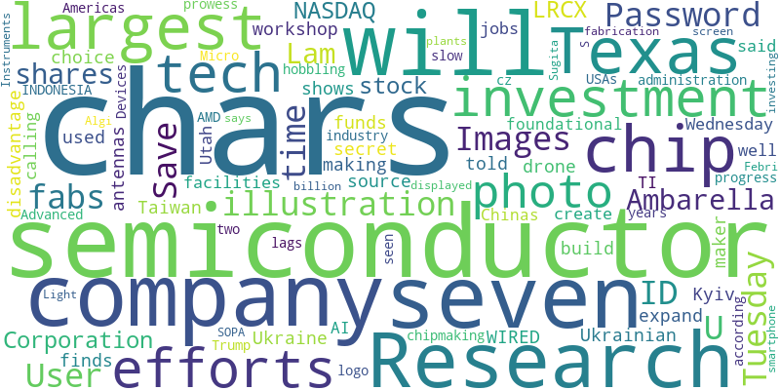
Semiconductors - Word Cloud

Slide 5
Taiwan Is Rushing to Make Its Own Drones Before It's Too Late
Source: Wired
Published: June 23, 2025
Unmanned vehicles are increasingly becoming essential weapons of war. But with a potential conflict with China looming large, Taiwan is scrambling to build a domestic drone industry from scratch.
But Ukraine also shows the disadvantage at which Taiwan finds itself. In a secret workshop in Kyiv, a Ukrainian drone maker told WIRED that he had no choice but to source his antennas and chips from … [+3051 chars]

Slide 6
Texas Instruments To Invest $60 Billion To Make Semiconductors In US
Source: Slashdot.org
Published: June 19, 2025
Longtime Slashdot reader walterbyrd shares news that Texas Instruments has announced plans to invest more than $60 billion to expand its U.S. manufacturing operations in the United States. From a report: The funds will be used to build or expand seven chip-ma…
The funds will be used to build or expand seven chip-making facilities in Texas as well as Utah, and will create 60,000 jobs, TI said on Wednesday, calling it the "largest investment in foundational … [+1018 chars]

Slide 7
China just two years behind USA on chip design, says White House tech Czar
Source: Theregister.com
Published: June 20, 2025
Expects Huawei to start exporting AI chips soon, creating global fight for tech stack dominance
China’s AI and chipmaking prowess lags the USA’s by just two years, and America’s efforts to slow its progress could be hobbling its own semiconductor industry, ac…
Chinas AI and chipmaking prowess lags the USAs by just two years, and Americas efforts to slow its progress could be hobbling its own semiconductor industry, according to Trump administration tech cz… [+2616 chars]

Slide 8
AMD's AI Moment May Be Coming. Will It Seize It?
Source: Forbes
Published: June 26, 2025
The AI semiconductor industry is vast and continues to grow rapidly.
INDONESIA - 2025/06/16: In this photo illustration, the AMD (Advanced Micro Devices) logo is seen ... More displayed on a smartphone screen. (Photo Illustration by Algi Febri Sugita/SOPA Images/Light… [+4379 chars]

Slide 9
Texas Instruments will invest $60 billion in U.S. chipmaking
Source: Quartz India
Published: June 18, 2025
The company will expand its operations in Utah and its home state of Texas
Texas Instruments is investing $60 billion in seven semiconductor fabrication plants, or fabs, which the company says is the largest such investment in U.S. history. The seven fabs will be spread acr… [+1389 chars]

Slide 10
Huawei’s latest notebook shows China is still generations behind in chipmaking
Source: Theregister.com
Published: June 23, 2025
Kirin X90 SoC made on two-year-old 7nm N+2 process
Despite concerted efforts by the Chinese to bolster domestic semiconductor production in defiance of US trade policy, new evidence uncovered by Canadian research outlet TechInsights suggests SMIC, the Middle …
Despite concerted efforts by the Chinese to bolster domestic semiconductor production in defiance of US trade policy, new evidence uncovered by Canadian research outlet TechInsights suggests SMIC, th… [+4375 chars]

Slide 11
Chinese graduates seeking semiconductor jobs targeted by scams
Source: Digitimes
Published: June 23, 2025
Fresh college graduates in China looking to enter the employment force have their hearts set on major players in the semiconductor industry. However, as they rush to submit resumes, the risk of being scammed has quietly grown.
Save my User ID and Password_x000D_
Some subscribers prefer to save their log-in information so they do not have to enter their User ID and Password each time they visit the site. To activate this function… [+307 chars]

Slide 12
Ambarella's Stock Pops 20% as the Chip Designer Reportedly Mulls a Sale
Source: Investopedia
Published: June 24, 2025
Shares of Ambarella jumped just over 20% Tuesday following a Bloomberg report the chip designer is considering a sale.
Cheng Xin / Getty Images_x000D_
Even with Tuesday's gains, Ambarella shares have lost about 15% of their value in 2025._x000D_
<ul><li>Ambarella shares rallied Tuesday after Bloomberg reported the company is co… [+1163 chars]

Slide 13
Cantor Fitzgerald Raised The PT on Lam Research (LRCX), Maintains a Buy Rating
Source: Yahoo Entertainment
Published: June 28, 2025
Lam Research Corporation (NASDAQ:LRCX) is one of the 11 Unstoppable Tech Stocks to Invest in. On June 24, Cantor Fitzgerald raised the firm’s price target on...
Lam Research Corporation (NASDAQ:LRCX) is one of the 11 Unstoppable Tech Stocks to Invest in. On June 24, Cantor Fitzgerald raised the firms price target on Lam Research Corporation (NASDAQ:LRCX) fro… [+1900 chars]

Slide 14
Samsung Electronics market cap now at a 9-year low
Source: SamMobile
Published: June 16, 2025
Investors haven't been too bullish on Samsung Electronics' stock for quite some time now as the company faces significant challenges on several fronts, particularly for its lucrative semiconductor division. That has resulted in a sustained pressure on the com…
Investors haven't been too bullish on Samsung Electronics' stock for quite some time now as the company faces significant challenges on several fronts, particularly for its lucrative semiconductor di… [+1425 chars]

Slide 15
Key Insights & Next Steps
• Review the latest market trends
• Consider the impact on your portfolio
• Stay tuned for our next update

