Slide 1
Weekly Market Insights
Covering Sectors:
⌚ Wearable Technology Sensors
📰 Generated on June 30, 2025

Slide 2
EXECUTIVE SUMMARY
📊 Market Overview
• Comprehensive analysis of 1 key sectors
• 6 articles analyzed
🔍 Sector Highlights
⌚ Wearable Technology Sensors:
Innovations in wearable sensors, health monitoring, and smart device technology

Slide 3
Wearable Technology Sensors Sector Update

Slide 4
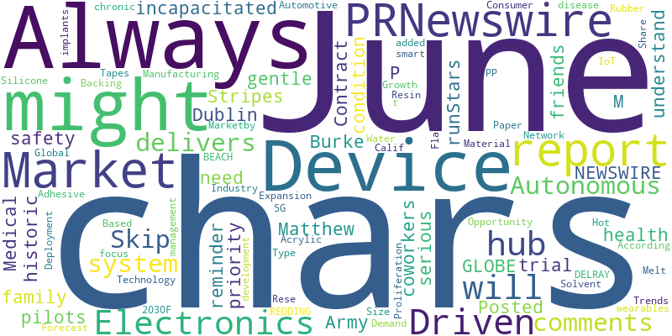
Wearable Technology Sensors - Word Cloud

Slide 5
Autonomous system that delivers incapacitated Army pilots to safety has historic trial run
Source: Freerepublic.com
Published: June 21, 2025
An Army in-flight system that can detect when a pilot is incapacitated and get the aircraft back to base has passed a key test, giving the service a boost in its quest to develop autonomous technology. The May test flight at Joint Base Langley-Eustis, Va., pa…
Skip to comments._x000D_
Autonomous system that delivers incapacitated Army pilots to safety has historic trial runStars and Stripes ^_x000D_
| June 20, 2025_x000D_
| Matthew M. Burke_x000D_
Posted on 06/20/2025 7:35:39 P… [+3680 chars]

Slide 6
Woman Refuses To Put Her Health At Risk For Sister’s Wedding Photo Aesthetic, Upsets Family
Source: Boredpanda.com
Published: June 18, 2025
How would you feel if you had diabetes and your own sister pressured you this way?
Your health should be your priority. Always! However, your family, friends, and coworkers might not always understand just how serious your condition is. They might need some (not so) gentle reminder… [+5672 chars]

Slide 7
Medical Device Contract Manufacturing Market Trends, Opportunity, and Forecast, 2020-2024 & 2025-2030 | Rise in Miniaturization and Wearable Devices, Contract Manufacturing Drives Innovations
Source: GlobeNewswire
Published: June 27, 2025
Contract manufacturing in the medical device sector offers key opportunities due to cost savings, operational efficiency, and technological advancements. The growing complexity of AI, IoT, and robotic devices, alongside miniaturization and wearable tech, is d…
Dublin, June 27, 2025 (GLOBE NEWSWIRE) -- The "Medical Device Contract Manufacturing Market - Global Industry Size, Share, Trends, Opportunity, and Forecast, 2020-2030F" report has been added to Rese… [+5322 chars]

Slide 8
Adhesive Tapes Market worth $111.31 billion by 2030 - Exclusive Report by MarketsandMarkets™
Source: PR Newswire UK
Published: June 17, 2025
DELRAY BEACH, Fla., June 17, 2025 /PRNewswire/ -- The report "Adhesive Tapes Market by Resin Type (Acrylic, Rubber, Silicone), Technology (Solvent, Hot-Melt, Water-Based), Backing Material (PP, Paper, PVC), End-use Industry (Packaging, Healthcare, Electric & …
DELRAY BEACH, Fla., June 17, 2025 /PRNewswire/ -- The report "Adhesive Tapes Marketby Resin Type (Acrylic, Rubber, Silicone), Technology (Solvent, Hot-Melt, Water-Based), Backing Material (PP, Paper,… [+8726 chars]

Slide 9
Printed Circuit Board Assembly (PCBA) Market to Reach $147.5 Billion by 2035, Growing at a CAGR of 4.7% from 2025, Says Meticulous Research®
Source: PR Newswire UK
Published: June 26, 2025
Market Growth Driven by Consumer Electronics Demand, Automotive Electronics Expansion, 5G Network Deployment, and IoT Device Proliferation REDDING, Calif., June 26, 2025 /PRNewswire/ -- According to a comprehensive market research report titled "Printed Circu…
Market Growth Driven by Consumer Electronics Demand, Automotive Electronics Expansion, 5G Network Deployment, and IoT Device Proliferation _x000D_
REDDING, Calif., June 26, 2025 /PRNewswire/ -- According t… [+10770 chars]

Slide 10
University of Galway leads €34m hub capitalising on health-tech research
Source: Siliconrepublic.com
Published: June 26, 2025
The new ARC Healthtech Hub will be led by University of Galway, in partnership with ATU and RCSI University of Medicine and Health Sciences.
The hub will will focus on chronic disease management with the development of smart implants, wearables and AI and ML driven modelling.
The University of Galway is set to be the headquarters for a new €34.3m Research Ireland hub aimed at accelerating... [3213 chars]

Slide 11
Key Insights & Next Steps
• Review the latest market trends
• Consider the impact on your portfolio
• Stay tuned for our next update

