Slide 1
Weekly Market Insights
Covering Sectors:
⚖️ Intellectual Property Litigation
📰 Generated on June 30, 2025

Slide 2
EXECUTIVE SUMMARY
📊 Market Overview
• Comprehensive analysis of 1 key sectors
• 10 articles analyzed
🔍 Sector Highlights
⚖️ Intellectual Property Litigation:
Key patent cases, IP disputes, and legal developments in tech

Slide 3
Intellectual Property Litigation Sector Update

Slide 4
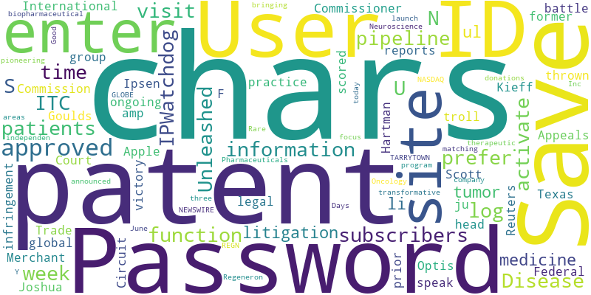
Intellectual Property Litigation - Word Cloud

Slide 5
LG Display sues Tianma, escalating the latest round of China-South Korea display patent battle
Source: Digitimes
Published: June 17, 2025
South Korean display technology firms have intensified patent litigation against Chinese competitors, reflecting growing tensions in the sector. Following Samsung Display's ongoing patent infringement lawsuits against Chinese companies BOE Technology Group an…
Save my User ID and Password_x000D_
Some subscribers prefer to save their log-in information so they do not have to enter their User ID and Password each time they visit the site. To activate this function… [+307 chars]

Slide 6
Taiwan tech giants unite to counter threats rising from global patent wars
Source: Digitimes
Published: June 26, 2025
As global patent litigation escalates, Taiwan's leading tech firms are coming under increasing fire. In 2024, several Taiwanese networking equipment manufacturers were blindsided by Huawei's demands for steep patent licensing fees. That same year, TSMC, the w…
Save my User ID and Password_x000D_
Some subscribers prefer to save their log-in information so they do not have to enter their User ID and Password each time they visit the site. To activate this function… [+307 chars]

Slide 7
A Big Win for Small Business Patent Owners: Leveling the Patent Litigation Playing Field
Source: IPWatchdog.com
Published: June 17, 2025
This week on IPWatchdog Unleashed I speak with F. Scott Kieff, former Commissioner on the International Trade Commission, and Joshua Hartman, head of Merchant & Gould’s ITC practice group. Our conversation, which took place on June 4, focused on the landmark …
This week on IPWatchdog Unleashed, I speak with F. Scott Kieff, former Commissioner on the International Trade Commission (ITC), and Joshua Hartman, head of Merchant &amp; Goulds ITC practice group. … [+5980 chars]

Slide 8
Apple Scores an Appeals Court Win in LTE Patent Fight With Patent Troll
Source: Mactrast.com
Published: June 17, 2025
Apple has scored a legal victory in its ongoing patent infringement battle with Texas patent troll Optis.Read More...
Apple has scored a legal victory in its ongoing patent infringement battle with Texas patent troll Optis, reports Reuters._x000D_
The U.S. Court of Appeals for the Federal Circuit has thrown out a prior ju… [+2207 chars]

Slide 9
Ipsen receives positive CHMP opinion for Cabometyx® in previously treated advanced neuroendocrine tumors
Source: Financial Post
Published: June 20, 2025
If approved, Cabometyx® would be the first and only systemic therapy approved in the European Union for previously treated neuroendocrine tumors, regardless of tumor site, grade or previous non-somatostatin analogue-based systemic therapy1,2 Recommendation ba…
About Ipsen_x000D_
We are a global biopharmaceutical company with a focus on bringing transformative medicines to patients in three therapeutic areas: Oncology, Rare Disease and Neuroscience._x000D_
Our pipeline… [+8783 chars]

Slide 10
Regeneron Announces First-of-its-Kind Donation Matching Program with Independent Charitable Patient Assistance Organization
Source: GlobeNewswire
Published: June 24, 2025
Initiative aims to expand and encourage philanthropy to help patients with retinal diseases afford their medications Initiative aims to expand and encourage philanthropy to help patients with retinal diseases afford their medications
TARRYTOWN, N.Y., June 24, 2025 (GLOBE NEWSWIRE) -- Regeneron Pharmaceuticals, Inc. (NASDAQ: REGN) today announced the launch of a pioneering matching program for donations to Good Days, an independen… [+10071 chars]

Slide 11
Gaming Patent Litigation on Both Sides of the ‘v’ | IPWatchdog Unleashed
Source: IPWatchdog.com
Published: June 23, 2025
This week on IPWatchdog Unleashed, we enter the patent litigation world for a conversation about gaming patent litigation. For too long, popular sentiment has been that patent owners are bad actors simply because they are patent owners. A more nuanced but sti…
This week on IPWatchdog Unleashed, we enter the patent litigation world for a conversation about gaming patent litigation. For too long, popular sentiment has been that patent owners are bad actors s… [+5811 chars]

Slide 12
Ipsen receives positive CHMP opinion for Cabometyx® in previously treated advanced neuroendocrine tumors
Source: GlobeNewswire
Published: June 20, 2025
PARIS, FRANCE, 20 June 2025 - Ipsen (Euronext: IPN; ADR: IPSEY) announced today that the Committee for Medicinal Products for Human Use (CHMP) of the European Medicines Agency (EMA) has issued a positive opinion for Cabometyx® (cabozantinib) for adult patient…
<ul><li>If approved, Cabometyx® would be the first and only systemic therapy approved in the European Union for previously treated neuroendocrine tumors, regardless of tumor site, grade or previous n… [+16317 chars]

Slide 13
Press Release: Dupixent approved in the US as the only targeted medicine to treat patients with bullous pemphigoid
Source: GlobeNewswire
Published: June 20, 2025
Dupixent approved in the US as the only targeted medicine to treat patients with bullous pemphigoid Approval based on pivotal results showing......
Dupixent approved in the US as the only targeted medicine to treat patients with bullous pemphigoid _x000D_
<ul><li>Approval based on pivotal results showing improvements in sustained disease remission and… [+21498 chars]

Slide 14
Takeaways from the Latest Copyright Drama: Film Studios Fight to Keep Their Creative Crown
Source: IPWatchdog.com
Published: June 24, 2025
In a moment that was both inevitable and seismic, Disney and Universal filed a high-profile copyright infringement lawsuit against Midjourney, a leading generative AI company specializing in image and video synthesis. The studios claim that Midjourney trained…
The creative pipeline, once guarded by multimillion-dollar production studios, is now accessible to anyone with a spark of imagination and a smartphone._x000D_
In a moment that was both inevitable and seis… [+8468 chars]

Slide 15
Key Insights & Next Steps
• Review the latest market trends
• Consider the impact on your portfolio
• Stay tuned for our next update

