Slide 1
Weekly Market Insights
Covering Sectors:
📰 Technology 📰 Finance
📰 Generated on June 30, 2025

Slide 2
EXECUTIVE SUMMARY
📊 Market Overview
• Comprehensive analysis of 2 key sectors
• 18 articles analyzed
🔍 Sector Highlights
📰 Technology:
Latest news and updates in Technology
📰 Finance:
Latest news and updates in Finance

Slide 3
Technology Sector Update

Slide 4
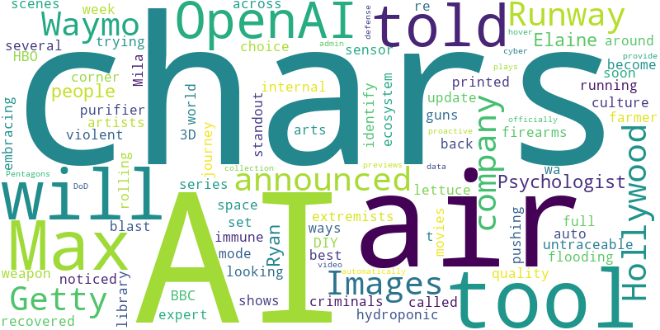
Technology - Word Cloud

Slide 5
Plantaform Smart Indoor Garden Review: Rewarding but Risky
Source: Wired
Published: June 27, 2025
We tested this unique indoor gardening solution that utilizes NASA technology, but air quality data raised concerns.
It was about a week into my journey as a hydroponic lettuce farmer when I noticed my Mila air purifier, set to auto mode, was running at full blast. Its internal air quality sensor told me the air wa… [+4100 chars]

Slide 6
How 3D-printed guns are spreading online
Source: BBC News
Published: June 19, 2025
The technology to build your own lethal weapon is promoted on social media
3D-printed guns could become "the weapon of choice" for criminals and violent extremists around the world, an expert has told the BBC. These DIY, untraceable firearms have been recovered in several r… [+6362 chars]

Slide 7
Futureproof
Source: The Verge
Published: June 18, 2025
AI tools are flooding the culture ecosystem — and no corner of the arts space is immune. In this series, we’re looking at the ways artists are embracing AI, pushing back on it, or trying their best to find an equilibrium with a new technology that’s both swee…
AI tools are flooding the culture ecosystem — and no corner of the arts space is immune. In this series, we’re looking at the ways artists are embracing AI, pushing back on it, or trying their best t… [+463 chars]

Slide 8
Max will show autoplaying video previews picked by AI
Source: The Verge
Published: June 17, 2025
Max — soon to be called HBO Max again — is rolling out an update that automatically plays video previews when you hover over shows and movies. The video previews are launching to users in the US now, but Max is still working on an “AI-assisted” tool to pick t…
The AI tool will identify standout scenes across Maxs library of shows and movies._x000D_
Max soon to be called HBO Max again is rolling out an update that automatically plays video previews when you hover… [+1056 chars]

Slide 9
OpenAI awarded $200 million US defense contract
Source: The Verge
Published: June 17, 2025
OpenAI is officially on the Pentagon’s payroll. The Department of Defence announced a $200 million contract with OpenAI to provide the US government with new artificial intelligence tools, including those used for proactive cyber defense. In a post outlining …
OpenAI will provide the DoD with AI tools for admin, data collection, and proactive cyber defense._x000D_
OpenAI is officially on the Pentagons payroll. The Department of Defence announced a $200 million c… [+2393 chars]

Slide 10
Runway is going to let people generate video games with AI
Source: The Verge
Published: June 27, 2025
So far, Runway is known for bringing generative AI to Hollywood. Now, the $3 billion startup is setting its sights on the gaming industry. This week, I was granted access to a new interactive gaming experience that Runway plans to make available to everyone a…
After making inroads in Hollywood, Runway is entering the gaming market._x000D_
So far, Runway is known for bringing generative AI to Hollywood. Now, the $3 billion startup is setting its sights on the gam… [+1549 chars]

Slide 11
Tesla's Robotaxi Service Hits the Road in Texas
Source: Wired
Published: June 22, 2025
The company debuted its autonomous ride-hailing service Sunday. The limited program is invite-only and uses around 20 cars—signs that Tesla has a long way to go to catch up to its robotaxi rivals.
The company has said that Tesla owners will eventually be able to transform their own cars into self-driving taxis that can collect fares while theyre not being used. But the company released no time… [+3287 chars]

Slide 12
Waymo’s robotaxis are coming back to New York City
Source: The Verge
Published: June 18, 2025
Waymo announced today that it intends to launch a fully autonomous robotaxi service in New York City — but first it needs to change state law to permit its vehicles to operate with safety drivers behind the wheel. The Alphabet-owned company said it has applie…
A Waymo vehicle waits on a street on May 14, 2025, in Los Angeles, California. | Photo: Getty Images_x000D_
Waymo announced today that it intends to launch a fully autonomous robotaxi service in New York… [+3380 chars]

Slide 13
I'm a psychologist, and people who have anxiety over AI tell me they're losing their sense of self-worth
Source: Business Insider
Published: June 19, 2025
Psychologist Elaine Ryan advises people not to avoid the technology, but to embrace it and reclaim their self-worth.
Psychologist Elaine Ryan regularly hears from people who have anxiety about AI.narith_2527/Getty Images_x000D_
<ul><li>Psychologist Elaine Ryan has been hearing from people who are anxious about the AI boo… [+3652 chars]

Slide 14
Finance Sector Update

Slide 15
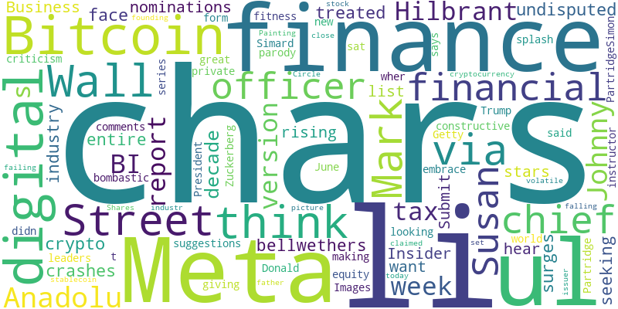
Finance - Word Cloud

Slide 16
Bitcoin Who? Wall Street Has a New Crypto Obsession
Source: Gizmodo.com
Published: June 21, 2025
While Bitcoin hits new highs, a little-known company is capturing the imagination of investors with a simple, yet revolutionary, idea: the stablecoin.
For over a decade, Bitcoin has been the undisputed face of digital finance. When you think “crypto,” you think Bitcoin. Its surges and crashes have been treated as bellwethers for the entire industry… [+3123 chars]

Slide 17
Looking for finance rockstars: Nominate an up-and-coming trader, investor, or dealmaker
Source: Business Insider
Published: June 23, 2025
Calling all bosses, colleagues, recruiters, and industry watchers to put forward the investors, traders, and dealmakers on their radars.
We're seeking nominations for Business Insider's list of rising stars on Wall Street, and we want to hear from you. _x000D_
Submit your suggestions below or via this form_x000D_
._x000D_
We're looking for the leaders … [+837 chars]

Slide 18
Meta's finance chief says Mark Zuckerberg is 'world-class' at giving feedback
Source: Business Insider
Published: June 19, 2025
Susan Li, who has spent nearly two decades rising through the ranks at Meta, says that being open to feedback has been key to her success.
Mark Zuckerberg is great at giving constructive criticism, said Meta's chief financial officer, Susan Li.Anadolu/Anadolu via Getty Images_x000D_
<ul><li>Meta's chief financial officer, Susan Li, says Mark … [+2049 chars]

Slide 19
The finance industry's newest social media sensation roasts private equity bros — and they love it
Source: Business Insider
Published: June 26, 2025
BI sat down with Johnny Hilbrant Partridge about his parody of private equity, which has become a cult hit on Wall Street and an unlikely side hustle.
Johnny Hilbrant PartridgeSimon Simard for BI_x000D_
<ul><li>Johnny Hilbrant Partridge's parody of private equity is making a splash on Wall Street</li><li>BI sat down with the fitness instructor about wher… [+9471 chars]

Slide 20
Trump Claims He Built Crypto—Just as His Family Cashes In
Source: Gizmodo.com
Published: June 27, 2025
The U.S. president now says he made crypto great again, just as his family stands to benefit from a booming digital empire.
In a series of bombastic new comments on June 27, President Donald Trump didn’t just embrace the world of cryptocurrency; he claimed to be its founding father. Painting a picture of a failing industr… [+3277 chars]

Slide 21
Circle stock plunges, set to close lower after huge IPO surge
Source: Yahoo Entertainment
Published: June 27, 2025
Circle Internet Group (CRCL) stock is sliding today, capping a volatile stretch since its initial public offering (IPO) earlier this month. Yahoo Finance...
Shares of stablecoin issuer Circle falling today here. The stock has had a volatile week, set to close in the red for its third full week of trading since its IPO. Yahoo Finance senior markets report… [+2313 chars]

Slide 22
Google might give At a Glance a Gemini makeover with extra smarts
Source: Android Central
Published: June 19, 2025
Google might be giving At a Glance a big upgrade, possibly rebranding it with the Gemini name and packing in a ton more features.
What you need to know_x000D_
<ul><li>Google might be building its own version of Samsung’s Now Bar to surface real-time info right on your lock screen.</li><li>According to a report, the upgraded version c… [+2760 chars]

Slide 23
Six Things I Wish I Knew Before Setting Up My Switch 2
Source: Kotaku
Published: June 20, 2025
You wake up at 1 am to score a pre-order. You put yourself in manageable debt to finance it. You confirm the card on file is valid when it ships. You stay home to make sure UPS doesn’t drop the package down an open manhole instead of your door. You make sure …
You wake up at 1 am to score a pre-order. You put yourself in manageable debt to finance it. You confirm the card on file is valid when it ships. You stay home to make sure UPS doesnt drop the packag… [+7203 chars]

Slide 24
Canada's Digital Services Tax To Stay In Place Despite G7 Deal
Source: Slashdot.org
Published: June 27, 2025
An anonymous reader quotes a report from Bloomberg: Canada is proceeding with its digital services tax on technology companies such as Meta despite a Group of Seven agreement that resulted in removing the Section 899 "revenge tax" proposal from U.S. President…
Canada is proceeding with its digital services tax on technology companies such as Meta despite a Group of Seven agreement that resulted in removing the Section 899 "revenge tax" proposal from U.S. P… [+1870 chars]

Slide 25
Key Insights & Next Steps
• Review the latest market trends
• Consider the impact on your portfolio
• Stay tuned for our next update

