Slide 1
Weekly Market Insights
Generated on June 26, 2025
Sectors: Technology, Finance

Slide 2
Executive Summary
• Latest updates from 2 key sectors
• 8 articles analyzed
• Key trends and insights for decision makers

Slide 3
Technology Sector Update

Slide 4
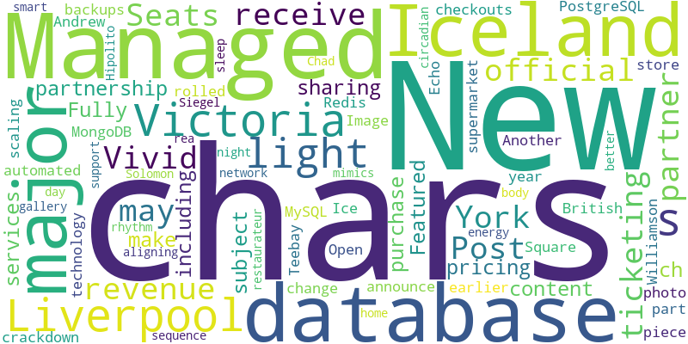
Technology - Word Cloud

Slide 5
Reese Witherspoon announces speaking tour, NYC show. Get tickets today
Source: New York Post
Published: June 25, 2025
The Oscar winner will take the stage to chat about her new thriller novel at Town Hall on Oct. 13.
Vivid Seats is the New York Post's official ticketing partner. We may receive revenue from this partnership for sharing this content and/or when you make a purchase. Featured pricing is subject to ch… [+4013 chars]

Slide 6
Show HN: I built a cloud on my own ASN w real 1:1 compute to fight the cartels
Source: Infuze.cloud
Published: June 25, 2025
Sup HN
I'm MX, a solo founder building Infuze Cloud, launching as a beta today.I started this project because I was tired of a long list of reasons why the cartels are ridiculous that I shall not dwell on for too long here because I had to rewrite this twice …
Managed Databases_x000D_
Fully managed database services including PostgreSQL, MySQL, MongoDB, and Redis with automated backups and scaling.

Slide 7
Iceland announce major change at checkouts as part of crackdown
Source: Manchester Evening News
Published: June 26, 2025
Another major British supermarket rolled out the new piece of technology earlier this year
Iceland announce major change at checkouts as part of crackdown
Another major British supermarket rolled out the new piece of technology earlier this year
The Iceland store in Williamson Square in Liverpool. (Image: Andrew Teebay/Liverpool Echo )
Ice... [2997 chars]

Slide 8
How smart tech is supporting health on the home front
Source: The Globe and Mail
Published: June 26, 2025
Smart-home technology – from wellness lighting to digital locks – has evolved beyond convenience to help improve health and emotional well-being
Open this photo in gallery: Solomon Siegel’s home in Victoria has a smart-light network that mimics the day-to-night light sequence, aligning with the body’s circadian rhythm to support better sleep and energy.Chad Hipolito
Victoria restaurateur, rea... [6782 chars]

Slide 9
Finance Sector Update

Slide 10
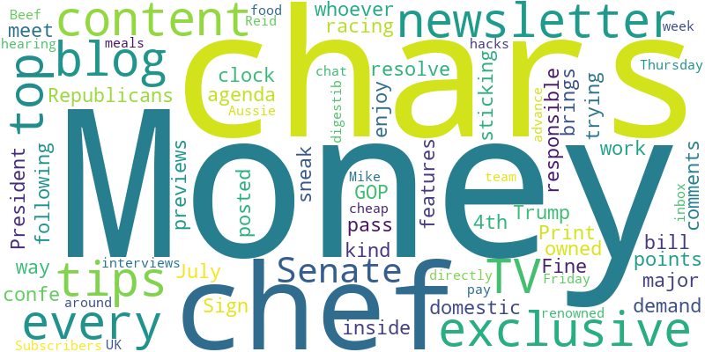
Finance - Word Cloud

Slide 11
Trump's signature policy bill is facing trouble on multiple fronts in the Senate
Source: NPR
Published: June 25, 2025
While Senate leaders have made several significant changes to the bill in recent days, the issue of funding for rural hospitals has emerged as a major roadblock.
Senate Republicans are racing the clock, trying to meet President Trump's demand that they pass his domestic agenda bill by July 4th as they work to resolve major sticking points inside the GOP confe… [+7362 chars]

Slide 12
Divided Fed proposes rule to ease capital requirements for big Wall Street banks - CNBC
Source: Slashdot.org
Published: June 25, 2025
Divided Fed proposes rule to ease capital requirements for big Wall Street banksCNBC Fed kicks off effort to ease bank leverage rulesReuters Big banks are closer to getting one of biggest regulatory rollbacks since 2008Yahoo Finance Federal Reserve Releases P…
The Fine Print: The following comments are owned by whoever posted them. We are not responsible for them in any way.

Slide 13
Money blog: Pound at near four-year high against dollar - which could be good news for shoppers
Source: Sky News
Published: June 26, 2025
Welcome to the Money blog, Sky News' personal finance and consumer hub. Today: our weekly Cheap Eats feature, in which a top chef tells us his most controversial opinion. And good mortgage news from Nationwide. Sign up below for our Money newsletter before the next edition on Friday.
Sign up to Money newsletter for exclusive tips, features and sneak previews
Our Money newsletter brings the kind of content you enjoy in the Money blog directly to your inbox every Friday.
Subscribers get top tips and exclusive content, with digestib... [401 chars]

Slide 14
Money blog: Nationwide changes mortgage rules to help first time buyers afford new builds
Source: Sky News
Published: June 26, 2025
Welcome to the Money blog, Sky News' personal finance and consumer hub. Today: our weekly Cheap Eats feature, in which a top chef tells us his most controversial opinion. And good mortgage news from Nationwide. Sign up below for our Money newsletter before the next edition on Friday.
Top TV chef on why you should pay for your meals out in advance
Every Thursday, our Money blog team interviews chefs from around the UK, hearing about their cheap food hacks and more. This week, we chat to Mike Reid, renowned TV chef and "Aussie Beef... [5370 chars]

Slide 15
Key Insights & Next Steps
• Review the latest market trends
• Consider the impact on your portfolio
• Stay tuned for our next update

