Slide 1
Weekly Market Insights
Generated on June 26, 2025
Sectors: Technology, Finance

Slide 2
Executive Summary
• Latest updates from 2 key sectors
• 8 articles analyzed
• Key trends and insights for decision makers

Slide 3
Technology Sector Update

Slide 4
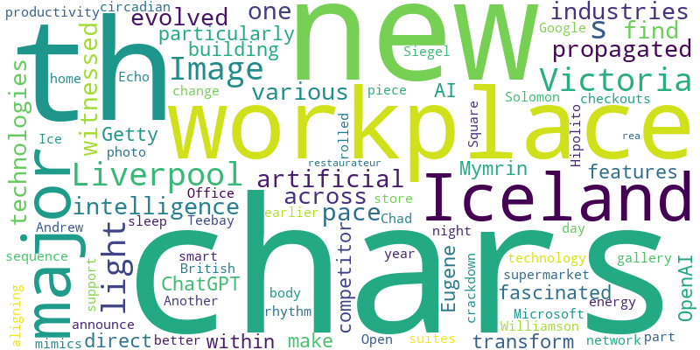
Technology - Word Cloud

Slide 5
Empowering Sustainability in the Energy Sector through AI
Source: Acm.org
Published: June 25, 2025
A new wave of AI technologies are leading to smart, responsive energy systems that will define our green future.
As one who has witnessed the pace at which artificial intelligence technologies have evolved and propagated across various industries, I find myself particularly fascinated by how AI can transform th… [+9495 chars]

Slide 6
OpenAI might be stealth-building the ultimate Google Workspace and Office 365 replacement
Source: ZDNet
Published: June 25, 2025
The AI company has long sought to transform its flagship chatbot into an all-purpose AI assistant.
Eugene Mymrin/Getty Images_x000D_
OpenAI is building new features within ChatGPT that would make it a direct competitor with workplace productivity suites like Google Workplace and Microsoft Office 365, Th… [+2955 chars]

Slide 7
Iceland announce major change at checkouts as part of crackdown
Source: Manchester Evening News
Published: June 26, 2025
Another major British supermarket rolled out the new piece of technology earlier this year
Iceland announce major change at checkouts as part of crackdown
Another major British supermarket rolled out the new piece of technology earlier this year
The Iceland store in Williamson Square in Liverpool. (Image: Andrew Teebay/Liverpool Echo )
Ice... [2997 chars]

Slide 8
How smart tech is supporting health on the home front
Source: The Globe and Mail
Published: June 26, 2025
Smart-home technology – from wellness lighting to digital locks – has evolved beyond convenience to help improve health and emotional well-being
Open this photo in gallery: Solomon Siegel’s home in Victoria has a smart-light network that mimics the day-to-night light sequence, aligning with the body’s circadian rhythm to support better sleep and energy.Chad Hipolito
Victoria restaurateur, rea... [6782 chars]

Slide 9
Finance Sector Update

Slide 10
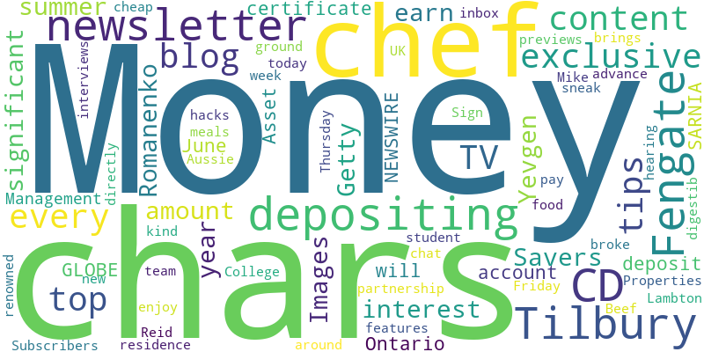
Finance - Word Cloud

Slide 11
How much will a $20,000 2-year CD account earn if opened now?
Source: CBS News
Published: June 25, 2025
It may take time to earn interest on a $20,000 2-year CD account but the returns could be well worth waiting for.
Savers can earn a significant amount of interest by depositing $20,000 into a 2-year CD this summer._x000D_
Yevgen Romanenko/Getty Images_x000D_
Depositing money into a certificate of deposit (CD) account will r… [+4142 chars]

Slide 12
Fengate Asset Management and Tilbury Properties break ground on new P3 student residence
Source: Financial Post
Published: June 25, 2025
SARNIA, Ontario, June 25, 2025 (GLOBE NEWSWIRE) — Fengate Asset Management (Fengate), in partnership with Tilbury Properties (Tilbury), broke ground today on the new Lambton College student residence in Sarnia, marking the official start of construction. Feng…
SARNIA, Ontario, June 25, 2025 (GLOBE NEWSWIRE) Fengate Asset Management (Fengate), in partnership with Tilbury Properties (Tilbury), broke ground today on the new Lambton College student residence i… [+5017 chars]

Slide 13
Money blog: Pound at near four-year high against dollar - which could be good news for shoppers
Source: Sky News
Published: June 26, 2025
Welcome to the Money blog, Sky News' personal finance and consumer hub. Today: our weekly Cheap Eats feature, in which a top chef tells us his most controversial opinion. And good mortgage news from Nationwide. Sign up below for our Money newsletter before the next edition on Friday.
Sign up to Money newsletter for exclusive tips, features and sneak previews
Our Money newsletter brings the kind of content you enjoy in the Money blog directly to your inbox every Friday.
Subscribers get top tips and exclusive content, with digestib... [401 chars]

Slide 14
Money blog: Nationwide changes mortgage rules to help first time buyers afford new builds
Source: Sky News
Published: June 26, 2025
Welcome to the Money blog, Sky News' personal finance and consumer hub. Today: our weekly Cheap Eats feature, in which a top chef tells us his most controversial opinion. And good mortgage news from Nationwide. Sign up below for our Money newsletter before the next edition on Friday.
Top TV chef on why you should pay for your meals out in advance
Every Thursday, our Money blog team interviews chefs from around the UK, hearing about their cheap food hacks and more. This week, we chat to Mike Reid, renowned TV chef and "Aussie Beef... [5370 chars]

Slide 15
Key Insights & Next Steps
• Review the latest market trends
• Consider the impact on your portfolio
• Stay tuned for our next update

