Slide 1
Police Inspectoare
Sanda Mihnea
Măzureanu Grigorian
Tuțac Alexandra

Slide 2
Login
In order to access any website feature the user has to be logged in. The accounts are predefined for the users.
An admin can create an account for a new police agent using the register button.
Admin’s accounts are predefined and they have to be manually registered into the database.

Slide 3
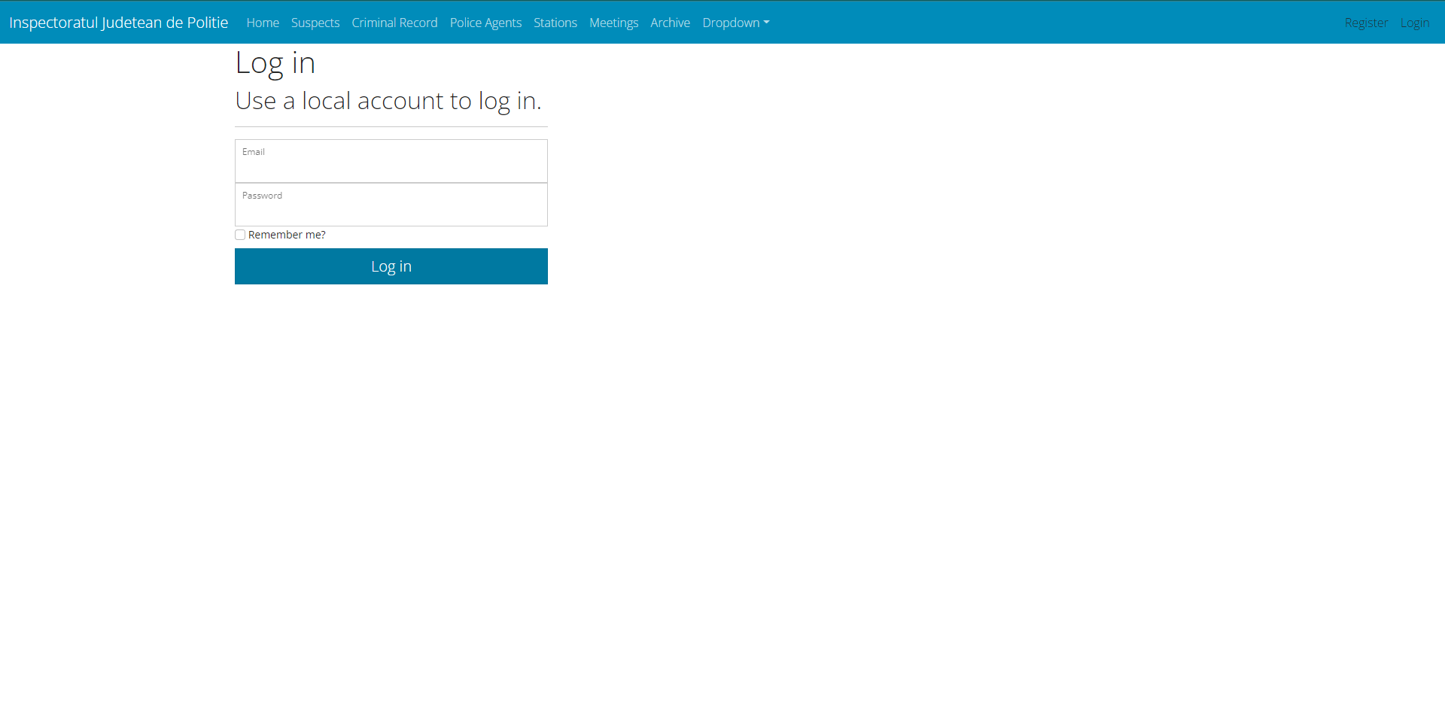

Slide 4
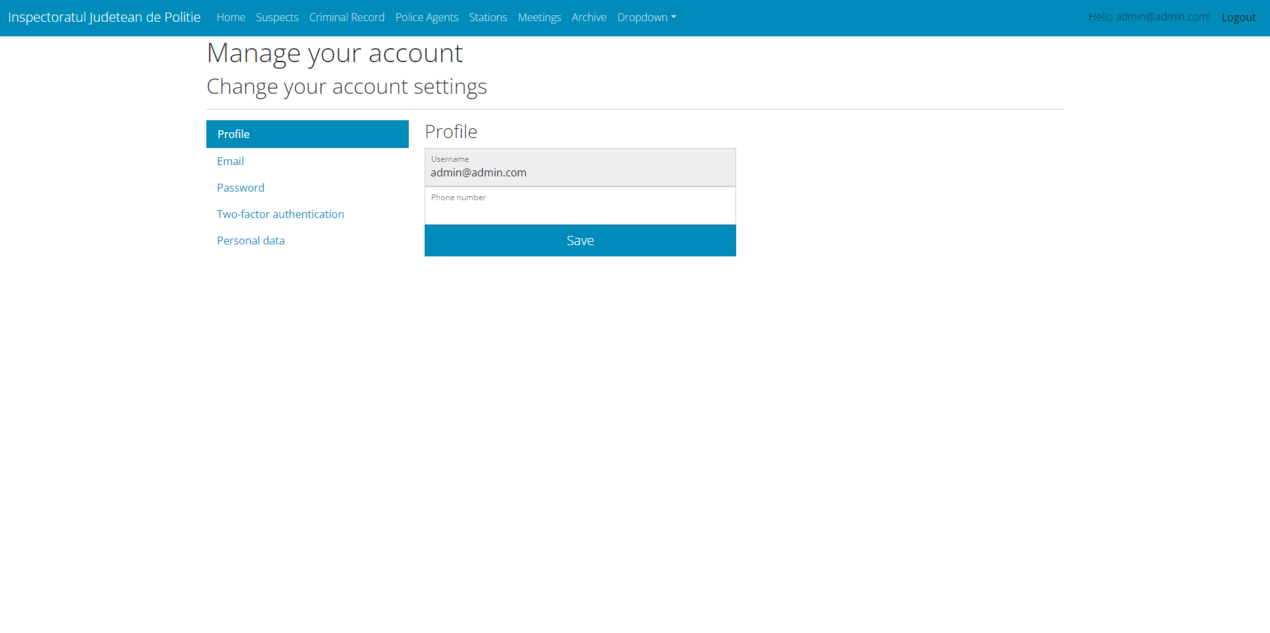
Connected user/admin

Slide 5
Contact
The home page has a contact button in order for any police agent or user to get in touch with the police inspectorate chief for different purposes.
Once pressed an email extension will be opened with the email for police inspectorate chief already filled in.
The user will have to fill in his email and the message.

Slide 6
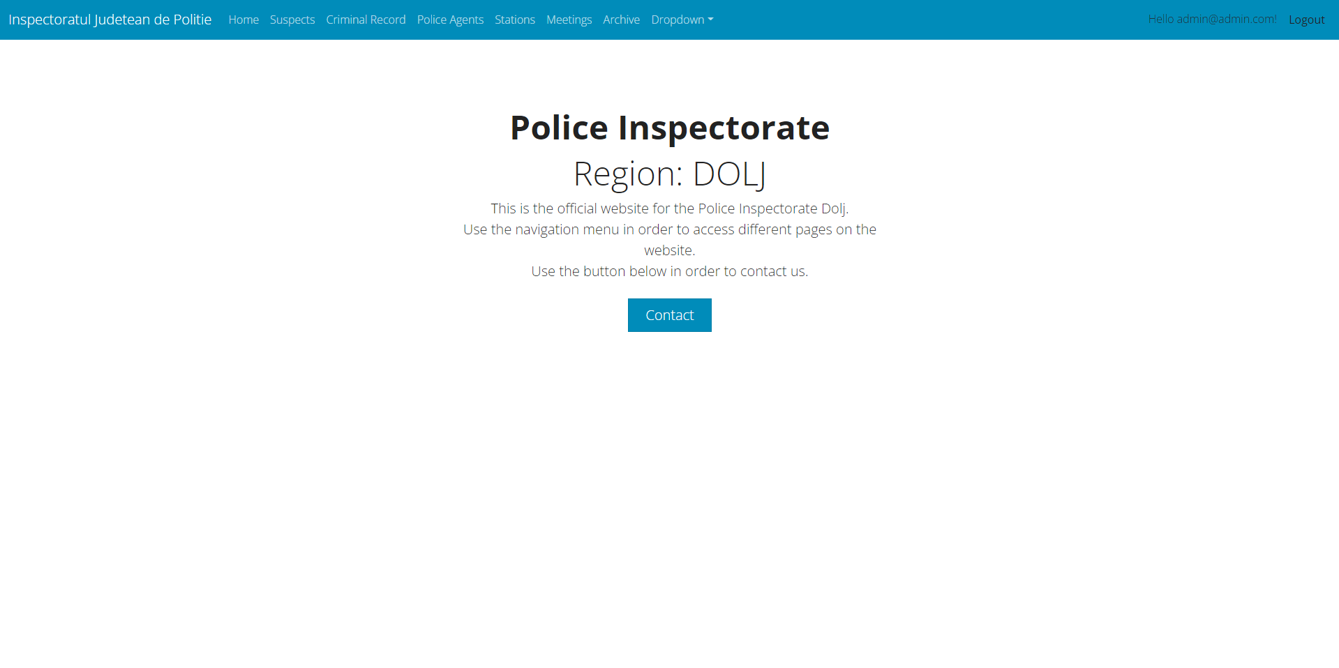
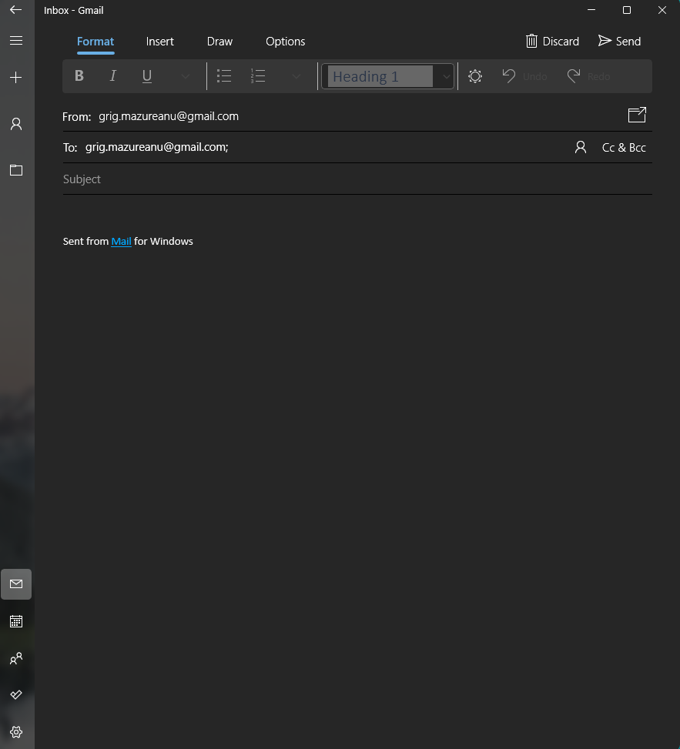

Slide 7
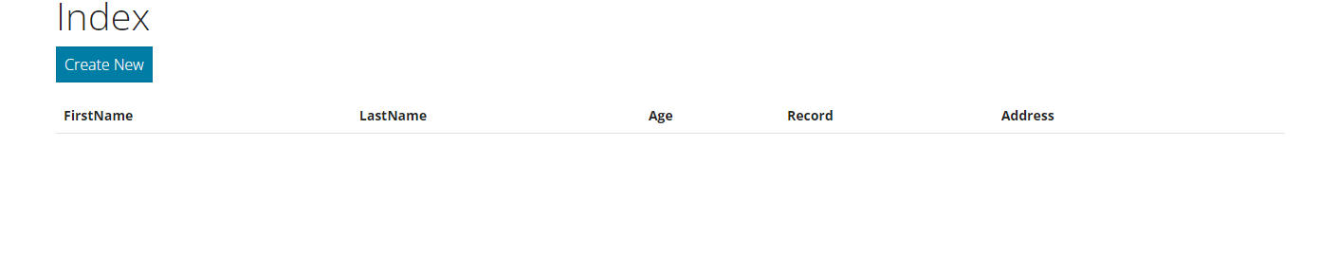
Suspects
In the suspects page the user can see, add and edit suspects.
The access to the CRUD operations is not restricted and any user regardless of his role can operate them.

Slide 8
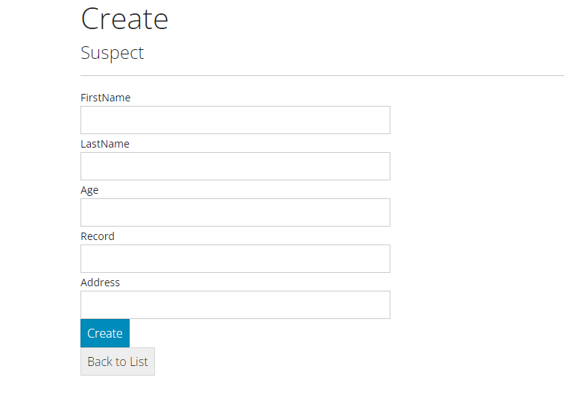
Create New Suspect
Once clicked this button the user will have to fill the following informations: Suspect first name, suspect last name, suspect age, suspect criminal record and suspect address

Slide 9
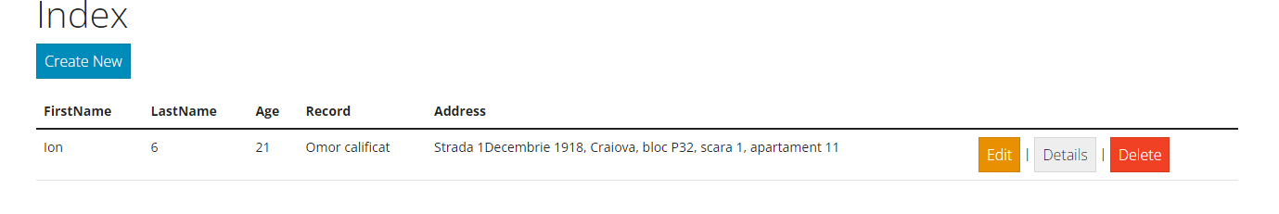
Edit/Details/Delete
Once created the suspect will be displayed on the main page for suspects. Also the information that have been filled up will be displayed.
After a new entry has been created for suspect 3 new additional buttons will be displayed representing: edit button(edit information regarding current entry), delete button(delete current entry) and detailed information button

Slide 10
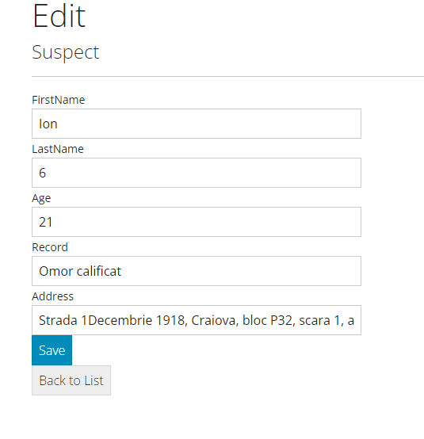
Edit
On edit button the previous filled information will be shown and the user can edit them and then save.

Slide 11
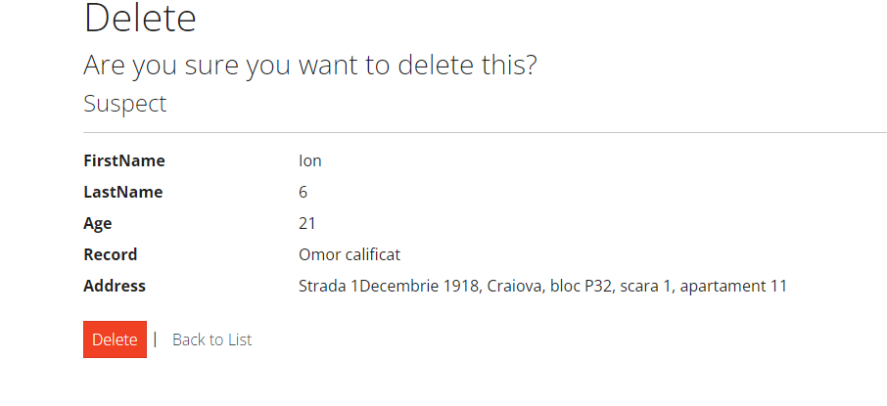
Delete
Confirmation prompt will be displayed so the user can not delete entry by mistake.
Hitting Delete again will delete the entry.

Slide 12
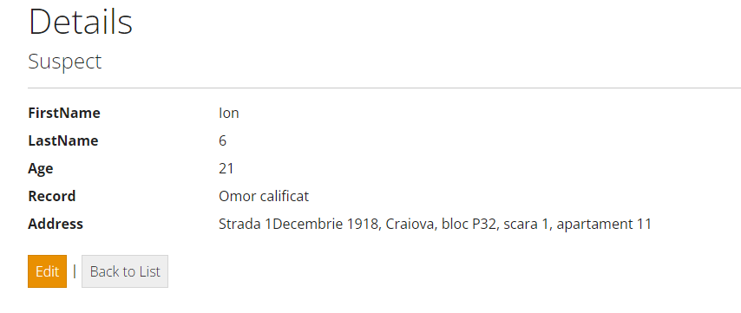
Details
Pressing Details button will get the user to a separate page where the information for the specific entry will be displayed in a better way, easier to read.
Also the user can edit from this page.

Slide 13
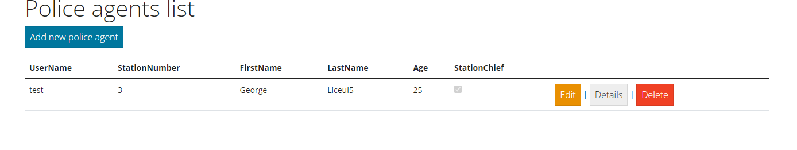
Police agents list
On this page the user can do the same CRUD operations presented before.
The difference is that the access for this feature is restricted.
Any user can see information but only the admin can add, edit and delete police agents.

Slide 14
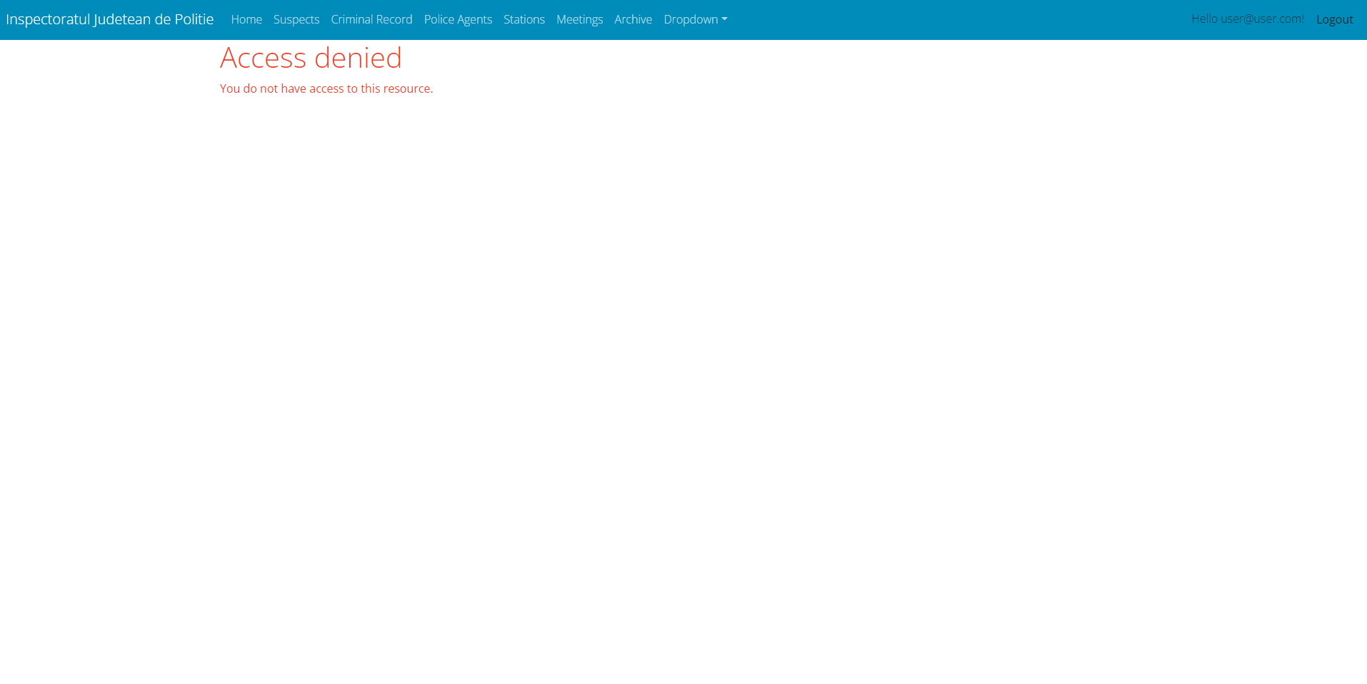
Access Denied
If a normal user tries to access a feature that is restricted only for admin role an access denied message will be displayed and the user won’t be redirected to the page he wants to access.

Slide 15
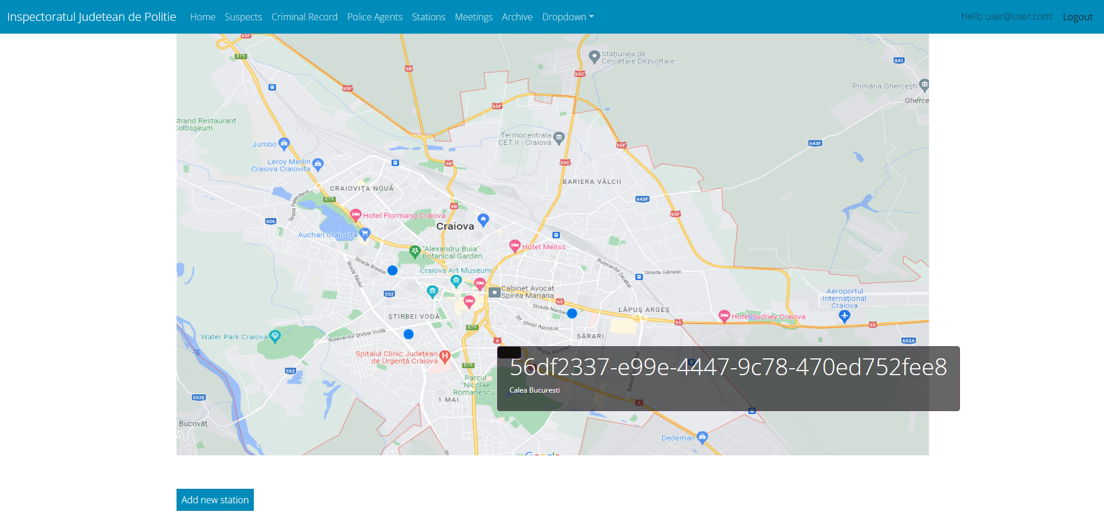
Stations
On station page any user can see a map for city Craiova.
On this map there are 3 blue dots representing the police stations in town.
If a user clicks any of the 3 blue dots, a pop-up will be displayed and information about the station will be displayed. Station id and station’s location.
Only the admin role can add, edit and delete stations.
Any user can see the stations, regardless of his role.

Slide 16
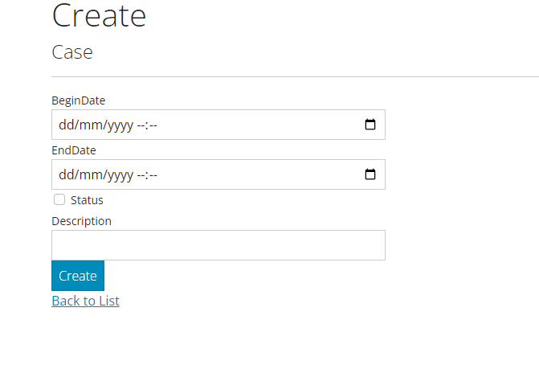
Archive/Criminal Record
On these pages any user can add new archive post/criminal record/case.
Archive is filtered so only cases that are at least 10 years old will be displayed.
Cases/Criminal record is filtered so cases that have not gone for 10 years will be displayed.
Other than this they are identical
CRUD operations can be performed as well.

