Slide 1
Debug and Test an HR SaaS
Grigori Schneider

Slide 2
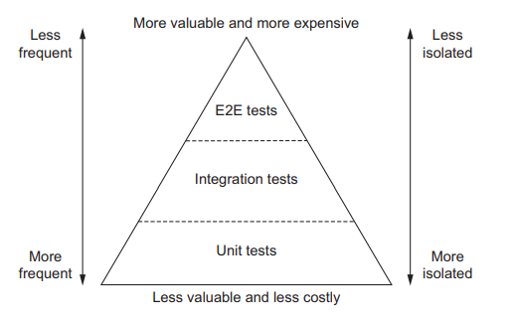
The testing pyramid

Slide 3
Test() function
A string describing what is being tested
A a callback function containing assertions and other testing logic
An optional timeout in millisecond

Slide 4
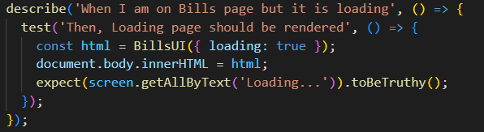

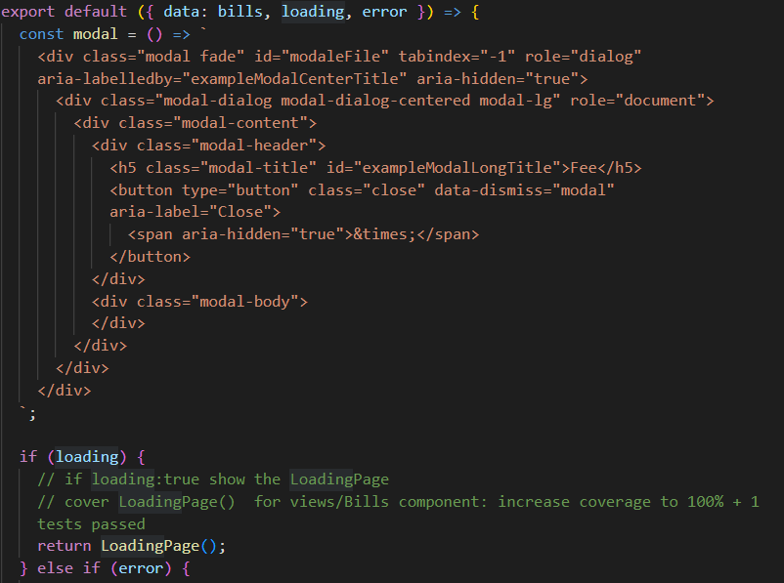
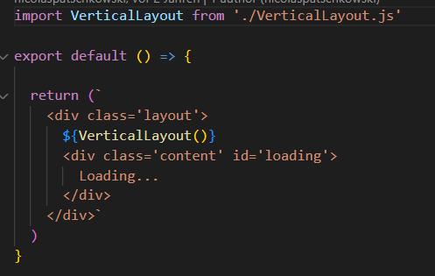
Bill.js
BillsUI.js
LoadingPage.js

Slide 5
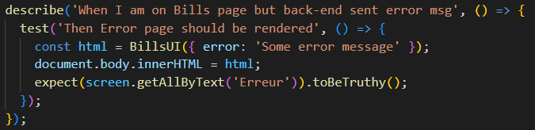

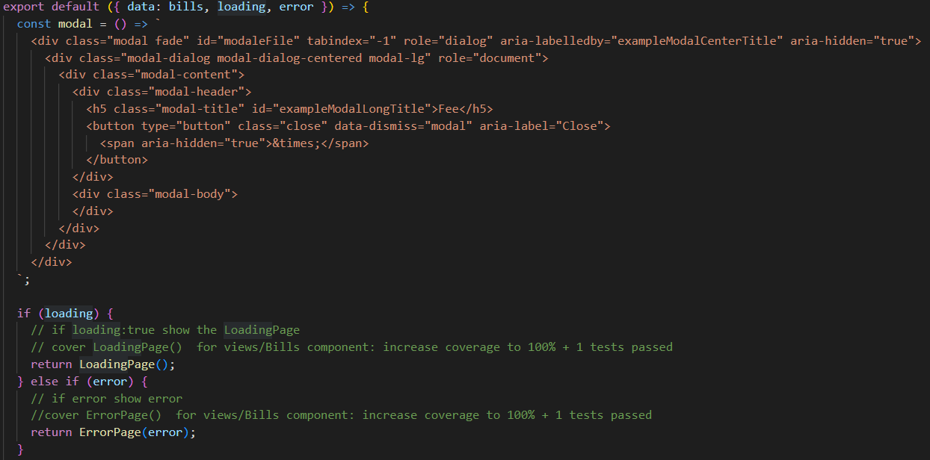
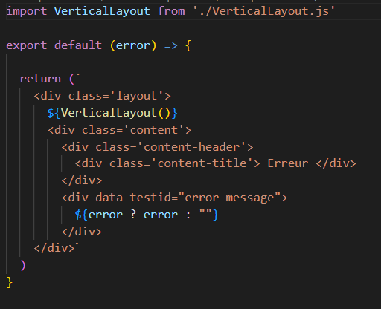
Bills.js
BillsUI.js
ErrorPage.js

Slide 6
Mocking with Jest
Testing with a real REST API not ideal for a few reasons:
  Incorporating REST API calls into our tests can create fragile tests that may fail simply due to network issues.
  If we were interacting with a production-grade database, we could accidentally alter official data.

Slide 7
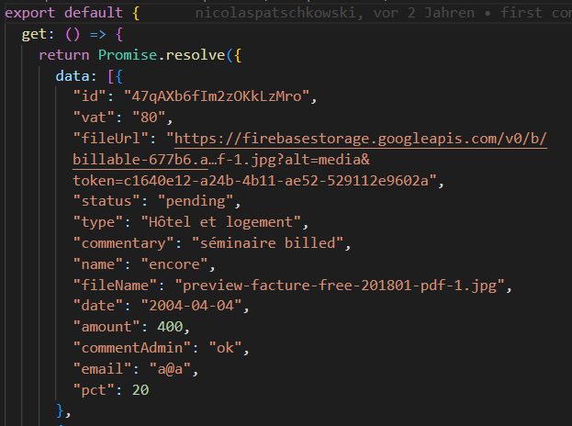
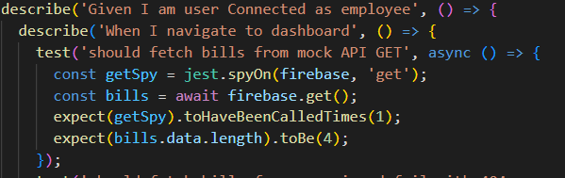
Bills.js
firebase.js

Slide 8
Integration tests
Integration test validate how the different pieces of your software work together.
Tests that call a function and check whether it has updated items in a database are in this category.
The scope of these test is broader than the scope of unit test but smaller than the scope of end-to-end tests. They assert the quality of the intermediary steps of the process

Slide 9
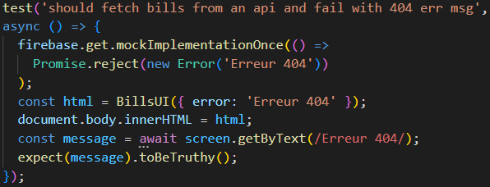
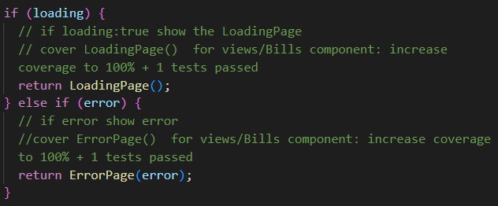
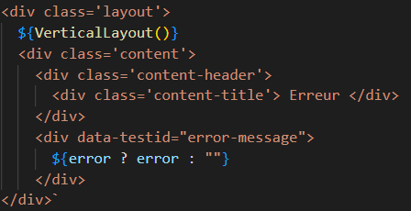
Bills.js
BillsUI.js
ErrorPage.js

Slide 10
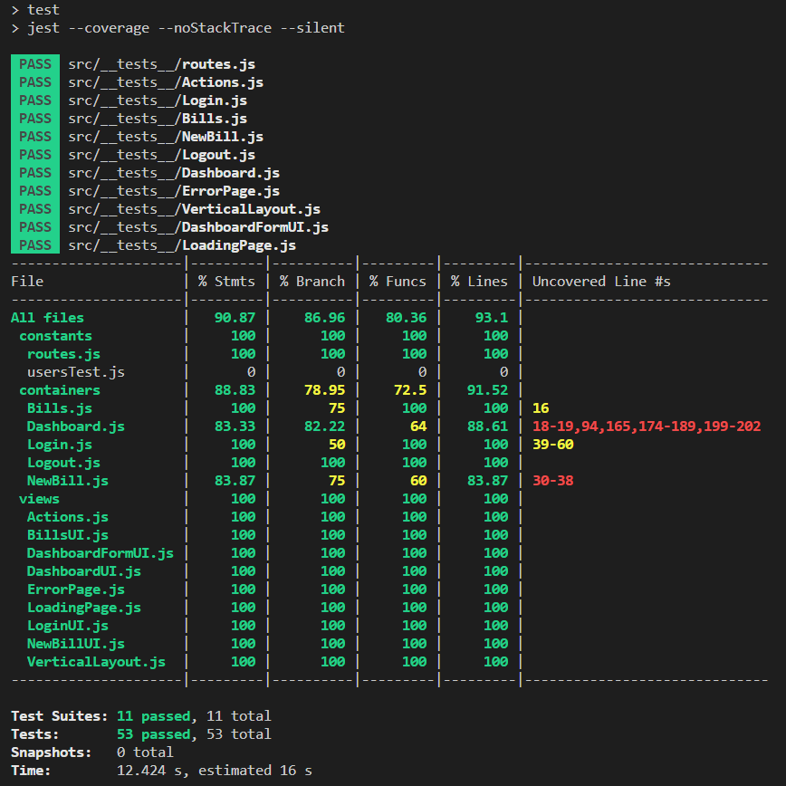
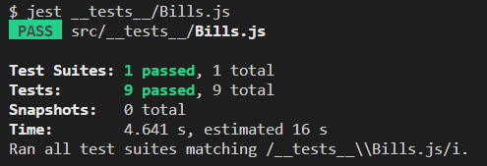
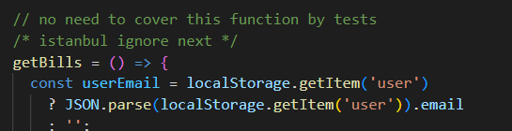
src/containers/Bills.js
Coverage Report

Slide 11
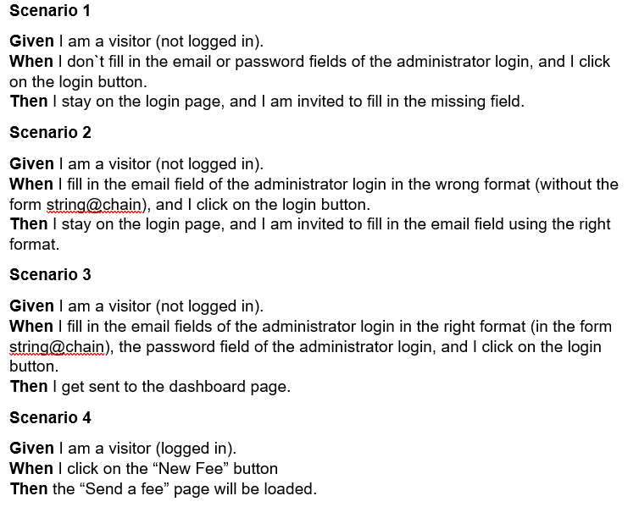
End-to-End (E2E) test
End-to-end tests:
validate your application from a users perspective,
treat your software as a black box
A test that controls a web browser and interacts with your application by clicking buttons and verifying labels
Their scope: entire application and its features.

Slide 12
Characteristics of each kind of test (1)
 | Unit tests | Integration tests | End-to-end tests
Target | Individual functions | Observable behavior and the integration among multiple functions | User-facing functionality
Quantity | Numerous tests per function | Somewhat frequent –many tests per observable behavior | Sparse – a few tests per feature
Speed | Very quick – usually a few milliseconds | Average – usually few seconds | Slow Many seconds up to minutes in complex cases
Execution frequency | Numerous times during the development | Regularly during the development of a feature | When features are complete
Feedback level | Specific problematic input and output for individual functions | Problematic behavior | Incorrect functionality

Slide 13
Characteristics of each kind of test (2)
 | Unit tests | Integration tests | End-to-End tests
Costs | Cheap Usually small, quick to update, run, and understand | Moderate Medium-sized, Reasonably fast to execute | Expensive Take a long time to run, and tend to be more flaky and convoluted
Knowledge of the application | Coupled Require direct access to the code itself, address its functions | Address functionality, but als through direct acces to the code, require acces to components like databases, the network, or filesystems | As unaware of the code as possible, interact with the application through the interface given to its users
Main goals | Provide quick feedback during development time, aid refactoring, prevent regressions, and document the code`s APIs by providing usage examples | Guarantee adequate usage of third-party libraries, and check whether the unit under test performs the necessary side effects, such as logging or interacting with separate services | Guarantee the application works for its end users

Slide 14
Thank you!
Q&A

