Slide 1
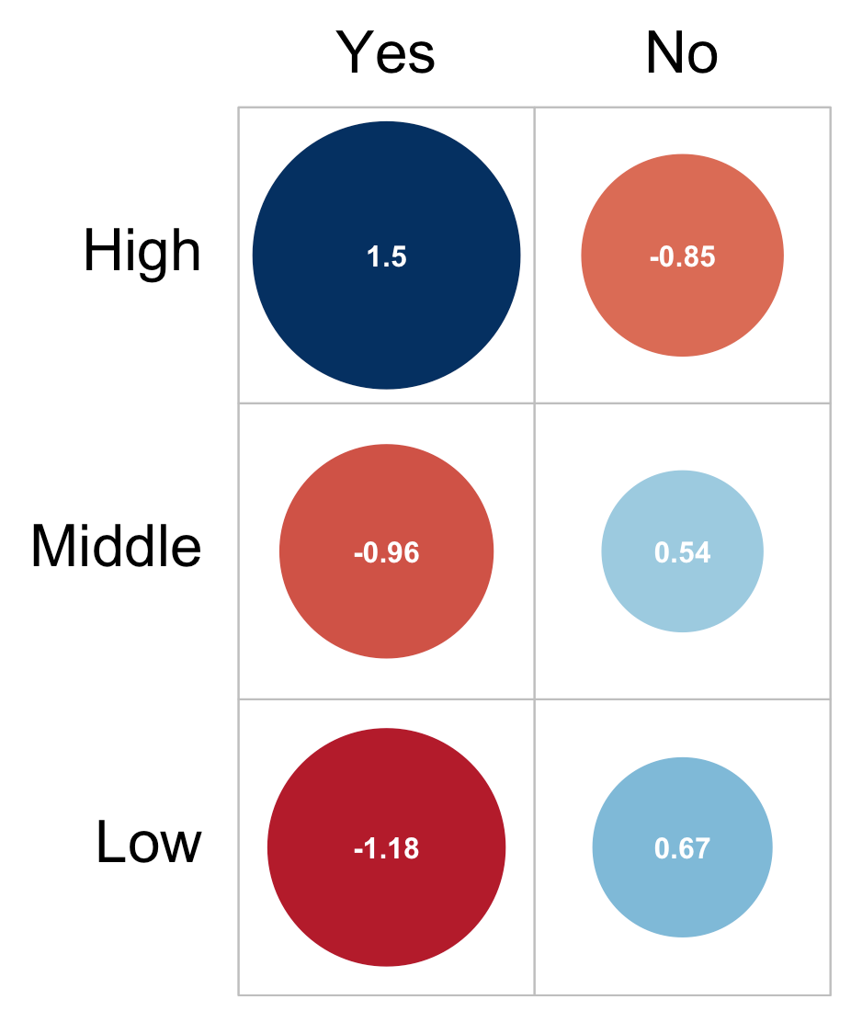
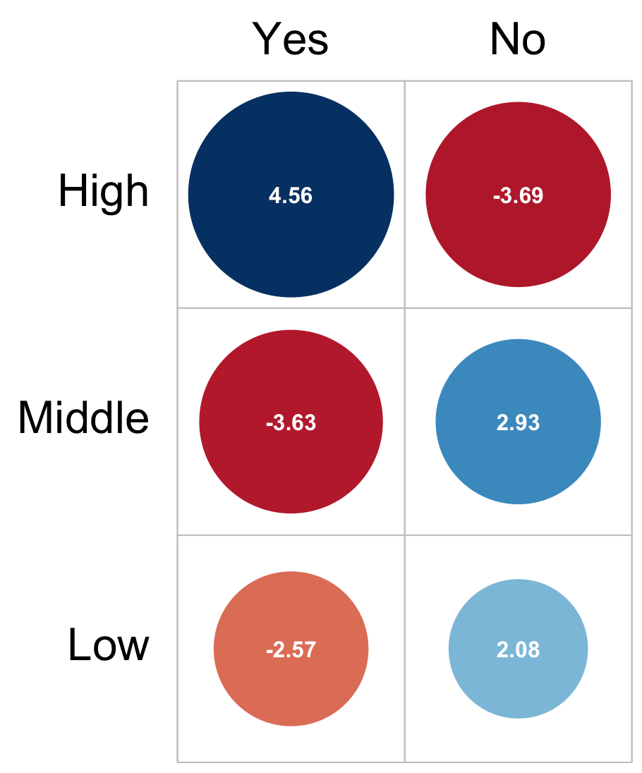
Is it possible to obtain informed consent online via internet/telefone in your routine setting?
1.5
-0.85
4.56
-3.69
-0.96
0.54
-3.63
2.93
-1.18
0.67
-2.57
2.08
A: Internet
B: Telefone
Notes:
Is it possible to obtain informed consent online via internet/telefone in your routine setting? (stratified by high, middle and low Gross Domestic Product per capita (GDPpc))

Slide 2
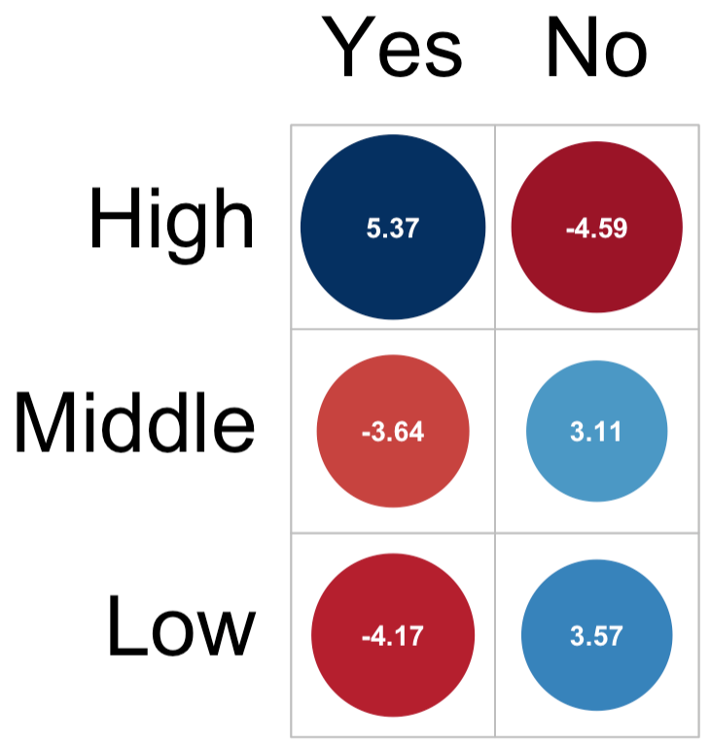
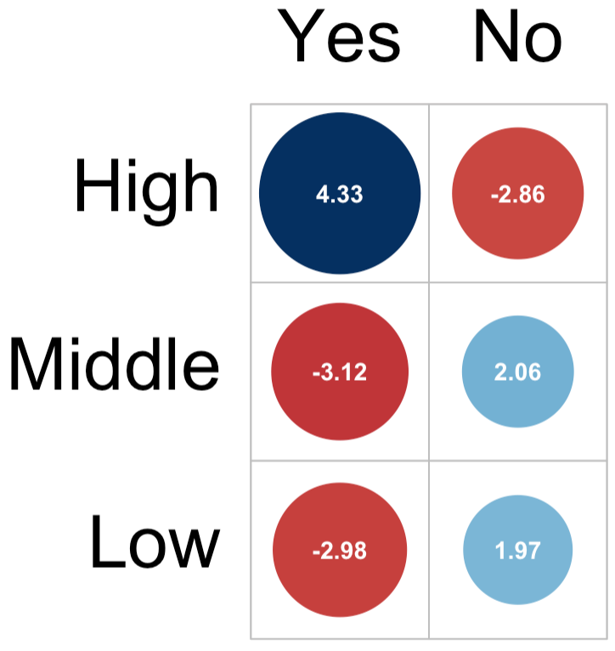
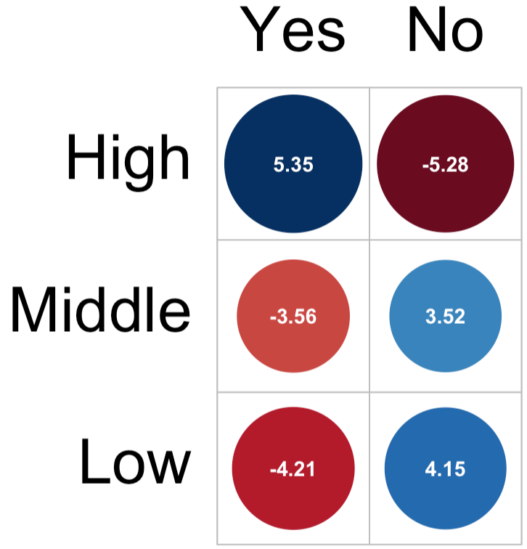
Is a remote informed consent in accordance with the legal requirements for simple, complex or repeated anaesthesia?
5.37
-4.59
4.33
-2.86
5.35
-5.28
-3.64
3.11
-3.12
2.06
-3.56
3.52
-4.17
3.57
-2.98
1.97
-4.21
4.15
Simple
Complex
Repeated

Slide 3
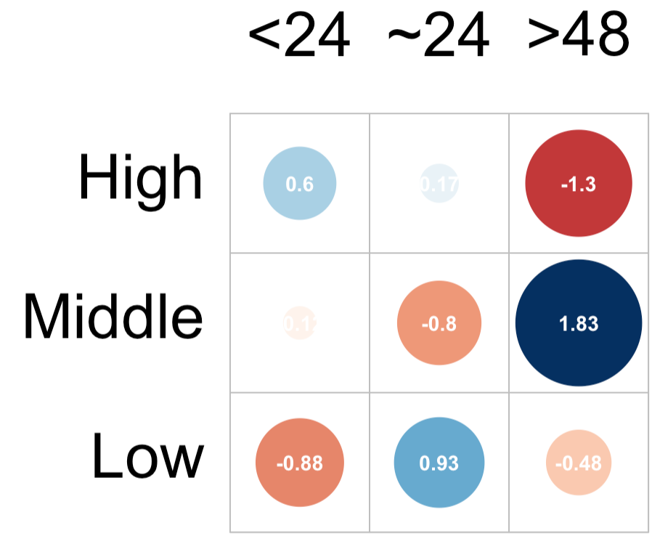
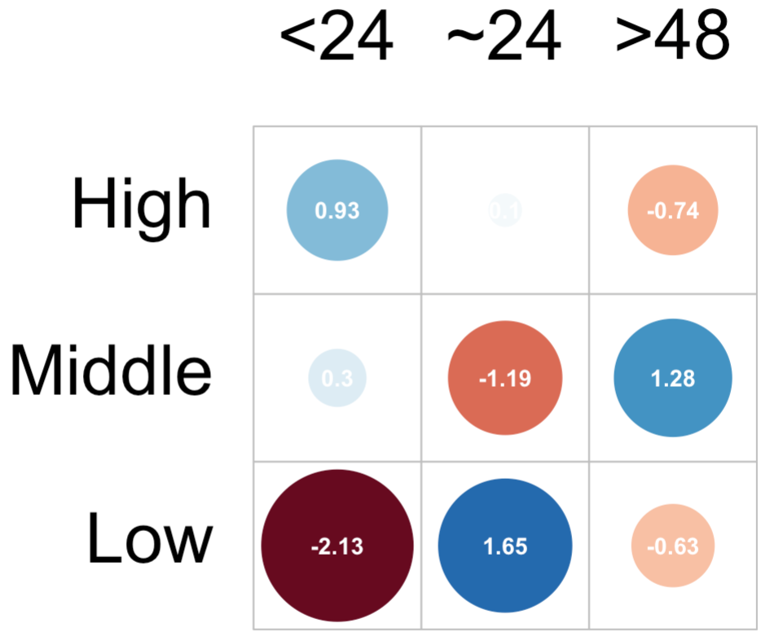
When do you need to obtain Informed consent for elective surgery based on legal requirements for simple and complex procedures?
Simple
Complex

Slide 4
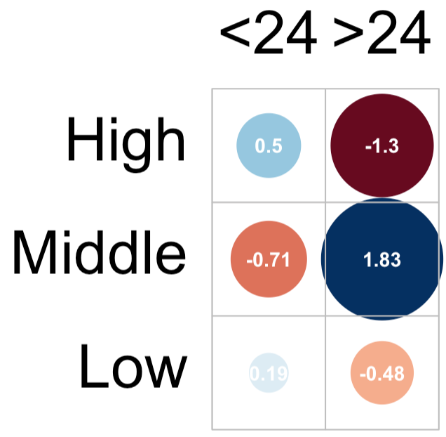
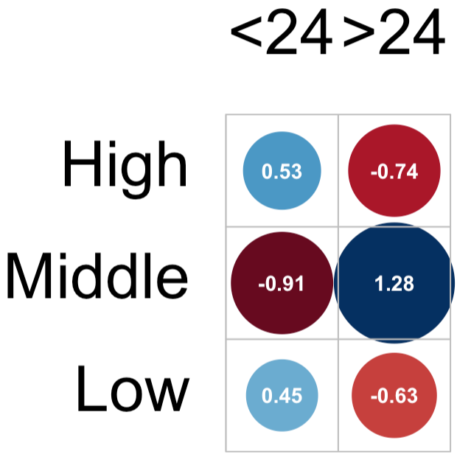
When do you need to obtain Informed consent for elective surgery based on legal requirements for simple and complex procedures?
Simple
Complex

