Slide 1
Table 1. Descriptive statistics of the study population stratified by gender.
 | female | male | Diverse | p
n (%) | 406 (43.6) | 521 (56) | 3 (0.3)
Profession (%) |  |  |  | <0.001
Medical doctor | 402 (99.0) | 516 (99.2) | 2 (66.7)
Nurse | 0 (0.0) | 1 (0.2) | 1 (33.3)
Physician assistant | 4 (1.0) | 2 (0.4) | 0 (0.0)
Other | 0 (0.0) | 1 (0.2) | 0 (0.0)
Your expert level (%) |  |  |  | 0.33
Anaesthesia technician | 4 (1.0) | 6 (1.2) | 0 (0.0)
Consultant | 303 (74.8) | 426 (81.8) | 2 (66.7)
Resident | 75 (18.5) | 67 (12.9) | 1 (33.3)
Special trained nurse | 0 (0.0) | 1 (0.2) | 0 (0.0)
Other | 23 (5.7) | 21 (4.0) | 0 (0.0)
Notes:
Table 1. Descriptive statistics of the study population stratified by gender.

Slide 2
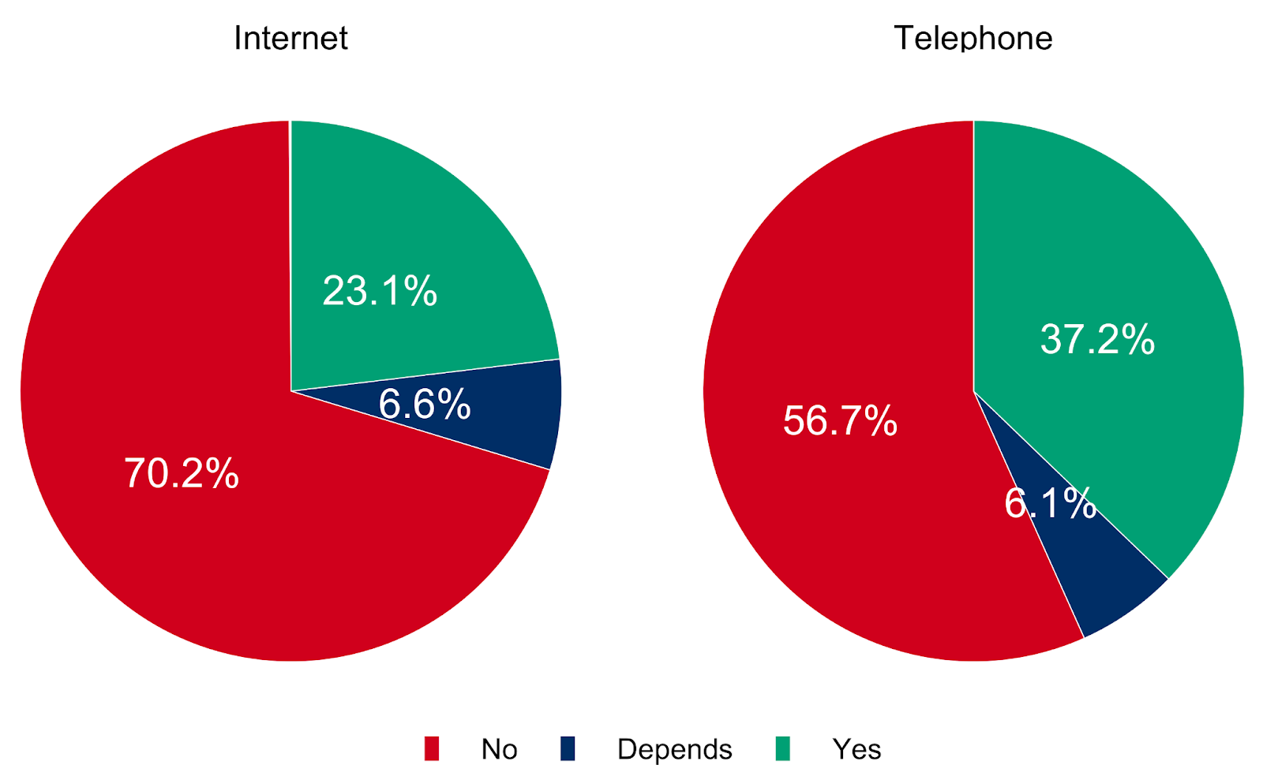
Notes:
Figure 1: Is it possible to obtain informed consent online via internet or telephone in your routine setting?

Slide 3
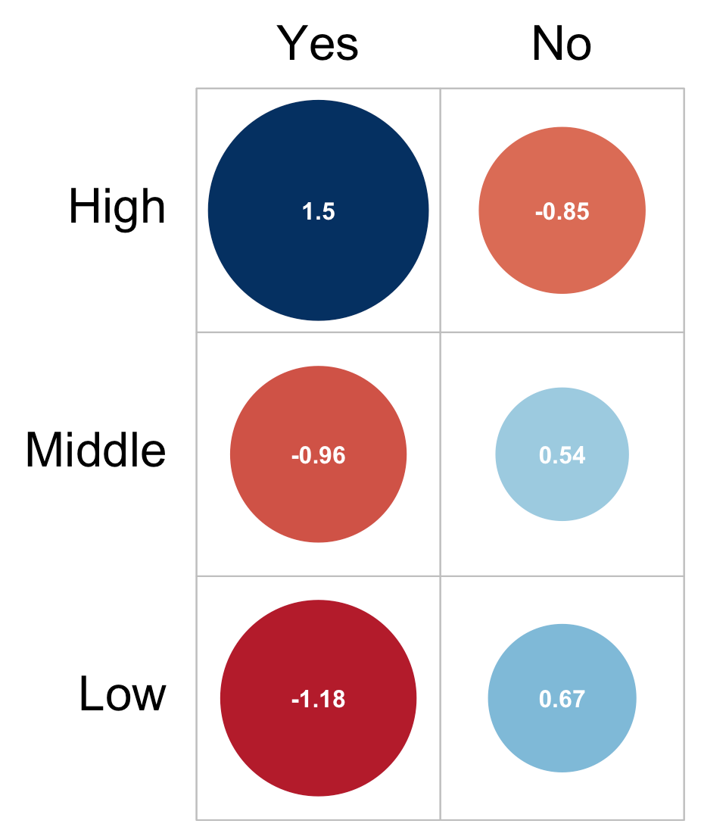
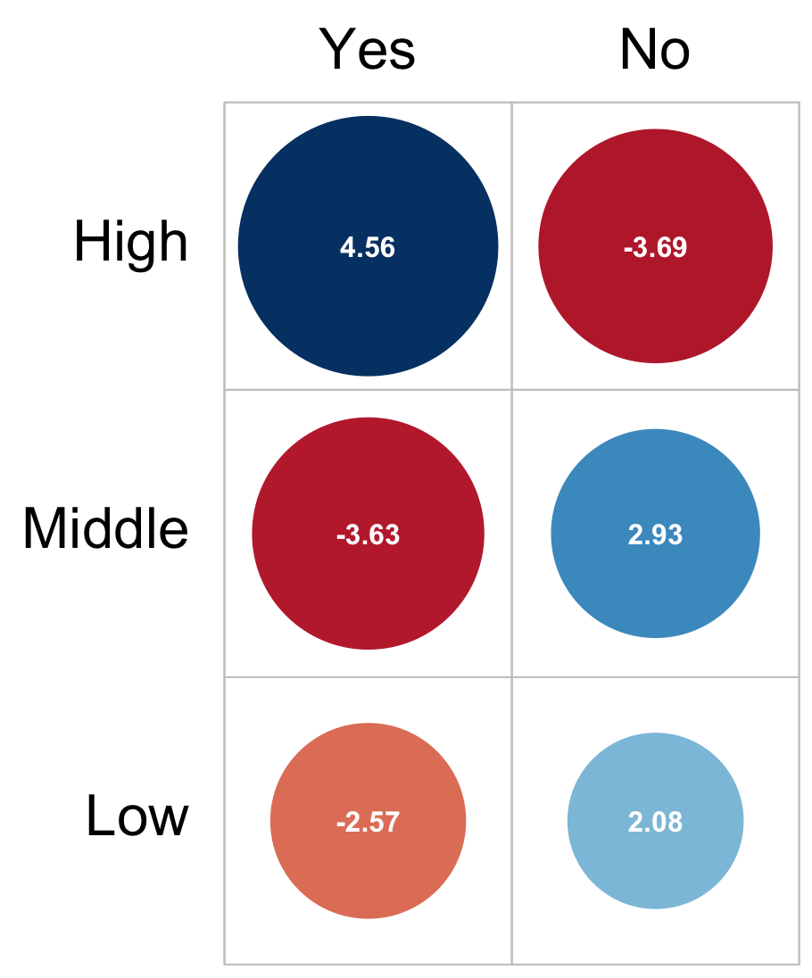
1.5
-0.85
4.56
-3.69
-0.96
0.54
-3.63
2.93
-1.18
0.67
-2.57
2.08
A: Internet
B: Telephone
Notes:
Figure 2: Is it possible to obtain informed consent online via internet/telefone in your routine setting? (stratified by high, middle and low Gross Domestic Product per capita (GDPpc))

Slide 4
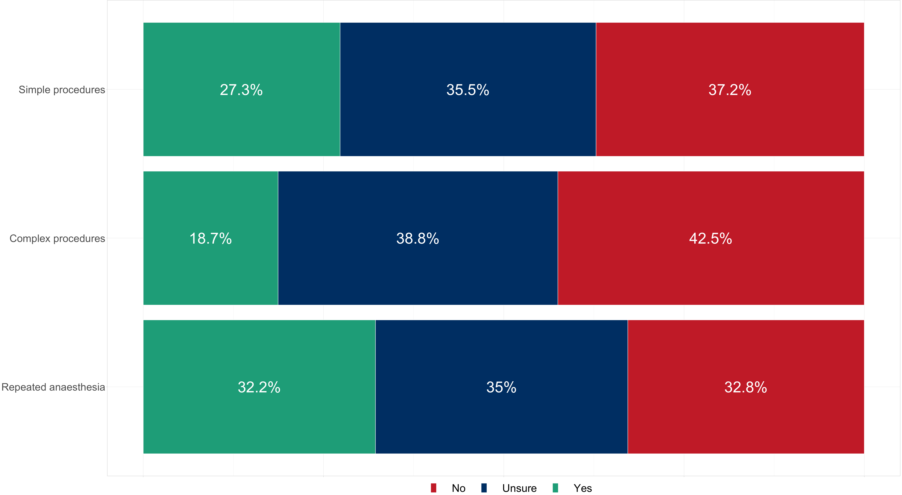
Notes:
Figure 3: Is a remote informed consent in accordance with the legal requirements for simple or complex procedures and would it be allowed for repeated anaesthesia?

Slide 5
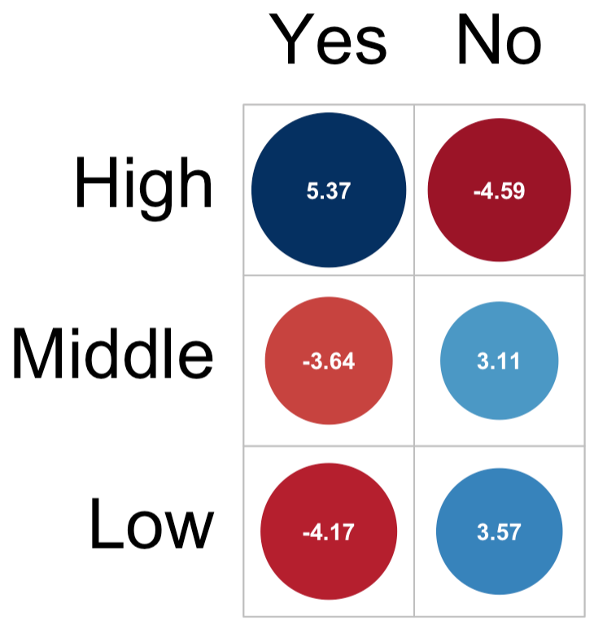
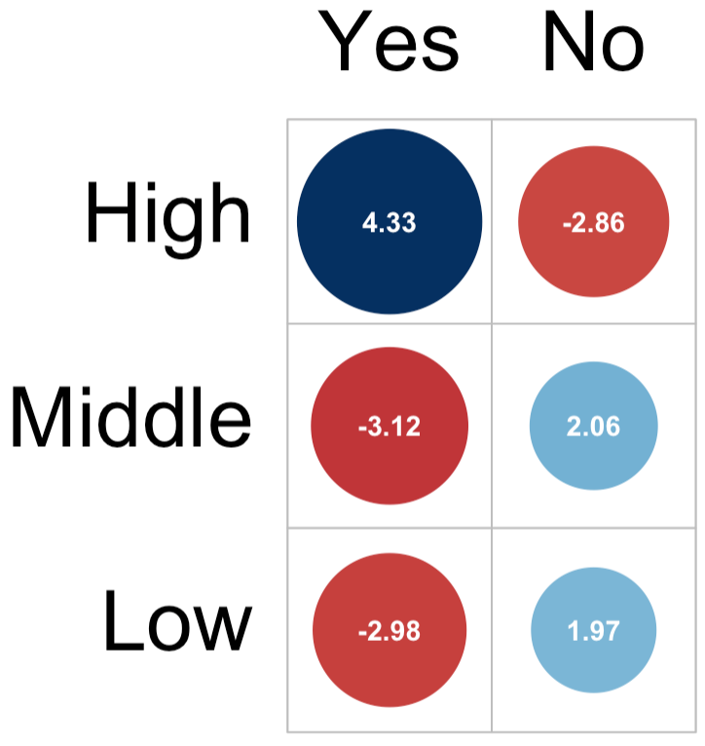
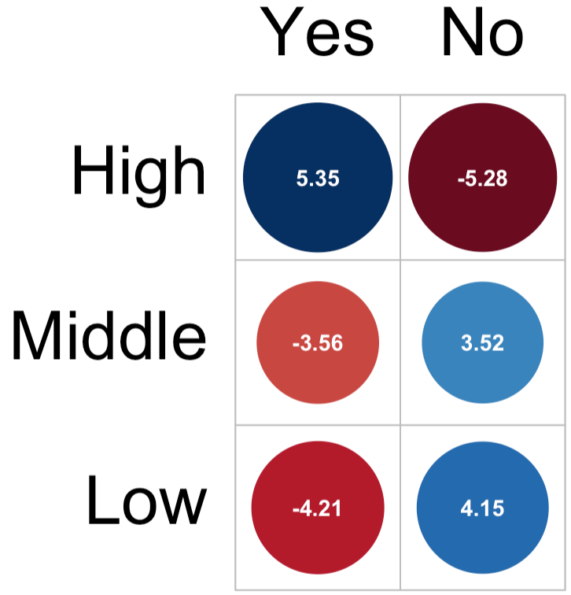
Simple
Complex
Repeated
Notes:
Figure 4: Is a remote informed consent in accordance with the legal requirements for simple, complex or repeated anaesthesia?

Slide 6
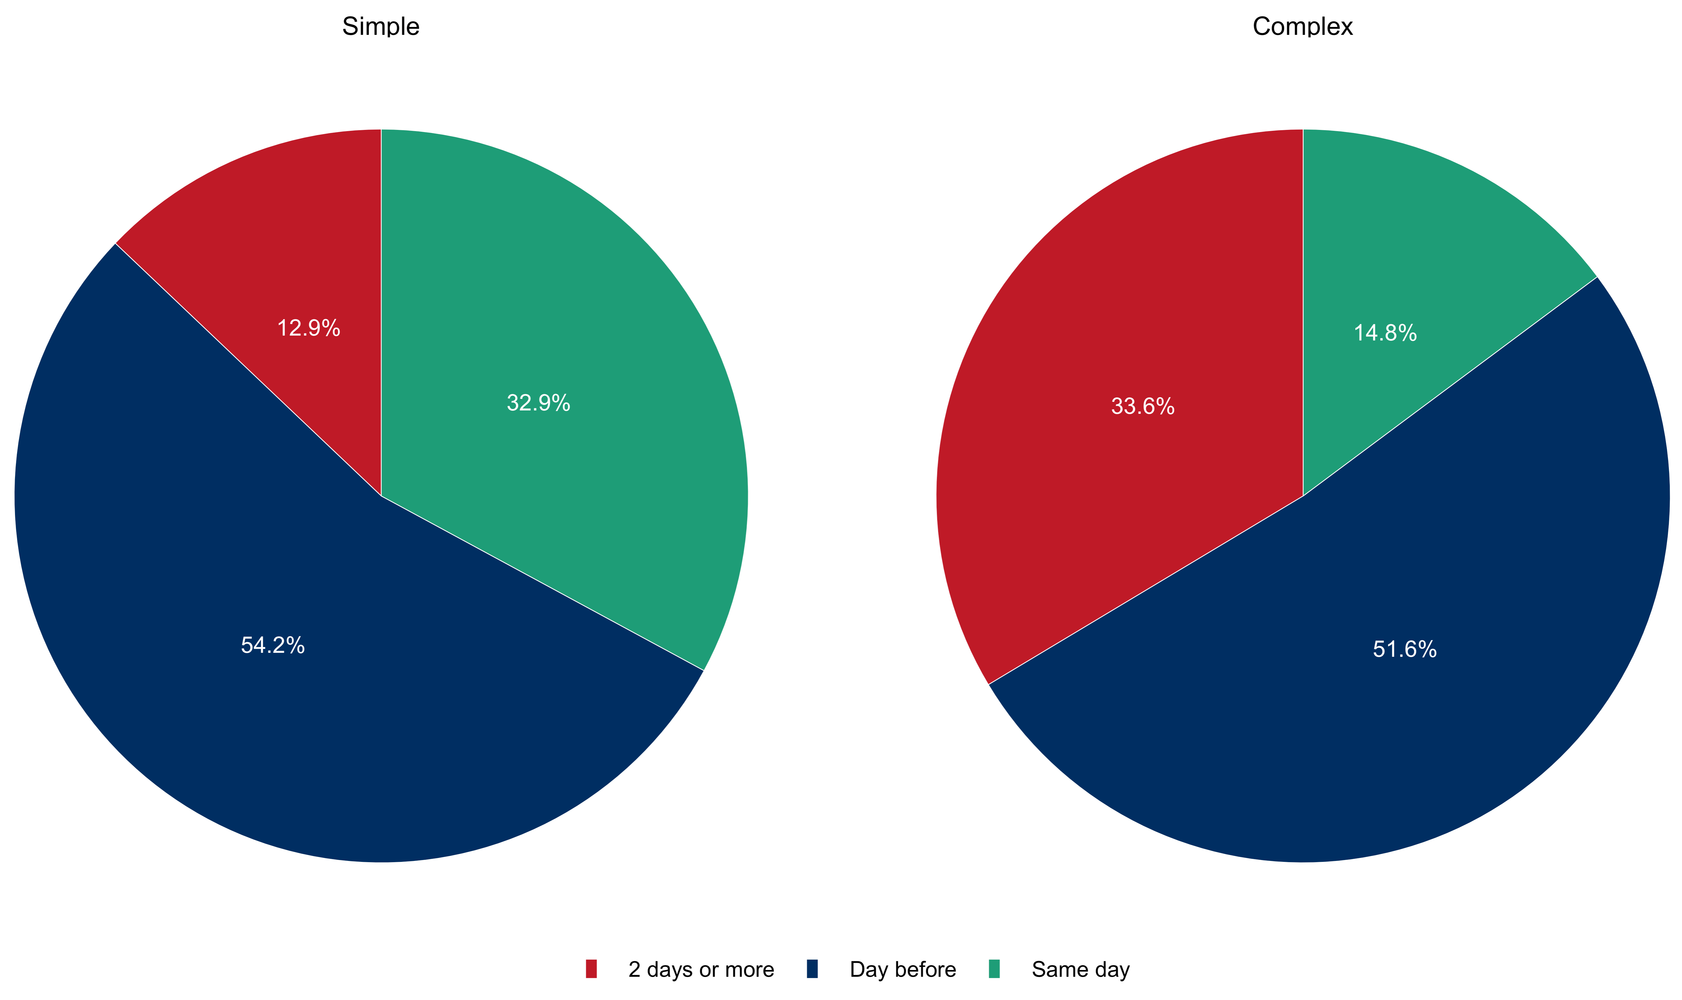
Notes:
Figure 5: When do you need to obtain Informed consent for elective surgery based on legal requirements for simple and complex procedures?

