Slide 1
WPF (Core) + MVVM
Artem Grigoryan
.Net Trainee

Slide 2
1. Introduction
WPF, XAML, MVVM Design pattern, MVVM Light Toolkit

Slide 3
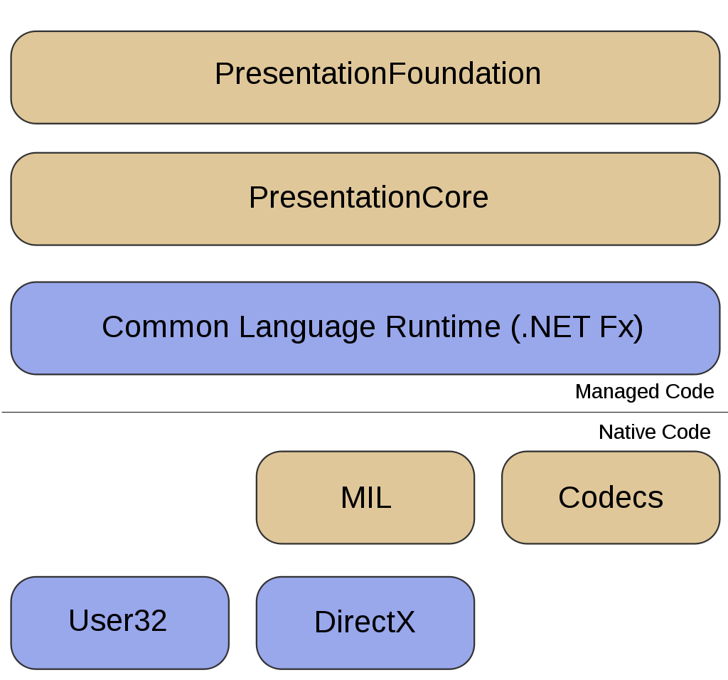
WPF
Windows Presentation Foundation (WPF) is a graphical subsystem originally developed by Microsoft for rendering user interfaces in Windows-based applications;
Was initially released as part of .NET Framework 3.0 in 2006;
WPF uses DirectX and attempts to provide a consistent programming model for building applications;
Separates the user interface from business logic, and resembles similar XML-oriented object models, such as those implemented in XUL and SVG.

Slide 4
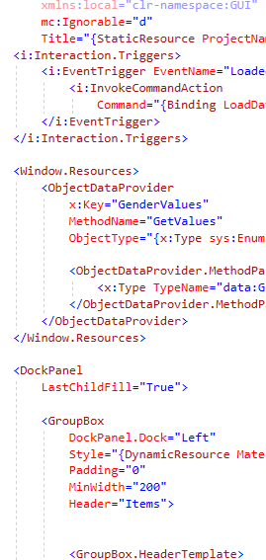
XAML
Is a declarative markup language.
Can initialize objects and set properties of objects using a language structure that shows hierarchical relationships between multiple objects.
Сan then associate a separate code-behind file for each XAML file that can respond to events and manipulate the objects that you originally declare in XAML.

Slide 5
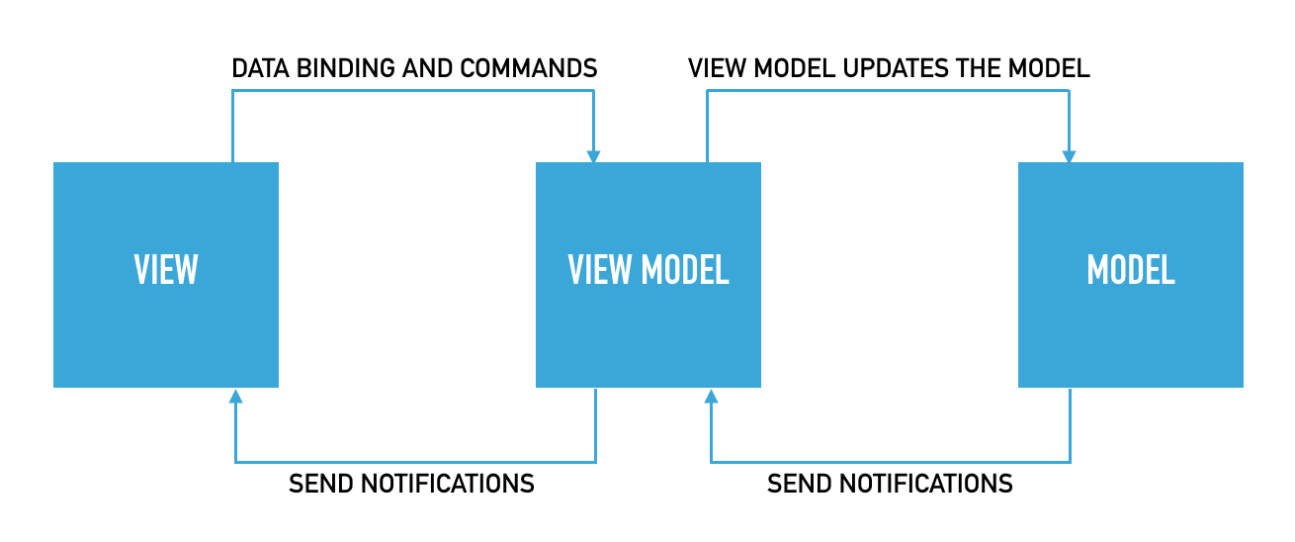
MODEL–VIEW–VIEWMODEL

Slide 6
Model
Model refers either to a domain model, which represents real state content (an object-oriented approach), or to the data access layer, which represents content (a data-centric approach).

Slide 7
View
As in the MVC, the view is the structure, layout, and appearance of what a user sees on the screen. It displays a representation of the model and receives the user's interaction with the view, and it forwards the handling of these to the view model via the data binding that is defined to link the view and view model.

Slide 8
View model
The view model is an abstraction of the view exposing public properties and commands.
MVVM has a binder, which automates communication between the view and its bound properties in the view model.
The view model has been described as a state of the data in the model
A view directly binds to properties on the view model to send and receive updates

Slide 9

MVVM Light Toolkit
The MVVM Light Toolkit helps you to separate your View from your Model;
Creates testable applications and allows you to have a much thinner user interface layer;
Design-time data to enable the Blend users to "see something" when they work with data controls.

Slide 10
ObservableObject
RaisePropertyChanged<T> ([CallerMemberName] string propertyName = null,
T oldValue = default, T newValue = default, bool broadcast = false)
Raises the PropertyChanged event if needed, and broadcasts a PropertyChangedMessage using the Messenger instance (or the static default instance if no Messenger instance is available).
Set<T>(ref T field, T newValue, [CallerMemberName] string propertyName = null);
Assigns a new value to the property. Then, raises the PropertyChanged event if needed.

Slide 11
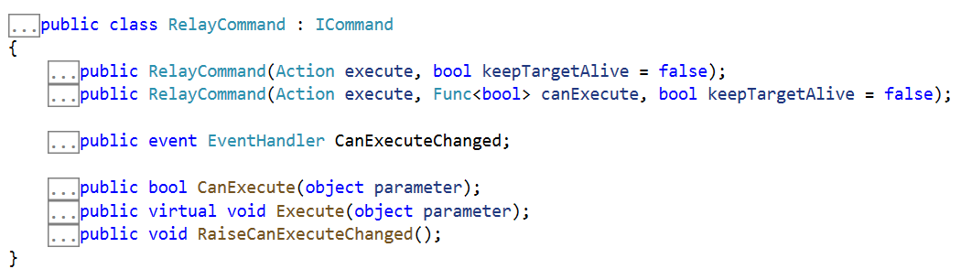
RelayCommand

Slide 12
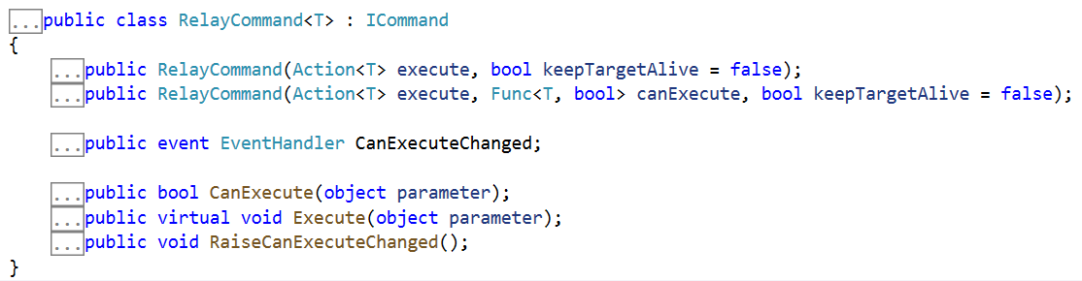
RelayCommand<T>

Slide 13
2. Preparation
MaterialDesignInXamlToolkit, RestSharp

Slide 14
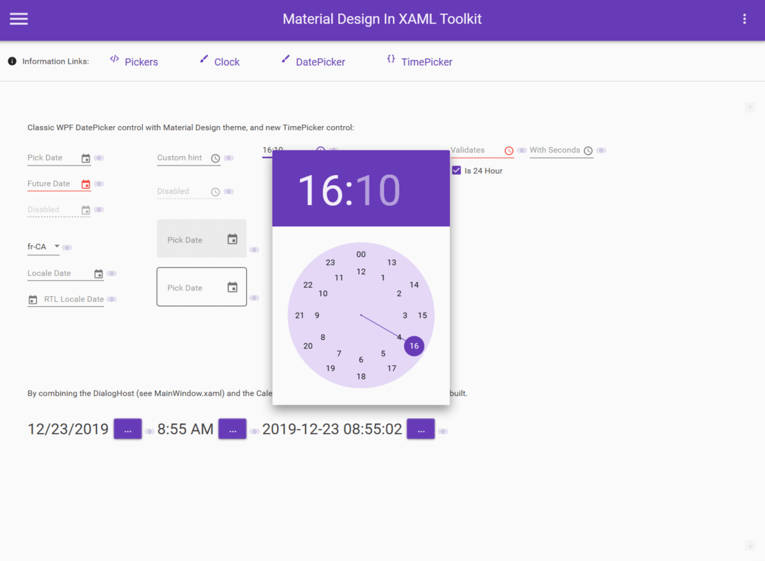
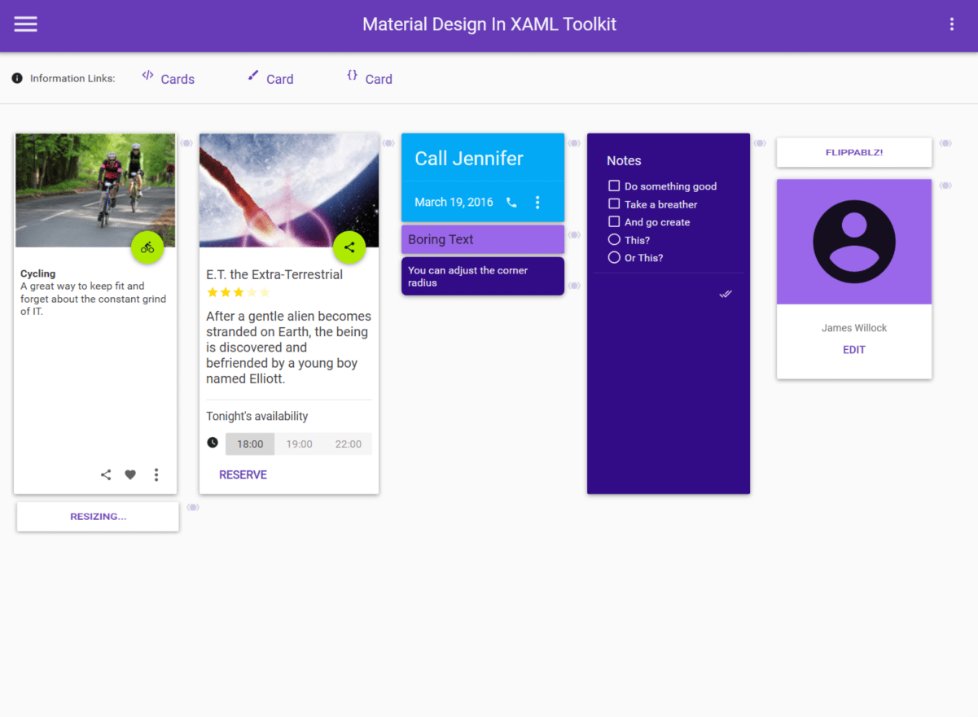
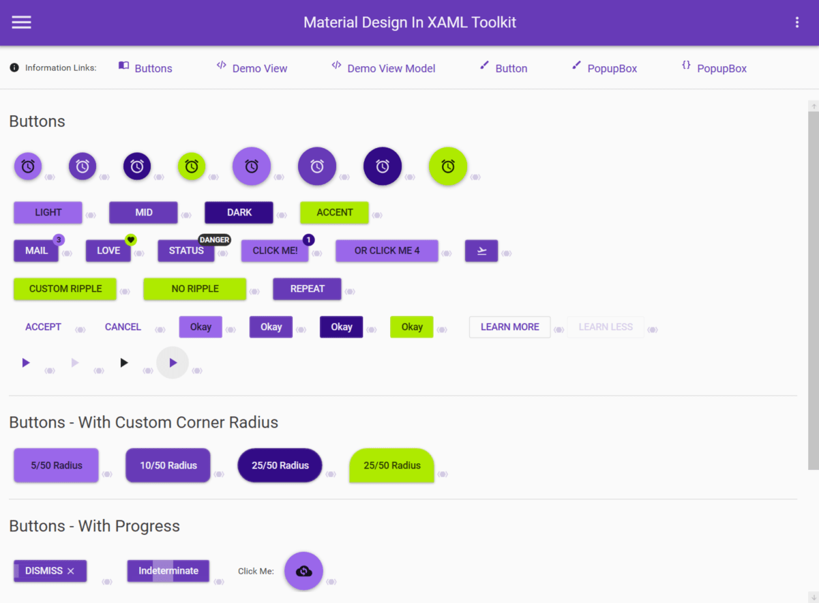
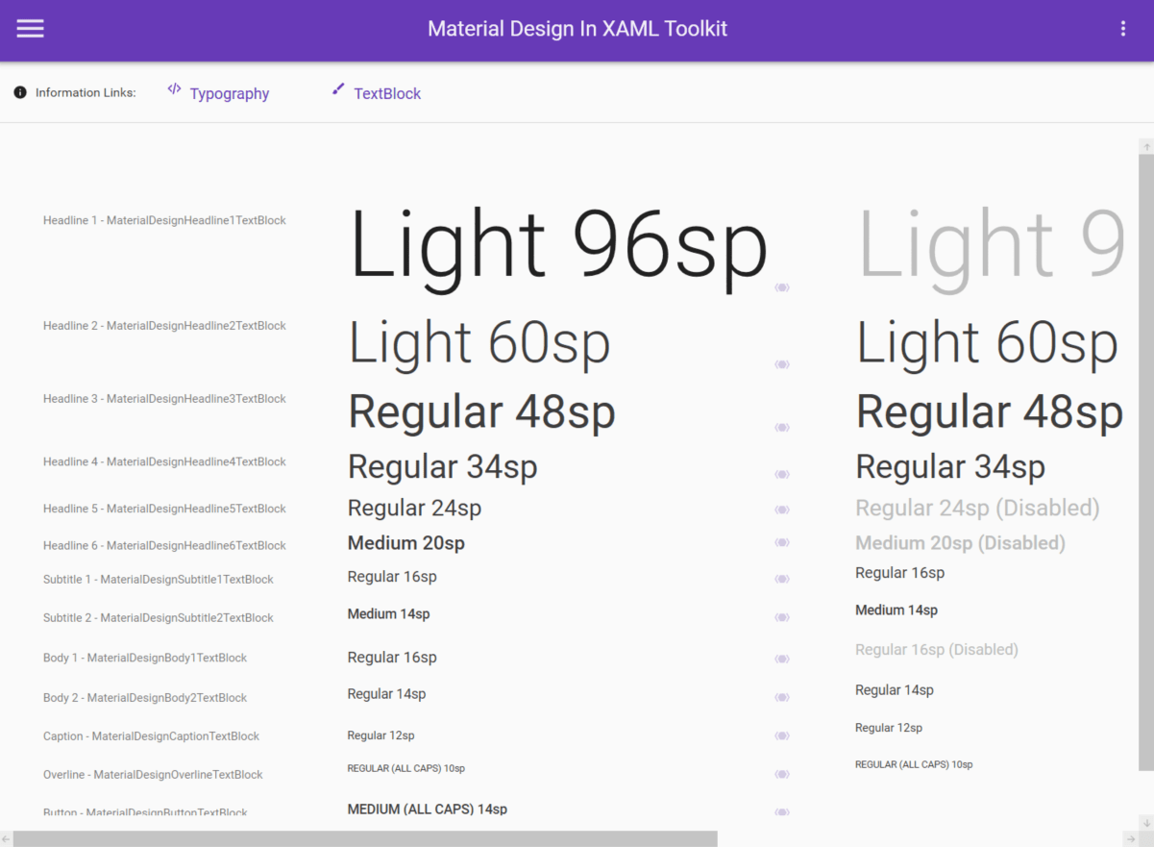
MaterialDesignInXamlToolkit
Material Design styles for all major WPF Framework controls
Additional controls to support the theme, including Multi Action Button, Cards, Dialogs, Clock
Easy configuration of palette (at design and runtime), according to Google's guidelines
Easy transition effects
Compatible with Dragablz, MahApps

Slide 15

RestSharp
RestSharp is HTTP client library for .NET. Featuring automatic serialization and deserialization, request and response type detection, variety of authentications and other useful features, it is being used by hundreds of thousands of projects.
RestSharp passed over 32 million downloads on NuGet, with average daily download count of 10,000.

Slide 16
3. Application
API (.Net Core 3.1), WPF (.Net Core 3.1)

Slide 17
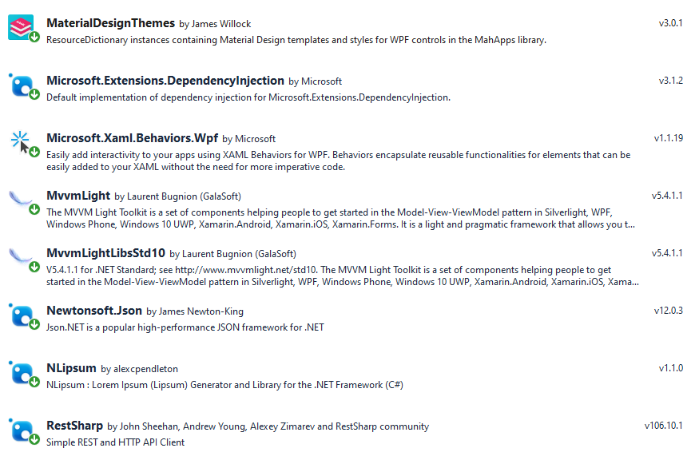
NuGet

Slide 18
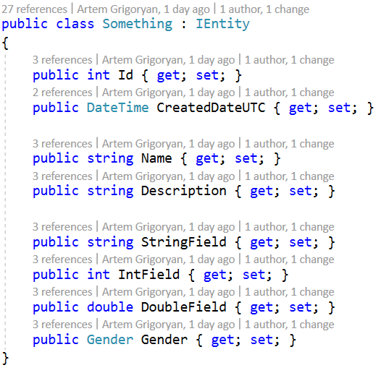
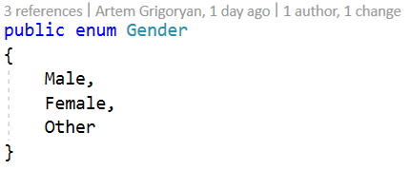
API

Slide 19
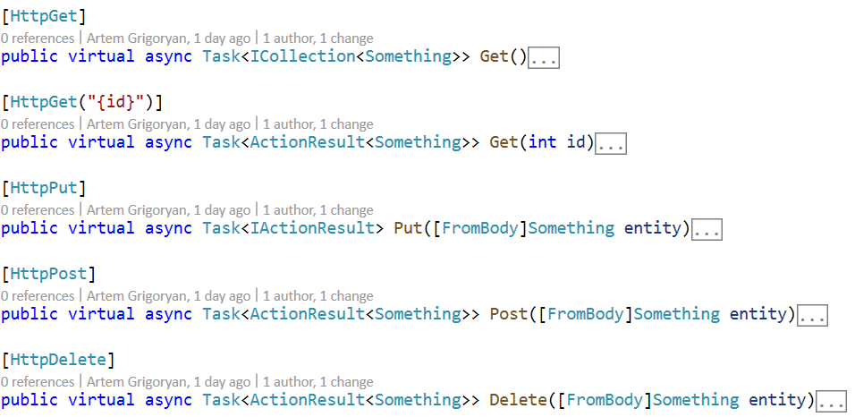
API

Slide 20
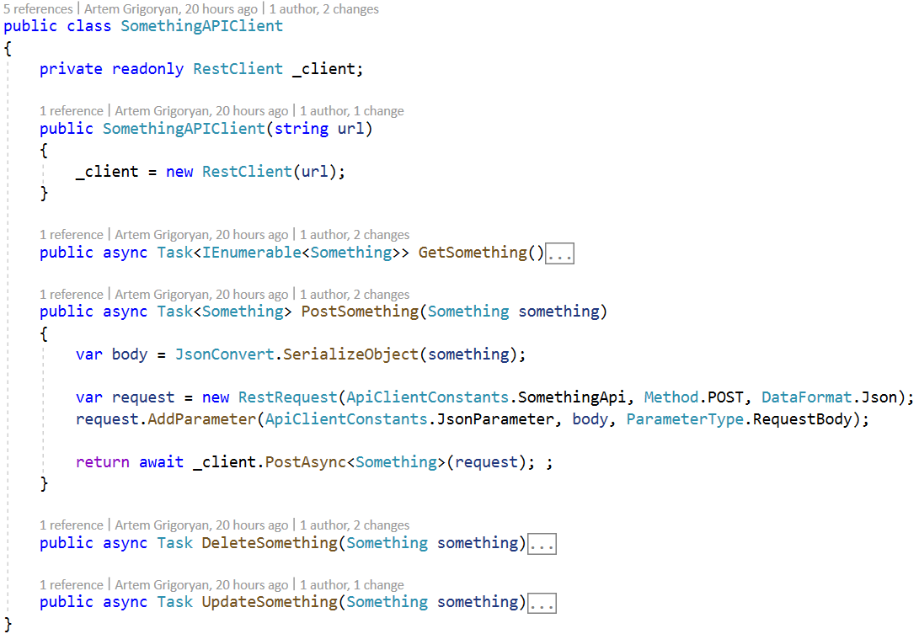
API Client

Slide 21
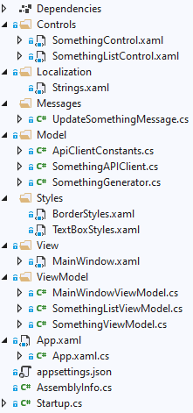
Structure
Controls – custom user controls;
Localization – resource files for localization;
Styles – controls styles
View – pages and windows
ViewModel – project view models

Slide 22
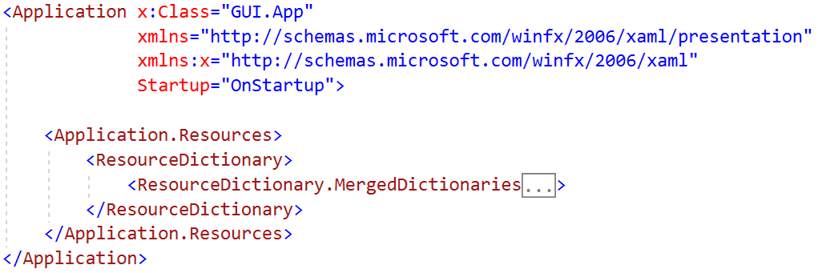
Entry point (App.xaml)

Slide 23
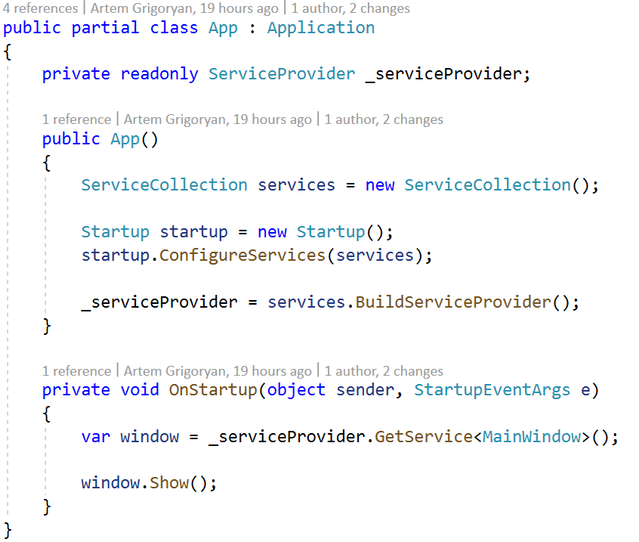
Entry point (App.xaml.cs)

Slide 24
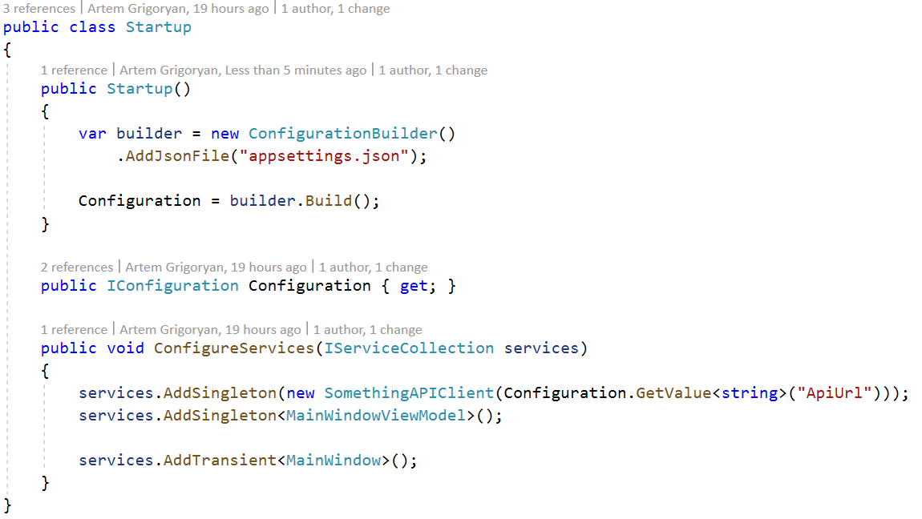
Entry point (Startup.cs)

Slide 25
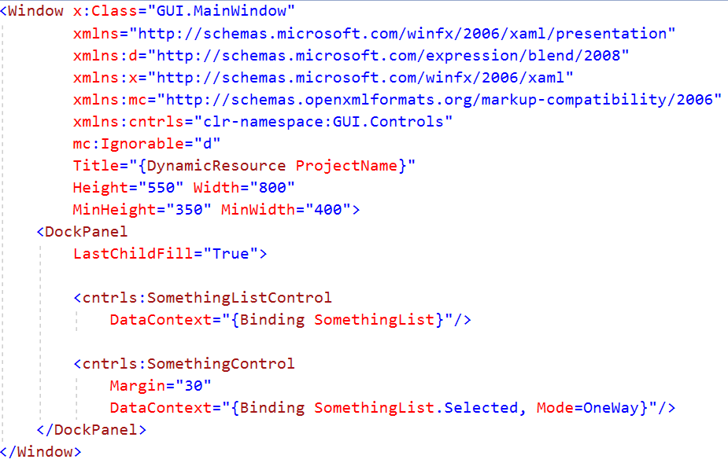
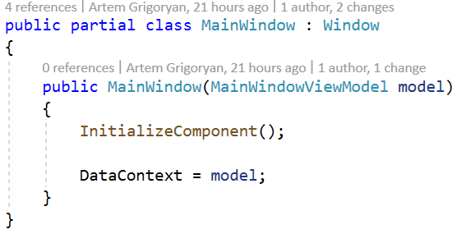
MainWindow

Slide 26
WPF - Resources
StaticResource – is a onetime lookup
DynamicResource – works more like a data binding. It remembers that a property is associated with a particular resource key. If the object associated with that key changes, dynamic resource will update the target property.

Slide 27
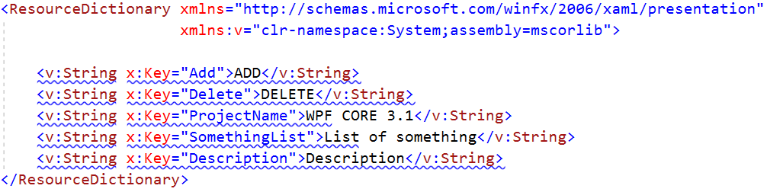
Dynamic resources (Strings.xaml)

Slide 28
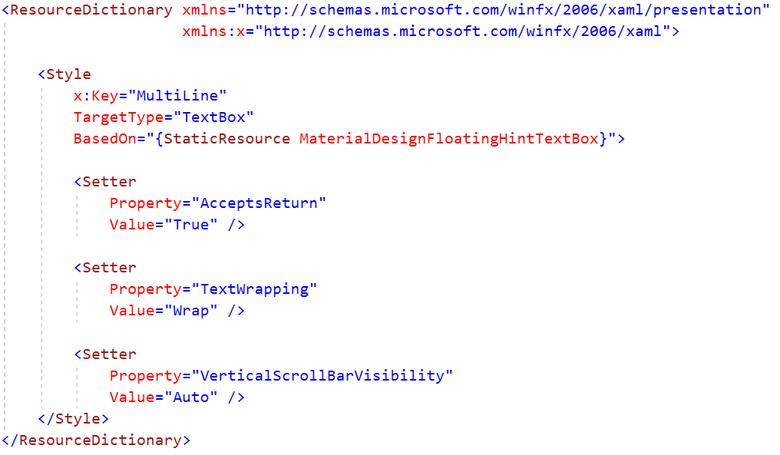
Static resources (TextBoxStyles.xaml)

Slide 29
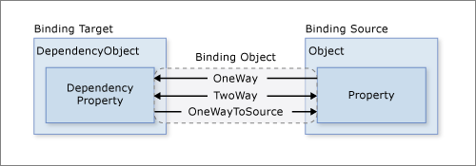
WPF - Bindings
OneWay – binding causes changes to the source property to automatically update the target.
TwoWay – binding causes changes to either the source property or the target property to automatically update the other.
OneWayToSource – is the reverse of OneWay binding; it updates the source property when the target property changes. One example scenario is if you only need to reevaluate the source value from the UI.

Slide 30
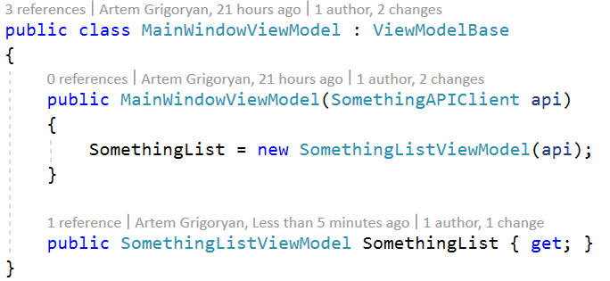
Main window view model
(MainWindowViewModel.cs)

Slide 31
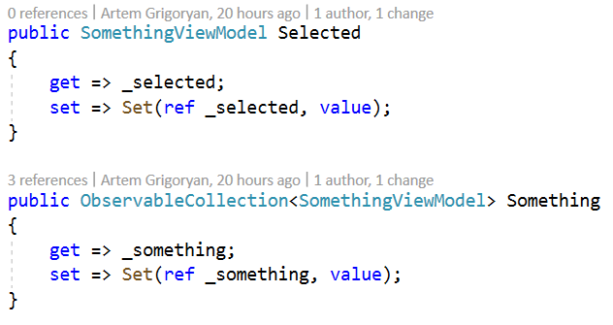
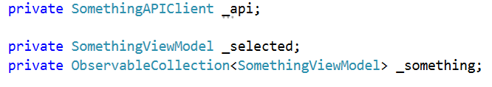
Something list view-model
Properties

Slide 32
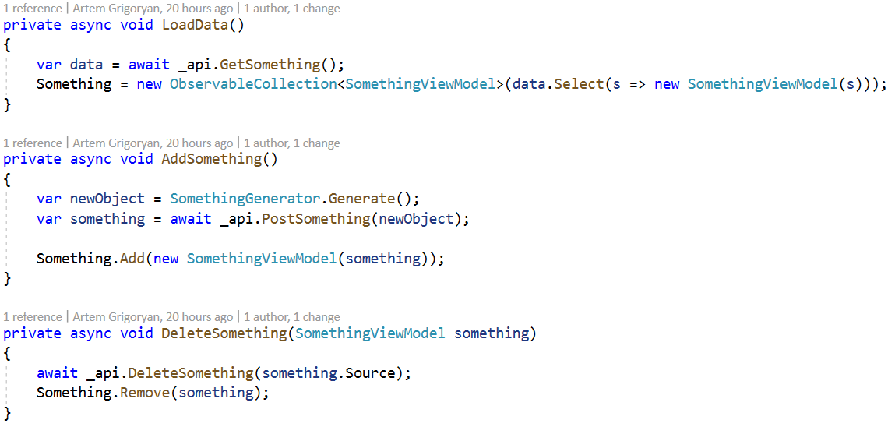
Something list view-model
Commands

Slide 33
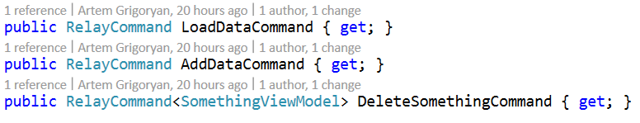
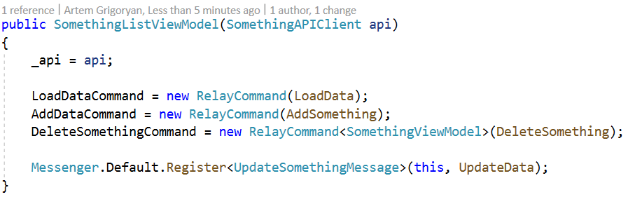
Something list view-model
Commands

Slide 34
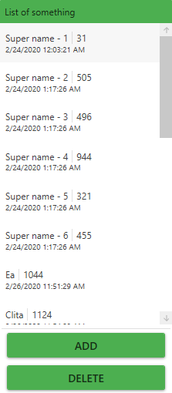
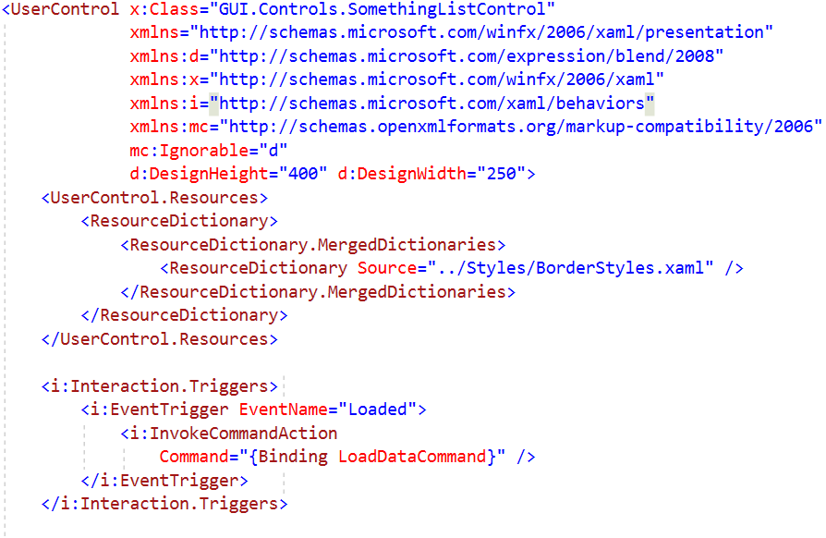
Something list view
(SomethingListControl.xaml)

Slide 35
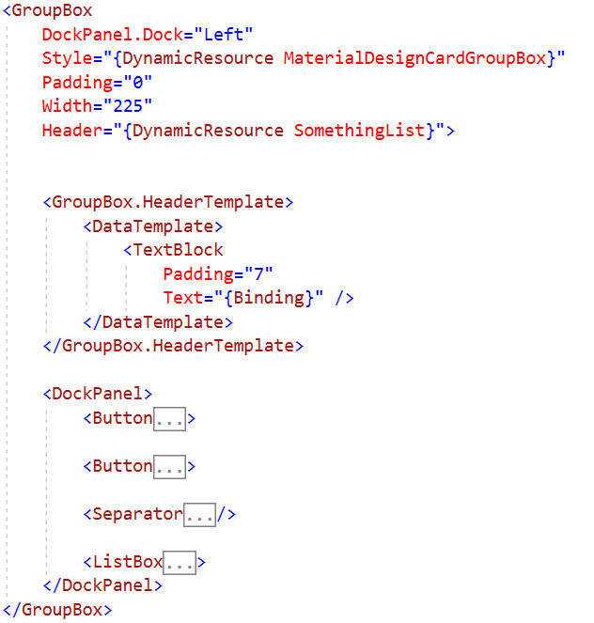
Something list view
(SomethingListControl.xaml)

Slide 36
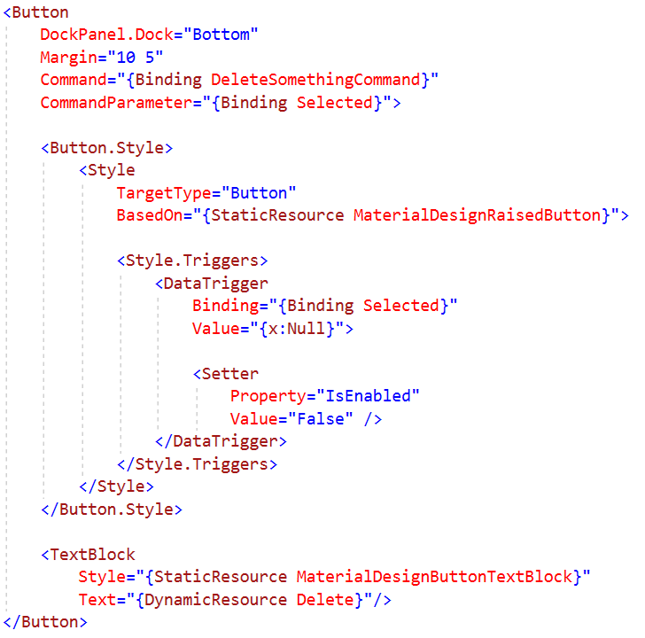
Something list view
(SomethingListControl.xaml)

Slide 37
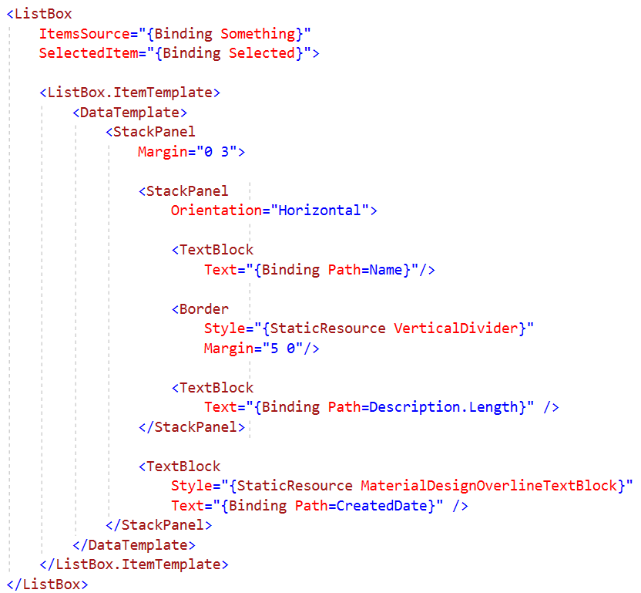
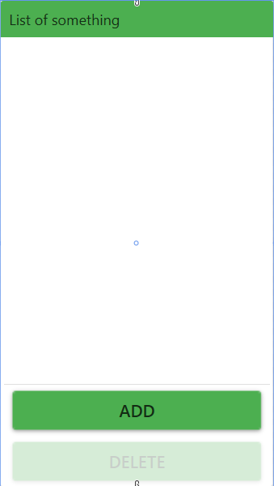
Something list view
(SomethingListControl.xaml)

Slide 38
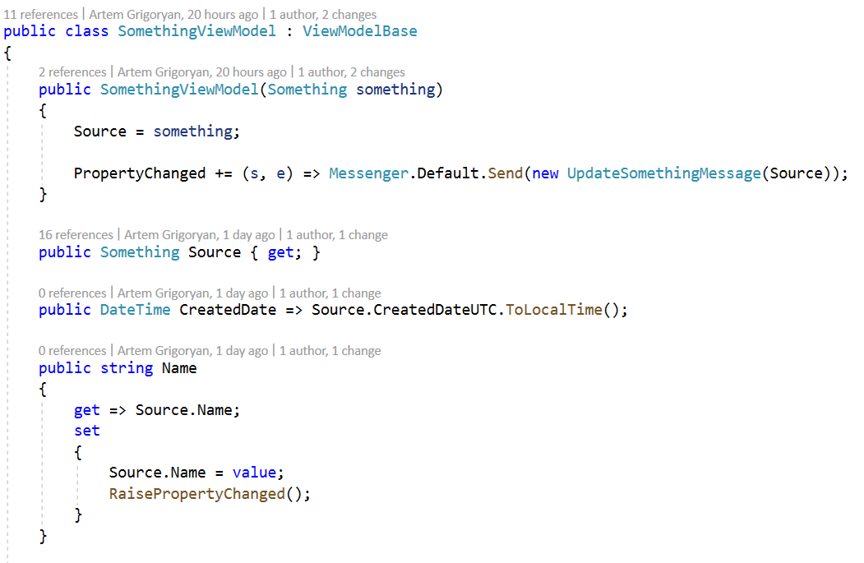
Something view-model

Slide 39
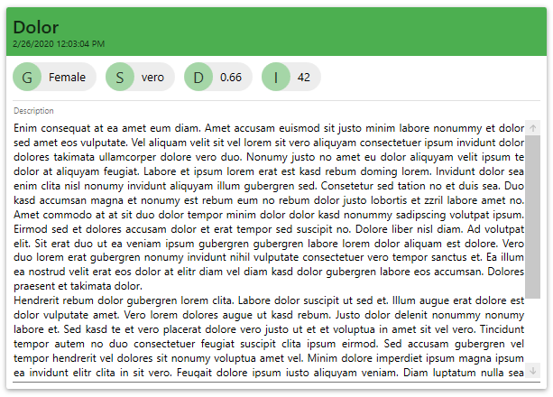
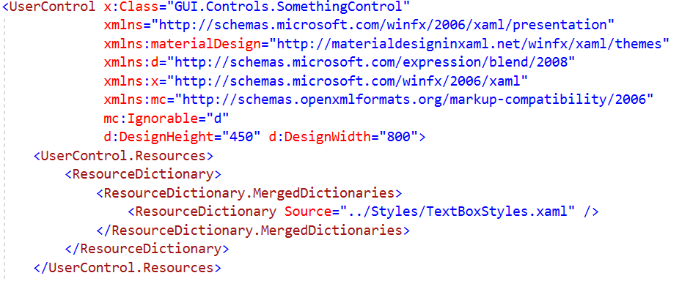
Something view
(SomethingControl.xaml)

Slide 40
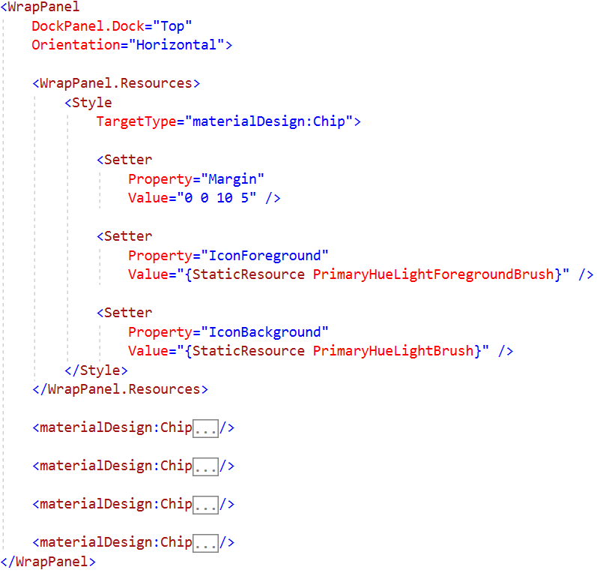
Something view
(SomethingControl.xaml)

Slide 41
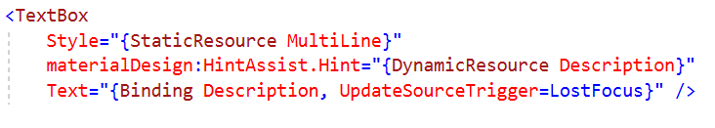
Something view
(SomethingControl.xaml)

Slide 42
UpdateSourceTrigger Property
Explicit – source won't be updated unless you manually do it;
LostFocus – source value will be updated each time the destination control loses focus;
PropertyChanged – source value will be updated each time the bound property changes.

Slide 43
Messenger
Messenger
Callback
Send Message
Register
ViewModelA
ViewModelB

Slide 44
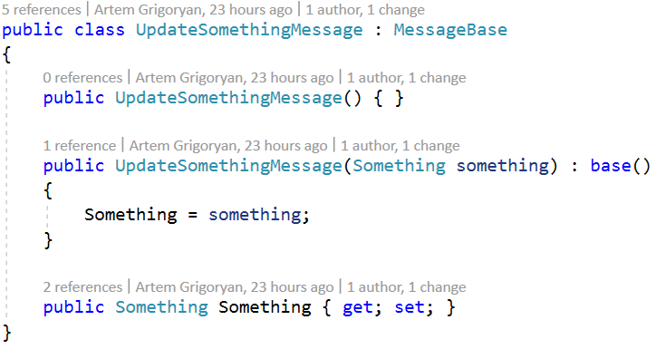
Messenger

Slide 45
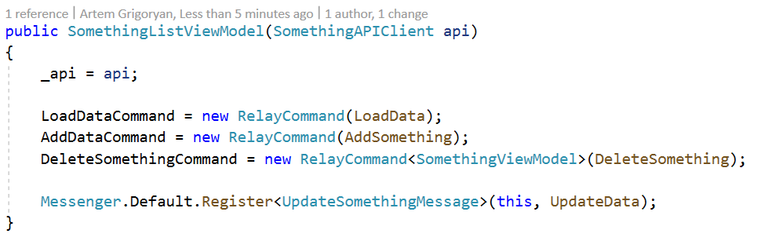
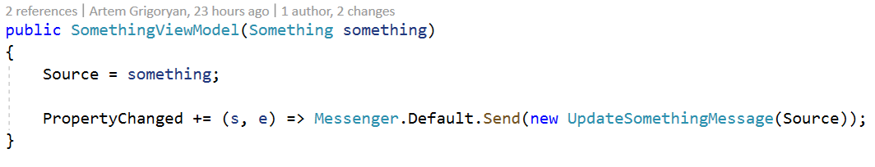
Messenger
SomethingListViewModel.cs
SomethingViewModel.cs

Slide 46
Thanks for attention!
Author: Artem Grigoryan
Email: Artem.Grigoryan@dataart.com
GitHub Repository: https://github.com/GrigoryanArtem/WPFPresentation

