Slide 1

ATAL BIHARI VAJPAYEE INDIAN INSTITUTE OF INFORMATION TECHNOLOGY AND MANAGEMENT GWALIOR
BTECH. PROJECT REPORT
Collaborative Artificial Intelligence in a Public Blockchain Network
Submitted by: Supervised by:
Rathin R Dr Saumya Bhadauria
(2019IMT-081)

Slide 2
OUTLINE:
Introduction
Motivation
Objective
Methodology
System Summary
Benefits
Results
Conclusion
Future Scope

Slide 3
Introduction:
It is a framework for sharing and improving a machine learning model. In this framework, anyone can freely access the model’s predictions or provide data to help improve the model. An important challenge is that the system must be robust and incentivize participation, but discourage manipulation. Our framework is modular, and we propose and justify three example choices of “incentive mechanisms” with different advantages.
The goal of this work is to address the current centralization of artificial intelligence by sharing models freely. Such centralization includes machine learning expertise, siloed proprietary data, and access to machine learning model predictions (e.g. charged on a per-query basis).

Slide 4
Problem Statement/Motivation:
Difficult to set up AI/ML systems :
• Lack of Quality/Inaccessible Data: Data being one of the most valuable entity in this era is quite inaccessible to common people or those that we get our hands into are poor quality data.
• Inadequate Infrastructure : To train Large data sets a computer requires high performance GPU, which is apparently quite expensive.
Model Decay : A Model looses its accuracy if it is not updated regularly. For example considering a model which predicts the rent of houses in an area. If the model is not updated regularly it will still calculate rents based on previous values not considering the new rents as time goes by(rent prices increases in real time).
AI Skills are centralized : Data sets are largely owned by certain organizations (eg.Google) which then sell those data collected from the users on per query basis. Google generates a revenue of 92M$ every 24hrs.

Slide 5
Objectives
• Store Models in the Blockchain. Put Models in Smart Contracts so that anyone can update them, they can be used for free since they only read the contract’s state.
• Now that we have a public Model , we’ll let people update it & use those updates to build a dataset.
• To create an immutable warehouse of datasets that, once stored in the blockchain as "good data," cannot be manipulated—exploiting the hackproof property of blockchain to secure the datasets from manipulators.
• The main goal is to create a "Wikipedia" of datasets. Any ordinary man should
have access to data for free at the ease of technology at our fingertips. Models can
be trained in this Dapp by giving a small number of gas fees to the network. This
can then be trained using blockchains computation power.

Slide 6
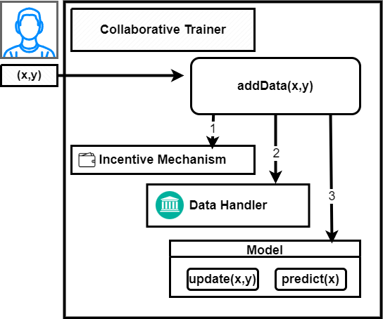
Methodology
Overview
3 steps for adding data
Boxes are smart contracts
Rounded boxes are methods

Slide 7
Supervised machine learning: data with labels: (x, y)
Minimize gas costs → efficient to train models
E.g. Naïve Bayes, Perceptron, or Nearest Centroid Classifier
Encoding “off-chain” then fine-tuning “on-chain”
E.g. Image recognition, use VGG, MobileNetv2
Cost of using Ethereum for Training Text Classification
Action | Gas Cost | USD¹
Deploy model contract of Perceptron with 100 weights | 3,845,840 | $4.71
Add data with 15 words (model agrees)² | 177,693 | $0.22
Add data with 15 words (model disagrees) ² | 249,037 | $0.30
¹Approximate costs in July 2019 with a modest gas price of 4gwei.
²Perceptron models are only updated when the model disagrees.

Slide 8
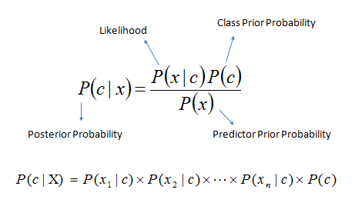
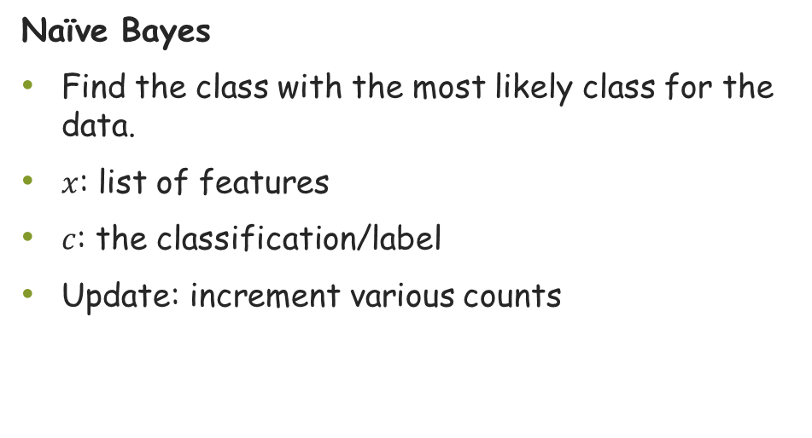
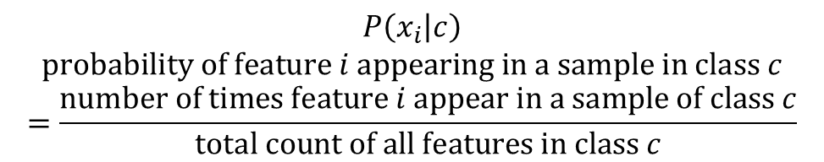
Models
Naïve Bayes
Find the class with the most likely class for the data.
$x$: list of features
$c$: the classification/label
Update: increment various counts
$$P\left(x_{i} | c\right)$$
$$probability of feature i appearing in a sample in class c$$
$$=\frac{number of times feature i appear in a sample of class c}{total count of all features in class c}$$

Slide 9
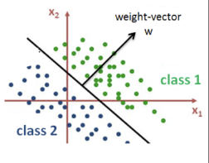
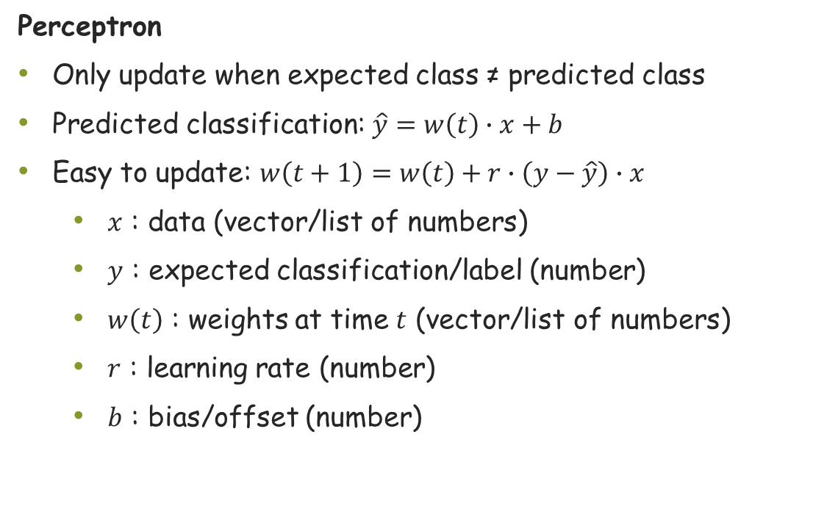
Models
Perceptron
Only update when expected class ≠ predicted class
Predicted classification: $\hat{y}=w\left(t\right)∙x+b$
Easy to update: $w\left(t+1\right)=w\left(t\right)+r∙\left(y−\hat{y}\right)∙x$
$x$ : data (vector/list of numbers)
$y$ : expected classification/label (number)
$w\left(t\right)$ : weights at time $t$ (vector/list of numbers)
$r$ : learning rate (number)
$b$ : bias/offset (number)

Slide 10
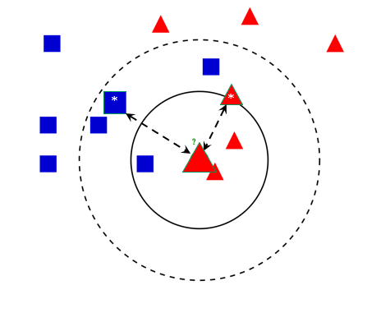
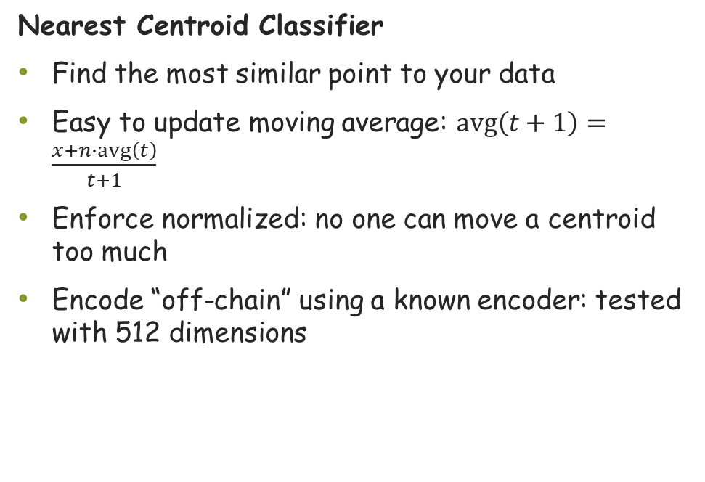
Models
Nearest Centroid Classifier
Find the most similar point to your data
Easy to update moving average: $avg\left(t+1\right)=\frac{x+n∙avg\left(t\right)}{t+1}$
Enforce normalized: no one can move a centroid too much
Encode “off-chain” using a known encoder: tested with 512 dimensions

Slide 11
Incentivizing quality data
There are many ways to encourage contributors to submit good quality data.
We analyze several examples in our paper:
Gamified (non-financial, points + badges like Stack overflow)
Based on established theory in Prediction Markets
Deposit, Refund, and Take: Self-Assessment

Slide 12


Incentivizing quality data
Based on prediction markets
Here an outside party, such as an academic institution or a company, provides a pool of reward funds and a test dataset. Participants are rewarded according to how well they improve the model’s performance as measured by the test data. When this provider is available, we will be able to give very robust incentives for participation. The mechanism is also resilient against manipulative or malicious providers and participants.
Phases
Commitment
Participation
Reward

Slide 13
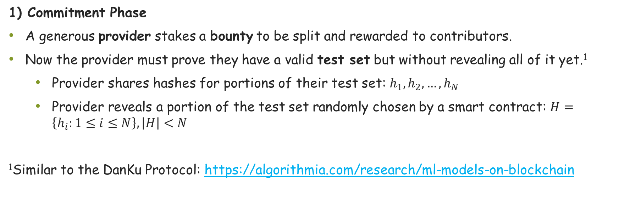
1) Commitment Phase
A generous provider stakes a bounty to be split and rewarded to contributors.
Now the provider must prove they have a valid test set but without revealing all of it yet.¹
Provider shares hashes for portions of their test set: $h_{1},h_{2},…,h_{N}$
Provider reveals a portion of the test set randomly chosen by a smart contract: $H=\left\{h_{i}:1≤i≤N\right\},\left|H\right|<N$
¹Similar to the DanKu Protocol: https://algorithmia.com/research/ml-models-on-blockchain

Slide 14

2) Participation Phase
Participants submit one training data sample at time along with a small deposit of funds.
The shared model is updated using the provided data sample.
3) Reward Phase
The provider reveals the rest of the test set and the smart contract validates that it matches the hashes they originally gave in the Commitment Phase.
Participants are rewarded based on how much their data contribution helped the model improve its accuracy on the test set:
change in loss (error rate): $L\left(h_{t−1},D\right)−L\left(h_{t},D\right)$
change in accuracy: $A\left(h_{t},D\right)−A\left(h_{t−1},D\right)$

Slide 15
Incentivizing quality data
Deposit, Refund, and Take: Self-Assessment:
Here are the highlights of the proposal:
• Deploy a model, h, already trained with some data.
• Deposit: Each data contribution with data x and label y also requires a deposit, d. Data and meta-data for each contribution is stored in the data handler.
• Refund: To claim a refund on their deposit, after a time t has passed and if the current model, h, still agrees with the originally submitted classification, i.e. if h(x) == y, then the contributor can have their entire deposit d returned. – We now assume that (x, y) is “good” data. – The successful return of the deposit should be recorded in a tally of points for the wallet address.
• Take: A contributor that has already had data validated in the Refund stage can locate a data point (x, y) for which h(x) != y and request to take a portion of the deposit, d, originally given when (x, y) was submitted.

Slide 16
Rewarded based on accuracy improvement with respect to a test set.

Slide 17
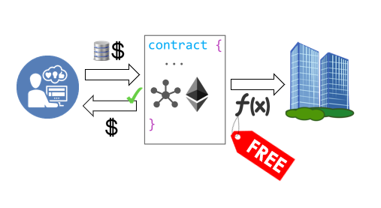
System Summary
Goals:
Free to use models in smart contracts
Build high quality datasets
Method:
Deploy an initial model
Contributors submit data + deposit
Contributors can get a reward after submitting good data
The model remains free to use for inference

Slide 18
Benefits
Consumers
Improve products and services you use
Instead of paying more for services, you pay if you want to update a service
Chance for rewards: achievements or digital assets
Developers
Easier to maintain deployed models
Analytics for their models
Services to direct to the best version of a choice of models

Slide 19
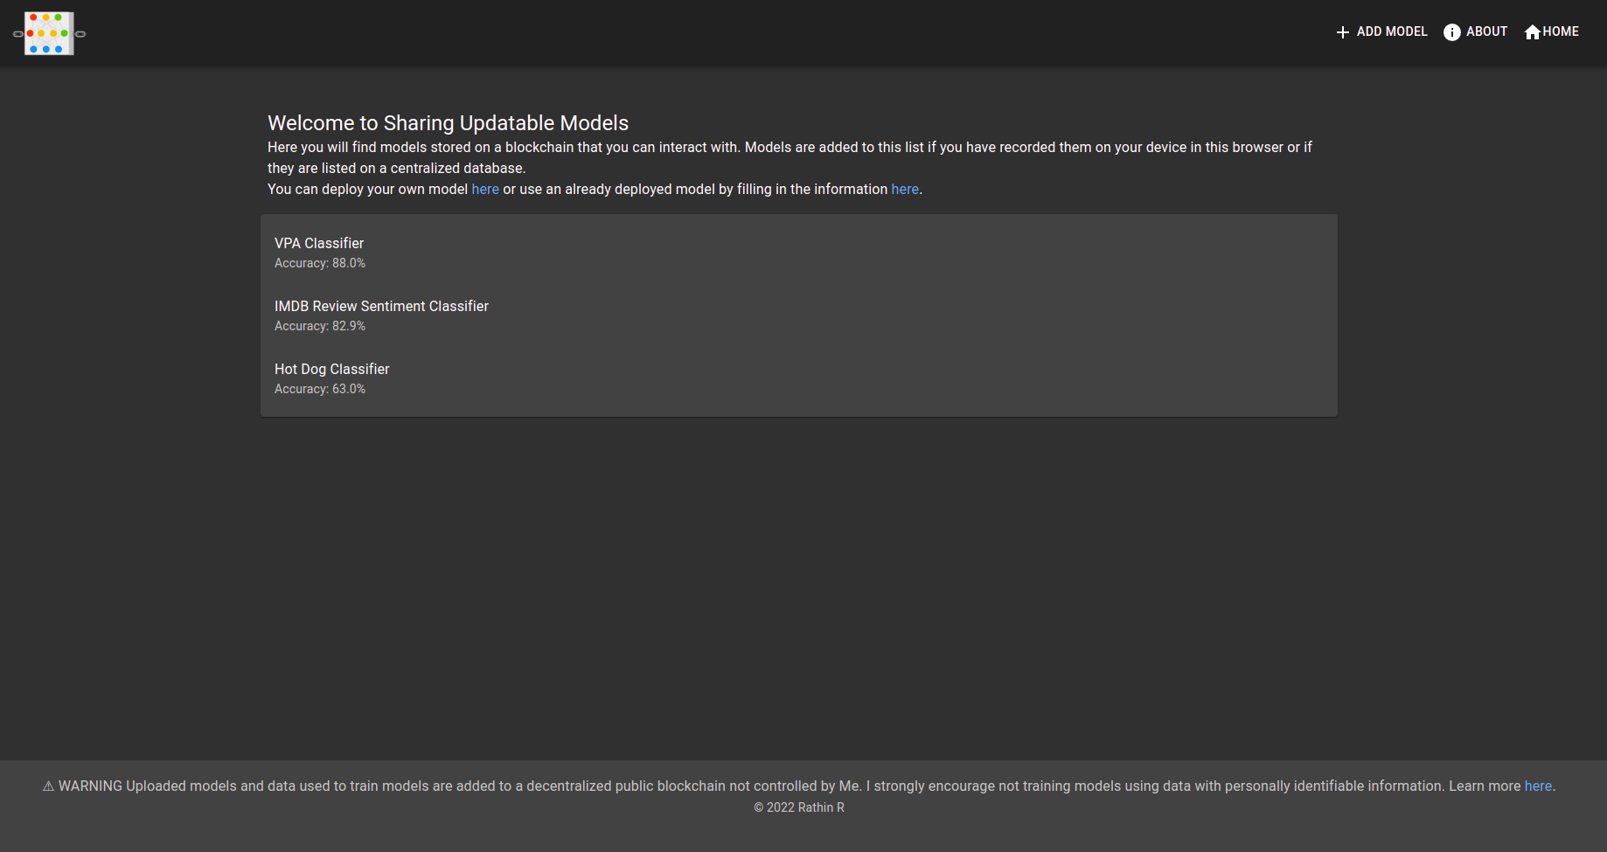
Results:

Slide 20
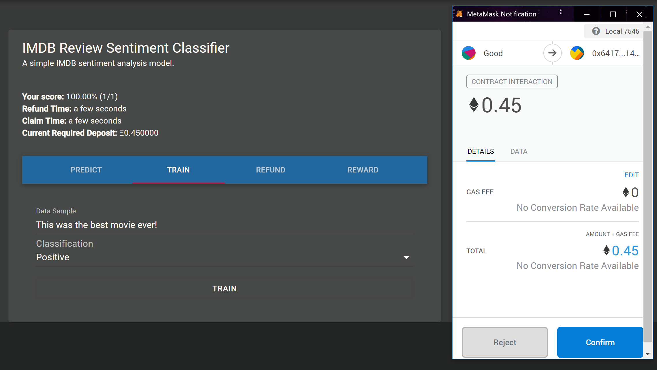

Slide 21
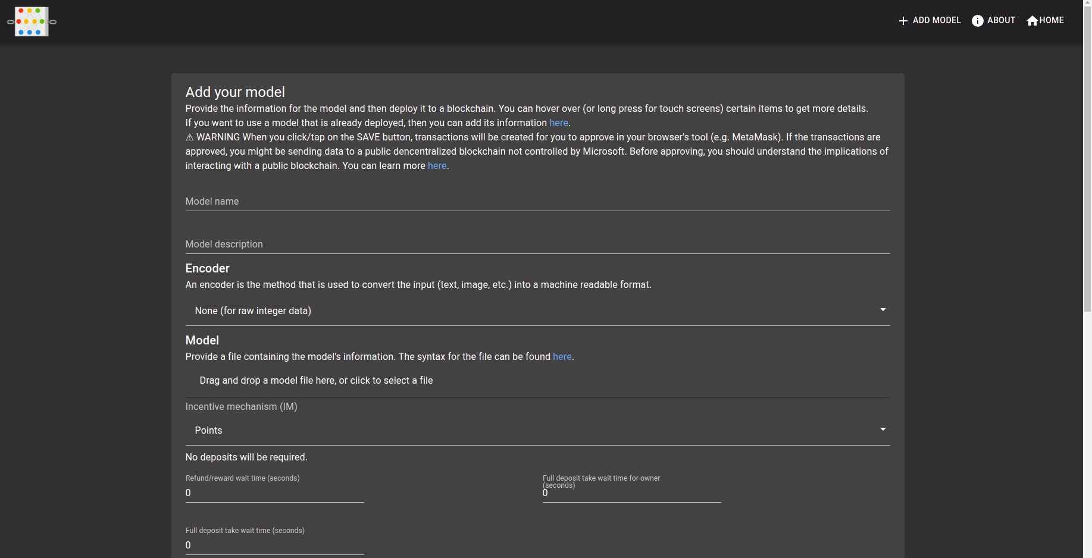

Slide 22
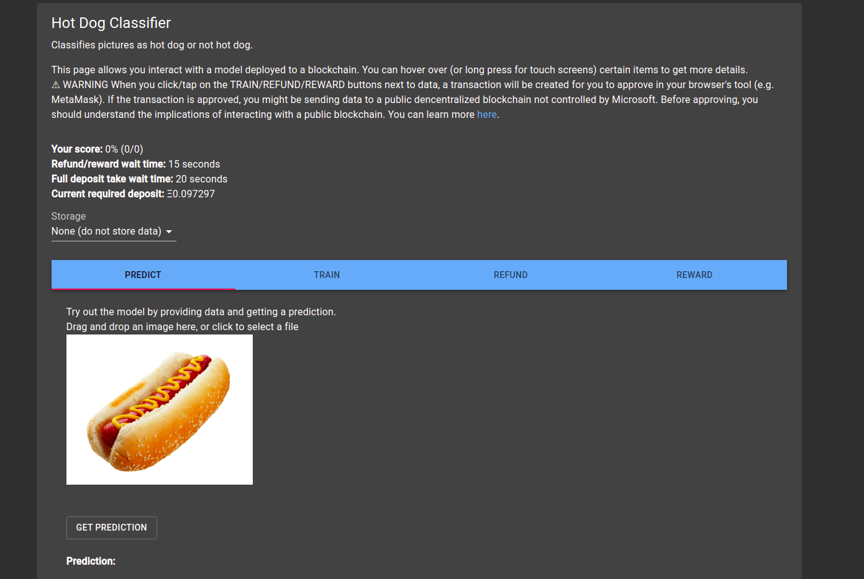

Slide 23
Future Scope:
There are a few areas where the presented framework can be configured and built upon.
A. Models
More research needs to be done on the types of models that will work well within this framework:
1) Unsupervised Models
2) Complex Models
3) Recovering Corrupted Models
B. Incentive Mechanisms
More exploration, analysis, and experiments with incentive mechanisms in this space needs to be done with emphasis on the type of model each incentive mechanism works well with. The incentive mechanisms imposed by the smart contract could be hidden to end users by 3rd party services that build services around this proposed framework. These services could validate data contribution themselves offering their own rewards to users of their platforms that do not wish to interact with these smart contracts.
C. Privacy
Contributors may not want to publish their data to a public blockchain. Initially we propose to only use this for framework for data that is safe to become public. E.g. certain queries to a personal assistant such as, “What will the weather be like tomorrow?”, which contains no personal data. Future work can be done to not submit data directly to the smart contract and instead just submit model updates

Slide 24
Conclusion:
I have presented a configurable framework for training a model and collecting data on a blockchain by leveraging several baseline incentive mechanisms and existing types of machine learning models for incremental learning. Ideal scenarios have varying data with generally agreed upon labels.
Currently, this framework is mainly designed for models that can be efficiently updated but we hoping to improve the framework with compatibility with more complex models.

