Slide 1
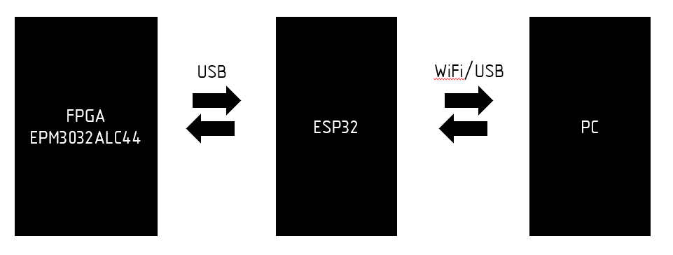
FPGA
EPM3032ALC44
ESP32
PC
USB
WiFi/USB

Slide 2
FPGA
EPM3032ALC44
ESP32
OS
RSMA
USB
WiFi/USB
RSMA API

