Slide 1
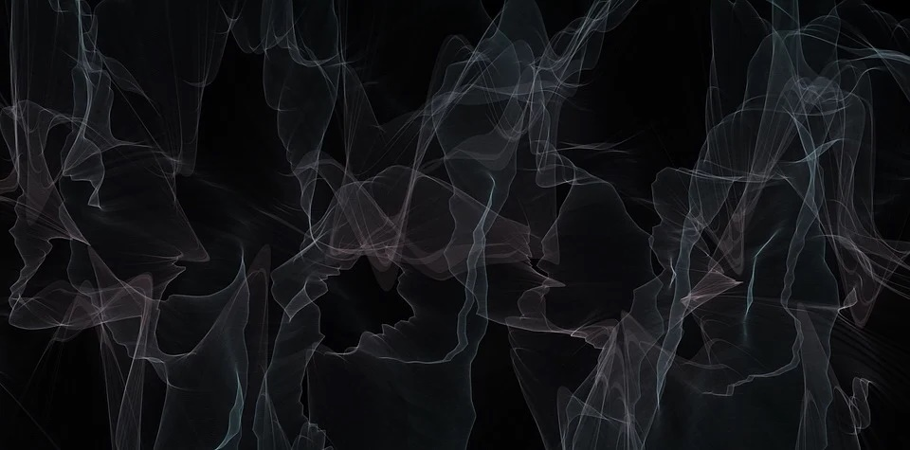

“Linked List”
Mini Project by Group 25
3rd Semester, Dec 2020
Data Structures
[CS201]
National Institute of Technology Silchar
Assam-788010

Slide 2
Group Members
Rahul Gautam Singh
[ 1912082 ]
Ashish Upadhyaya
[ 1912132 ]
Prottay Adhikary
[ 1912157 ]
Saurabh Sinha
[ 1912159 ]
Subhojit Ghimire
[ 1912160 ]

Slide 3
A BRIEF ON LINKED LIST
Linear collection of data elements.
Consists of a collection of nodes which together represent a sequence.
Used to implement several other common abstract data types, including lists, stacks, queues, associative arrays, and S-expressions, though it is not uncommon to implement those data structures directly without using a linked list as the basis.
Nodes in a linked list must be read in order from the beginning as linked lists are inherently sequential access.

Slide 4
A BRIEF ON SINGLY LINKED LIST
Collection of ordered set of elements.
Contains nodes which have a data field as well as 'next' field.
Can be traversed only in one direction.
Nodes in a linked list must be read in order from the beginning as linked lists are inherently sequential access.
Time Complexity of adding a new node at the end: O(n)
Space Complexity: O(n)

Slide 5
A BRIEF ON DOUBLY LINKED LIST
Collection of ordered set of elements.
It can be either singly or doubly linked list.
The last node of the circular singly list contains a pointer to the first node of the list.
The last node of the circular doubly list contains a pointer to the first node of the list, and the first node contains a pointer to the last node of the list.
Time Complexity of adding a new node at the end: O (n)
Space Complexity: O (n)

Slide 6
A BRIEF ON CIRCULAR LINKED LIST
Collection of ordered set of elements.
It can be either singly or doubly linked list.
The last node of the circular singly list contains a pointer to the first node of the list.
The last node of the circular doubly list contains a pointer to the first node of the list, and the first node contains a pointer to the last node of the list.
The circular linked list has no beginning and no ending. There is no null value present in the next part of any of the nodes.
Time Complexity of adding a new node at the end: O (n)
Space Complexity: O (n)

Slide 7
Welcome to
Beeth!
TM

Slide 8
















04.00 PM 12%
3
04.00 PM 12%
3
Menu
04.00 PM
TUE, 29 FEB
Phone
Alarm
PhoneBook
B
GrimStore
Beeth!
YouTube
Alerts
OK
Back
Menu
Contacts
25
1 . , ?
2 ABC
3 DEF
4 GHI
5 JKL
6 MNO
7 PQRS
8 TUV
9 WXYZ
* +
[
0
#

Slide 9
Beeth!TM is a simple, but elegant music player which will help the hearing-impaired peoples to feel the music.
Beeth!TM is an application on the worlds most used OS for feature phones, Grimiod.
3
Menu
04.00 PM 12%
Phone
Alarm
PhoneBook
B
GrimStore
Beeth!
YouTube
OK
OK
Back
Back
25
It’s delightfully simple and a fantastic option for fans of minimalism.
And the most important thing is, this app is specially designed for hearing-impaired peoples .
1 . , ?
2 ABC
3 DEF
4 GHI
5 JKL
6 MNO
7 PQRS
8 TUV
9 WXYZ
* +
[
0
#

Slide 10
3
Menu
04.00 PM 12%
Phone
Alarm
PhoneBook
B
GrimStore
Beeth!
YouTube
Let’s Have a inside look of
OK
Back
25
Beeth!
TM
1 . , ?
2 ABC
3 DEF
4 GHI
5 JKL
6 MNO
7 PQRS
8 TUV
9 WXYZ
* +
[
0
#

Slide 11
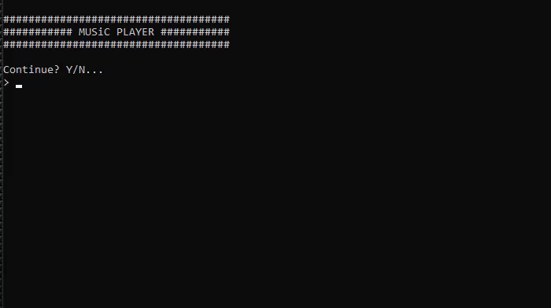

Preview:
Behind the Scene:
Preview:
3
Menu
04.01 PM 12%
Phone
Alarm
PhoneBook
B
GrimStore
Beeth!
YouTube
Beeth!
Songs
Playlists
OK
Back
25
Hmm.. Looks like there is no songs here.
Start adding songs!
1 . , ?
2 ABC
3 DEF
Add
Back
4 GHI
5 JKL
6 MNO
7 PQRS
8 TUV
9 WXYZ
* +
[
0
#

Slide 12
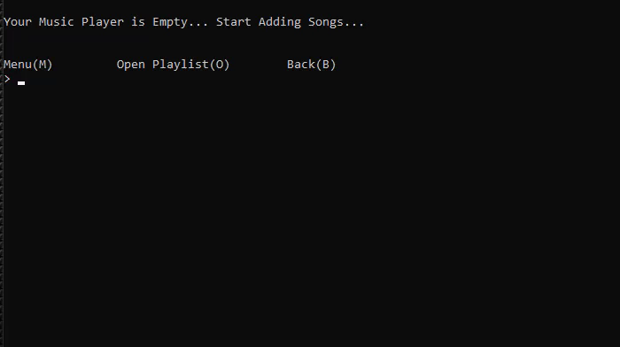

Preview:
Behind the Scene:
3
04.01 PM 12%
Beeth!
Beeth!
Songs
Songs
Playlists
Playlists
1/1
Believer
Imagine Dragons
Artist Name:
Loading…
Imagine Dragons
Song added Successfully!
Song Name:
Believer
Hmm.. Looks like there is no songs here.
Start adding songs!
DONE
DONE
Back
Back
25
1 . , ?
2 ABC
3 DEF
4 GHI
5 JKL
6 MNO
7 PQRS
8 TUV
9 WXYZ
* +
[
0
#

Slide 13
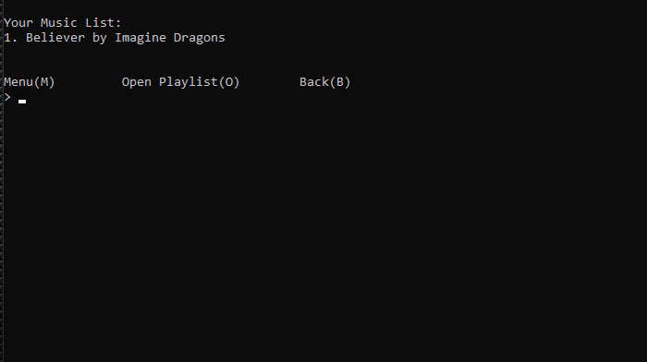



Preview:
Behind the Scene:
3
04.02 PM 12%
Beeth!
Songs
Playlists
1/8
1/7
1/3
1/5
1/4
1/1
1/2
1/10
1/6
1/9
Believer
Imagine Dragons
Lovely
Billie Eilish, Khalid
Fearless
Josh A.
Add
DONE
Delete
25
1 . , ?
2 ABC
3 DEF
4 GHI
5 JKL
6 MNO
7 PQRS
8 TUV
9 WXYZ
* +
[
0
#

Slide 14
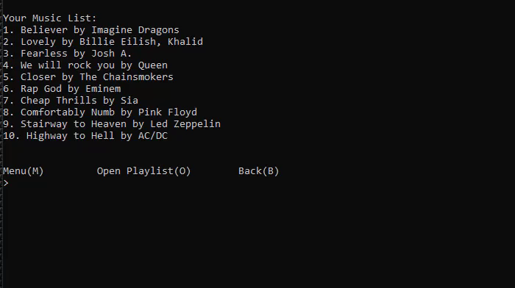

Preview:
Behind the Scene:
3
04.05 PM 11%
Beeth!
Songs
Playlists
Playlist Name
Rock
Oh-ho!
You haven’t created any playlist yet!
Create
Back
25
1 . , ?
2 ABC
3 DEF
4 GHI
5 JKL
6 MNO
7 PQRS
8 TUV
9 WXYZ
* +
[
0
#

Slide 15
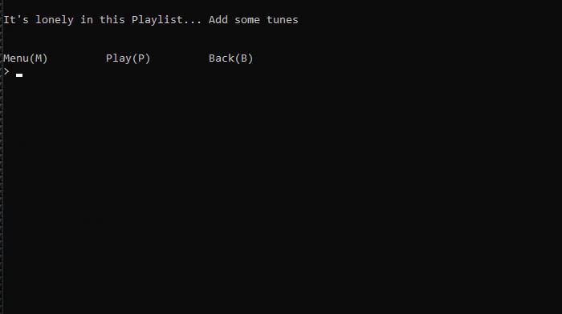
Preview:
Behind the Scene:
3
04.06 PM 11%
Beeth!
Songs
Playlists
0 Selected
Believer
Imagine Dragons
Lovely
Billie Eilish, Khalid
Fearless
Josh A.
SECLECT
25
1 . , ?
2 ABC
3 DEF
4 GHI
5 JKL
6 MNO
7 PQRS
8 TUV
9 WXYZ
* +
[
0
#

Slide 16
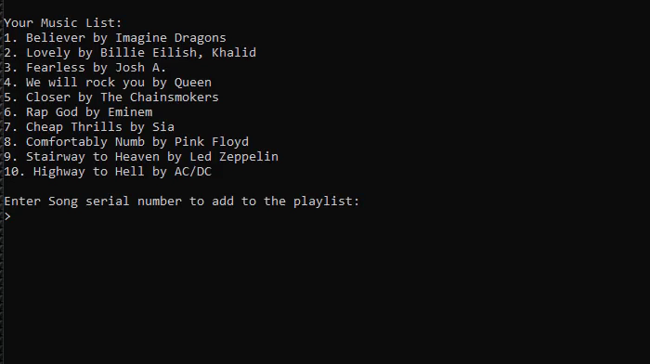
Preview:
Behind the Scene:
3
04.06 PM 11%
Beeth!
Songs
Playlists
1 Selected
Believer
Imagine Dragons
Lovely
Billie Eilish, Khalid
Fearless
Josh A.
SECLECT
25
1 . , ?
2 ABC
3 DEF
4 GHI
5 JKL
6 MNO
7 PQRS
8 TUV
9 WXYZ
* +
[
0
#

Slide 17
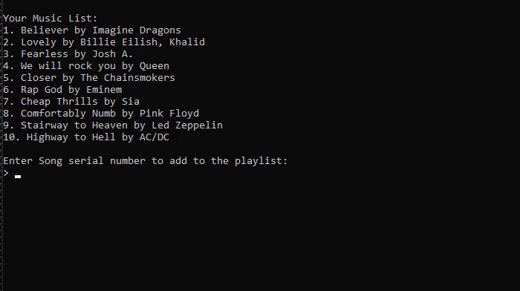

Preview:
Behind the Scene:
3
04.07 PM 11%
Beeth!
Songs
Playlists
1 Selected
Lovely
Billie Eilish, Khalid
Fearless
Josh A.
We will rock you
Queen
SECLECT
25
1 . , ?
2 ABC
3 DEF
4 GHI
5 JKL
6 MNO
7 PQRS
8 TUV
9 WXYZ
* +
[
0
#

Slide 18
Preview:
Behind the Scene:
3
04.07 PM 11%
Beeth!
Songs
Playlists
1 Selected
Lovely
Billie Eilish, Khalid
Fearless
Josh A.
We will rock you
Queen
SECLECT
25
1 . , ?
2 ABC
3 DEF
4 GHI
5 JKL
6 MNO
7 PQRS
8 TUV
9 WXYZ
* +
[
0
#

Slide 19
Preview:
Behind the Scene:
3
04.07 PM 11%
Beeth!
Songs
Playlists
1 Selected
Lovely
Billie Eilish, Khalid
Fearless
Josh A.
We will rock you
Queen
SECLECT
25
1 . , ?
2 ABC
3 DEF
4 GHI
5 JKL
6 MNO
7 PQRS
8 TUV
9 WXYZ
* +
[
0
#

Slide 20
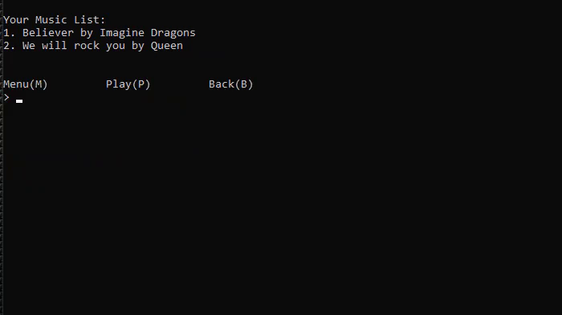
Preview:
Behind the Scene:
3
04.07 PM 11%
Beeth!
Songs
Playlists
2 Selected
Lovely
Billie Eilish, Khalid
Fearless
Josh A.
We will rock you
Queen
SECLECT
25
1 . , ?
2 ABC
3 DEF
4 GHI
5 JKL
6 MNO
7 PQRS
8 TUV
9 WXYZ
* +
[
0
#

Slide 21

Preview:
Behind the Scene:
3
04.07 PM 11%
Beeth!
Songs
Playlists
2 Selected
Fearless
Josh A.
We will rock you
Queen
Rap God
Queen
SECLECT
25
1 . , ?
2 ABC
3 DEF
4 GHI
5 JKL
6 MNO
7 PQRS
8 TUV
9 WXYZ
* +
[
0
#

Slide 22
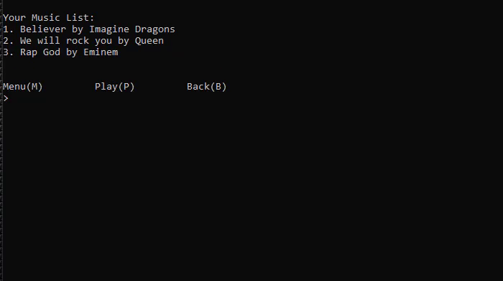
Preview:
Behind the Scene:
3
04.07 PM 11%
Beeth!
Songs
Playlists
3 Selected
Fearless
Josh A.
We will rock you
Queen
Rap God
Eminem
SECLECT
25
1 . , ?
2 ABC
3 DEF
4 GHI
5 JKL
6 MNO
7 PQRS
8 TUV
9 WXYZ
* +
[
0
#

Slide 23
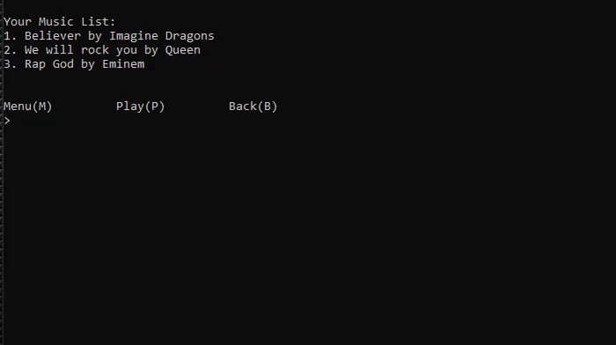

Preview:
Behind the Scene:
3
04.08 PM 11%
Beeth!
Songs
Playlists
1/1
Rock
3 songs
PLAY
Back
25
1 . , ?
2 ABC
3 DEF
4 GHI
5 JKL
6 MNO
7 PQRS
8 TUV
9 WXYZ
* +
[
0
#

Slide 24
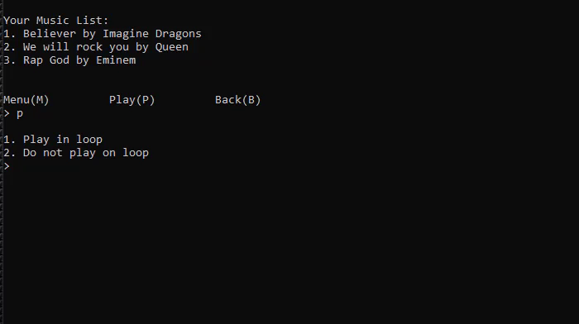
Preview:
Behind the Scene:
3
04.08 PM 11%
Beeth!
Songs
Playlists
1/1
Rock
2 songs
Want to play in loop?
Want to play in loop?
Yes
No
25
1 . , ?
2 ABC
3 DEF
4 GHI
5 JKL
6 MNO
7 PQRS
8 TUV
9 WXYZ
* +
[
0
#

Slide 25
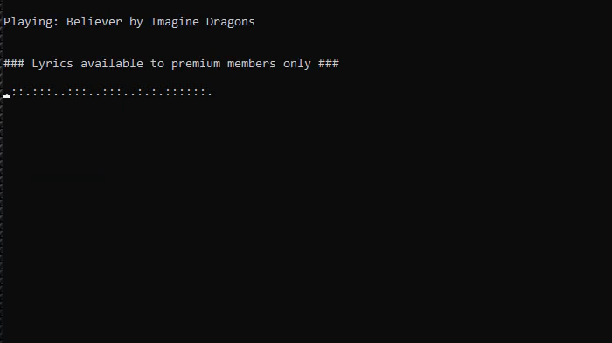

Preview:
Behind the Scene:
3
04.12 PM 11%
Beeth!
< >
Lyrics
Back
25
1 . , ?
2 ABC
3 DEF
4 GHI
5 JKL
6 MNO
7 PQRS
8 TUV
9 WXYZ
* +
[
0
#

Slide 26
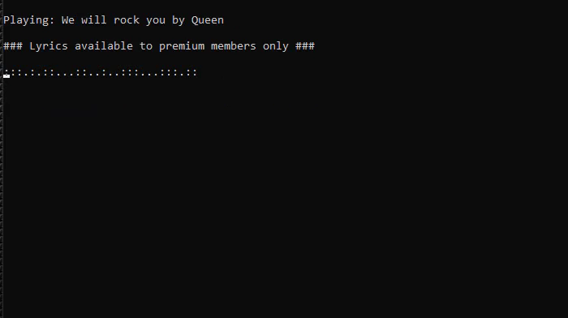
Preview:
Behind the Scene:
3
04.15 PM 10%
Beeth!
< >
Lyrics
Back
25
1 . , ?
2 ABC
3 DEF
4 GHI
5 JKL
6 MNO
7 PQRS
8 TUV
9 WXYZ
* +
[
0
#

Slide 27
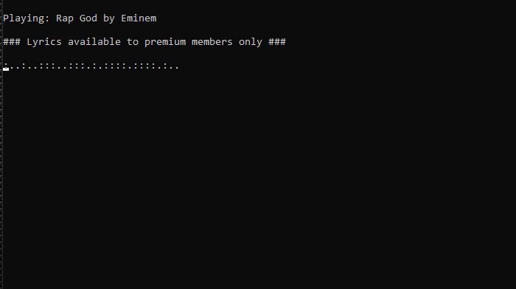

Preview:
Behind the Scene:
3
04.16 PM 10%
Beeth!
< >
Lyrics
Back
25
1 . , ?
2 ABC
3 DEF
4 GHI
5 JKL
6 MNO
7 PQRS
8 TUV
9 WXYZ
* +
[
0
#

Slide 28

Preview:
Behind the Scene:
3
04.15 PM 10%
Beeth!
< >
Lyrics
Back
25
1 . , ?
2 ABC
3 DEF
4 GHI
5 JKL
6 MNO
7 PQRS
8 TUV
9 WXYZ
* +
[
0
#

Slide 29
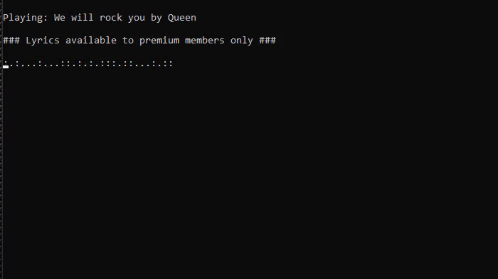
Preview:
Behind the Scene:
3
04.15 PM 10%
Beeth!
< >
Lyrics
Back
25
1 . , ?
2 ABC
3 DEF
4 GHI
5 JKL
6 MNO
7 PQRS
8 TUV
9 WXYZ
* +
[
0
#

Slide 30

Preview:
Behind the Scene:
3
04.15 PM 10%
Beeth!
< >
Lyrics
Back
25
1 . , ?
2 ABC
3 DEF
4 GHI
5 JKL
6 MNO
7 PQRS
8 TUV
9 WXYZ
* +
[
0
#

Slide 31
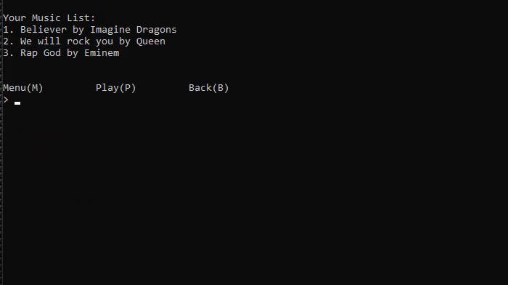
Preview:
Behind the Scene:
3
04.16 PM 10%
Beeth!
Songs
Playlists
1/1
Rock
3 songs
PLAY
Back
25
1 . , ?
2 ABC
3 DEF
4 GHI
5 JKL
6 MNO
7 PQRS
8 TUV
9 WXYZ
* +
[
0
#

Slide 32
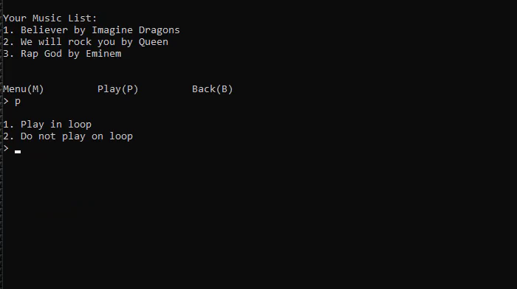
Preview:
Behind the Scene:
3
04.16 PM 10%
Beeth!
Songs
Playlists
1/1
Rock
2 songs
Want to play in loop?
Yes
No
25
1 . , ?
2 ABC
3 DEF
4 GHI
5 JKL
6 MNO
7 PQRS
8 TUV
9 WXYZ
* +
[
0
#

Slide 33

Preview:
Behind the Scene:
3
04.15 PM 10%
Beeth!
< >
Lyrics
Back
25
1 . , ?
2 ABC
3 DEF
4 GHI
5 JKL
6 MNO
7 PQRS
8 TUV
9 WXYZ
* +
[
0
#

Slide 34
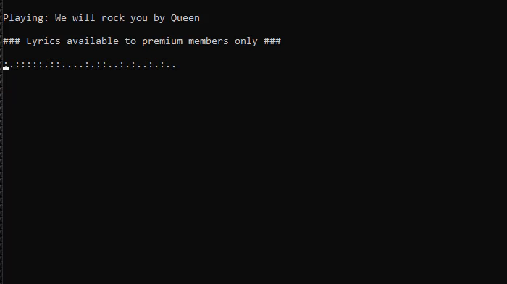
Preview:
Behind the Scene:
3
04.19 PM 10%
Beeth!
< >
Lyrics
Back
25
1 . , ?
2 ABC
3 DEF
4 GHI
5 JKL
6 MNO
7 PQRS
8 TUV
9 WXYZ
* +
[
0
#

Slide 35

Preview:
Behind the Scene:
3
04.16 PM 10%
Beeth!
< >
Lyrics
Back
25
1 . , ?
2 ABC
3 DEF
4 GHI
5 JKL
6 MNO
7 PQRS
8 TUV
9 WXYZ
* +
[
0
#

Slide 36
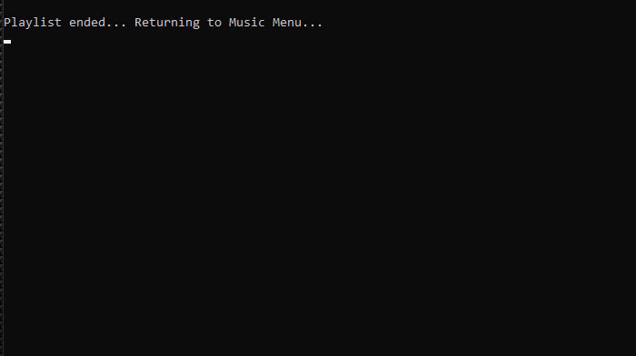
Preview:
Behind the Scene:
3
04.22 PM 10%
Beeth!
Songs
Playlists
1/1
Rock
2 songs
Playlist Ended!
PLAY
Back
25
1 . , ?
2 ABC
3 DEF
4 GHI
5 JKL
6 MNO
7 PQRS
8 TUV
9 WXYZ
* +
[
0
#

Slide 37
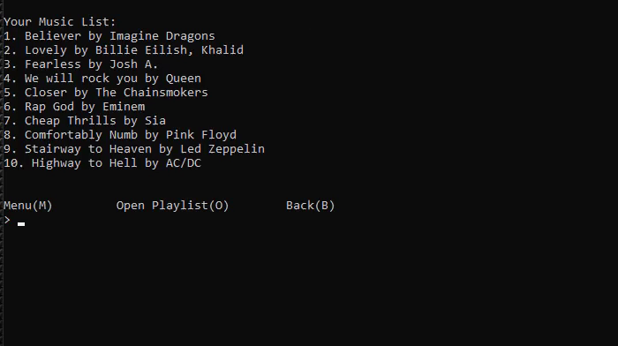
Preview:
Behind the Scene:
3
04.22 PM 10%
Beeth!
Songs
Playlists
1/10
Believer
Imagine Dragons
Lovely
Billie Eilish, Khalid
Fearless
Josh A.
Add
DONE
Delete
25
1 . , ?
2 ABC
3 DEF
4 GHI
5 JKL
6 MNO
7 PQRS
8 TUV
9 WXYZ
* +
[
0
#

Slide 38
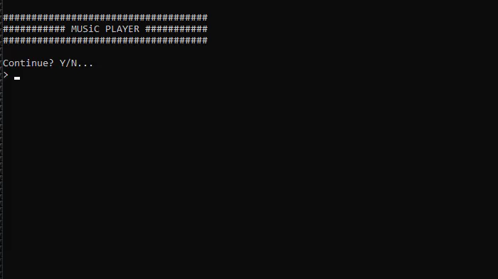
Preview:
Behind the Scene:
3
04.23 PM 9%
3
04.23 PM
TUE, 29 FEB
Alerts
Menu
Contacts
25
1 . , ?
2 ABC
3 DEF
4 GHI
5 JKL
6 MNO
7 PQRS
8 TUV
9 WXYZ
* +
[
0
#

Slide 39
Bibliography
Linked List || https://en.wikipedia.org/wiki/Linked_list
Singly Linked List || https://en.wikipedia.org/wiki/Linked_list
Doubly Linked List || https://www.tutorialspoint.com/data_structures_algorithms/ doubly_linked_list_algorithm.htm
Circular Linked List || https://www.javatpoint.com/circular-singly-linked-list
Image Sources
a. https://www.codesdope.com/course/data-structures-linked-lists/
b. https://stackoverflow.com/questions/62763503/how-to-implement-doubly-linked-list-after-the-first-element
c. https://medium.com/@avinash.sarguru/implementing-circular-linked-list-19f130dce538
Make sure to visit our GitHub to view the code for this program:
https://github.com/GrimScythe2001/Beeth

Slide 40
THANK YOU!!!

