Slide 1
POKÉMON
AI
Reinforcement Learning for Pokémon Battles
Dustin Boston · Jonathan Navarro
poke-env
MaskablePPO
TensorBoard

Slide 2
The Game & The Simulator
Pokémon Showdown
What is Pokémon?
Turn-based 1v1 battles between trainers
Each turn: use a move OR switch Pokémon
Moves have types, power, and limited PP
Goal: faint all opponent Pokémon to win
Mix of tactics (damage) and strategy (tempo)
Runs locally as a Node.js server
Fast, repeatable simulation for training
Browser UI enables human vs bot demos

Slide 3
Reinforcemet
Learning
Trial and error: the agent takes actions,
receives rewards and improves over time.
AGENT
Our Pokémon Bot
↓ Action (move / switch)
↑ State + Reward
ENVIRONMENT
Pokémon Battle

Slide 4
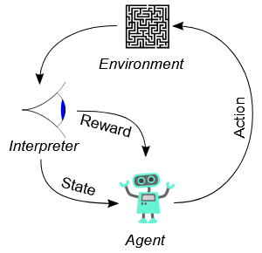
How We Frame the Problem
OBSERVATION
ACTION
839-dim numeric vector
describing the full battle state:
HP, moves, status, field effects
11 choices per turn:
4 moves + 6 switches + 1 default
Masked so only legal moves are picked
REWARD
EPISODE
Shaped intermediate rewards
plus ±2.0 win / loss terminal
Gives signal before the battle ends
One complete battle
Averages ~47 turns per game
Each episode starts fresh
We train a PPO policy that maximizes total expected reward over the course of a battle.

Slide 5
System Architecture
Pokémon
Showdown
1
poke-env
2
Gymnasium
Env
3
MaskablePPO
4
→
→
→
Local Node.js
battle server
Player & Env
connector API
Obs + reward
+ action mask
Policy & value
network (SB3)
↑
Encoder + Action Mask
battle → obs vector / legal actions → mask
The Encoder converts raw battle data into the 839-dim observation vector consumed by the policy network.

Slide 6
Action Space & Masking
11 Actions Per Turn
Why Masking Matters
Actions 0 – 5
✗ Without Masking
Illegal actions get sampled → noisy gradients → training diverges or fails entirely
Switch to bench Pokémon (slots 0 – 5)
Actions 6 – 9
Use move in slot 0, 1, 2, or 3
✓ With MaskablePPO
Illegal logits forced to −∞ → never sampled → stable, correct training
Action 10
Default / forced (recharge, no moves)
Masking is a correctness feature AND a training-stability feature.

Slide 7
Reward Design
Shaped rewards give earlier feedback;
terminal signals shape the policy.
+2.0
−2.0
−1.0
WIN
LOSS
DRAW / TIME
+0.25
−0.25
±0.04×HP
OPPONENT KO
OWN KO
HP DAMAGE

Slide 8
Training Curriculum
1
2
3
Phase 1: vs Random
Phase 2: vs Heuristic + Pool
Phase 3: Evaluation
→
→
Train from scratch
against SimpleRandomBot
Builds basic legal play
and move fundamentals
Seed from Phase 1 model
Face stronger opponents
Keeps bot well-rounded
and adaptable
Eval against any model
or opponent at any time
Win rate tracked
with tqdm + logging
A fixed opponent becomes "solved." Starting easy builds a baseline policy, then harder opponents push it further.

Slide 9
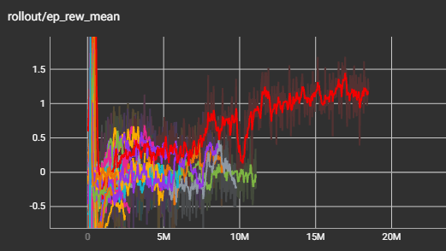
Tracking Agents / Agent 29
1.20
18.4M
Episode Reward
Timesteps Trained
47 turns
~0.021
Avg Battle Length
KL Divergence
−0.49
0.56
Entropy Loss
Explained Variance
TensorBoard is a visualization tool that lets you track and graph training metrics like reward, loss, and entropy in real time as your model learns.
Agent 29 — the most trained and stable model: 18.4M+ timesteps over ~1.9 days.

Slide 10
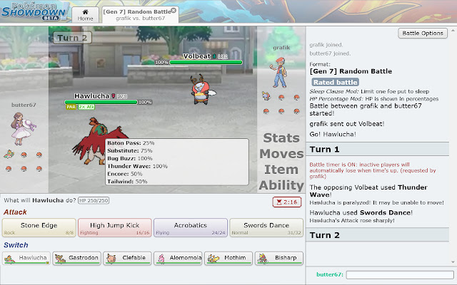
Live Demo:
Human vs Bot
1
Start Pokémon Showdown locally (Node.js)
2
Run bot connector — logs in the bot account
3
Open localhost:8000 and challenge the bot
4
Watch the agent pick actions in real time

Slide 11
Limitations & Next Steps
LIMITATIONS
NEXT STEPS
Self-play stability depends heavily on reward design
Self-play against evolving agent versions
Random Battles still have unfair type matchup luck
Longer training runs (50M+ timesteps)
Generalization limited by training distribution
Experiment with obs space and reward shaping
poke-env / Showdown / SB3 APIs frequently change

Slide 12
Q&A
Questions?
Dustin Boston · Jonathan Navarro

