Slide 1
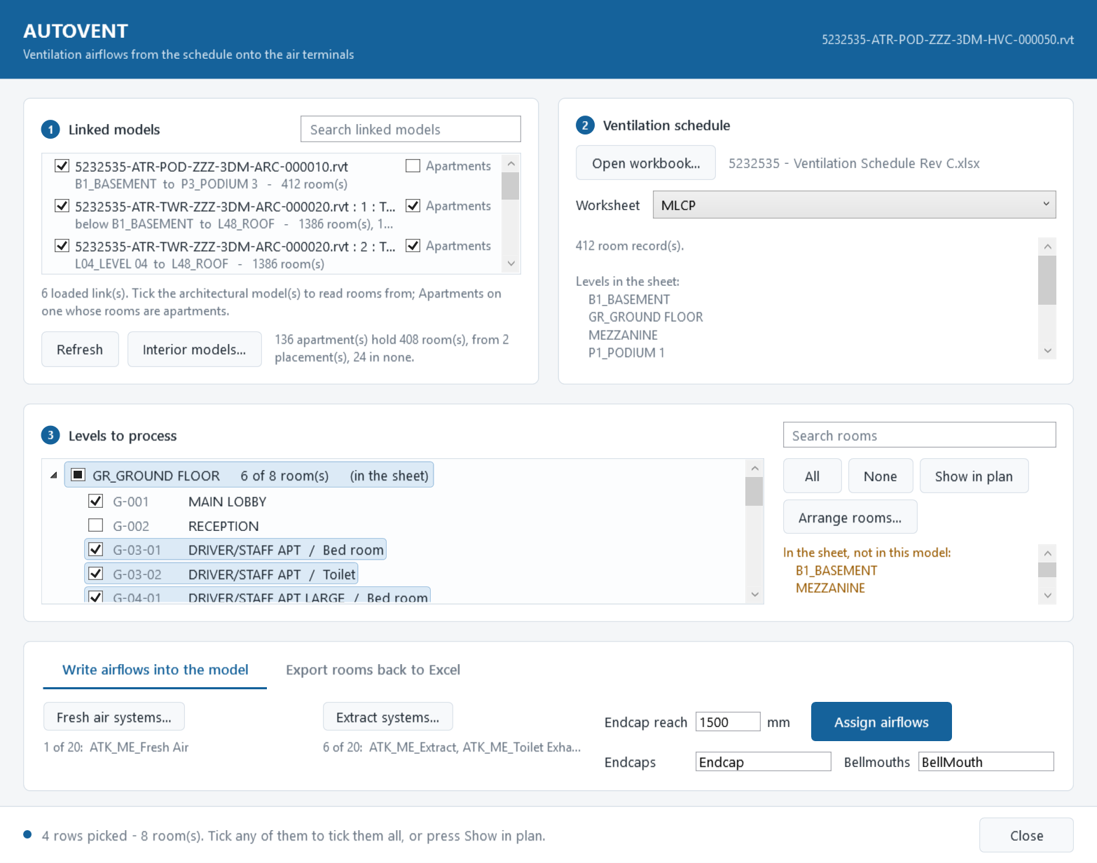
AUTOVENT
ATKINS → MECHANICAL · REVIT 2022 – 2027
Ventilation airflows from the Excel schedule onto Revit air terminals - and the model's rooms back into the sheet
A guide for Revit users

Slide 2
What AUTOVENT does
xlsx
Assign airflows
fresh air and extract onto every terminal
rvt
Excel ventilation schedule
Revit MEP model
The office ventilation calculation
One row per room, under a blue row per level
Fresh air and total exhaust in L/s
The architect's models linked in
Air terminals on fresh air and extract systems
FCUs fed by endcaps or bellmouths
Export rooms
names, numbers, areas, heights, WC counts
i
Rooms come from the architect's linked models. The levels are your model's levels.
AUTOVENT · a guide for Revit users
2

Slide 3
Before you start
1
Install once
Run ATKINSMEC-Setup.exe - no admin rights needed. AUTOVENT appears on the ATKINS tab, Mechanical panel.
2
Open your MEP model
With the architect's models linked and loaded: the rooms are read from them.
3
Terminals on the right systems
Fresh air and extract terminals on duct systems named Fresh, Extract or Exhaust - or tick the system types in the window.
4
The ventilation workbook
The office layout: a blue row per level, a row per room. No workbook yet? AUTOVENT can export a new one.
AUTOVENT · a guide for Revit users
3

Slide 4
The window at a glance
1
Linked models
Which architect's models the rooms are read from.
2
Ventilation schedule
The workbook, and the worksheet with the airflows.
3
Levels to process
Your model's levels, each with the linked rooms on it. Tick what to process.
4
4
Write airflows · Export
The two jobs: airflows onto the terminals, or rooms into Excel.
AUTOVENT · a guide for Revit users
4

Slide 5
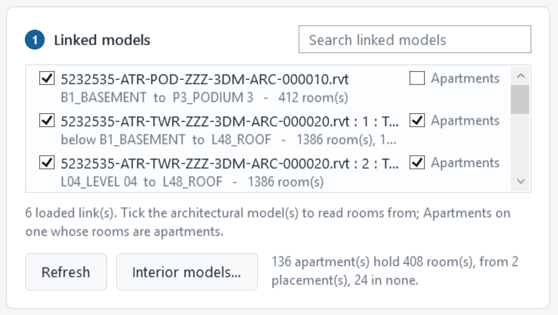
Step 1 · Tick the linked models
Tick each architect's model to read rooms from. A model linked twice shows twice - one row per placement.
The grey line says which of your levels it covers, and how many rooms.
Search narrows a long list; a ticked model it hides still counts.
Apartments and Interior models... are for apartment jobs - slide 15.
Refresh reads the links again after one is reloaded or a room is drawn.
AUTOVENT · a guide for Revit users
5

Slide 6
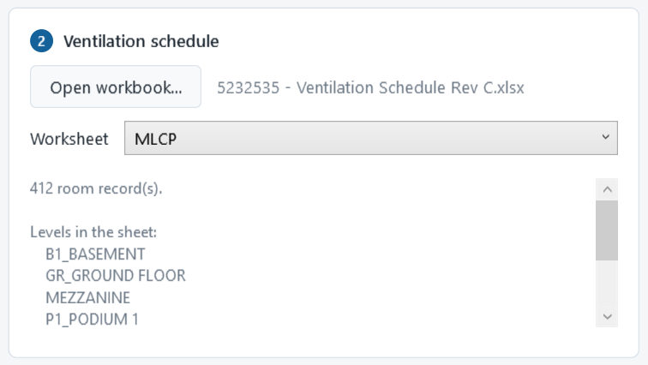
Step 2 · Open the ventilation workbook
It reads every room row:
Space name
Room number
Fresh air (L/s)
Total exhaust, max. rounded up (L/s)
Columns are found by their headings, wherever they sit.
Rows under a blue level row belong to that level.
In the sheet, not in this model: the sheet's level rows must carry your model's level names. Rows under any other level match nothing.
AUTOVENT · a guide for Revit users
6

Slide 7
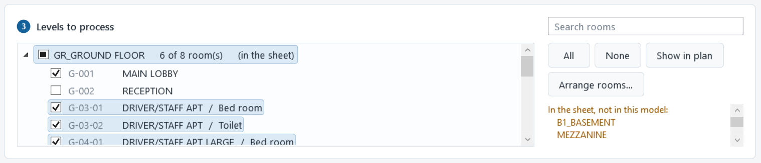
Step 3 · Choose the levels and rooms
Your model's levels
Each linked room goes on the level its floor stands on - up to the next level. A floor up to 300 mm below a level still counts.
Tick rooms, not only levels
Open a level to tick single rooms. An unticked room is left out of the airflow write and the export.
Find and show
Search by room number or name. Show in plan - or a double-click on a room - zooms to it in a plan of its level.
AUTOVENT · a guide for Revit users
7

Slide 8
How a room finds its row in the sheet
In the model
In the sheet
Name
MASTER BEDROOM
=
MASTER BEDROOM
Number
121.046
=
121.046
Level
LEVEL 03
=
LEVEL 03
All three must match. Capitals and spaces at the ends do not matter; everything else does.
121.46 no match 121.046
L03 no match LEVEL 03
Renamed a room in Arrange rooms...? The new name is used both ways, so it still matches.
AUTOVENT · a guide for Revit users
8

Slide 9
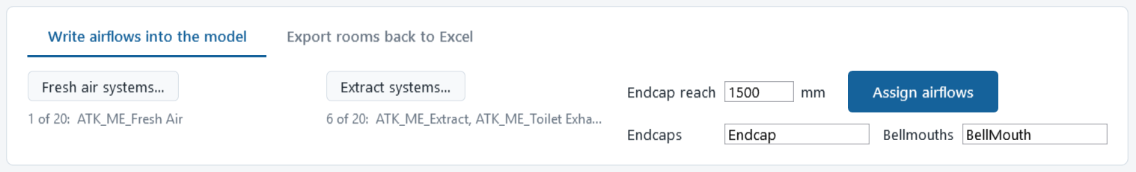
Step 4 · Assign airflows
Fresh air · Extract
Each button opens the duct system types to tick. Tick none and the names decide.
Endcap reach
How far an endcap or bellmouth looks for the FCU it feeds. 1500 mm unless you change it.
Endcaps · Bellmouths
Family names, a comma between. Bellmouth: feeds an FCU only when it faces one.
Assign airflows
Writes the Flow of every terminal in one step - a single Ctrl+Z undoes it.
AUTOVENT · a guide for Revit users
9

Slide 10
Which airflow each terminal gets
FCU
FCU
FCU
room's air ÷ 2
into the room
air of the room it supplies
air of the room it supplies
Grille or diffuser
Bellmouth into its room
Endcap on an FCU
Bellmouth facing an FCU
The room's air, shared equally between the room's terminals on that side.
Treated like a grille - FCU in the room or not.
The air of the rooms that FCU supplies, wherever the endcap stands.
In the ceiling void, mouth on the unit: it feeds that FCU, like an endcap.
AUTOVENT · a guide for Revit users
10

Slide 11
One room, two FCUs
MEETING ROOM
Fresh air in the sheet: 100 L/s
Every endcap serving a room gets an equal share - the shares add back up to the room's total.
One FCU drawn with no endcap? The others carry all of it, and the result says so: the gap is worth modelling.
Nothing is written twice; nothing is lost.
FCU 1
FCU 2
endcap
endcap
50 L/s
50 L/s
AUTOVENT · a guide for Revit users
11

Slide 12
Reading the result
AUTOVENT
What to look at
Models: 3
Levels: LEVEL 03
Rooms in scope: 69
Rooms matched to the sheet: 68
Terminals updated: 41
Terminals skipped (read-only): 0
Bellmouths feeding an FCU: 12 of 27
1 room(s) with fresh air and no terminal or endcap to take it:
121.046 MASTER BEDROOM: 50 l/s
Full details: ATKINSMEC_debug_log.txt on your Desktop.
Matched against in scope: a big gap means names, numbers or levels differ - slide 8.
Skipped: the terminal's Flow cannot be written - a family setting.
A room with air and nothing to take it: no terminal in it, an endcap or bellmouth name missing, or the FCU beyond the reach.
The log lists every terminal and why it got what it got.
AUTOVENT · a guide for Revit users
12

Slide 13
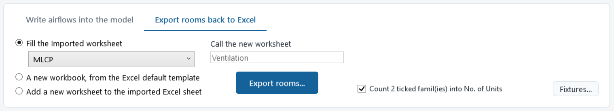
Export rooms back to Excel
Fill the imported worksheet
Replaces its level and room rows with the model's rooms. Other columns keep their formulas; rows copy the sheet's own formatting.
A new workbook
Built from the office ventilation calculation: its headings, formulas and ASHRAE tables. Typed inputs are left blank.
Add a worksheet
The same new sheet, added to the workbook you imported. Every other sheet is left alone; a name in use is refused.
AUTOVENT · a guide for Revit users
13

Slide 14
What goes into the sheet
Space
Room No.
Area
Height
No. of Units
Occupancy
Fresh air
From Revit: name, number, area and height. Numbers go in as text, so 0123 stays 0123.
No. of Units: the WCs and urinals standing in each room. Fixtures... picks the models and families.
Project name and job number from Project Information.
Then fill in occupancy and the rest - and use the sheet for Step 2.
LEVEL 03
MASTER BEDROOM
121.046
18.5
2.70
=...
ENSUITE
121.048
6.2
2.40
1
=...
LIVING/DINING
121.053
31.4
2.70
=...
Sub Total
=...
=...
from Revit
office formula
yours to fill in
AUTOVENT · a guide for Revit users
14

Slide 15
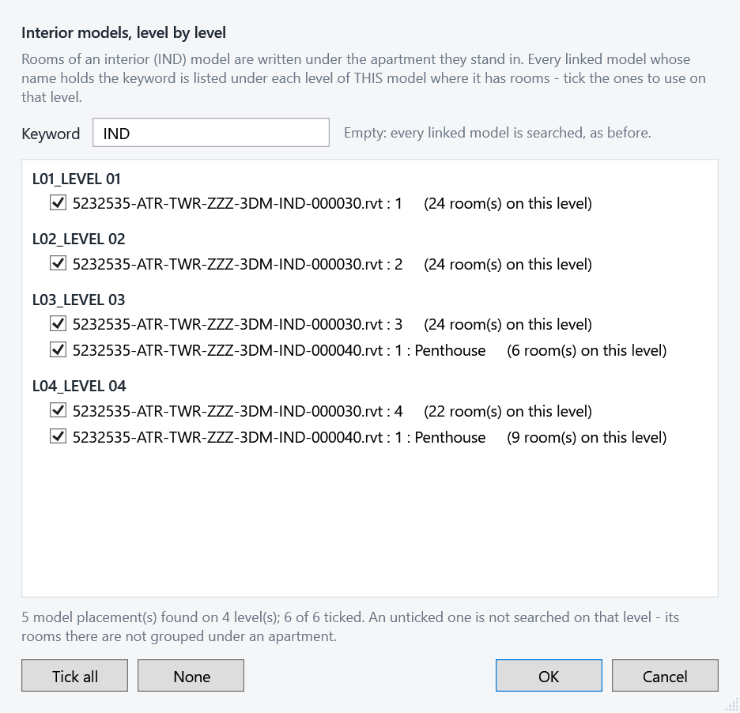
Apartments: ARCH apartments, IND rooms inside
1
Tick Apartments on the architect's model that draws the apartments.
2
Interior models... finds the IND models by keyword, level by level. Untick one to leave it out on that level.
3
Grouped like Tower-1: each IND room under the apartment it stands in, on the same level: apartment down column F, rooms in H, bedrooms merged.
Rooms in no apartment are counted and listed in ATKINSMEC_apartments_log.txt on the Desktop.
AUTOVENT · a guide for Revit users
15

Slide 16
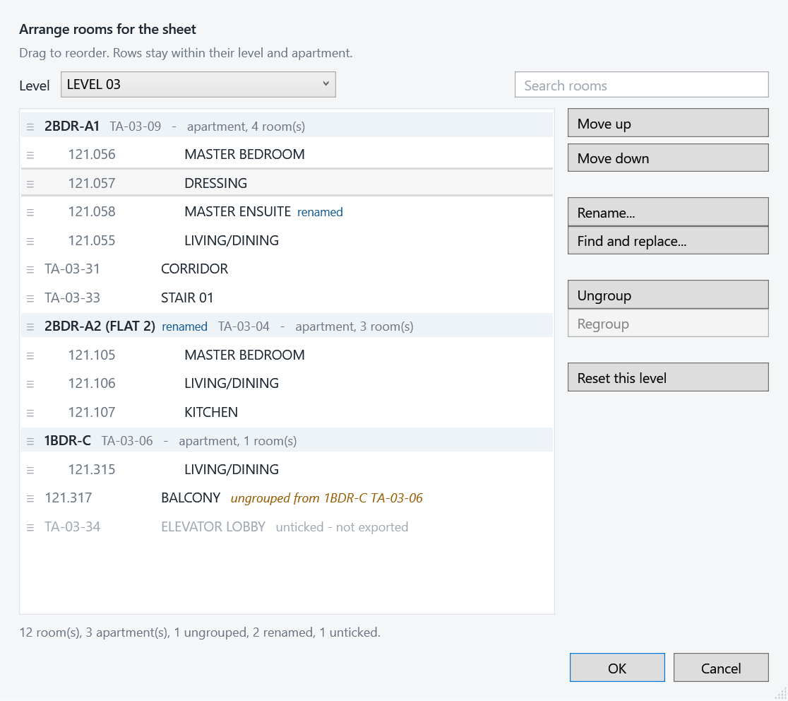
Arrange rooms for the sheet
Reorder
Drag a room, or Move up / Move down. Rooms stay inside their level and apartment.
Rename
Rename... or F2. The new name goes into the sheet and is matched when airflows are written.
Find and replace
Change text in many names at once - one level or all.
Ungroup
Write an interior room as an ordinary room. Regroup puts it back under its apartment.
Saved with this model.
AUTOVENT · a guide for Revit users
16

Slide 17
Good to know
Remembered per model
Links, system types, reach, endcap and bellmouth names, fixtures, apartments, arrangement - shared by every local copy.
Refresh
Reads links, rooms and levels again after a link is reloaded or a room is drawn.
One model per window
The window works on the model it was opened on. Switch back to it to run.
Fits a laptop
The window resizes, and scrolls when the screen is short.
Desktop logs
ATKINSMEC_debug_log.txt after every airflow run; ATKINSMEC_apartments_log.txt for apartments.
Undo
Assign airflows is one step in Revit: Ctrl+Z undoes all of it.
AUTOVENT · a guide for Revit users
17

Slide 18
When something looks wrong
You see
Check
No rooms matched
The dialog shows the first room and the first sheet rows side by side: compare name, number and level.
In the sheet, not in this model
The sheet's level rows must carry your model's level names.
A room with air, nothing to take it
No terminal in it, an endcap or bellmouth name missing, or the FCU beyond the reach.
Rooms on the wrong level
ATKINSMEC_debug_log.txt lists each link's levels and checks one room's floor two ways.
IND rooms not under their apartment
ATKINSMEC_apartments_log.txt says, level by level, where each interior room stood.
AUTOVENT · a guide for Revit users
18

Slide 19
The workflow
1
2
3
4
Tick the linked models
Open the workbook
Tick levels and rooms
Assign airflows or Export
Something looks wrong? Send the Desktop log with the model name - it shows what AUTOVENT saw.

