Slide 1


Slide 2
Genes Summary
Chromosome
Plasmids
Phages
Peptides
Annotation
SNVs
Stats
Alignments

Slide 3











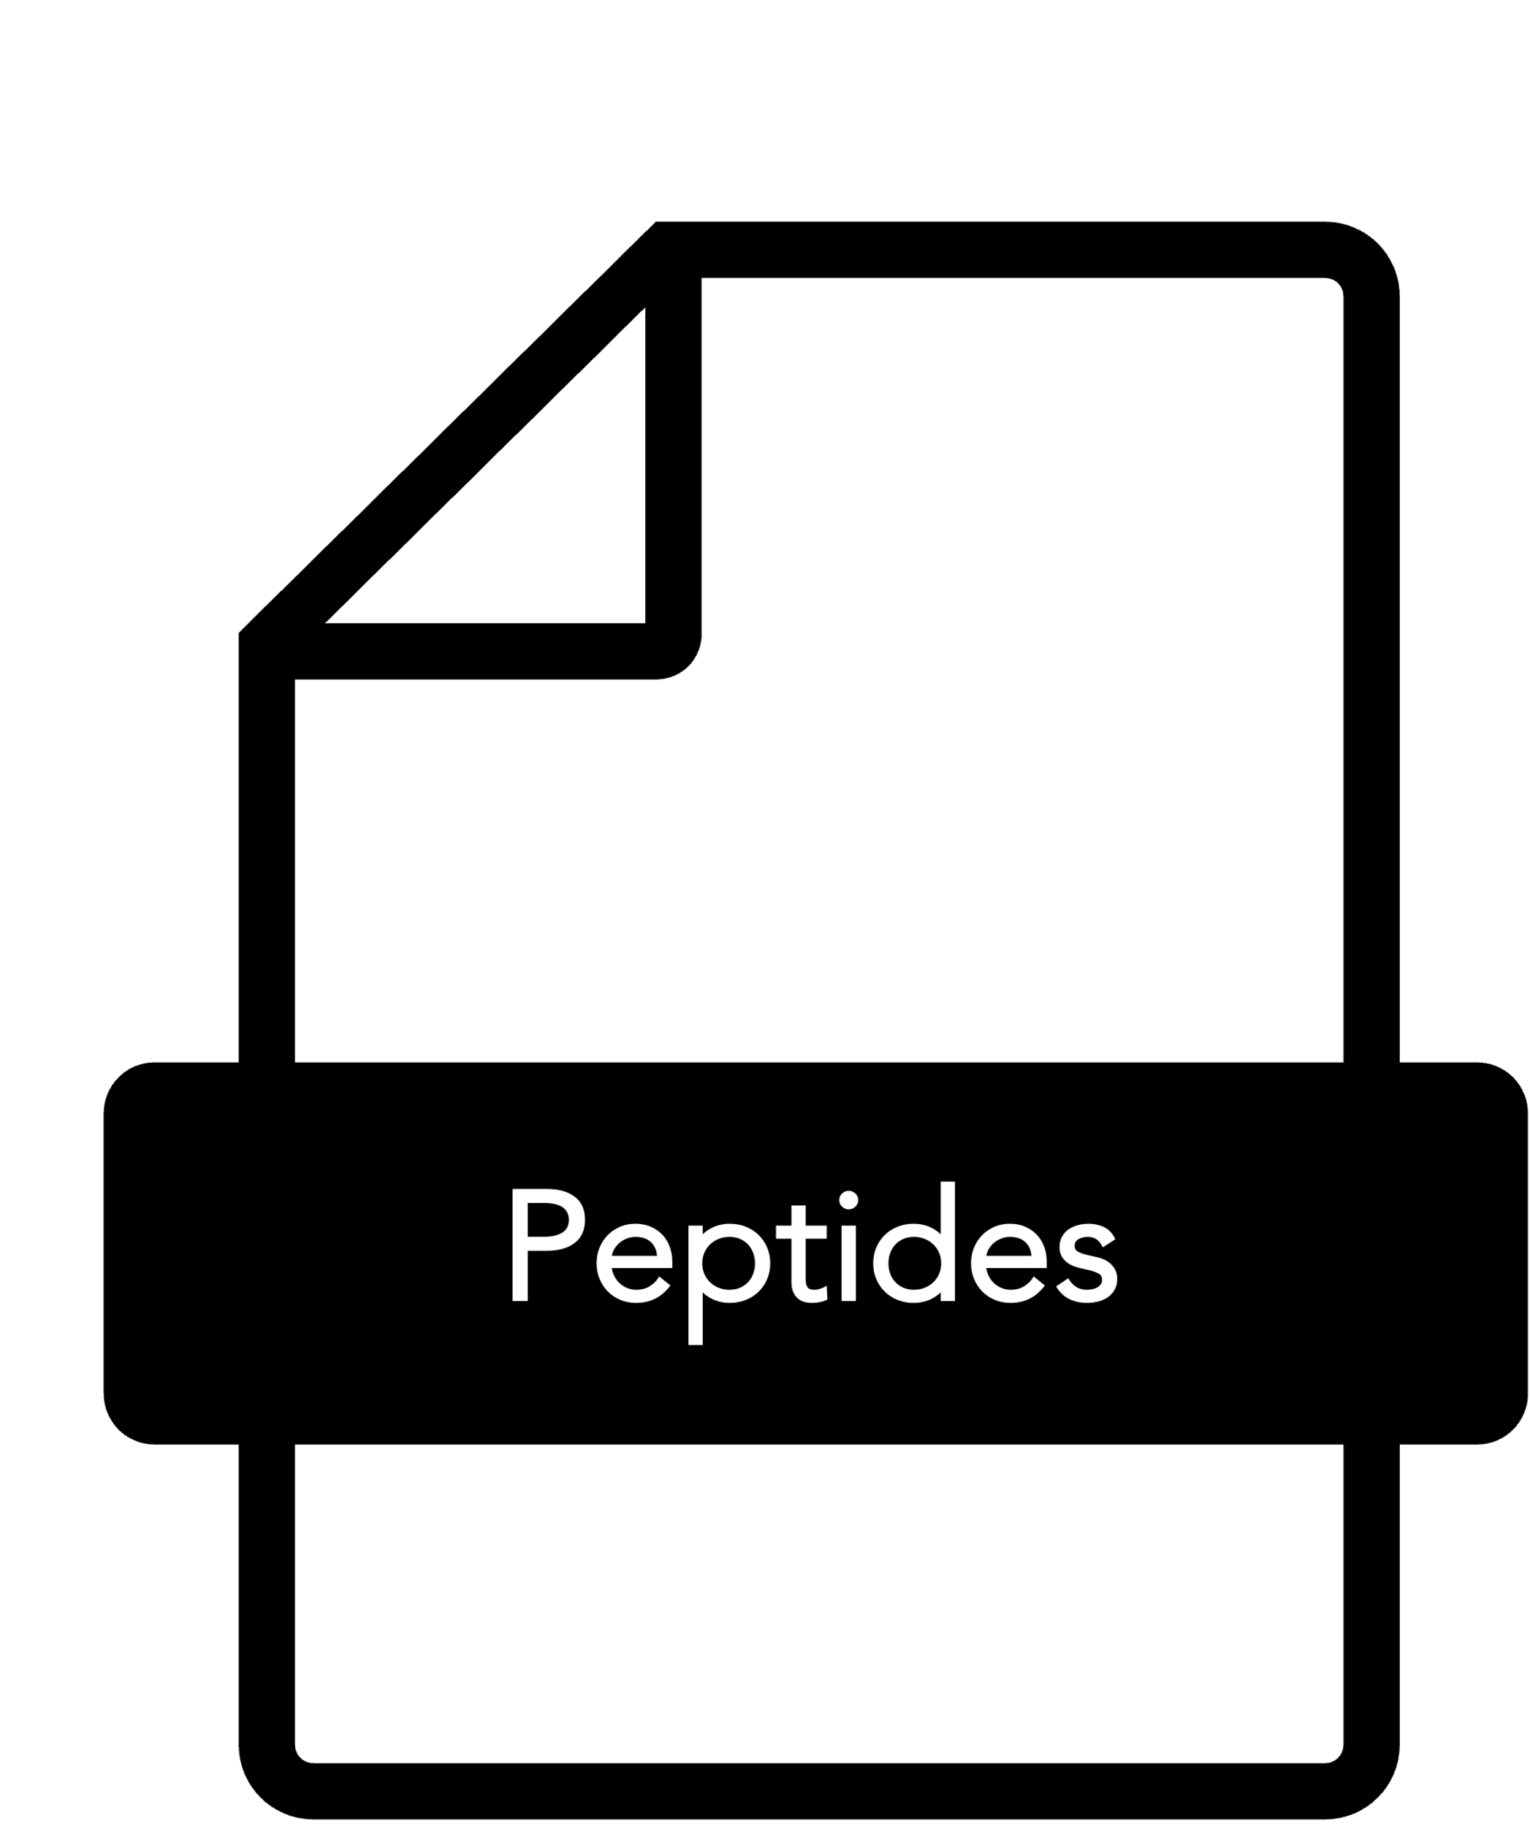

pharokka
6
plasclass
checkv
Short reads
trimmomatic
prokka
1
2
3
4
5
7
fastqc
unicycler
prokka
gtdbtk
checkm
minimap2
Splitting
8
9
12
13
11
samtools
prodigal
blast
15
10
fromAssembly2gene
snippy

Slide 4
Assembly, Annotation and Classification
Quality control of reads (short, long, or both)
Cleaning reads
De-novo Assembly (short, long or hybrid)
Quality Control of the assembly and detection of contamination
Identification of the species in the sample
Identification of plasmids, phages and prophages
Genes Annotation
Comparative genomics (when genome reference provided)
Coverage of reference genome
Identification of core genome
Identification of Single Nucleotide Variants (SNV)
Identification of rearrangements and larger deletions
Characterization of genes of interest (when genes sequences provided)
Alignments to genes of interest
Summary table to identy presence, absence and truncated genes
Generation peptides sequences from the denovo assembly
READS FORWARD
READS REVERSE
READS LONG
REFERENCE
GENES

Slide 9

pharokka
9
5
plasclass
6
checkv
Short reads
phage
trimmomatic
prokka
plasmid
1
2
3
4
8
10
fastqc
unicycler
prokka
gtdbtk
7
chromosome
checkm
minimap2
11
12
15
16
splitting
14
samtools
prodigal
blast
17
13
fromAssembly2feature
snippy

Slide 10
pharokka
9
5
plasclass
6
checkv
Short reads
phage
trimmomatic
prokka
plasmid
1
2
3
4
8
10
fastqc
unicycler
prokka
gtdbtk
7
chromosome
checkm
minimap2
qualimap
11
12
15
16
splitting
14
samtools
prodigal
blast
17
13
fromAssembly2feature
snippy

