Slide 1
QUADRUPLE-TANK PROCESS
CENTRALISED CONTROL

Slide 2

TABLE OF CONTENTS
01
02
03
Tank system
Simulink Model
Linearization
04
05
Discretization
Min-Max Control

Slide 3
01
Quadruple-Tank Model
General presentation of the model and its equations

Slide 4
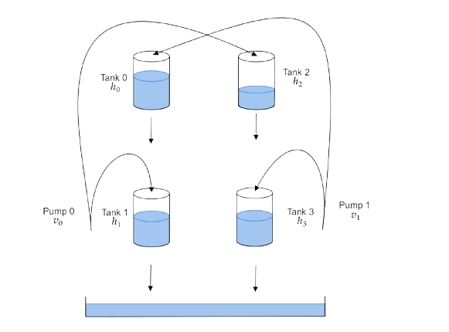
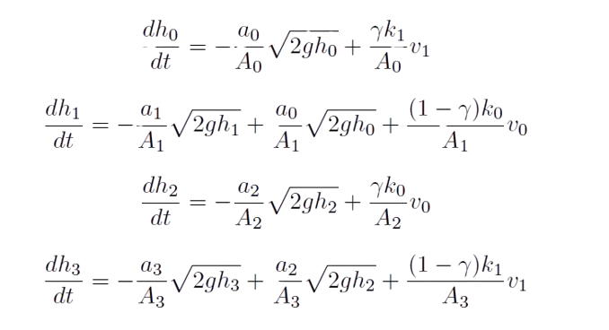
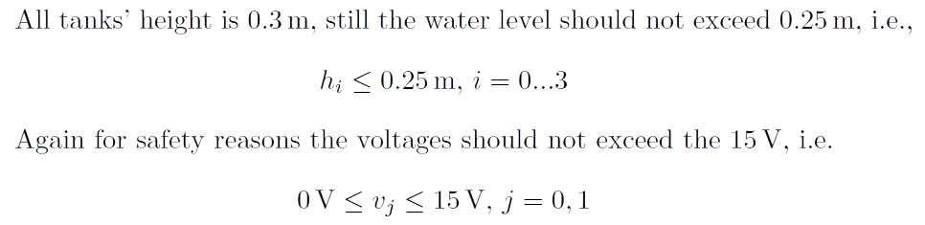

Slide 5

Designing the simulink model
02

Slide 6
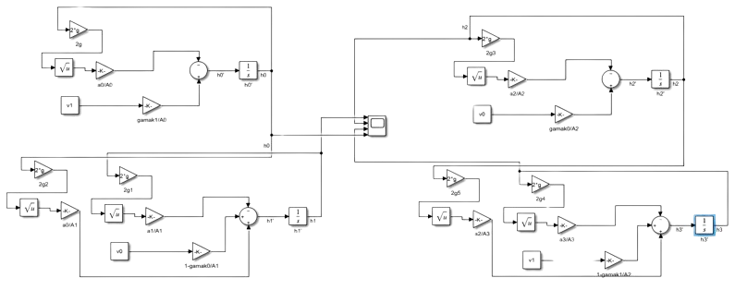
Quadruple-Tank Model

Slide 7

Linearization
03
Linearizing the system around equilibrium point (heq, veq) with v=[9.5, 9.5]

Slide 8

FINDING EQULIBRIUM POINTS
Define System:
Create nonlinear equations representing tank interconnections.
Initial Guess:
Set initial water heights for all tanks to 0.
Solve Nonlinear System:
Use fsolve to find a solution iteratively.
Display Result:
We get matrix with equilibrium height values:
[0.1220,0.1286, 0.1077, 0.1251]

Slide 9
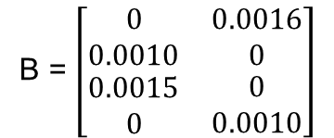
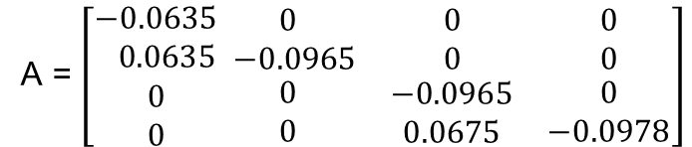
LINEARIZATION AROUND EQUILIBRUM POINT
We calculate matrices A and B and obtain the linearized system:
Ẋ(t) = A* x(t) + B* u(t)
A = $\left[\begin{aligned}−0.0635 \\ 0.0635 \\ 0 \\ 0\end{aligned}\begin{matrix}0 & 0 & 0 \\ −0.0965 & 0 & 0 \\ \begin{aligned}0 \\ 0\end{aligned} & \begin{aligned}−0.0965 \\ 0.0675\end{aligned} & \begin{aligned}0 \\ −0.0978\end{aligned}\end{matrix}\right]$
B = $\left[\begin{matrix}0 & 0.0016 \\ 0.0010 & 0 \\ \begin{aligned}0.0015 \\ 0\end{aligned} & \begin{aligned}0 \\ 0.0010\end{aligned}\end{matrix}\right]$

Slide 10

04
Discretization
Discretizing the obtained linearized system in continuous time with sampling
time Ts = 0.1 s

Slide 11
DISCRETIZATION
Define System matrices A and B:
We initialize continuous-time system matrices A and B, which describe the dynamics of a linear system.
Specify time sample:
We set the variable Ts to 0.1
Discretize the System Using c2d
Employing the c2d function, we discretize the continuous-time system with matrices A and B, using the specified time step. This results in discrete-time matrices A_d and B_d.

Slide 12
Controlling the system using relay
05

Slide 13
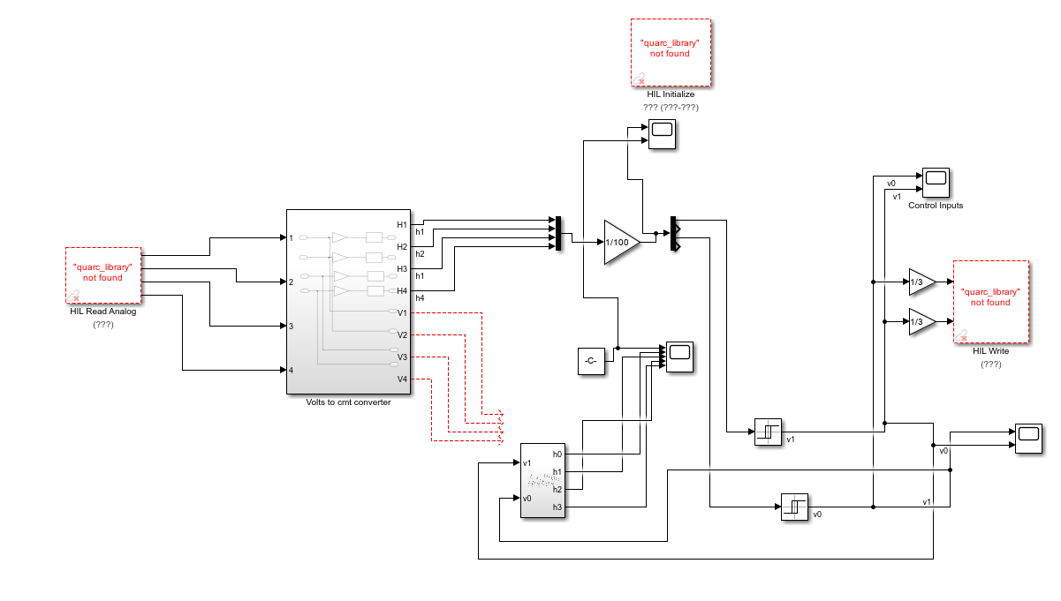

Slide 14
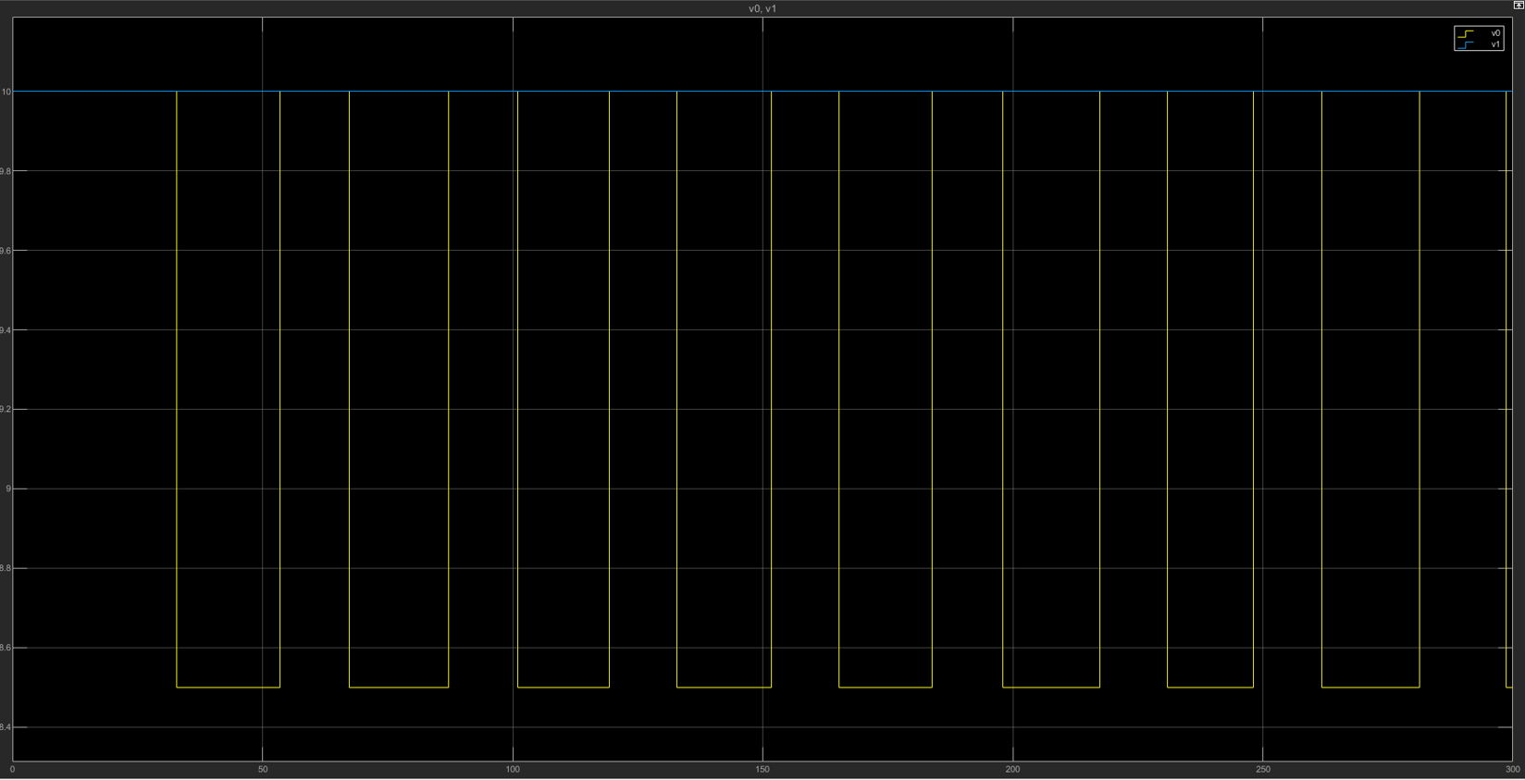
Graph of Voltage Values

Slide 15
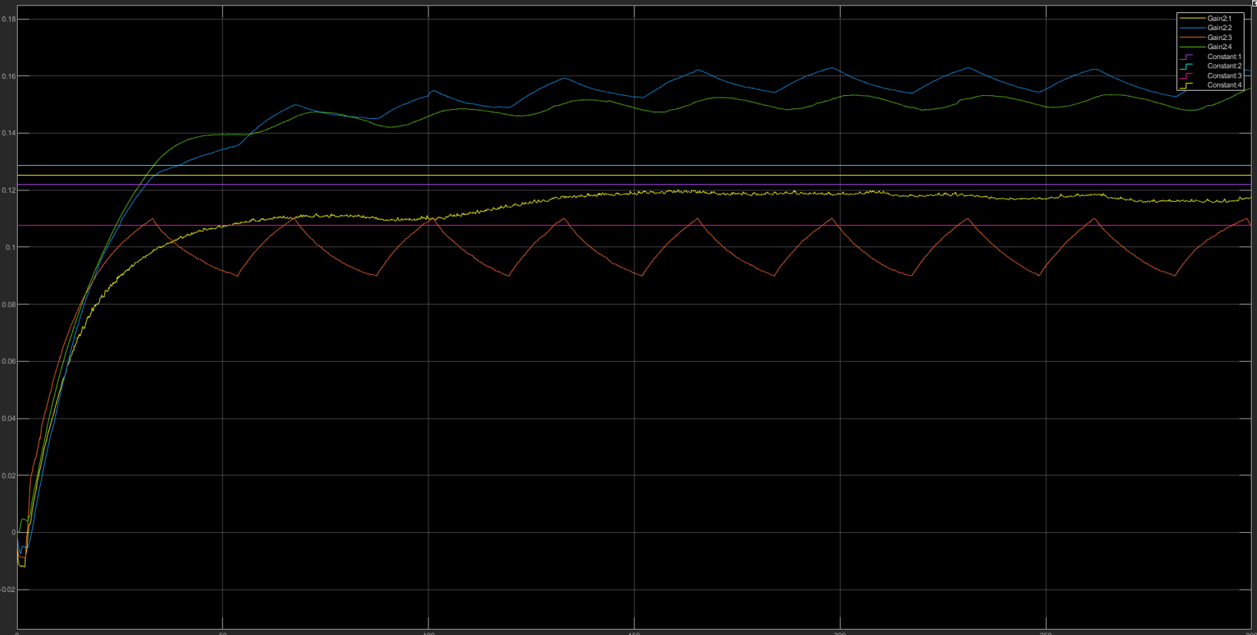
Height values of the real system

Slide 16
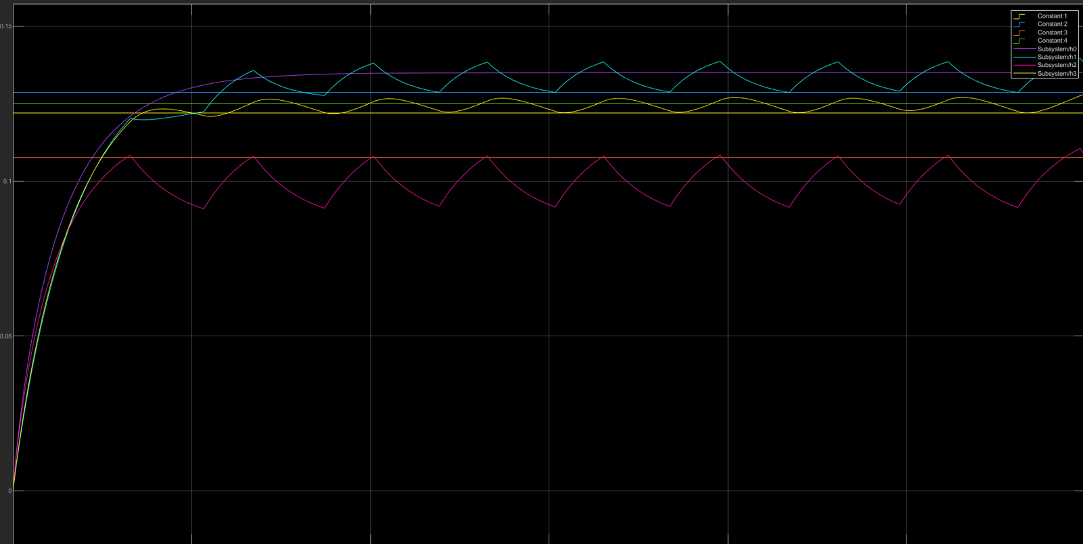
Height values of the simulated system

Slide 17

06
Centralized Control
Designing the centralized control based on the cost function

Slide 18
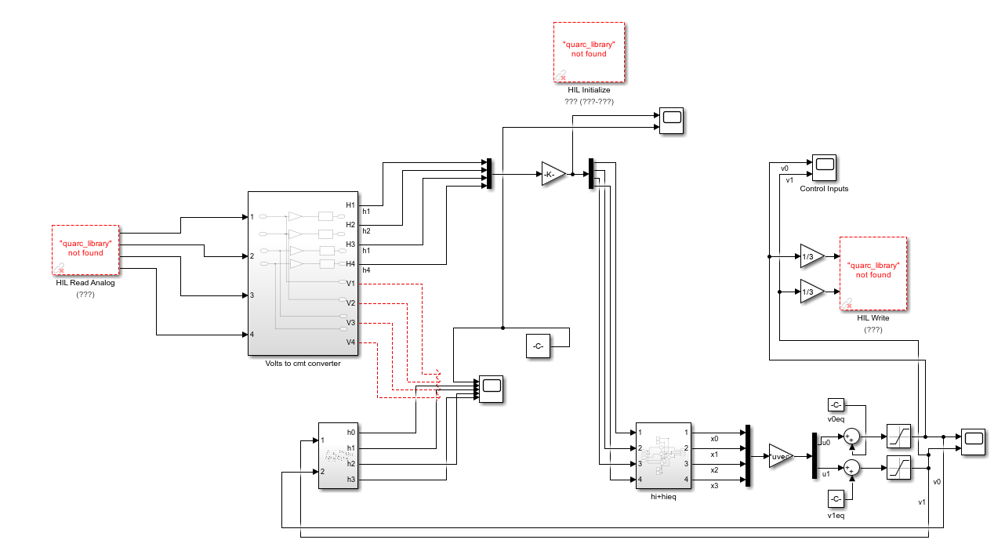

Slide 19
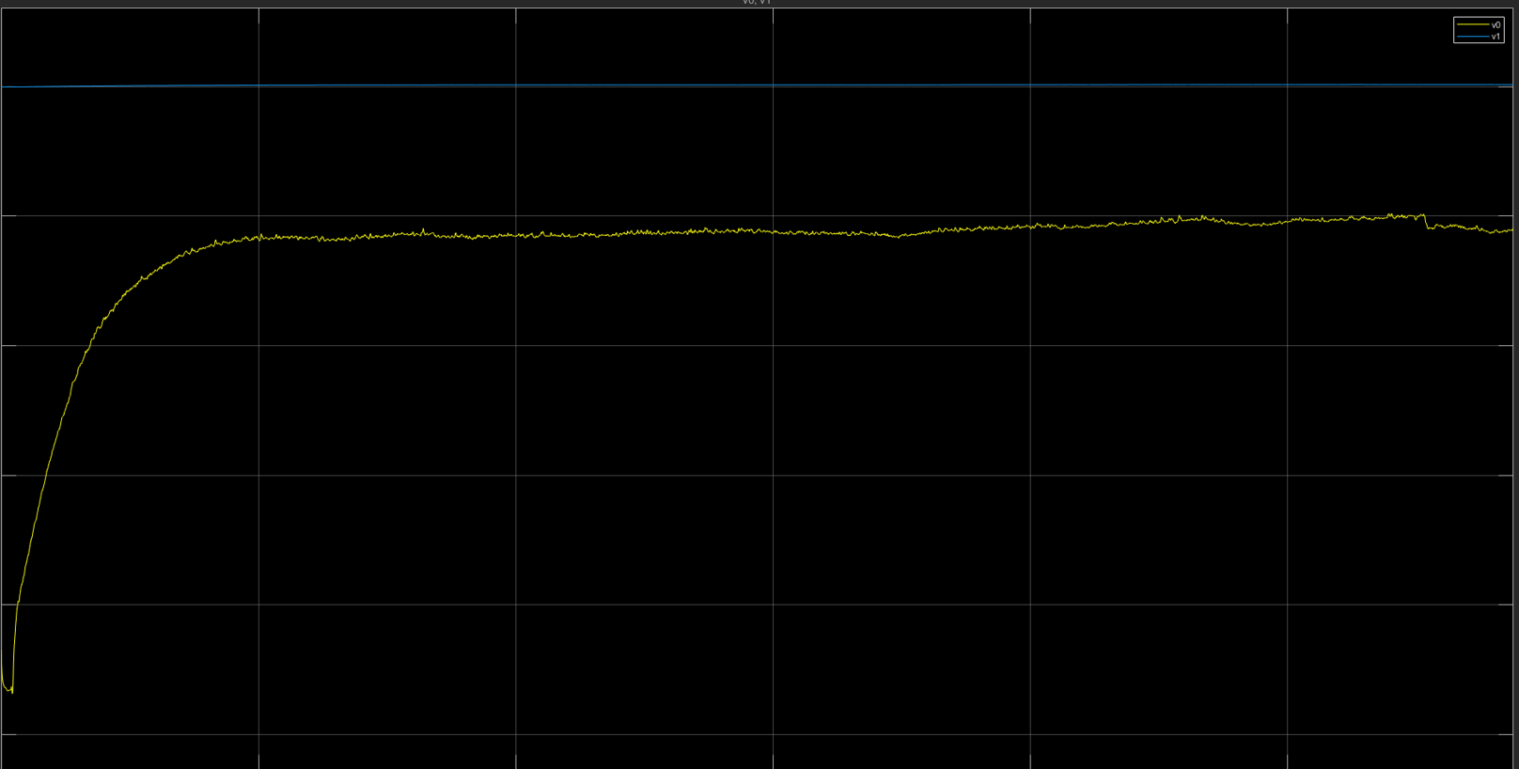
Graph of Voltage Values

Slide 20
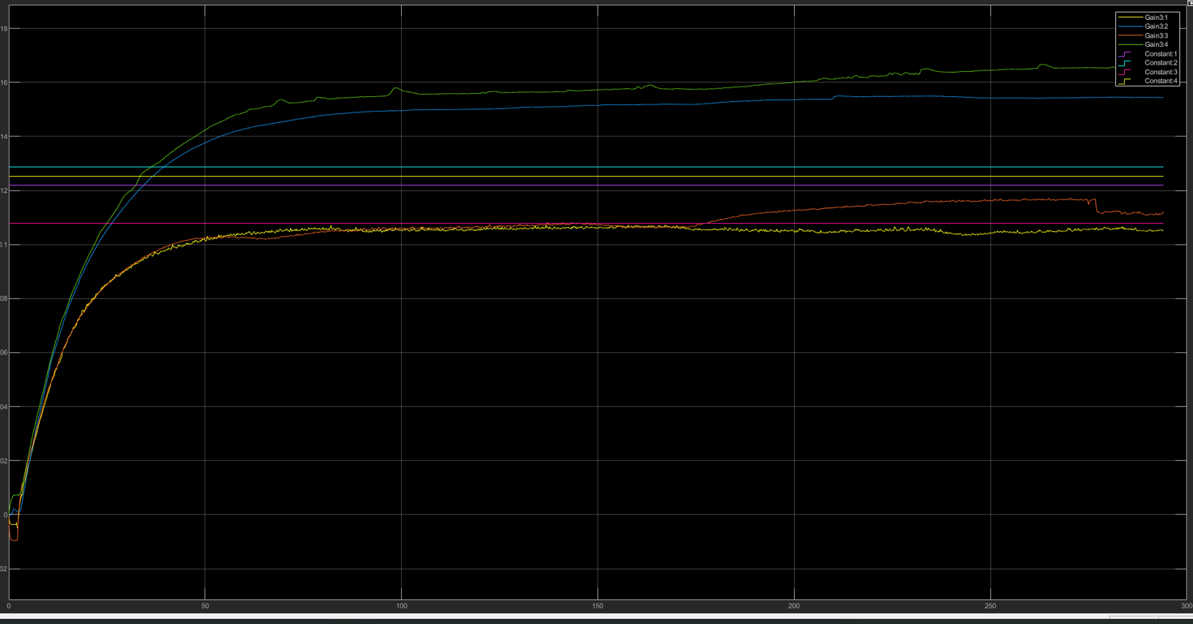
Height values of the real system

Slide 21
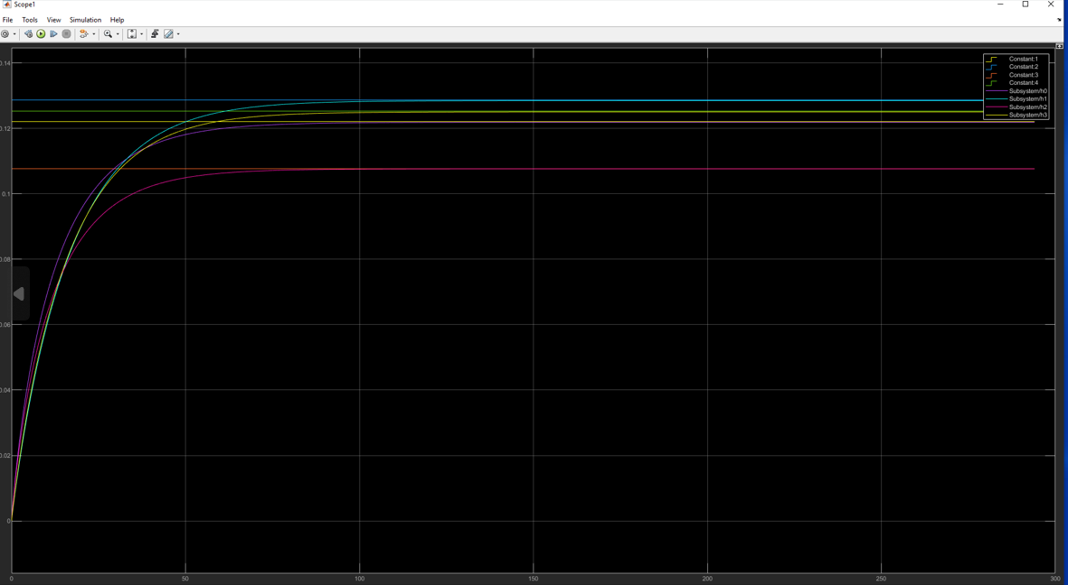
Height values of the simulated system

Slide 22
Thank You
Grisela Daja

