Slide 1
Relationship between Credit Scores and economic demographics of Toronto neighbourhoods

Slide 2
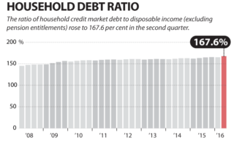
Background
We have all heard about how bad the average
Canadian’s debt is in Canada
Average Canadian has $1.67 of debt for every dollar earned
Many horror stories on the internet
Bank offering debt consolidation loan or second mortgage, which is not really solve Canadians’ indebtedness

Slide 3
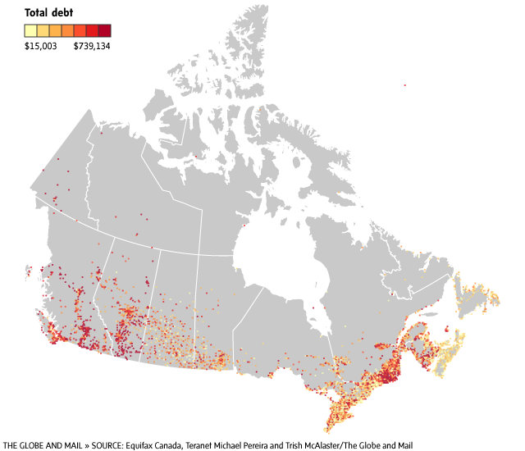
Study Area
Look at one of Canada’s most indebted cities, Toronto
Look at the neighbourhoods data downloaded mostly from the City of Toronto websites

Slide 4
Research Questions
What are the best Toronto neighbourhoods to set up debt reconciliation firms?
What is the relationship the between average credit scores and economic demographics of Toronto neighbourhoods?

Slide 5
Methodology
Gather the data
Make chloropleth maps for:
Credit scores
home prices
How many people are employed for each neighbourhood?
Social Assistance Recipients
Average Mortgage payments
Look for correlations between the chloropleth maps

Slide 6
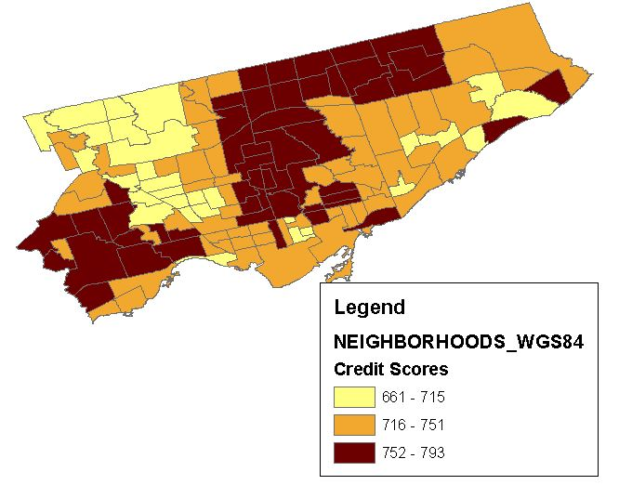
Findings – Credit Scores

Slide 7
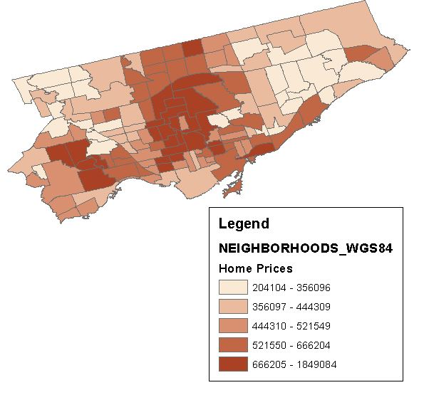
Findings – Home Prices

Slide 8
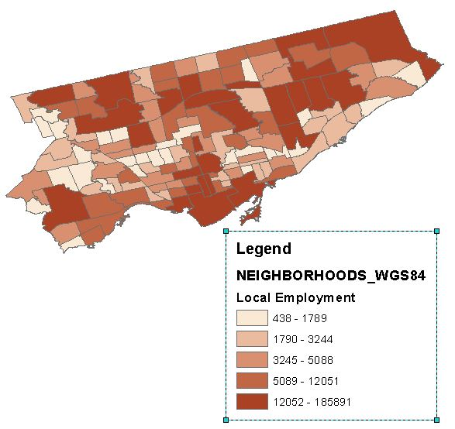
Findings – Local Employment

Slide 9
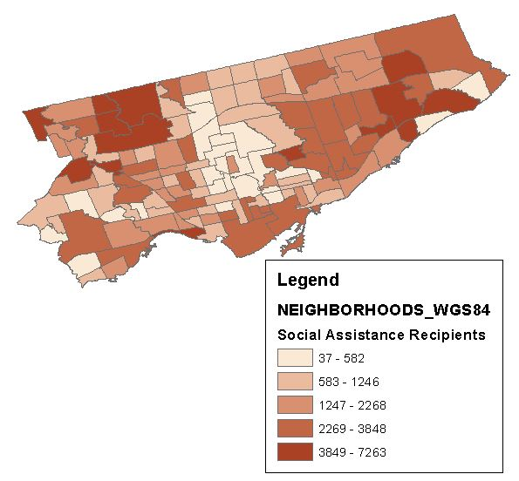
Findings – Social Assistance Recipients

Slide 10
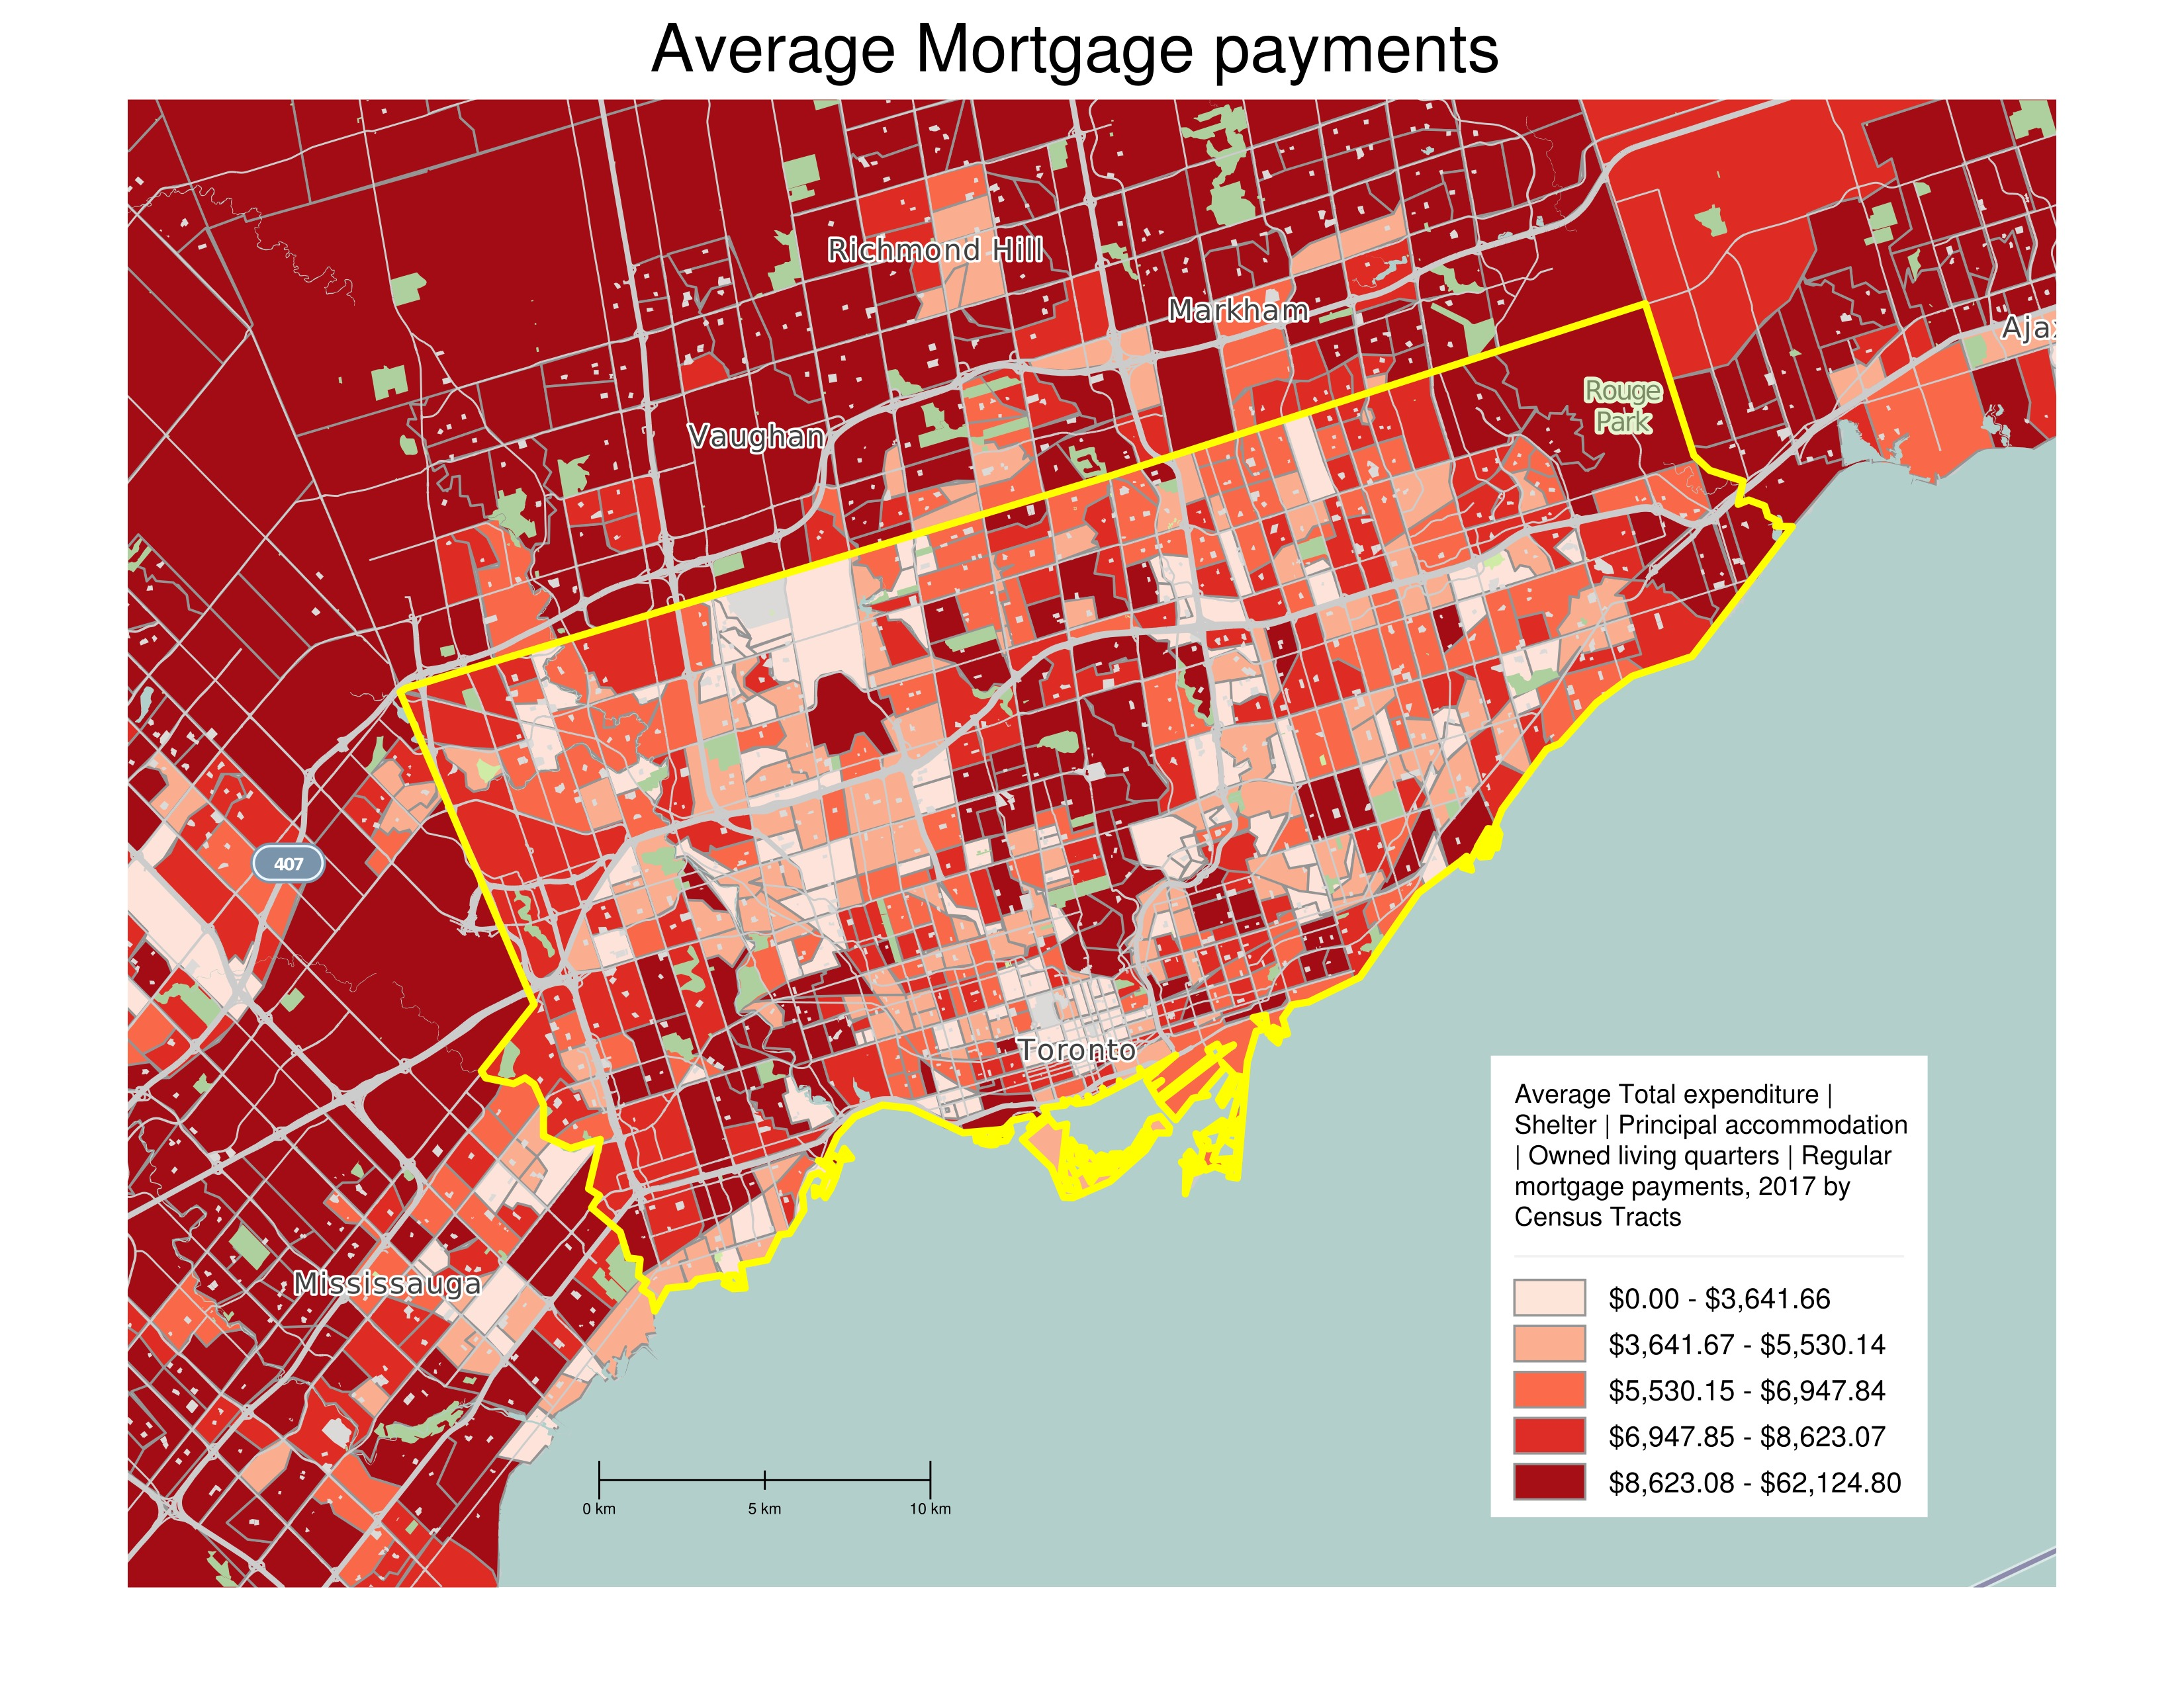
Findings – Average Mortgage Payments

Slide 11
Limitations
Local Employment Factor doesn’t factor in the effect of commutes
Predictions on what neighborhoods to set up debt reconciliation businesses could be too generalized or biased
Perhaps creating an suitability layer will remedy this issue

Slide 12
Conclusions and Recommendations
Place the debt reconciliation businesses in the Northwest area of Toronto or perhaps in Islington-Etobicoke or the Yonge St Corridor.
Depends on the market the business wants to target
However, any recommendation could be biased because of:
locational competition
business set up costs
People that do not care about their debt or their credit score. They do not seek to borrow money in the future.

Slide 13
References
Economic Demographics by neighbourhoods data - https://www1.toronto.ca/wps/portal/contentonly?vgnextoid=aec380ece073b410VgnVCM10000071d60f89RCRD&vgnextchannel=7576e03bb8d1e310VgnVCM10000071d60f89RCRD
regression and statistics - https://www.opendataexplorer.ca/toronto-wellbeing-low-income-vs-debt-score.html
neighbourhood boundaries - https://www1.toronto.ca/wps/portal/contentonly?vgnextoid=04b489fe9c18b210VgnVCM1000003dd60f89RCRD
Simply Analytics - http://simplyanalytics.com/
http://www.macleans.ca/economy/realestateeconomy/how-canadian-homes-became-debt-traps/
http://sydenhamcurrent.ca/2016/12/06/canadian-household-debt-hits-record-high/
https://www.theglobeandmail.com/real-estate/how-high-home-prices-have-buried-canadians-indebt/article30223649/

