Slide 1

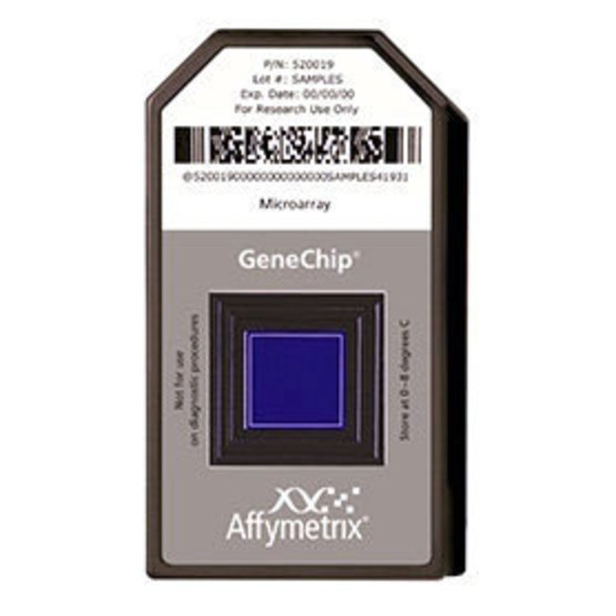
Cluster Analysis of IBD Dataset

Slide 2
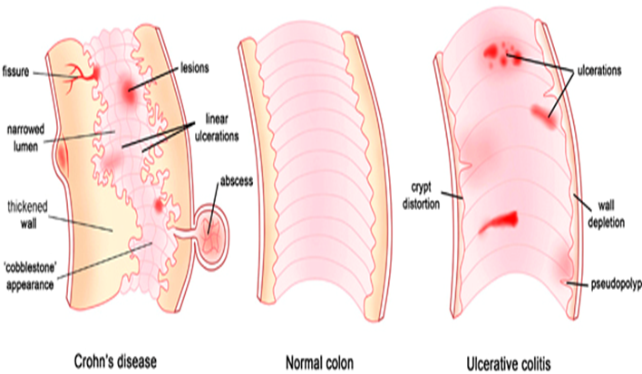
Introduction
225 unique genes, 185 selected candidate genes
309 probe sets out of 22000 probe sets in the Gene chip
126 individuals
Inflammatory Bowel Disease comprises of:
  Crohn’s Disease
  Ulcerative Colitis
Counts of each disease type
Crohn’s Disease | Normal | Ulcerative Colitis
59 | 41 | 26

Slide 3

Hypothesis
Research Question: Can data features cluster the state of the patient?
Hypothesis
Given the 309 probesets, we can cluster patients into 3 or more biological groups
Be able to predict which biological group future patients belong to.
Make an inference on what certain genes could be the cause to Inflammatory Bowel Disease.

Slide 4
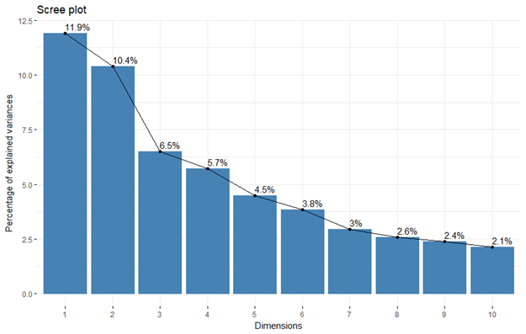
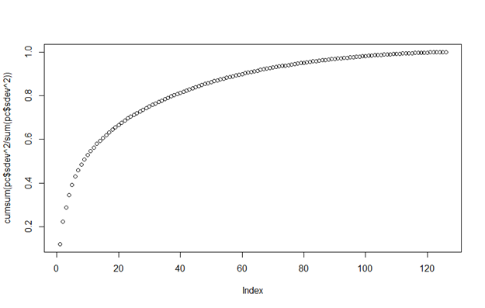
PCA
Correlation

Slide 5
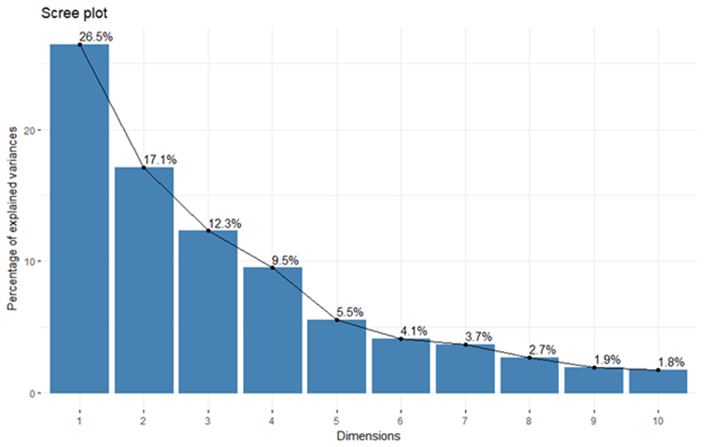
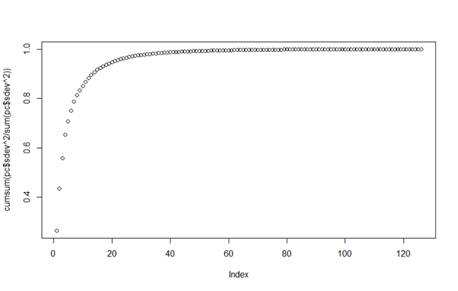
PCA (Continued)
Covariance

Slide 6
Case Study

Slide 7
Conclusion
Can not cluster perfectly
The following probesets causes Crohn’s Disease:
The following probesets causes Ulcerative Disease:

Slide 8
References

