Slide 1
Examining Spatial Clustering of school age children to predict which Toronto Schools are overcrowded
By: Grisham Nathan
Student No: 1001314927

Slide 2
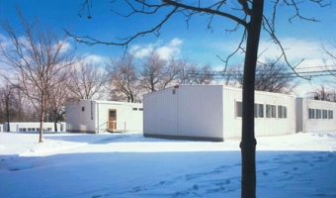
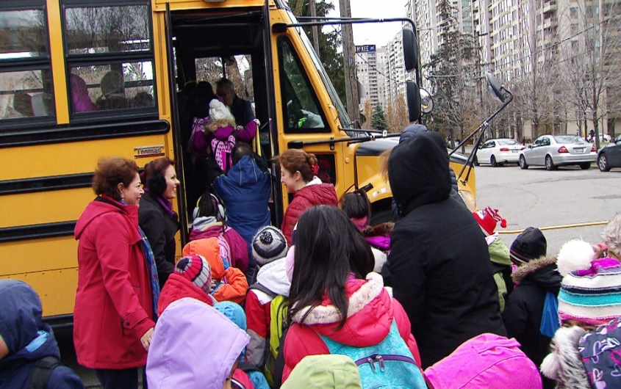
Background/Problem

Slide 3
Research Questions/Objectives
Which schools in Toronto are overcrowded or are going to be overwhelmed?
This is done by observing the spatial clustering of school age children by census tract
Then check which schools are located in census tracts with high amounts of school age children
Most of the overcrowded schools in Toronto are located in North York and along the Yonge St. Corridor

Slide 4



Data
University of Toronto Map & Data Library Website
Toronto Open Data Website
CHASS (Computing in the Humanities and Social Sciences)

Slide 5
Methods
Descriptive Statistics of School Locations
Mean Center
Standard Deviational Ellipse
Standard Distance
Global Moran’s I
Local Moran’s I
Inverse Distance
Queen Contiguity

Slide 6
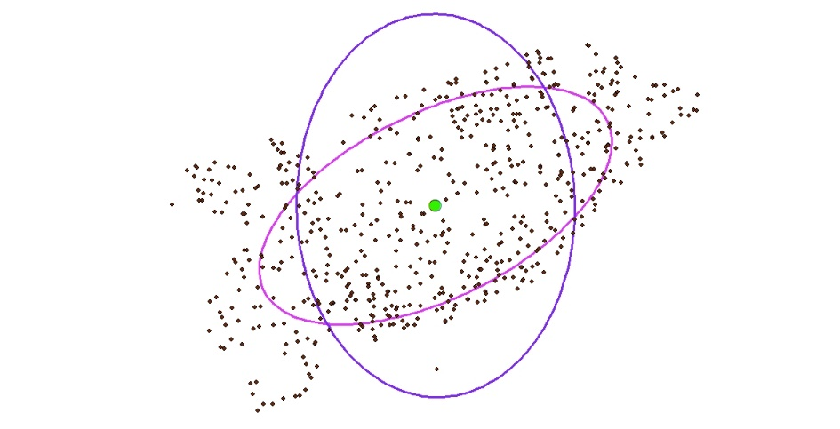
Results – Descriptive Statistics

Slide 7
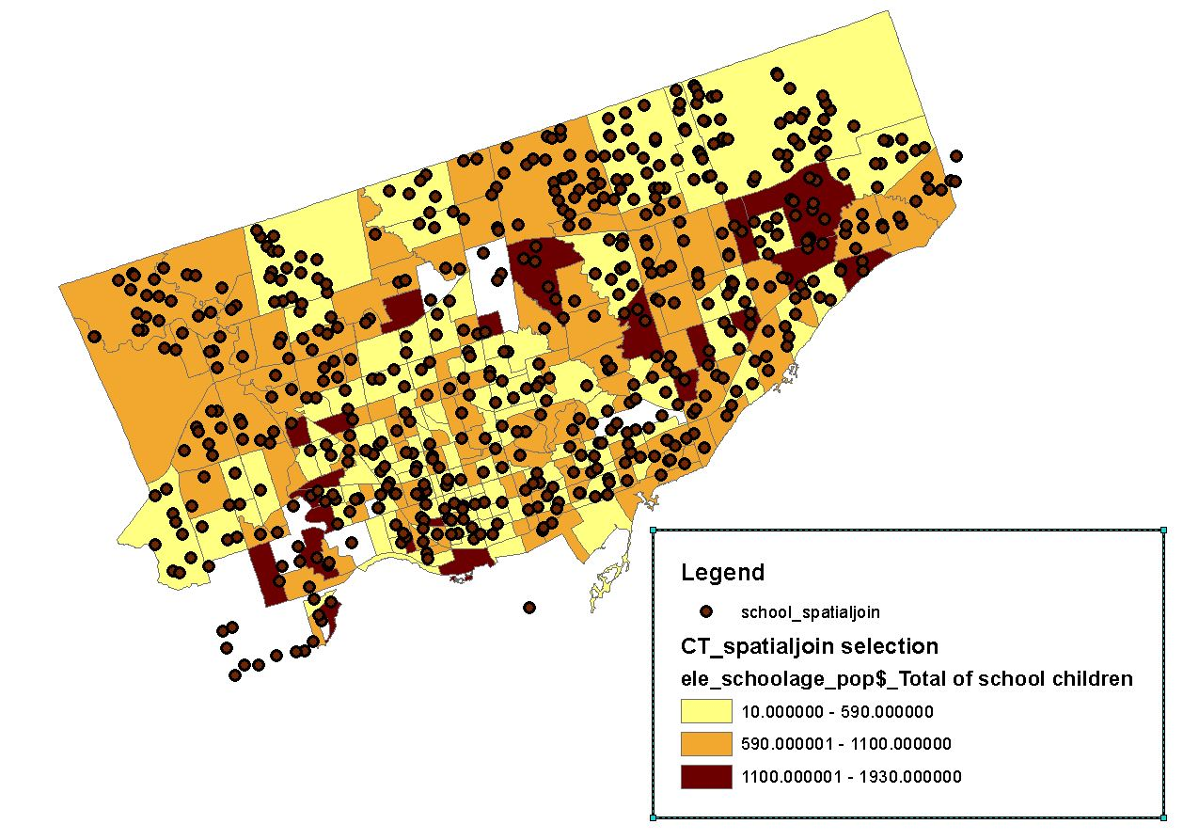
Results – School age Children Counts

Slide 8

Results – Global Moran’s I
Used Queens Contiguity, Euclidean Distance
And Row Standardization

Slide 9
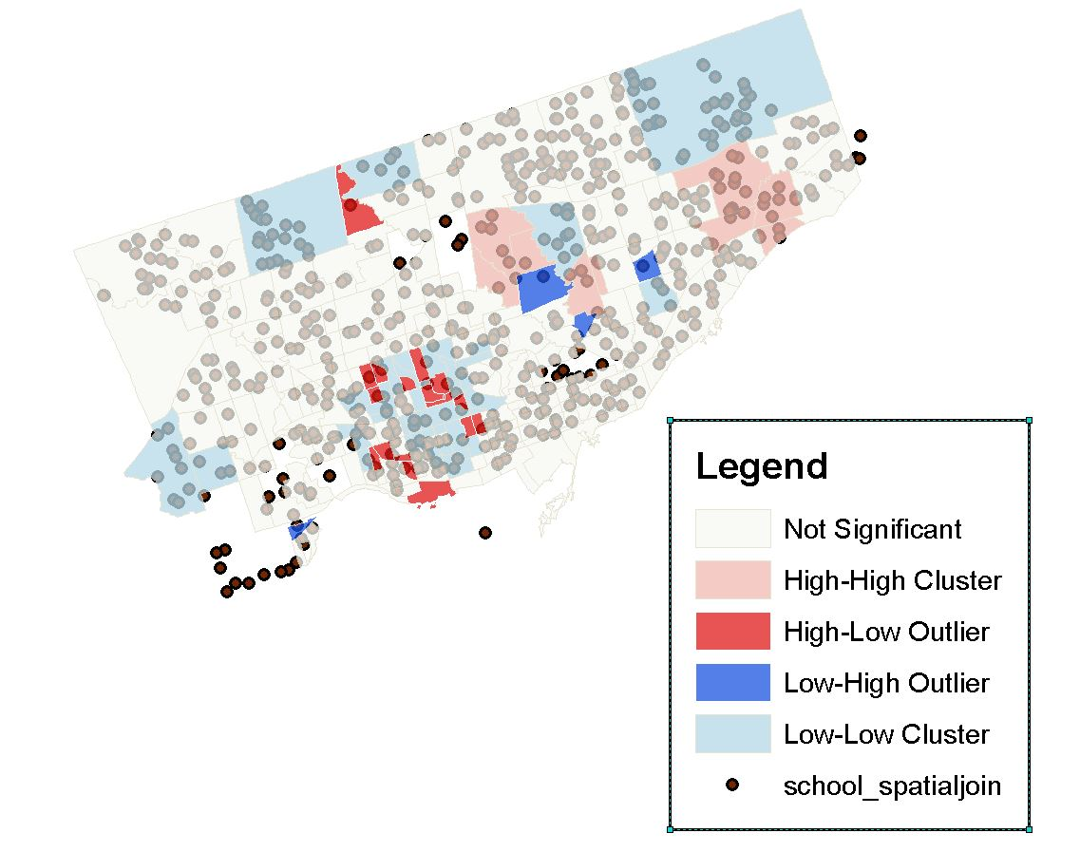
Results – Local Moran’s I (IDW)

Slide 10
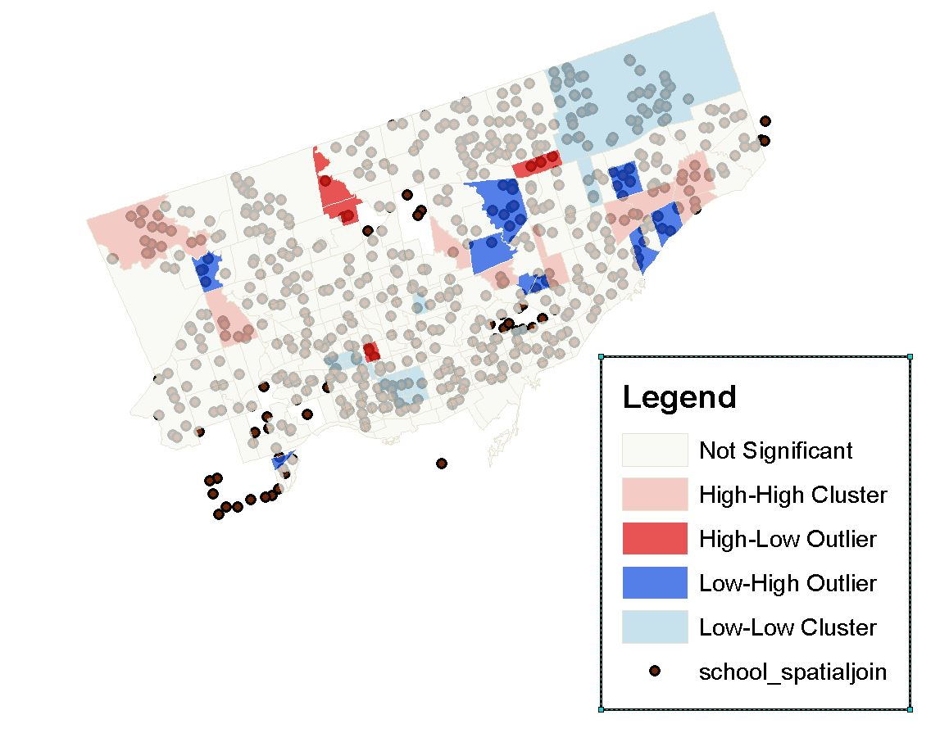
Results – Local Moran’s I (Queen’s Contiguity)

Slide 11
Discussion
For Local Moran’s I with IDW, I used row standardization, FDR, Euclidean distance and 3500 meter distance band
Same settings for Local Moran’s I with Queen’s contiguity except the 3500 meter distance band

Slide 12
Conclusion
We can infer which Toronto schools in certain census tracts are overcrowded or are prone to being overwhelmed.
Flaws and Limitations
Does not consider capacity of the schools
3500 meter distance band for the Local Moran’s I using inverse distance is most probably a biased estimate
Some census tracts that are missing from my analysis

Slide 13
References + Acknowledgements
http://maps.library.utoronto.ca/cgi-bin/files.pl?idnum=1422
https://www1.toronto.ca/wps/portal/contentonly?vgnextoid=16a91e22fe370410VgnVCM10000071d60f89RCRD&vgnextchannel=75d6e03bb8d1e310VgnVCM10000071d60f89RCRD
https://www.tcdsb.org/ProgramsServices/EarlyYears/Kindergarten/Documents/TCDSB_FixedAttendanceBoundary_KeyMap_Website.pdf
https://www.insidetoronto.com/news-story/1938795-east-york-parents-ask-tdsb-to-fix-decaying-infested-and-overflowing-schools/
https://www.thestar.com/yourtoronto/education/2017/10/29/parents-want-developers-to-kick-in-and-help-expand-overcrowded-toronto-schools.html

