Slide 1
SnekBot,
a
Q-Learning Agent with Polynomial Approximation
(that plays Slither.io)
Graham Northup

Slide 2
What is Slither.io?
(interactive demonstration)

Slide 3
Writing Agents for Slither.io
Uses a simple score based on the length of your snake (= reward antiderivative)
Has only three input values: mouse X, mouse Y, boosting?
  Can simplify to two using polar coordinates: heading, boosting?
Game is written in (obfuscated) JavaScript, so it’s not very difficult to inspect client state :)
  Actual simulation runs on the remote server, so no “cheating”

Slide 4
Writing Agents for Slither.io
Not perfect, though:
  Permadeath—episodes end very abruptly
  Necessarily online; SnekBot plays against other human players in realtime
    (But the time lost in not running episodes quickly can be spent doing deeper learning!)
  Huge state space—more on that later

Slide 5
Introducing SnekBot v0.3.9
Not technically a learning agent, but a basis for one.
(interactive demonstration)

Slide 6
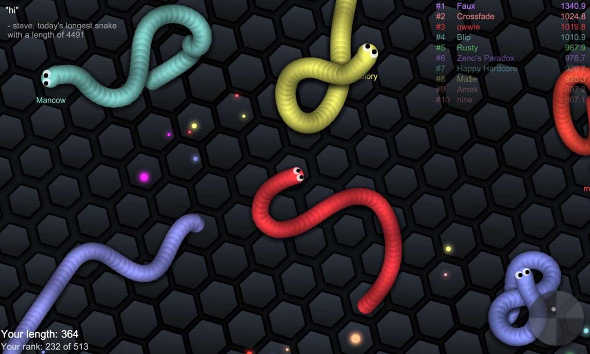
How SnekBot Sees the World
(Also known as SnekBot’s feature vector [F])

Slide 7
How SnekBot Sees the World
F₀: Distance from Center

Slide 8
How SnekBot Sees the World
F₁: Distance to Nearest Food
F₂: Size of Nearest Food

Slide 9
How SnekBot Sees the World
F₄: Distance to Nearest Snake Point
F₅: Size of Nearest Snake

Slide 10
How SnekBot Sees the World
F₆: Number of “Visible” Snakes (frequently includes snakes not actually visible on screen)

Slide 11
How SnekBot Sees the World
F₇: Occluded Solid Angle (using a raycast to a constant distance)

Slide 12
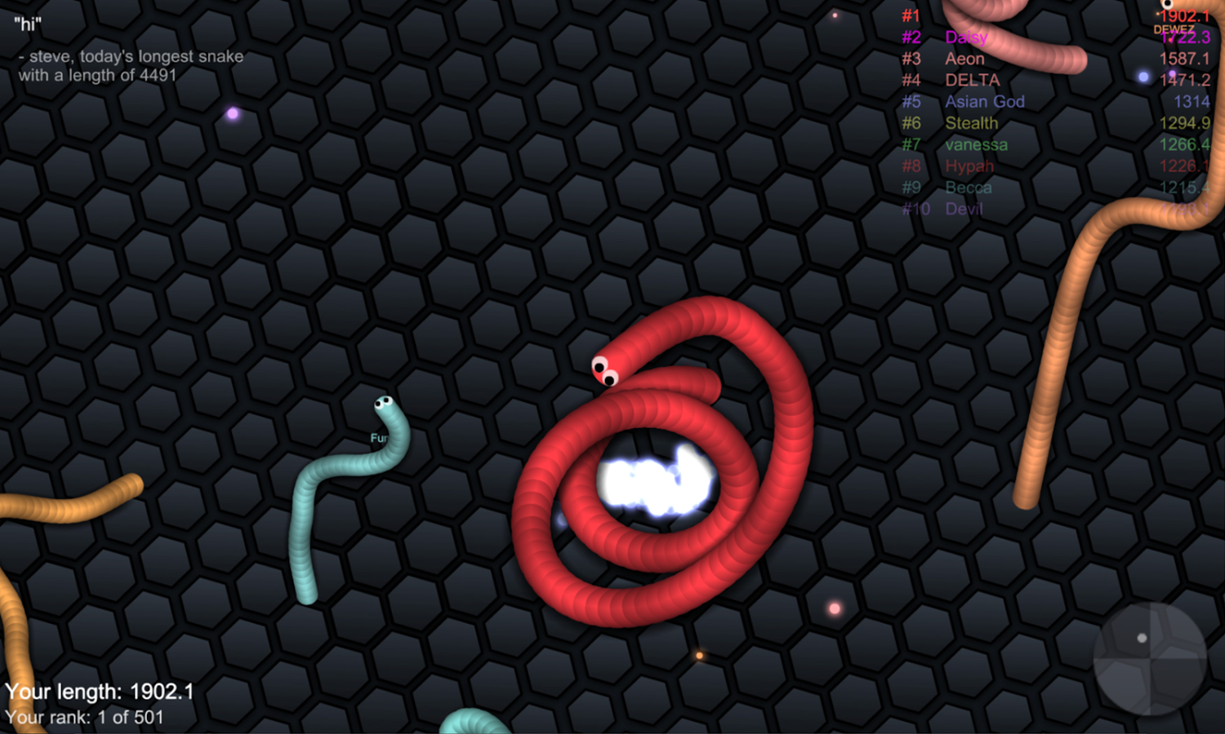
How SnekBot Sees the World
F₇: Occluded Solid Angle (using a raycast to a constant distance)

Slide 13
Polynomial-Approximated
Q-Learning
Traditional Q-Learning is based on the “Q” heuristic function, which uses the cross-product of states and possible actions
  States with even a modest number of variables with large domains (e.g., Z₁₀₂₄) explode exponentially
  Continuous domains are strictly unusable without approximation (e.g., rounding)
Slither.io has, e.g., (x, y) in Z₄₀₀₀₀, so memory would be an issue
  Most of these states have duplicated information!

Slide 14
Polynomial-Approximated
Q-Learning
Instead, SnekBot uses a polynomial approximation of state:
  It assumes all the information needed for action decision is in the feature vector
  Thus that all rewards can be found as a sum of (arbitrarily learned) polynomials over each element of the feature vector
  Storage is a matrix of size |F| x [polynomial degree]
    Already much better than 40000²!

Slide 15
Polynomial-Approximated
Q-Learning
Downsides:
  The feature vector has to be chosen very carefully to be as widely encompassing as possible
  It’s not always easy to choose elements which are (1) mostly independent and (2) for which it can be theorized that a polynomial can correlate the reward function
  Algorithm hasn’t even been proven “correct” in some minimizing sense yet
    (Unless you assume the feature vector is perfect and stick to degree 1 :)

Slide 16

Polynomial-Approximated
Q-Learning
Algorithm
  Do Q-Learning
  …EXCEPT...

Slide 17
Polynomial-Approximated
Q-Learning
Polynomial Weight Update:
  When accumulating reward, update the matrix by increasing every term n >= 1 with:
  x^{n}_{t+1} = x^{n}_{t} + [Eta] * [Gamma]^{n} * [Reward]
    [Gamma] is an “inertia” factor for higher powers that serves dual purpose:
      It brings higher powers closer to the time-based mean of the lower powers (esp. x¹)
      It helps avoid blowup of the learning rate for higher powers

Slide 18
Polynomial-Approximated
Q-Learning
Decay Step:
  After all reward-based updates, multiply all matrix values by a (0, 1] factor [Decay]
    Helps expunge incompetent “poor choices” learned early in the exploration phase

Slide 19
Polynomial-Approximated
Q-Learning
To the code!
(interactive demonstration)

Slide 20
Results
Much worse!
  SnekBot v0.3.9 relies on carefully-tuned parameters learned from a human player
  SneqBot vQ0.0.1 has almost no initial guidance
    Then it fails
    Then it dies
  SneqBot doesn’t (yet) remember learned parameters across episodes, which probably doesn’t help
    If it did, there would be a strong negative reward (punishment) for each death

Slide 21
Results
Solutions:
  Initialize SneqBot with analogues drawn from SnekBot
  Allow online rapid training by allowing an observer to give feedback
  Actually give the learner the time and persistence needed to train :)

