Slide 1
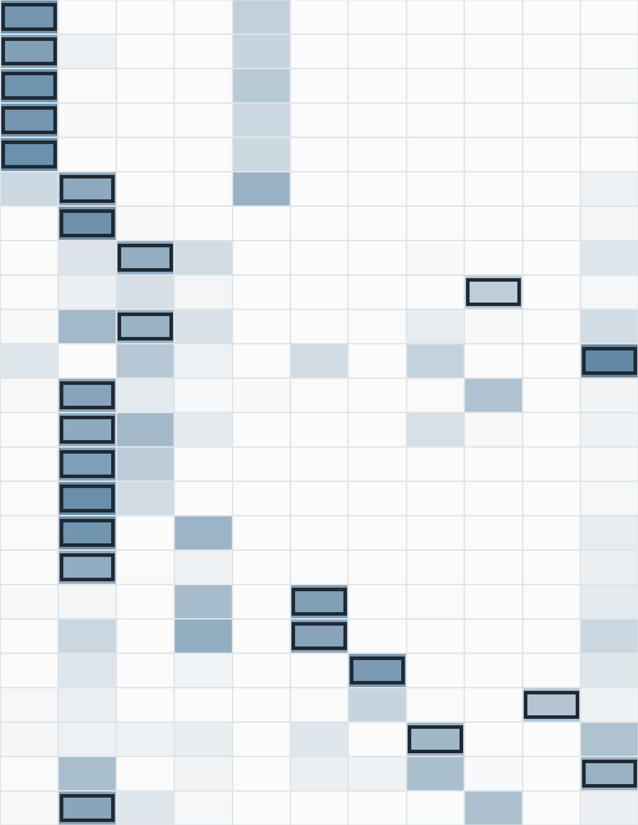
A
From the reasoning path to cell-type tags
Disease Validated pathway
Cell-type tags
Alzheimer's disease
endocytosis [GO:0006897]
Neurons
Microglia
Glial cells
“Particularly important in neurons for APP and receptor trafficking at synapses, and in microglia for uptake/clearance of Aβ and debris.”
Parkinson's disease
lysosome [GO:0005764]
Dopaminergic neurons
Neurons
Glial cells
“Central in dopaminergic neurons and glia in PD-affected midbrain and striatum, where α-synuclein burden is high.”
Rheumatoid arthritis
Fc gamma R-mediated phagocytosis [KEGG:04666]
Macrophages
Immune cells
Neutrophils
“Synovial macrophages and infiltrating neutrophils in inflamed joint fluid and pannus.”
Type 2 diabetes
insulin secretion [GO:0030073]
Pancreatic beta cells
“Highly specific to pancreatic beta cells within the islets of Langerhans.”
C
B
Disease-level pathway cell-type contexts
Pathway cell contexts by disease
Parkinson’s disease
Alzheimer’s disease
Neurons
364 (88%)
Progressive supranuclear palsy
Neurons
280 (90%)
Major depressive disorder
Glial cells
133 (43%)
Dopaminergic neurons
278 (67%)
Alzheimer's disease
Glial cells
123 (30%)
Parkinson's disease
Hippocampal neurons
111 (36%)
Microglia
51 (12%)
Amyotrophic lateral sclerosis
Cortical neurons
109 (35%)
Astrocytes
44 (11%)
Multiple sclerosis
Microglia
73 (24%)
Systemic lupus erythematosus
Astrocytes
70 (23%)
Type 2 diabetes
Chronic kidney disease
Pyramidal neurons
61 (20%)
Pancreatic beta cells
361 (47%)
Colorectal cancer
Hepatocytes
258 (34%)
Chronic obstructive pulmonary disease
Excitatory neurons
27 (9%)
Immune cells
85 (11%)
Obstructive sleep apnea
Glutamatergic neurons
10 (3%)
Endothelial cells
61 (8%)
Crohn's disease
Endothelial cells
8 (3%)
Asthma
Macrophages
38 (5%)
Autoimmune thyroiditis
Cell-type context group
Neural / glial
Immune
Epithelial
Stromal / vascular
Metabolic
Tuberculosis
Rheumatoid arthritis
D
Psoriasis
Alzheimer’s disease: pathway-level cell-type context
Atrial fibrillation
endocytosis [GO:0006897]
6
4
4
4
3
3
1
1
Heart failure
plasma membrane [GO:0005886]
7
4
4
2
2
2
1
Hepatocellular carcinoma
synapse [GO:0045202]
2
2
2
2
Type 2 diabetes
vesicle-mediated transport [GO:0016192]
6
1
1
2
1
1
1
Hypertension
Autophagy - animal [KEGG:04140]
4
2
2
2
3
2
Coronary artery disease
Golgi apparatus [GO:0005794]
4
3
2
Inflammatory bowel disease
Protein processing in ER [KEGG:04141]
4
2
2
4
2
3
4
1
Neurons
Fibroblasts
Glial cells
Hepatocytes
cell adhesion molecule binding [GO:0050839]
4
3
3
2
1
1
3
1
Immune cells
Epithelial cells
Cardiomyocytes
Smooth muscle cells
Endothelial cells
glutamatergic synapse [GO:0098978]
2
2
2
2
Pancreatic beta cells
Disease class
Intestinal epithelial cells
lysosome [GO:0005764]
4
1
1
3
3
1
Tag frequency
Central nervous system / neuropsychiatric
postsynaptic density [GO:0014069]
4
2
2
2
1
1
7
Immune / inflammatory
Pathway proportion
Cell-type context
Neurons
Microglia
Cardiometabolic
Cortical neurons
Glial cells
Astrocytes
Endothelial cells
Respiratory / renal
Hippocampal neurons
Pyramidal neurons
Excitatory neurons
Epithelial / cancer
0
0.5
1.0
Figure 4
Glutamatergic neurons
Cell-type context

