Slide 1

Yoga Infographic
By Kelvin Ocampo-Diaz
Project for NMAD 155
Survey Of Emerging Visual Design
26 April, 2020

Slide 2
Contents
Introduction of Yoga Infographic
Why I picked this topic
Draft Infographic and Typography
How did I do on Illustrator
Before and After Final Infographic
Problem and Solution
References

Slide 3
Introduction of Yoga Infographic
I create an infographic for education purpose, and the infographic will be a topic of “Yoga.” We know this is a exercise of poses in a yoga studio. But also, there are more than just a word of “Yoga” behind. The infographic will be shown “Yoga Chakra” in the final infographic.

Slide 4
Why I picked this topic
I picked this topic because I have been doing yoga since September 2016. All these years, I have improved my flexibility, balance, and strength. As I started getting great at yoga so I started researching the name of list in poses. I believe that when I started doing yoga and I feel meaningful inside me that I am very confident about myself.

Slide 5

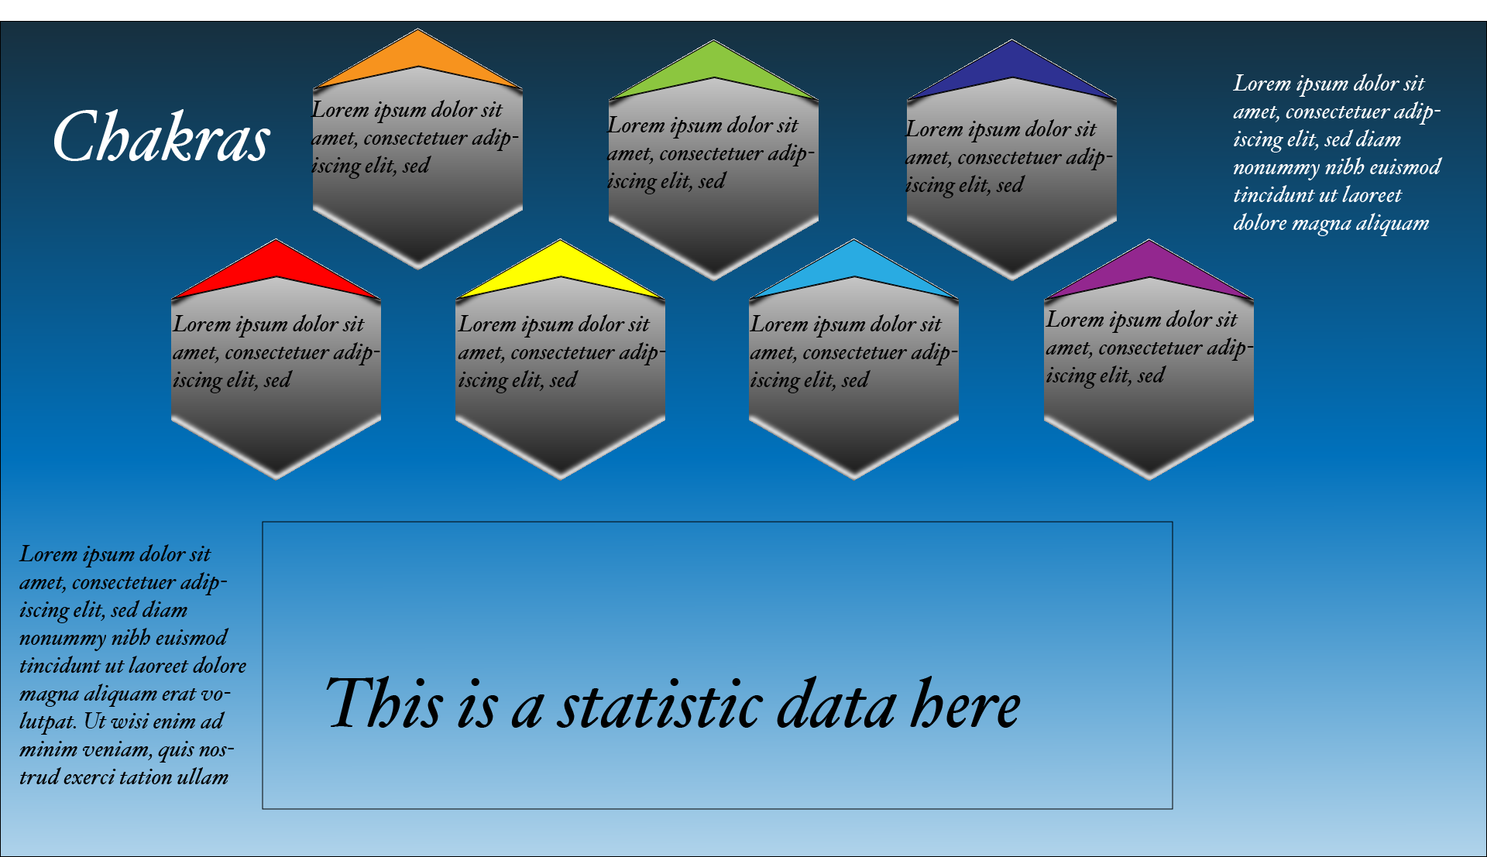
Draft Infographic and Typography
I started two separated artboards so I could brainstorm and create an infographic for ideas.

Slide 6
Draft Infographic and Typography
I picked this typeface because they are calm and smooth as yoga usual. For the color in the fonts, I picked a group of blue because they are atmosphere we look up in the sky peacefully.

Slide 7
Draft Infographic and Typography
I created seven chakras with different color each with information inside the containers. I also added two texts outside of the container so I could description other than the chakras.

Slide 8
How did I do on Illustrator
For the infographic project, I have used only Illustrator.
What do I do in Illustrator:
Gradient
Pen Tool
Text Tool
Type on a Path Text
Using Panels (Properties, Layers, Appearances, etc)
I use those tools to create an infographic from beginning to complete.

Slide 9
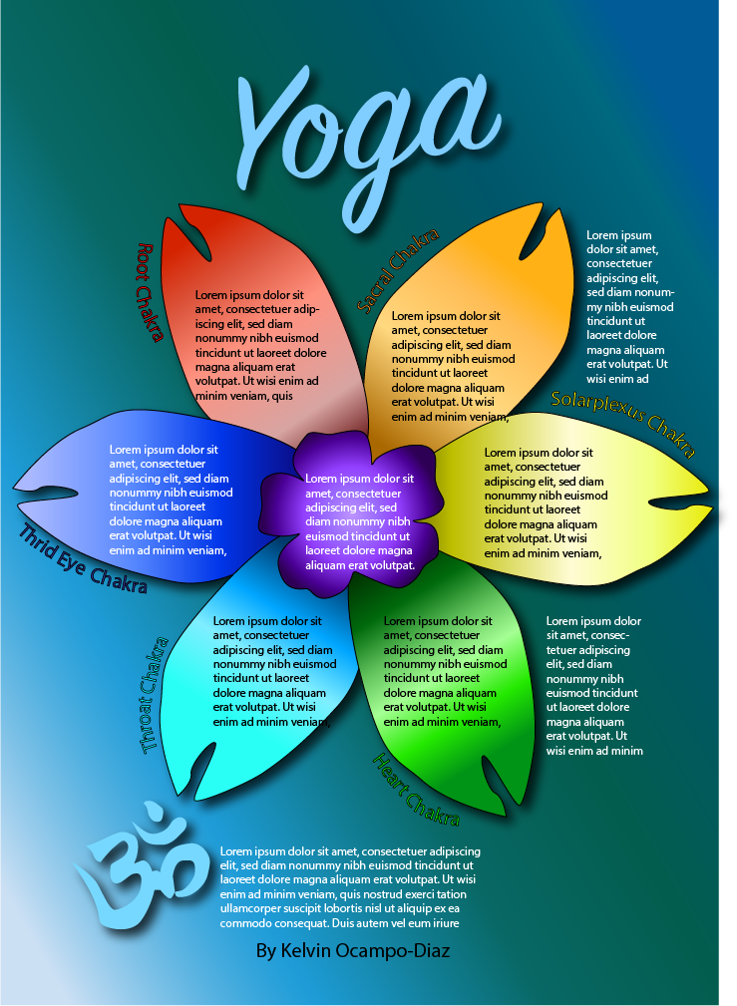
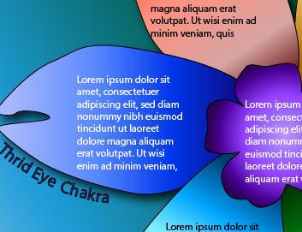
Before Final Infographic
I drew seven different color of petals in the center. Before infographic, I did not put any content in the containers because I needed to see if there are any texts that fit in the containers with the size of fonts.

Slide 10
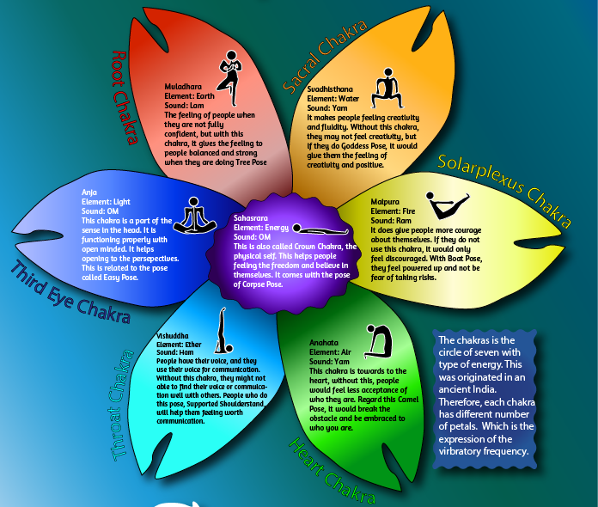
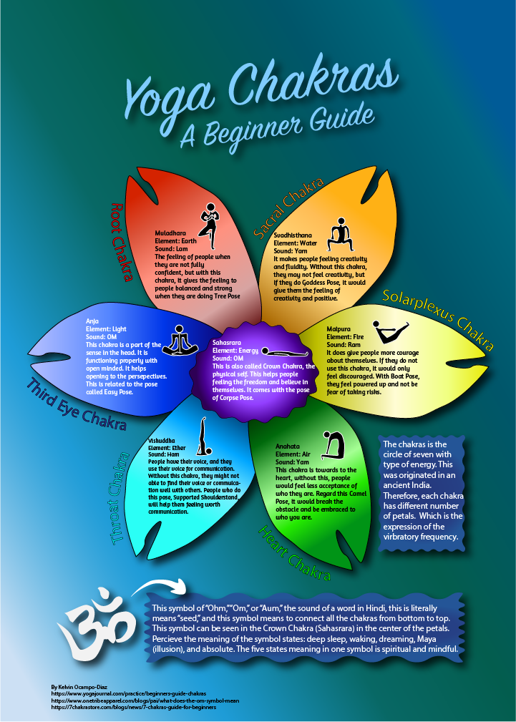

Slide 11
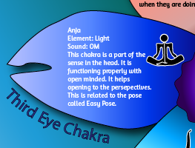

After Final Infographic
Finally, I added poses related to the meaning in each petal containers.
I added the block behind the text because it would be easier to read in a block that is noticeable with darker color than the background.

Slide 12
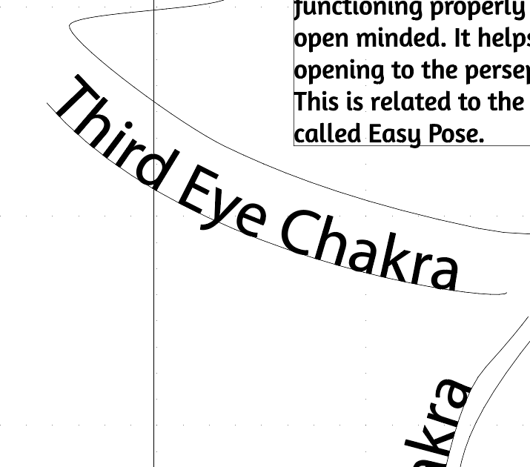
Problem and Solution
Problem
I started drawing with a Pen Tool, I have been struggling with it because they are hard to control in curves. I used Direct Selection Tool to control the curve better afterwards.
The hard part is Type on a Path Text, because I had to repeat drawing the curve line so depending on the words could fit on a length of the line. I added an unnecessary second curve line so I could put the left words on a path. After the feedback, I finally fixed the Path Text by using the control key and click the archer to stretch it horizontally.
Solution

Slide 13
References in Infographic
https://www.yogajournal.com/practice/beginners-guide-chakras
https://www.onetribeapparel.com/blogs/pai/what-does-the-om-symbol-mean
https://7chakrastore.com/blogs/news/7-chakras-guide-for-beginners

